Slide 1


AWS S3 + IAM
Secure Cloud Document
Management System
A full-stack file storage platform secured entirely through AWS Identity & Access Management — no extra services, no wasted permissions.
Tanmay Garg

Slide 2







Agenda
What we'll walk through
1. Problem Statement
5. Key Features
Why generic cloud storage falls short
What users and admins can actually do
2. Our Solution
6. Security & Protection
How the platform resolves it
IAM, JWT, bcrypt, presigned URLs
3. System Architecture
7. Future Scope
Browser, backend, and S3 working together
Where this project goes next
4. Technologies Used
The stack behind the platform
Secure Cloud Document Management System
2

Slide 3


Problem Statement & How It Resolves
The gap in everyday cloud file storage — and the fix
The Problem
Our Solution
Teams need a private place to store and share files, but standing up 'secure' cloud storage often means juggling several AWS services and broad, over-permissioned credentials.
One S3 bucket holds everything — files, folders, even user accounts as JSON — so there's a single, auditable surface instead of several services.
Files are frequently left in publicly-readable buckets, or access keys carry far more permission than the app actually needs.
Access is governed entirely by one least-privilege IAM policy scoped to that bucket; the bucket itself stays fully private, files reach users only via 5-minute presigned URLs.
No clean separation between what a normal user can see and what an admin can see across everyone's files.
JWT-based auth cleanly separates user and admin roles, and every request is checked against the caller's own S3 key prefix before it runs.
Secure Cloud Document Management System
3

Slide 4



System Architecture
How a request travels from the browser to S3 and back
fetch() + JWT
IAM credentials
Browser
Node.js + Express
Amazon S3
HTML / CSS / JS
Auth, presigned URLs
Files, folders, users
Every S3 call is governed by one least-privilege IAM policy scoped to a single bucket
No database — user records live in S3 too, as JSON objects under _system/users/
Secure Cloud Document Management System
4

Slide 5







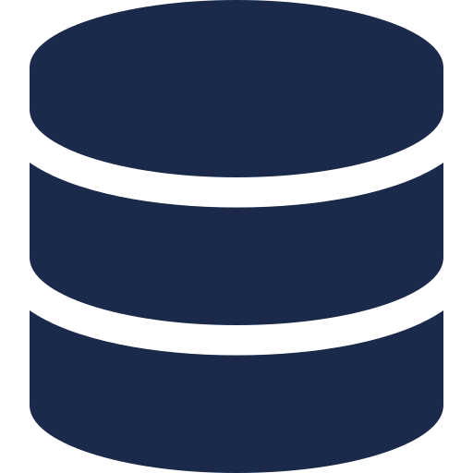
Technologies Used
The stack powering the platform, end to end
HTML / CSS / JS
Node.js + Express
AWS SDK v3 (S3)
IAM
Frontend
Backend framework
Object storage client
Access-control layer
JWT
Docker
Git & GitHub
S3 (JSON objects)
Session authentication
Containerized deployment
Version control
No separate database
Secure Cloud Document Management System
5

Slide 6






Key Features
What users and admins can actually do
Upload files & folders
Browse & navigate
View & download
Direct-to-S3 uploads under each user's own prefix
Breadcrumb navigation through nested folders
Presigned URLs, 5-minute expiry, generated per request
Delete recursively
Admin dashboard
Role-based access
Removing a folder deletes everything inside it in S3
Lists every registered user, pulled from S3 JSON records
Signup email decides user vs. admin automatically
Secure Cloud Document Management System
6

Slide 7





How This Is Protected — Security in Layers
Five independent layers, each narrowing what an attacker could reach
Authentication
Passwords hashed with bcrypt; JWT issued on sign-in, verified on every request
Least-privilege IAM
The backend's IAM user can only GetObject / PutObject / DeleteObject / ListBucket on one bucket — nothing else in the AWS account
Private bucket, no public access
'Block all public access' stays on; the bucket is never opened up
Presigned URLs
Files are only ever reachable via short-lived (5-minute) signed links generated after an ownership check
Per-user isolation
Every object lives under users/<userId>/ and the backend rejects any key outside the caller's own prefix
Secure Cloud Document Management System
7

Slide 8


The IAM Policy, Up Close
Even if backend credentials leaked, the blast radius is one bucket
{
"Version": "2012-10-17",
"Statement": [
{
"Sid": "ListBucketOnly",
"Effect": "Allow",
"Action": ["s3:ListBucket"],
"Resource": "arn:aws:s3:::YOUR_BUCKET"
},
{
"Sid": "ObjectReadWriteDelete",
"Effect": "Allow",
"Action": [
"s3:GetObject",
"s3:PutObject",
"s3:DeleteObject"
],
"Resource": "arn:aws:s3:::YOUR_BUCKET/*"
}
]
}
Scoped to one bucket
Both statements name only this bucket's ARN — read, write, delete, list, nothing more
No console access
The IAM user has programmatic access keys only — never a password or console login
No wildcard resources
Every Resource is explicit; there's no "*" that could reach other buckets or services
Secure Cloud Document Management System
8

Slide 9



Future Scope
Where this project can go from here
Multi-factor authentication
Server-side encryption (KMS)
File versioning
Add TOTP-based MFA on top of the existing JWT flow
Encrypt every object at rest with a customer-managed KMS key
Enable S3 versioning so deleted or overwritten files stay recoverable
Malware scanning on upload
CloudFront distribution
Usage analytics for admins
Scan objects on PutObject before they become downloadable
Serve files through a CDN edge layer instead of direct S3 URLs
Storage-per-user, upload trends, and activity logs on the admin dashboard
Secure Cloud Document Management System
9

Slide 10
Thank You
Questions & Discussion
Tanmay Garg
Secure Cloud Document Management System — AWS S3 + IAM

