Slide 1


SPOTIFY
CASE STUDY
Presented By :TANMAY GARJE

Slide 2
INTRODUCTION
This dataset captures a user's complete music streaming history on Spotify. It includes:
  Timestamps of when each track was played
  Track name, artist, and album
  Reasons for playing and stopping the track
  Duration played and whether the track was skipped

Slide 3
PROBLEM STATEMENT
TO ANALYZE A USER'S SPOTIFY STREAMING HISTORY AND
GENERATE INSIGHTS INTO THEIR LISTENING HABITS,
PREFERENCES, AND BEHAVIORAL PATTERNS.

Slide 4
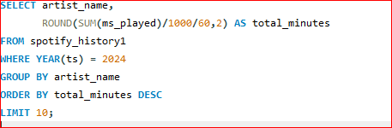
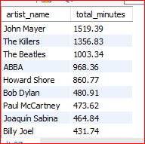
1. WHICH ARTISTS WERE MOST LISTENED TO THIS YEAR?

Slide 5
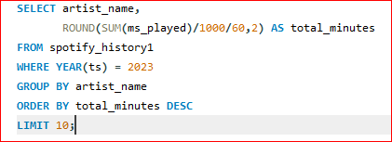
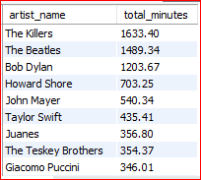
2. HOW DOES THAT COMPARE TO LAST YEAR ?

Slide 6
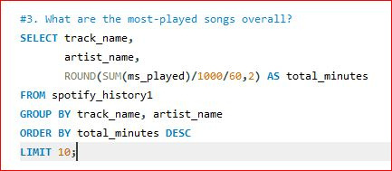
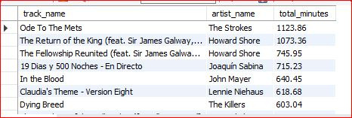
3. WHAT ARE THE MOST-PLAYED SONGS OVERALL ?

Slide 7
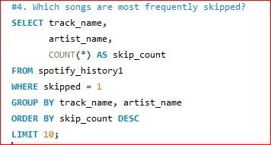
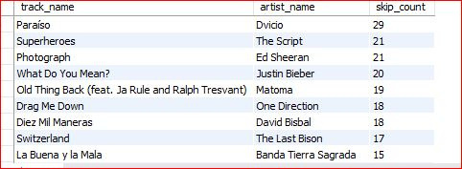
4. WHICH SONGS ARE MOST FREQUENTLY SKIPPED ?

Slide 8
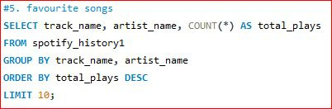
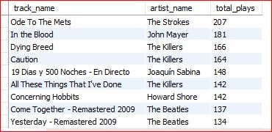
5. FAVOURITE SONGS

Slide 9
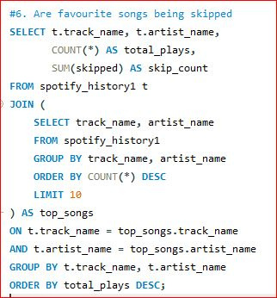
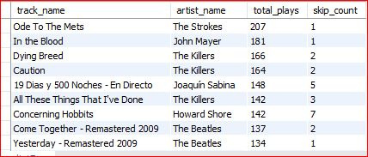
6. ARE FAVOURITE SONGS BEING SKIPPED ?

Slide 10
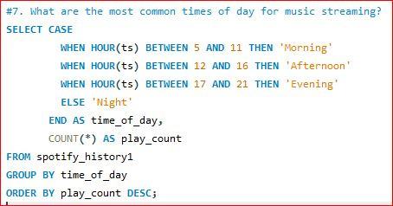
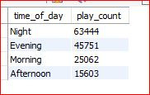
7. WHAT ARE THE MOST COMMON TIMES OF DAY FOR MUSIC STREAMING ?

Slide 11
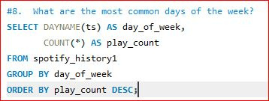
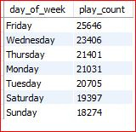
8. WHAT ARE THE MOST COMMON DAYS OF THE WEEK ?

Slide 12
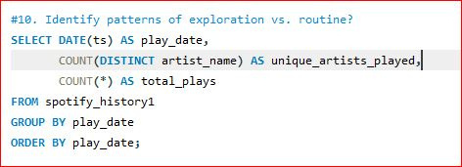
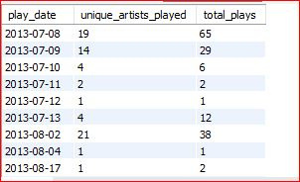
9. IDENTIFY PATTERNS OF EXPLORATION VS. ROUTINE ?

Slide 13
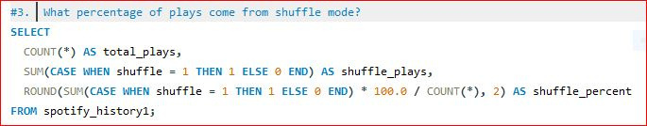

10. WHAT PERCENTAGE OF PLAYS COME FROM SHUFFLE MODE ?

Slide 14
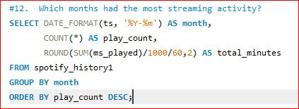
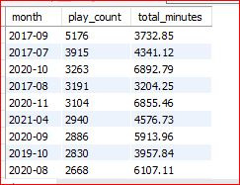
11. WHICH MONTHS HAD THE MOST STREAMING ACTIVITY ?

Slide 15
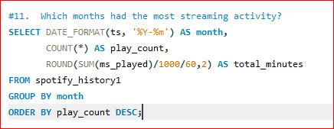
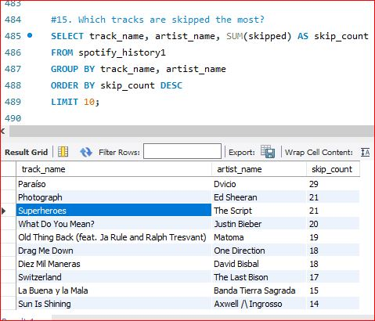
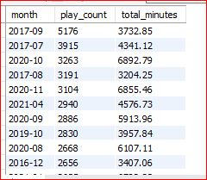
KEY INSIGHTS ANALYZING DATA

Slide 16
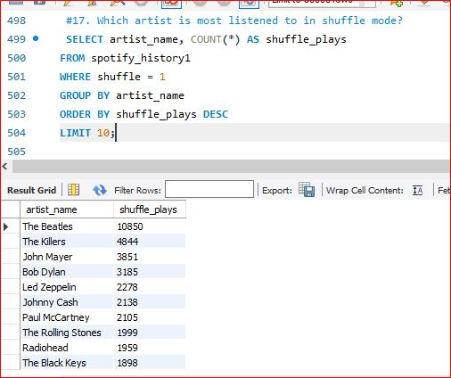
KEY INSIGHTS ANALYZING DATA

Slide 17
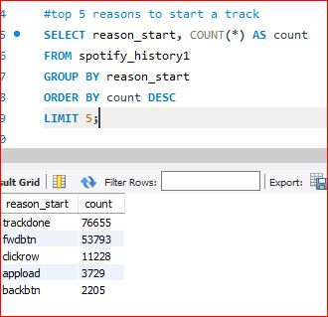
KEY INSIGHTS ANALYZING DATA

Slide 18
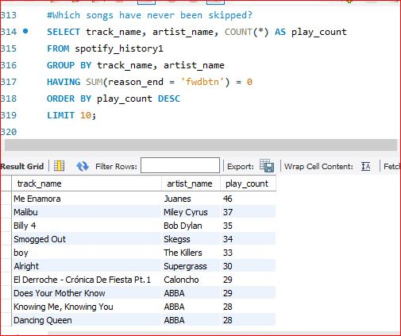
KEY INSIGHTS ANALYZING DATA

Slide 19
THANK
YOU

