Slide 1

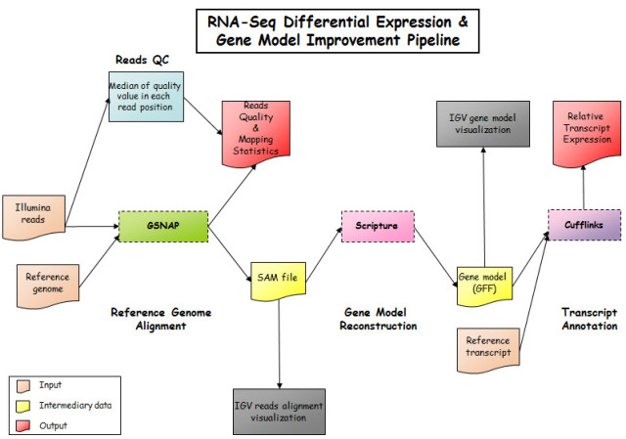
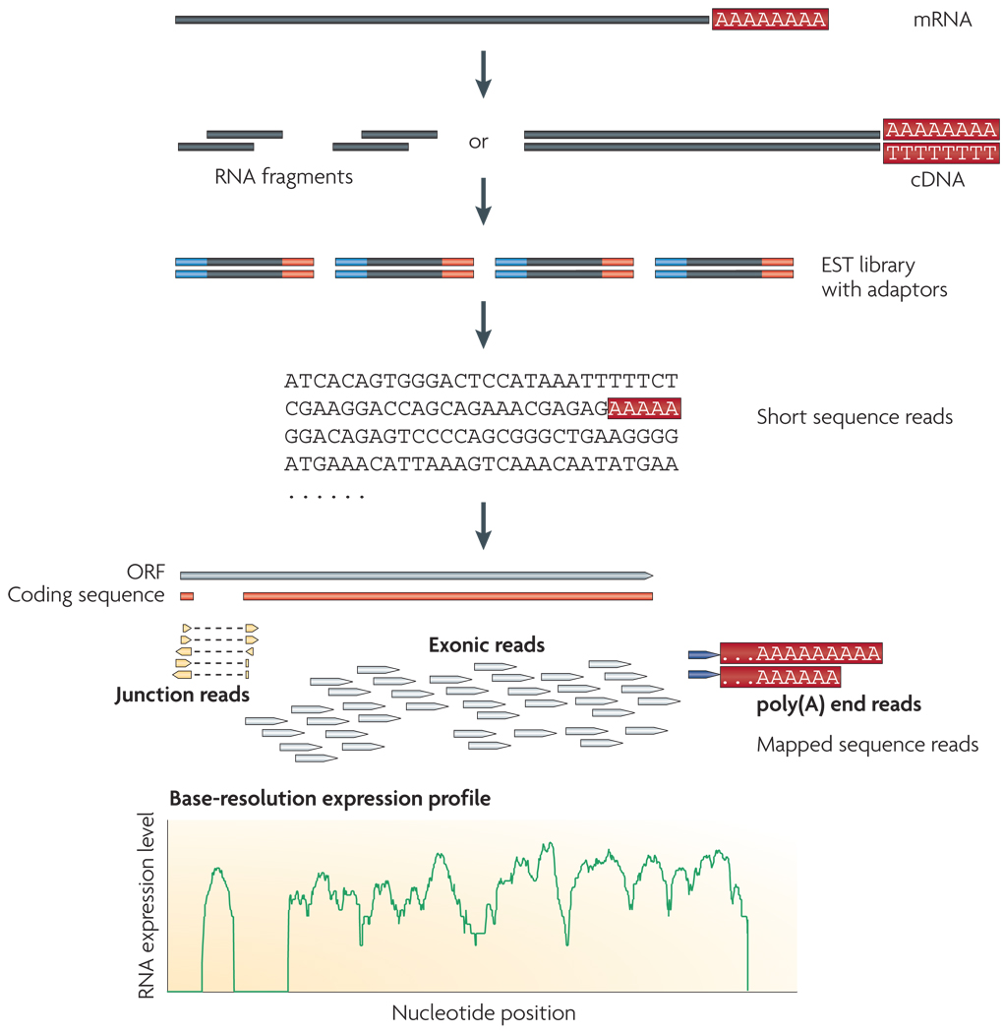
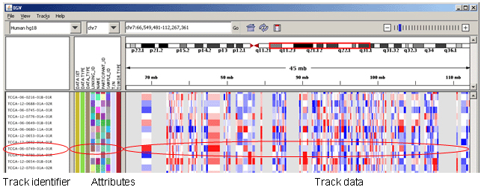
Single Cell Transcriptomics Reveals Heterogeneity of Gene Expression in Mouse Cells
Tanmay Ghai, Nupur Banerjee, Dr. Rizi Ai and Dr. Wei Wang
Department of Chemistry and Biochemistry, University of California, San Diego, 9500 Gilman Drive, La Jolla, California
Introduction
The following diagram on the left shows the relationship between GSNAP and Cufflinks, and how they end up producing short reads, which then leads to analyzing the gene expression levels of various cells.
Picture: http://gingerplum.files.wordpress.com/2011/08/8-20-20111.jpg?w=640&h=448
Mapping and Assembly
What exactly is RNA-seq?
RNA-seq: next-generation sequencing to extract information about the content of RNA sequences.
3 main steps: quantify the abundance of mRNA, determine the structure of genes (their different sized ends, and splicing patterns), and to quantify the varying expression levels of each transcript.
A typical RNA-seq project involves
converting long strands of RNA into many short parts of cDNA (complimentary DNA).
sequencing adaptors attach to the each short cDNA fragment and subsequently, a sequence is produced with the use of high-throughput sequencing technology.
Sequences produced are then compared and aligned with a transcriptome (also known as a reference genome).
categorized aligned sequence into three groups: exonic reads, junction reads, and poly(A) end-reads. These different reads can then be used to view the basic expression profile of a gene.
Why we conduct RNA-seq and why is it important?
Recently RNA-seq has recently revolutionized the world of transcriptomics. Using RNA-seq, we now have much more knowledge on differential expression of genes and their levels of expression, post-transcriptional mutations and even gene fusions.
Furthermore, RNA-seq helps us understand what exactly a transcriptome is. A basic definition of a transcriptome is a complete set of all the transcripts in a cell and their quantity. However, RNA-seq takes this to a whole new level by allowing us to understand the nuances within a transcriptome.
This is essential because we can then interpret the functional elements of a genome, reveal the molecular structure of cells and tissues, and understand disease, which could lead to potential cures or prevention information.
Why single-cell RNA-seq?
Using single cell RNA-seq analysis can give us much more substantial information about gene expression, protein levels, and phenotypic output.
This gives us valuable insight on how cellular heterogeneity within gene expression can lead to different traits and inherited information between organisms.
Single cell analysis is vital because it helps us identify previously unperceived variation among genes and gene expression.
 | Mapping Quality | Total Reads | Proper Paired | % Proper Paired | Unique Mapper | % Unique mapper | Genes | Isoforms
Cell_1 | Very good! | 9421315 | 7859185 | 83.4 | 7430034 | 78.9 | 3182 | 3446
Cell_2 | Very good! | 7813112 | 6312444 | 80.8 | 5881004 | 75.3 | 4751 | 5165
Cell_3 | Very good! | 7252243 | 5968877 | 82.3 | 5509608 | 76.0 | 4150 | 4517
Cell_4 | Very good! | 8762922 | 7243616 | 82.7 | 6827052 | 77.9 | 3337 | 3596
Cell_5 | Very good! | 9619357 | 7713570 | 80.2 | 7211808 | 75.0 | 3821 | 4154
Cell_6 | Very good! | 8035212 | 6537042 | 81.4 | 6197844 | 77.1 | 3514 | 3789
Cell_7 | Very good! | 9166757 | 7588491 | 82.8 | 7141259 | 77.9 | 3877 | 4215
Cell_8 | Very good! | 8119591 | 6598845 | 81.3 | 6196639 | 76.3 | 3716 | 4027
Cell_9 | Very good! | 7946851 | 6526587 | 82.1 | 6142598 | 77.3 | 4019 | 4371
Cell_10 | Very good! | 9672123 | 7979027 | 82.5 | 7552492 | 78.1 | 3204 | 3429
Cell_11 | Very good! | 6814517 | 5653627 | 83.0 | 5403171 | 79.3 | 2737 | 2896
Cell_12 | Very good! | 9024335 | 7363060 | 81.6 | 6917248 | 76.7 | 3239 | 3498
Cell_13 | Very good! | 8224518 | 6855884 | 83.4 | 6472480 | 78.7 | 4488 | 4867
Cell 14 | Very good! | 8168995 | 6761990 | 82.8 | 6395450 | 78.3 | 3215 | 3475
Cell 15 | Very good! | 8266431 | 6838516 | 82.7 | 6522522 | 78.9 | 2369 | 2519
Cell 16 | Very good! | 8525597 | 7079661 | 83.0 | 6586434 | 77.3 | 4576 | 4955
Cell_17 | Very good! | 8477944 | 6883249 | 81.2 | 6421991 | 75.7 | 4012 | 4375
Cell 18 | Good | 7065766 | 5565973 | 78.8 | 5239209 | 74.1 | 5069 | 5506
Visualization Through IGV Tools
A typical RNA-seq experiment. First, long RNA strands are converted into cDNA fragments. Sequencing adaptors are added to each cDNA fragment, and the sequence of the cDNA is obtained. These reads are aligned with the reference genome, and are classified as exonic reads, junction reads, or poly(A) end-reads. Finally, these types are used to generate a base-resolution expression profile for each gene².
The Integrative Genomics Viewer (IGV) is a high-performance visualization tool for interactive exploration of large, integrated genomic datasets. Simply put
IGV tools is a tool that converts the reads produced by Cufflinks, in the RNA-seq process, into a visualization that helps us understand what these strands, sequences, and reads really mean.
Above is an example of a visualization of a read that has been tested with a human cell (not the same as our process, which involves mice cells). The image records each track identifier with the correlating attribute and the data that is produced with that read.
Methodology and Procedures
Results
Selected Genes with Different Expression Levels
Differentially Expressed Genes
Software
1. Gsnap (version 2013-02-05) - GSNAP aligns the single and paired-end reads of the transcripts and produces short reads of RNA sequences.
Command - gsnap -t 4 -A sam -N 0 –D dir -d mm10 -s mm10.splicesites.iit --force-xs-dir --split-output=s *_1.fastq *_2.fastq
Input - .fastq files and Output - .sam files
2. Samtools ( version 0.1.18) – SAM Tools provide various utilities for manipulating alignments in the SAM format, including sorting, merging, indexing and generating alignments in a per-position format. Command - samtools-0.1.18/samtools view -Sb s.concordant_uniq > s.concordant_uniq.bam
Input - .sam file and Output - .bam file
3. Cufflinks ( version 2.1.1) - Cufflinks assembles the transcripts and looks for differential expression and regulation of the genes in the RNA-seq samples. Also, it constructs sets of transcripts that give information about the reads that were observed in the experiment.
Command - cufflinks-2.1.1.Linux_x86_64/cufflinks -p 4 -G genes.gtf merge_concordant.bam
Input - .sam file and Output – transcripts.gtf, transcripts.expr, and genes.expr.
4. Cuffdiffs ( version 2.1.1 ) - Cuffdiffs can be used to find significant changes in transcript expression, splicing, and promoter use.
Command – cuffdiff ../s1/genes.gtf ../s1/merge_concordant.bam ../s2/merge_concordant.bam
Input - .gtf file and .sam files and Output - .fpkm_tracking files among others
Single Cell Samples:
To conduct this RNA-Seq experiment, we used data from 18 bone-marrow dendritic cells (BMDCs) from a mouse (mus musculus).¹
Gene Ontology: From the data that we used, we selected ten genes to compare the expression levels between the 18 single BMDCs.
Gene | Expression level (FPKM) | Function
Zf12 | 0 | Gene not expressed
Ints8 | 7.10652e-317 | Component of the Integrator complex, a complex involved in the small nuclear RNAs (snRNA) U1 and U2 transcription and in their 3'-box-dependent processing.
Foxp1 | 0.0682131 | Expressed in developing lung, neural, intestinal and cardiovascular tissues.
Hook1 | 3.48482 | Defects in Hook1 are the cause of the azh (abnormal spermatozoon head shape) mutant phenotype,
Timm22 | 10.531 | Essential core component of the TIM22 complex, a complex that mediates the import and insertion of multi-pass transmembrane proteins into the mitochondrial inner membrane.
Phyh | 16.3463 | Defects in Phyh are the cause of lupus nephritis, a severe autoimmune disease.
Capza1 | 21.6231 | F-actin-capping proteins bind in a Ca(2+)-independent manner to the fast growing ends of actin filaments thereby blocking the exchange of subunits at these ends.
Snrpe | 52.9471 | Belongs to the snRNP Sm proteins family.,
1600029D21Rik | 1066.27 | May participate in the wound response during the healing process, and promote wound repair
Lyz2 | 23255.5 | Lysozymes have primarily a bacteriolytic function; those in tissues and body fluids are associated with the monocyte-macrophage system and enhance the activity of immunoagents.
We used Cuffdiff to compare the gene expression levels from two different cells, in order to verify the accuracy of our results. We found that 982 genes were differentially expressed between cells 1 and 2, while 22,378 genes were not differentially expressed between the two. Since the large majority of the expression levels were in a similar range, and there was no significant difference between the two cells, we concluded that our results were precise.
Conclusions & Future Work
RNA-seq has now become a vital part of bioinformatics and will continue to help us gain new knowledge and insight about genes, their expression levels, and what these expression levels mean.
In this study, 18 mouse single-cell RNA-seq were analyzed, including mapping, assembly, quantification and functional analysis
Differential expressed genes were compared between cell 1 and cell2
In the future, the functions of 982 differentially expressed genes will be further analyzed to determine the heterogeneity between cells. With this information, we can identify what certain genes lead to various diseases and with this knowledge we can further learn how to prevent those genes from being expressed
References
The table above represents the gene’s expressed throughout the RNA-seq process and the level at which they are expressed in the units FPKM, which stands for “for end pair sequencing.” To the right, each gene’s function is explained. This information can be found at http://david.abcc.ncifcrf.gov.
Shalek AK, Satija R, Adiconis X, Gertner RS, Gaublomme JT, Raychowdhury R, Schwartz S, Yosef N, Malboeuf C, Lu D, Trombetta JJ, Gennert D, Gnirke A, Goren A, Hacohen N, Levin JZ, Park H, Regev A. Single-cell transcriptomics reveals bimodality in expression and splicing in immune cells. Nature. 2013 Jun 13;498(7453):236-40
Wang Z, Gerstein M, Snyder M. Nat Rev Genet. RNA-Seq: a revolutionary tool for transcriptomics. 2009 Jan;10(1):57-63.
Trapnell C, Roberts A, Goff L, Pertea G, Kim D, Kelley DR, Pimentel H, Salzberg SL, Rinn JL, Pachter L. Nat Protoc. Differential gene and transcript expression analysis of RNA-seq experiments with TopHat and Cufflinks. 2012 Mar 1;7(3):562-78.
Notes:
Fonts
Font used in Title is Helvetica Bold 100 pt.
Font used on Presenters is Helvetica 54 pt.
Font Sizes for body text should be no smaller than 14 pt. And no larger than 24
Secondary Tiles should be sized larger than body text by at least 10 pts.
Note:
Not all computers have the same fonts. When designing your poster please keep this in mind. Common fonts that are easily found on the majority of machines will be
Helvetica
Times
Times Roman
Arial
Verdana
Symbol
Georgia
Impact
Courier
Book Antiqua
Using one of these fonts will save you time and headaches down the road.
2. When working with text from Word. Do not simply drag the text from Word into Powerpoint creating a “Text Box”. It makes it to hard to adjust the size and position in your poster. Also numerous errors such as spacing between words, character switching and formating errors can occur. When ever possible create the text using the Powerpoint text tool. This will eliminate many of the text problems occurring in printing. One other way would be to select the text in word, copy, then “paste it into Powerpoint.
3. Accenting Text can be bone with color, It is best to keep the title in black.
Graphics
Note:
1. For printing purposes images should be no smaller than 250dpi. Do Not use images that you have taken off the web! These images are 72 dpi and are absolutely no use for printing. Tif files seem to work the best. Images can be converted through Photoshop and various other programs. If creating images in a scientific application make sure you can export the file as a Tif. Excel files can also be used in Powerpoint
2. Colored Backgrounds are nice but are not needed. Plain white is best for presenting your material. Colored Backgrounds waste too much of the ink on the printer, and if it is a complicated color can cause banding or streaking . Color should be used in graphs, charts, images, and text.
3. In the lower right corner is the Purdue Logo. This is the official logo of the University. And Should be displayed accordingly with the co-branding identity of the Department of Biological Sciences underneath.
The co-branded school or department name appears no taller than one-half the height of the small caps in the word “Purdue” and no shorter than the font size in
the word “university” in the Purdue signature. Co-branded school or department name aligns right or left with the Purdue signature.
( officially Frutiger is the font suppose to be used as the dept. name however it is not that common on all computers if you do have this Font you can use it instead of Verdana which is found in this Template.)
4. Try putting a lined border around graphs and images to keep them from appearing like they are floating. The line tool has many options and widths. Keep it simple, the single lines work the best.
5. There is a black line bordering the poster area. For poster printing purposes all material should be set within this border.
If you do not wish to have a border around the edge when the poster is printed, simply select and delete after you have the final layout complete.
Layout
Notes:
There are many different ways to lay out your material. One suggested method is to separate information into different columns. Columns shouldn’t be much wider than 8.5 inches. Wider columns tend to be harder to read when presenting a lot of material. At 8.5 inches wide per column 4 columns across would give you nice spacing between each one and make it easy to read. Whatever your column width, try to keep it consistent through out the poster

