Slide 1

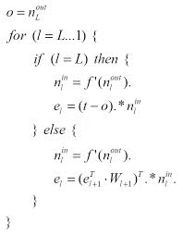
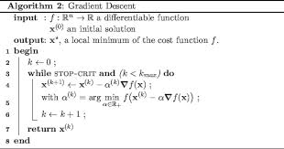
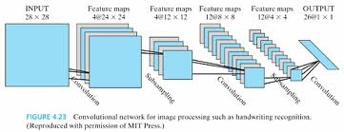
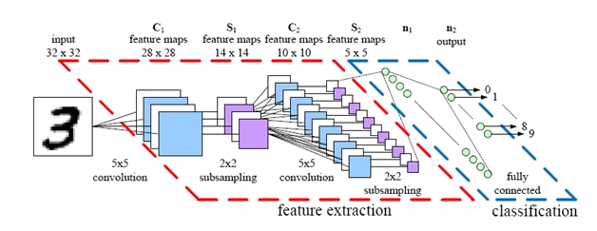
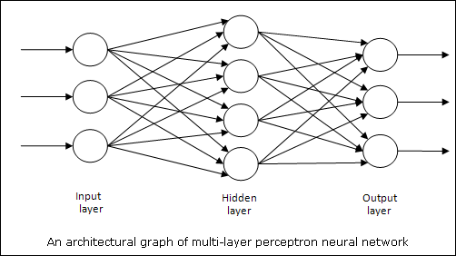


Algorithmic Learning and Training with Convolutional Neural Networks
Tanmay Ghai ^{[1]}, Schuyler Eldridge^{[2]},Ajay Joshi ^{[3]}
Evergreen Valley High School, 3300 Quimby Rd, San Jose, CA 95148 ^{[1]} ; Boston University, 8 St Marys St, Boston, MA 02215^{[2, 3]}
Abstract
Methods and Materials
Convolutional Neural Networks have been of interest to scientists ever since Yan LeCun’s extensive research on them in the twentieth century. These networks are a form of artificial feed-forward neural networks that are widely based on biological processes and are known for being used in real world applications such as image detection, recognition, and classification. Here we have tried to train one such implementation of a Convolutional Neural Network, provided from the Deep Learning Toolbox, to see if in fact it can be trained to distinguish between different images. Our work has been conducted on the MATLAB platform and the data we have chosen to train the CNN with has been selected from the UCI Dataset Repository. The dataset consists of images of people from Carnegie Mellon University with different facial expressions, features, and orientations that the CNN should detect after being trained. To train the CNN to be able to distinguish between images, an algorithm called RPROP or Error Backpropagation was utilized and from previous papers, the proposed success rate was 97.6 percent. We are not proposing a certain rate of success, we are just expecting, after execution, that the CNN is able to distinguish amongst images with differences such as sunglasses vs. no sunglasses, happy vs. sad expressions, and facing left vs. facing right.
Materials: MATLAB, datasets to test with from the UCI data repository, and the Deep Learning toolbox for CNN’s which can be found online.
RPROP –
2) Gradient Descent –
Chart 1. Bar graph for the results
Introduction
Conclusions
As Convolutional Neural Networks have become of more and more interest in the past century, scientists have been working on effective methods to find real world applications for these artificial feed-forward processes. CNN’s have mainly been utilized in processes that deal with image detection, recognition, and classification, and we wanted to understand the theory behind these networks as well as do some tests to see if they can actually be trained to classify and recognize different images
Convolutional Neural Networks are divided into three layers: convolution, subsampling, and output. In each layer versions of the input image are created and altered. In this experiment we tried to see the effects of using an algorithm called Resilient Backpropagation versus an algorithm called Gradient Descent.
Results
Overall the results were pretty conclusive the Resilient Backpropagation is a better algorithm than Gradient Descent when training and testing Convolutional Neural Networks. Along with the accuracy, the execution time of RPROP was much less than that of Gradient Descent.
Some reasons to possibly explain why RPROP is a better algorithm:
1) Requires no parameter tuning
2) Learning and adaptation only affected by the
sign of the partial derivative
3) Computer friendly and easy to code
4) Learning is equally spread over the network, not just in one layer
5) RPROP is a fast learner compared to GD
This experiment only deals with two different learning algorithms and RPROP turned out to be the better one. However, there may still be better ways to train Convolutional Neural Networks out there.
I used about 100 images off of the UCI dataset repository, including one of my own to test the Convolutional Neural Network coded in MATLAB after they had been trained.
I tested images that were different in facial expressions(happy and sad) as well as images that had sunglasses or not. The table below shows the results for the accuracy of each training algorithm as well as the execution time.
Algorithm | Happy vs. Sad | Sunglasses | Accuracy Happy vs. Sad | Accuracy Sunglasses | Execution Time
RPROP | 100 images, 55 happy 45 sad | 55 images 33 sunglasses 22 no sunglasses | Reported : 47 happy 53 sad 92 % accuracy | Reported: 27 sunglasses and 28 no sunglasses 89 % accuracy | Happy vs. Sad: 1 hour and 42 minutes Sunglasses: 45 minutes and 22 seconds
Gradient Descent | 100 images 55 happy 45 sad | 55 images 33 sunglasses 22 no sunglasses | Reported: 40 happy 60 sad 85 % accuracy | Reported: 24 happy and 31 sad 84 % accuracy | Happy vs. Sad: 2 hours and 57 minutes Sunglasses: 3 hours and 12 minutes
Figure 1. Picture of CNN Architecture.
Figure 2. Picture of one of the dataset images
Figure 3: Basic Design of CNN’s
References
http://www.uow.edu.au/~phung/docs/cnn-matlab/cnn-matlab.pdf
http://archive.ics.uci.edu/ml/datasets.html
http://www.mathworks.com/matlabcentral/fileexchange/38310-deep-learning-toolbox
http://andrew.gibiansky.com/blog/machine-learning/convolutional-neural-networks/
I would really like to thank my mentors for mentoring and helping me research such an interesting topic this summer.

