Slide 1

COVID-19 (SARS-CoV-2)
Real Data analysis

Slide 2
Table of contents
01
Introduction
02
Data Exploration & Interpretation
Data Analytics
03
Data Analysis &
Model Development
04
Conclusion

Slide 3

*01* Introduction

Slide 4
Introduction
COVID-19- Background
COVID-19 is caused by severe acute respiratory syndrome coronavirus 2 (SARS-CoV-2).
Declared a pandemic by WHO in May 2020
Symptoms occur 1-14 days after contact with the virus.
Preventive measures- Social Distancing,Wearing Masks, Sanitizer, Face Coverings.
Reference- https://en.wikipedia.org/wiki/Coronavirus_disease_2019

Slide 5
COVID-19 in the US
We will study the impact of COVID-19 in the USA.
First Case- 20 January 2020 in Washington
Number of Cases since then- More than15 Million
Most affected areas- California , Texas and Florida.
Total Number of deaths – 282,000
Reference- https://news.google.com/covid19/map?hl=en-US&mid=%2Fm%2F09c7w0&gl=US&ceid=US%3Aen

Slide 6
Research and Development
59 Vaccine candidates are in clinical research phases with 17 in phase II-III.
Top Universities working towards the vaccine- John Hopkins University and the University Of Oxford (in collaboration with AstraZeneca).
Companies developing vaccine- Pfizer and BioNtech, Moderna.
Pfizer Inc and BioNTech, Moderna and the University of Oxford (in collaboration with AstraZeneca), announced positive results from interim analyses of their Phase III vaccine trials.
Reference- https://en.wikipedia.org/wiki/COVID-19_drug_development

Slide 7

Goal of the project
We will focus on predicting the number of daily covid-19 cases in the United States Of America(USA) by analyzing the COVID-19 dataset from here- https://covidtracking.com/data/national

Slide 8

*02* Data Exploration & Interpretation

Slide 9
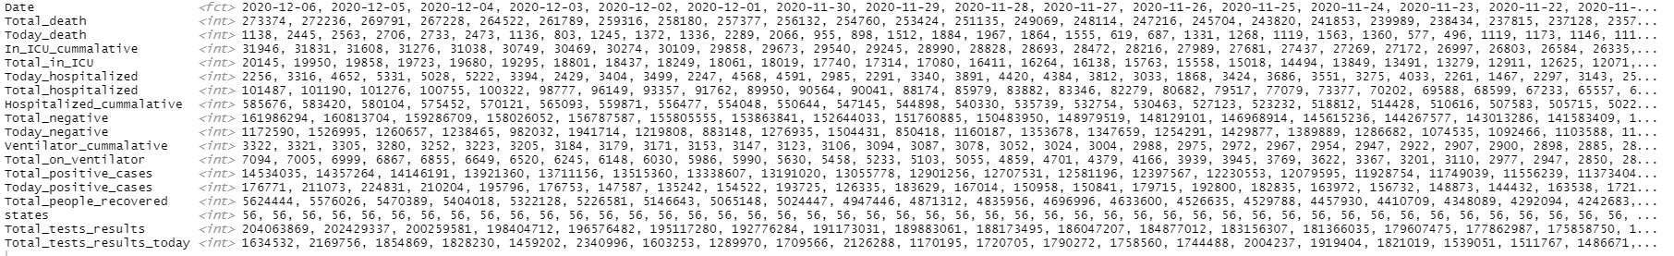
Exploring the dataset
The dataset consists of 18 columns which consists of the Date, total deaths, deaths on that day, total number of people in ICU, Number of people hospitalized, Total number of positive patients, number of people tested positive today, Total number of negative patients, number of negative tested today, states, total tests. I have modified the column names for a better understanding.

Slide 10
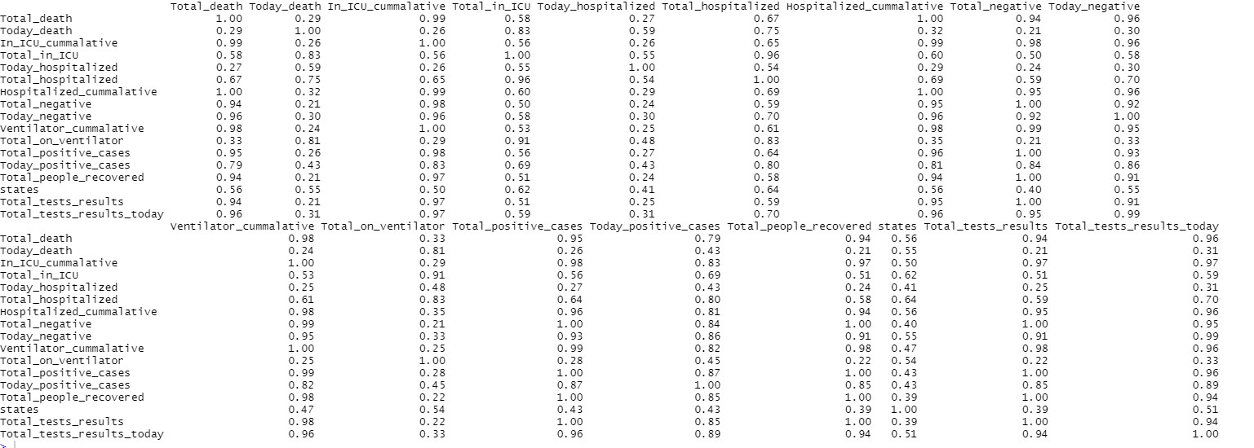
Exploring the dataset
Here in this slide, we can see the correlation between the variables.

Slide 11
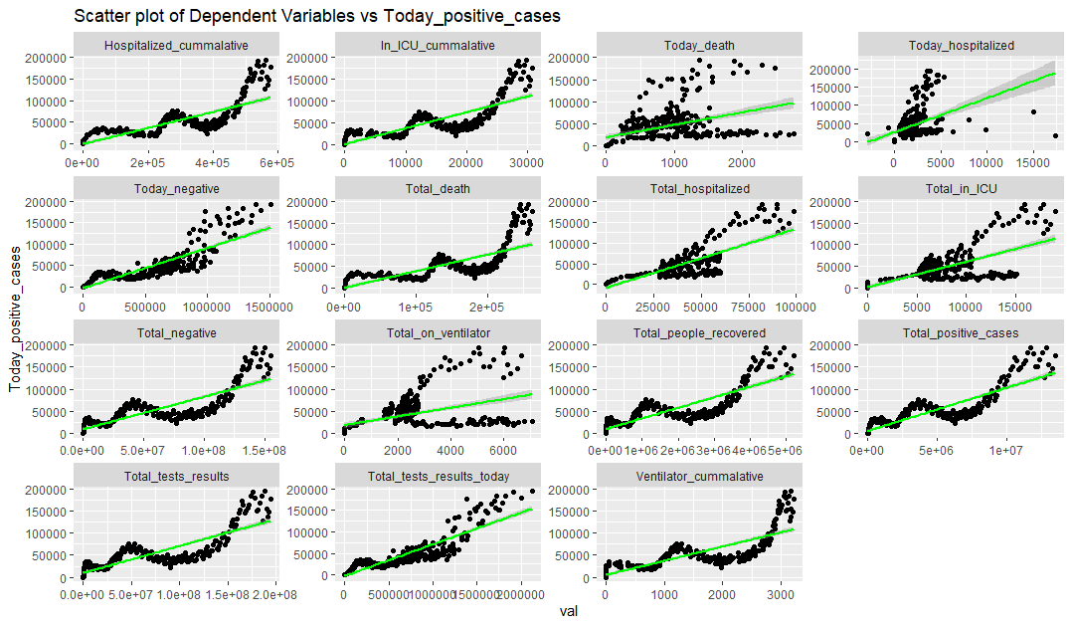
Exploring the dataset
This is the scatterplot of each variable with our target variable which is ‘Today_positive_cases
There is a positive relation with most of the variables. We will see the effect of this in the models.

Slide 12
Limitations with the Data
As the number of Covid-19 positive and negative cases have increased over time, so the dataset is imbalanced, and we need to correct this imbalance, to get better predictions on our test set.
The differences between the variables is very high . For example- The total number of positive cases is 14,534,035, and the negative is 161,986,294 which is more than 10 times the positive cases. So, we need to scale the data for the model to perform better.

Slide 13
Correcting Imbalance
We used the smoteR for correcting the imbalance in the dataset. SmoteR (Torgo et al., 2013) is an adaption for regression of the well-known Smote (Chawla et al., 2002) algorithm.
SmoteR oversamples the rare case in the data (which is defined by us in the function) and under samples the non- rare case. The weightage of under and over sampling is also to be provided to the function.
We used SmoteRegress() function from the UBL library available in R.
Reference- https://shiring.github.io/machine_learning/2017/04/02/unbalanced and https://cran.rstudio.com/web/packages/UBL/UBL.pdf

Slide 14
Scaling the balanced Dataset
We scaled the dataset using scale() function available in R. scale compresses the dataset which is helpful when the order of magnitude in the variables is different. (like in our case).
It calculates the mean and standard deviation of the vector, then "scale" each element by those values by subtracting the mean and dividing by the standard deviation.
Reference- https://stackoverflow.com/questions/20256028/understanding-scale-in-r

Slide 15

*03* Data Analysis & Model Development

Slide 16
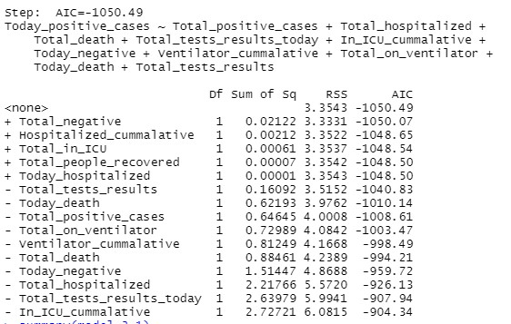
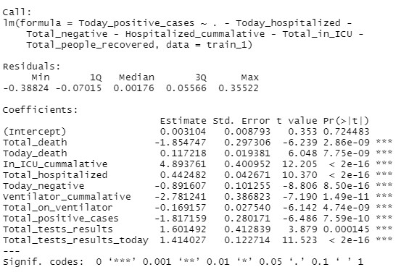
Model Development and evaluation
Linear Regression Model
We performed forward, backward and stepwise selection to select the best features.
We implemented the linear regression model with the most relevant features selected from the model with least AIC in the selection techniques.
We predict the values of our test set and report an MSE of 0.1037821 and R^ of .926

Slide 17
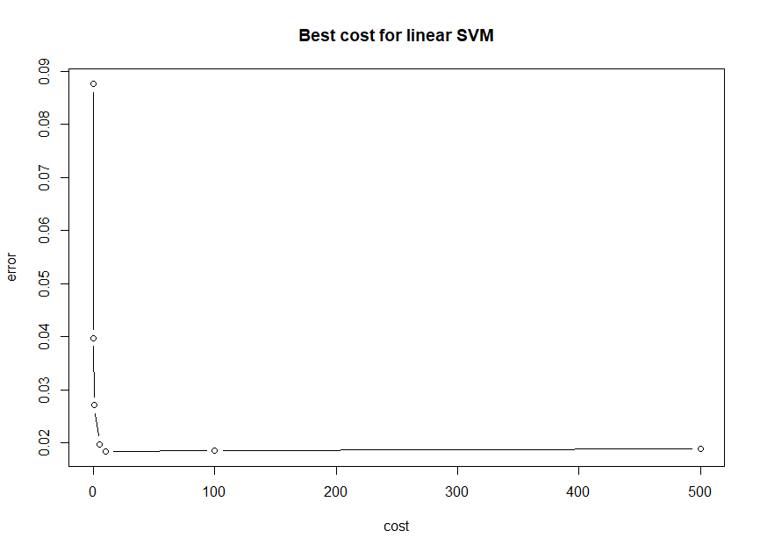
Model Development and evaluation
Linear SVM Model
Initially, we tuned the parameters for the model (using the tune() function available in R) to get the best cost value. We can see from the graph that it is 10.
We used the e1071() package for svm. We implemented the model with the best cost value. We predicted the values of our test set and get an MSE of 0.097984 which is lower than what we got in linear regression and R^2 of .934

Slide 18
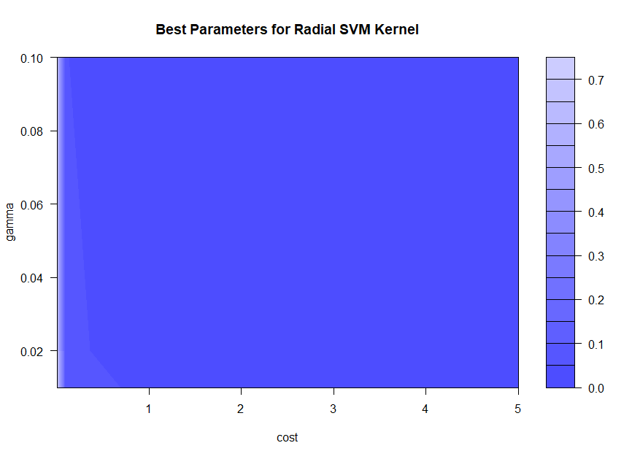
Model Development and evaluation
Radial Kernel SVM Model
We tune the parameters to get the best cost and gamma values for our model. The best cost and gamma values were 5 and 0.02.
We train our model with the tuned parameters to get the best performance. We then run the model on the test set and the MSE increases to 0.1843159 and R^2 of .873.

Slide 19
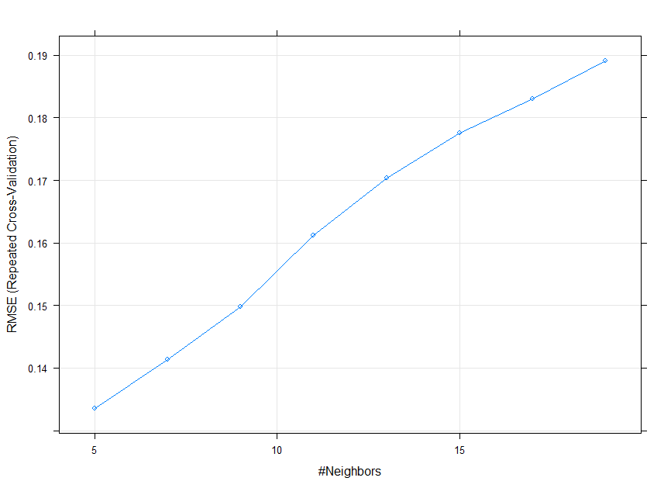
Model Development and evaluation
K-Nearest Neighbour (KNN) Model
We used the caret() package to train our KNN model. We preprocessed the model to find the best K value. A 10-fold cross validation(repeated CV) was used to get the best value of K which came out to be K=5.
Now use this model to predict the values on our test set, the MSE comes out to be 0.1349 for this model and R^2 of .902

Slide 20

*04* Interpretation & Conclusion

Slide 21
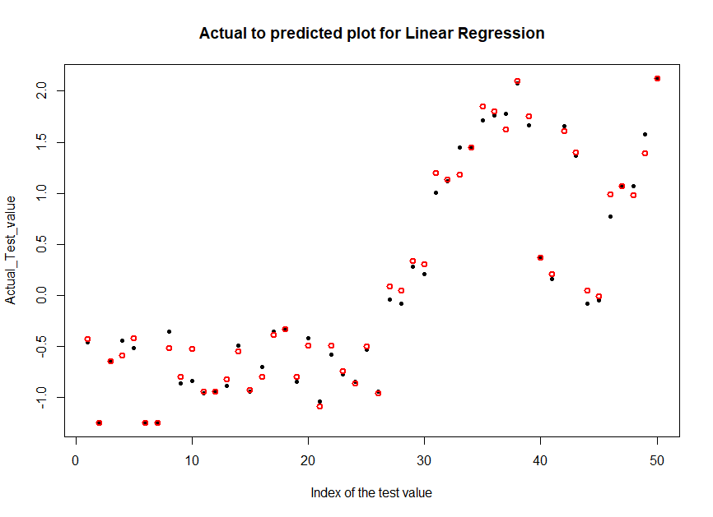
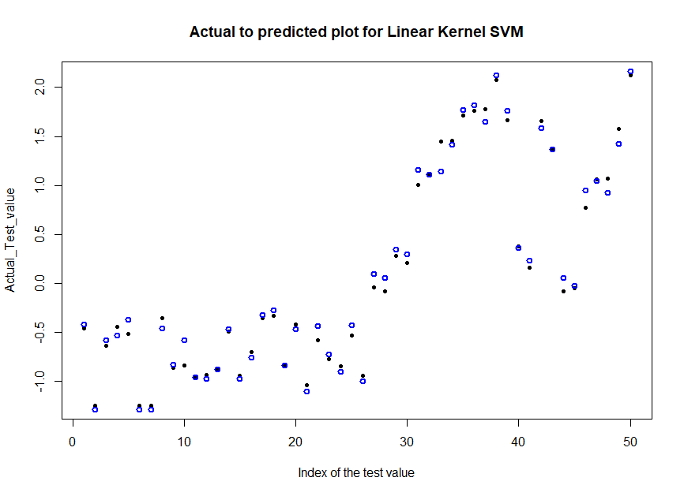
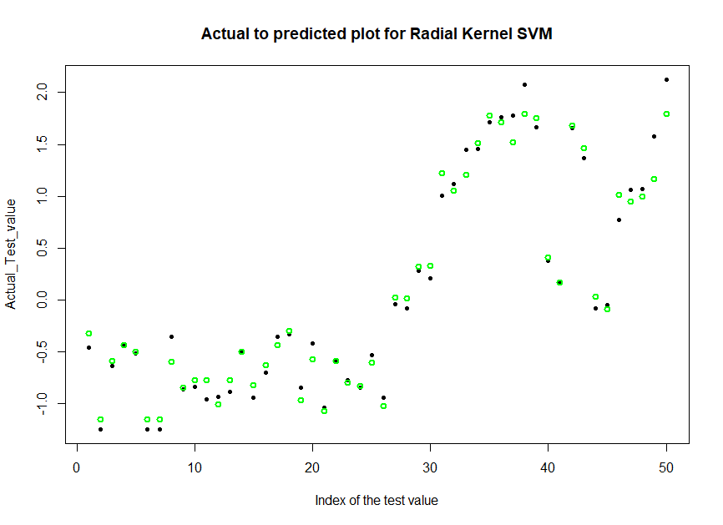
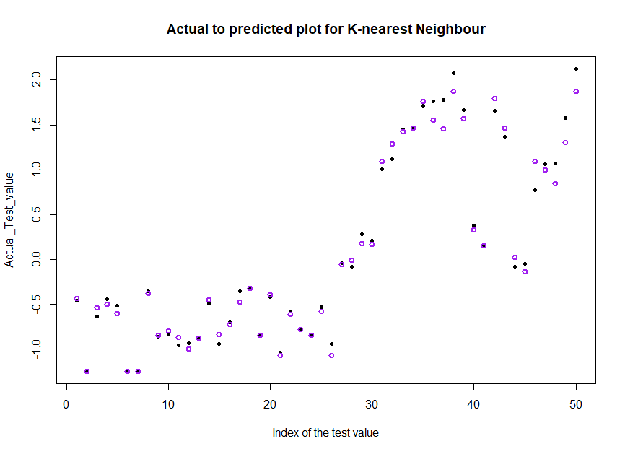
Model Comparison
MSE= 0.10
R^2=0.92
MSE= 0.097
R^2=0.93
MSE= 0.18
R^2= 0.87
MSE= 0.135
R^2= 0.90
Linear Regression
Linear Kernel SVM
Radial Kernel SVM
K-Nearest Neighbors (KNN)

Slide 22

Conclusion
Among all the algorithms we have used, the Linear SVM gives us the lowest Mean squared error (MSE) and highest accuracy.
So, we can conclude that for our balanced and scaled dataset, Linear SVM gives the best prediction with the least error.
Also, Linear Regression is the one after that which tells us about the relation of our target variable with the predictors. Total deaths and today negative were positively related to our target variable which is today positive.

Slide 23
Thank you
From
Tanmay Gupta

