Slide 1

Data analytics approach

Slide 2
Table of contents
01
Introduction
02
Data Exploration & Interpretation
Data Analytics
03
Model Development
04
Iinterpretation

Slide 3
Company
Sprocket Central Pty Ltd specializes in high-quality bikes and accessible cycling accessories for riders.
The marketing team wants to boost their business by analyzing the current customer base and determine customer trends and behavior
We have explored, preprocessed and analyzed the customer dataset for sprocket Central Pty Ltd.

Slide 4

*01* Introduction

Slide 5

Introduction
Sprocket Central wants to focus on the new high value customers based on transaction, customer demographic and address data
We will analyze the customer demographics and forecast the most important ones that will affect our sales.
We will predict the anticipated sales for the company.
Customer Demographics include age, gender, location, income distribution and jobs.

Slide 6

*02* Data Exploration & Interpretation

Slide 7
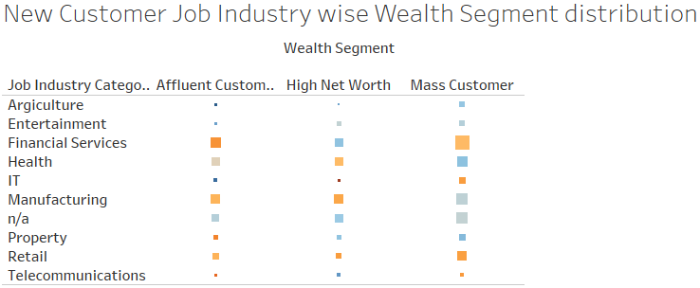
1. Bike Purchase with respect to wealth segment and job category
Exploring the demographics-
We can see higher purchases from customers financial services, Manufacturing and Retail.
Most mass customers from Financial services, manufacturing industry, N/A and Retail.
So we should focus on the customers having Mass customer wealth and are in Financial services and manufacturing industry.
*Size determine the purchase i.e. big box means higher purchase

Slide 8
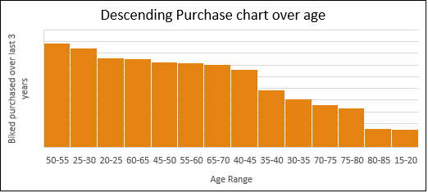
Exploring the demographics-
2. Age and Gender
Female’s have purchased more bikes than male within the last 3 years, so we should target female customers
Our customer base lies within 20-30 years and 50-60 years, so we should target people of that age.

Slide 9
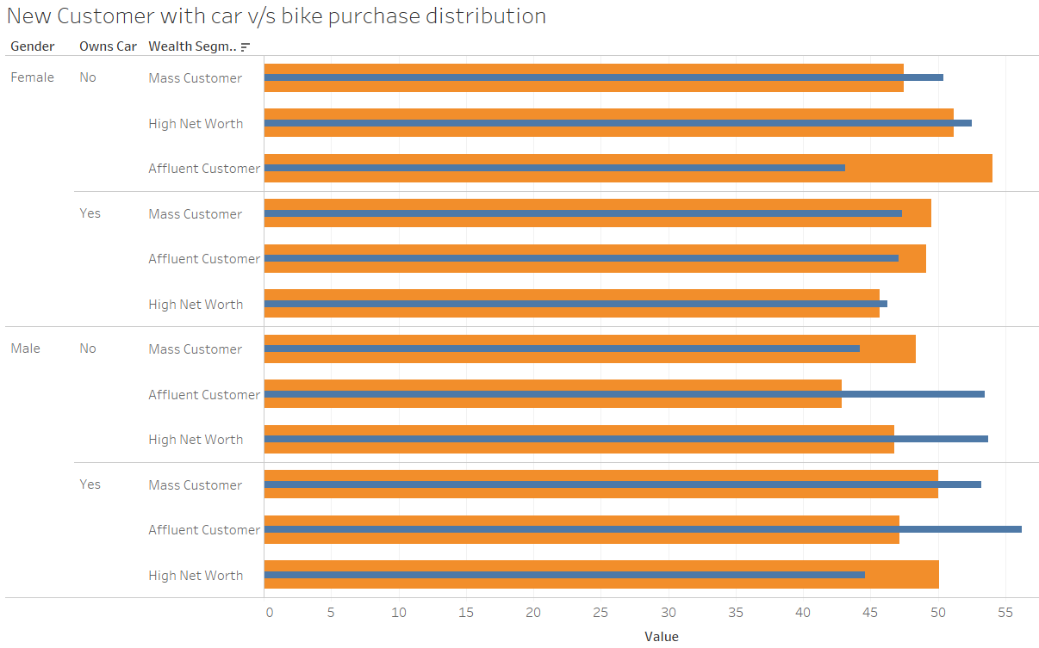
3. Purchase with respect to Gender, age and wealth distribution as compared to car ownership
Exploring the demographics-
Female’s aged between 40-45 preferred bikes over cars.
Both male and female are our high-valued customers.
Wealth segment doesn't tell much about the purchase as all the segments have almost similar purchases.
Most of the customers are between 45-55 years age.
The people who choose to buy a car also buy a bike.

Slide 10

*03* Model Development

Slide 11
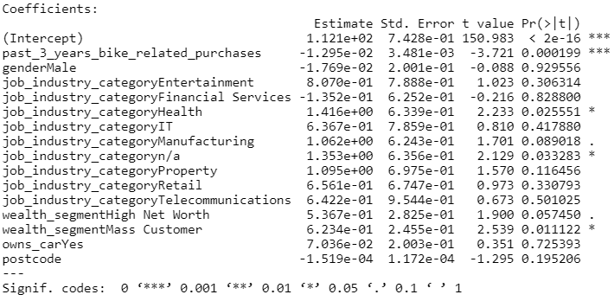
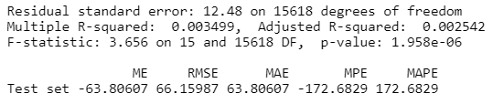
Linear Regression Model
The model shows important customer behavior characteristics to consider for targeting customers.
Important characteristics to consider are job industries- health and N/A ; wealth segment –mass customers.

Slide 12
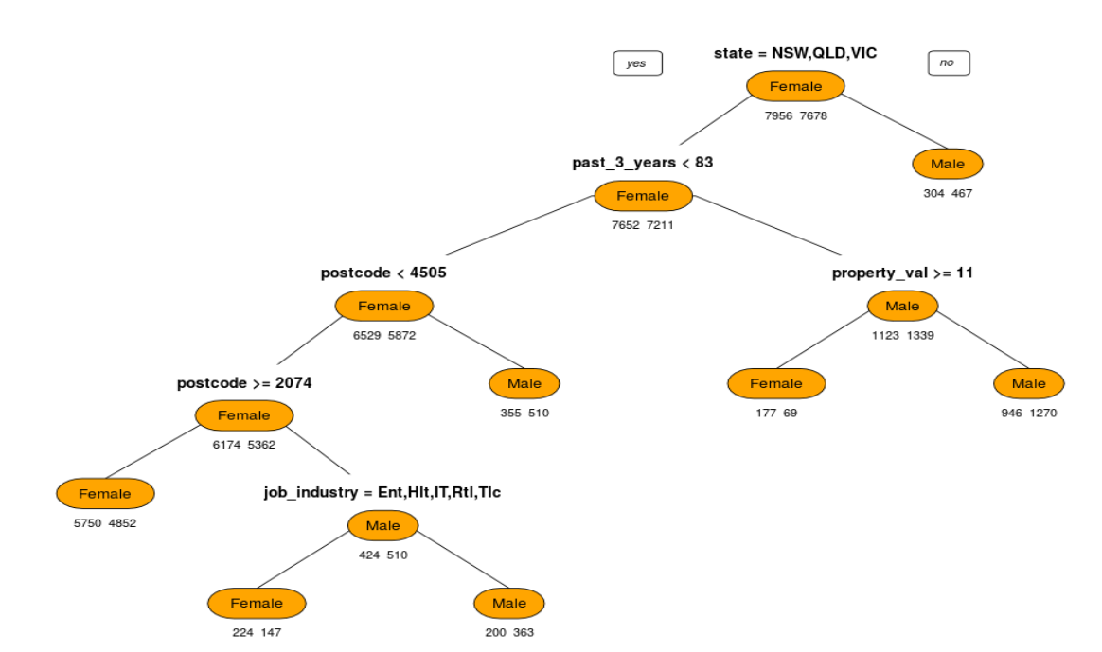
Decision Tree model
We have implemented the model for state, gender and job industry for the purchase of last 3 years.
The model shows that our sales for NSW,QLD and VIC by females in the job industry Entertainment, healthcare, IT, retail and telecommunication are the best. We should use these as our target.

Slide 13

*04* Interpretation & Conclusion

Slide 14

Conclusion
We can see that the timeframe of 3 years is good to determine the target customers as it shows significance of the variables.
Highest bike purchase was from the entertainment industry, so we can focus on the industry as they has the highest average purchase over the last 3 years
We can interpret from the results that; we should focus on female customers having job backgrounds in financial services and Manufacturing as thy had more purchases over last 3 years

Slide 15
Thank you
From
Tanmay Gupta

