Slide 1
CAN Communication
By : Preet Kang

Slide 2
What is CAN ?
Controller Area Network : BROADCAST BUS
Very deterministic communication bus.
Heavily used in the automotive industry.
Defines protocol and hardware interface.
Standard baud rates (bps):
  100K, 125K, 250K, 500K or 1M
Differential Pair – Half duplex
  2-wires, but we cannot send AND receive data at the same time.
  What is a differential pair?
  No such thing as magic, so why use a differential pair ?

Slide 3
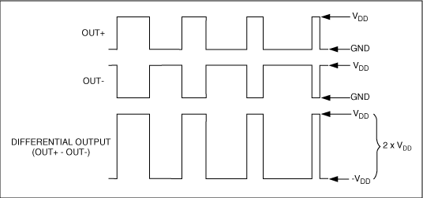
Differential Pair
A single wire when referenced from ground can provide:
  0-3.3v signal difference.
Differential pair with the same 3.3v can provide 6.6v difference:
  Logic 0: 3.3 – 0.0 = +3.3v
  Logic 1: 0.0 – 3-3 = -3.3v
  Note: No ground wire
The signal difference between logic “0” or “1” is greater.

Slide 4
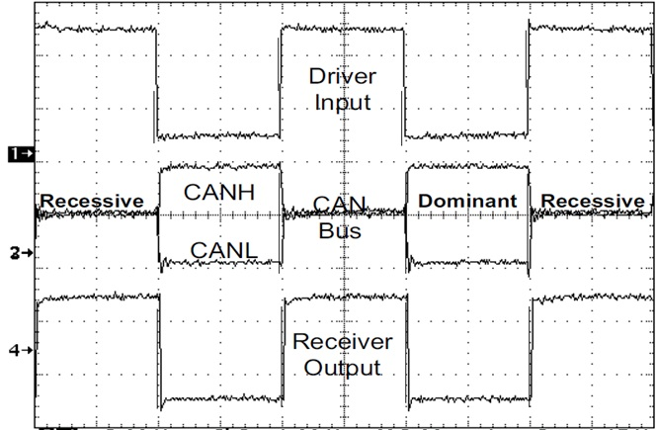
CAN Transceiver Voltage Levels
Logic 1 is when CANH = CANL = ~2.5v
  Zero volt difference
  Recessive bit
Logic 0 is when CANH = 3.5v, CANL = 1.5v
  2v difference
  Dominant bit

Slide 5
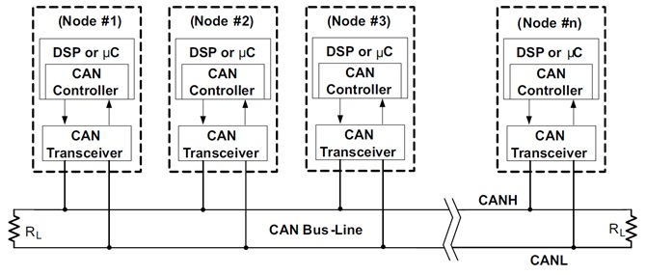
CAN Bus Interface
CAN Transceiver
  Rx/Tx becomes CANL/CANH.
  CANL/CANH is ONE differential signal.
Termination Resistors

Slide 6
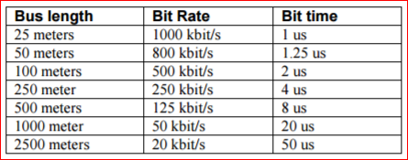
Cable Length Reference
Number of nodes affect the cable length because more CAN transceivers add more capacitance to the bus

Slide 7
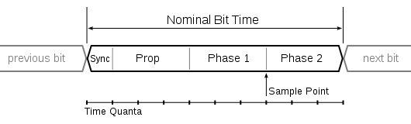
Baud Rate Configuration
The following parameters dictate the baud rate and need to be configured in the CAN peripheral
  Sync
  Prop
  Phase 1
  Phase 2

Slide 8
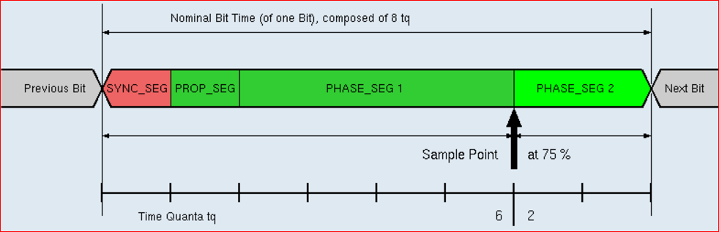
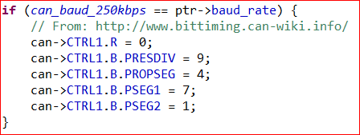
CAN Bit-rate Configuration
Confusing, but not difficult to understand

Slide 9
CAN Bit-rate Configuration
Find the bit-rate of the CAN peripheral
Say, 40Mhz, and we are trying to achieve 250Kbps CAN speed:
  Clock is therefore 25nS but times by 10 (PREDIV) = 250nS
  We are trying to achieve 4uS which equates to 250Kbps
PROPSEG = 5 * 250nS = 1.250uS
PSEG1 = 8 * 250ns = 2.000uS
PSEG2 = 2 * 250ns = 0.500uS
SYNC = 1 * 250ns = 0.250uS
Notes:
Updated the slide on the other ppt

Slide 10
Microcontroller Interface
CAN bus wires MUST BE interfaced to a CAN transceiver and terminated on each end with 120 ohm resistors.
  Rx/Tx to CAN transceiver
  Tx controls CANL/CANH as ONE signal
TX wire? RX wire? What?
  Normally, if you are transmitting, RX = TX since the receiving wire will sense exactly what you are trying to transmit
  But since logic 0 is dominant, you could be trying to transmit a “1” and another CAN bus node could over-power with “0” since that is dominant.
  While a transmitter is transmitting, other CAN Nodes could break the transmission, such as during arbitration and error frames (more on that later)
What about the resistor?
  Avoids signal reflexion.
  Yes, you REALLY do need it.

Slide 11
CAN Frame
Frame-based communication
  Each frame contains an ID, length (DLC), and up to 8 data bytes.
Contains a message ID field (11-bit or 29-bit)
Each node asserts an ACK to indicate good frame.
  SW may or may not “accept” the frames.
  Note: HW ALWAYS ACKs, with the next layer being:
    HW message ID filter (CAN peripheral of the microcontroller)
    SW message ID filter (Your Software)
Only if NO ONE ACKS: message may be re-transmitted.
  Retransmission errors can eventually lead to “Bus Off” state as specified in CAN specifications.

Slide 12
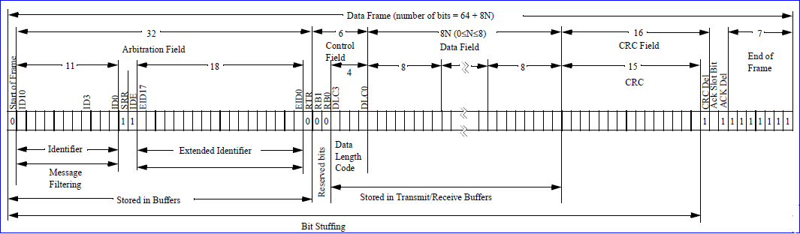
CAN Frame (11-bit ID)
Electrical level synchronization
  Only one transmitter can transmit at a time.
  Transmitter with highest priority will go ahead first.
  Lower priority message IDs will “back-off”.
Source: Microchip Application Note
Notes:
SRR (Substitute Remote Request) bit must be set as recessive when using 29-bit ID such that 11-bit ID messages have priority over 29-bit ID messages.
SRR=1 means message will request Remote Request (RTR will be 1)
RB0, RB1 = Reserved bits (unused?)
Del = Delimiter which allows the CAN peripherals to process the CRC or the ACK and take appropriate action

Slide 13
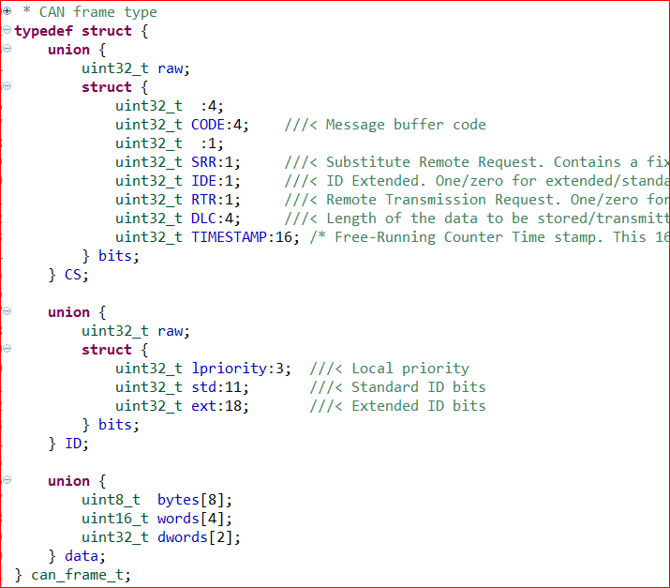
CAN Frame Data Structure in FW

Slide 14
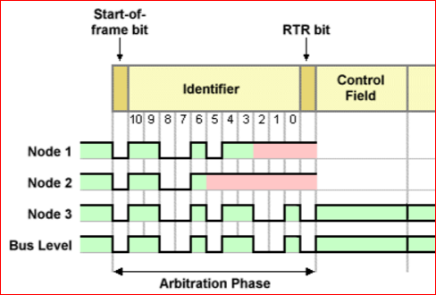
Arbitration
Zero is dominant
Lower message ID wins

Slide 15
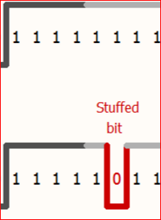
Bit Stuffing
CAN HW can “stuff” extra bits to improve CAN BUS signal integrity.
BUS will never see more than five 1’s or 0’s
Bits are stuffed to avoid contiguous 1s or 0s on the BUS:
  After anyone sends five 1s, an extra “0” is padded
  Everyone knows this is not a real bit, it was sent just to improve signal integrity, so this “stuffed bit” is ignored
  Likewise, anyone sending five 0s, will send a dummy “1”
If you send 8 bytes with all zeroes:
  Real bits: 8 * 8 = 64
  Actual bits: 64/5 = 12(stuffed bits) + 64 (real bits) = 76 bits

Slide 16
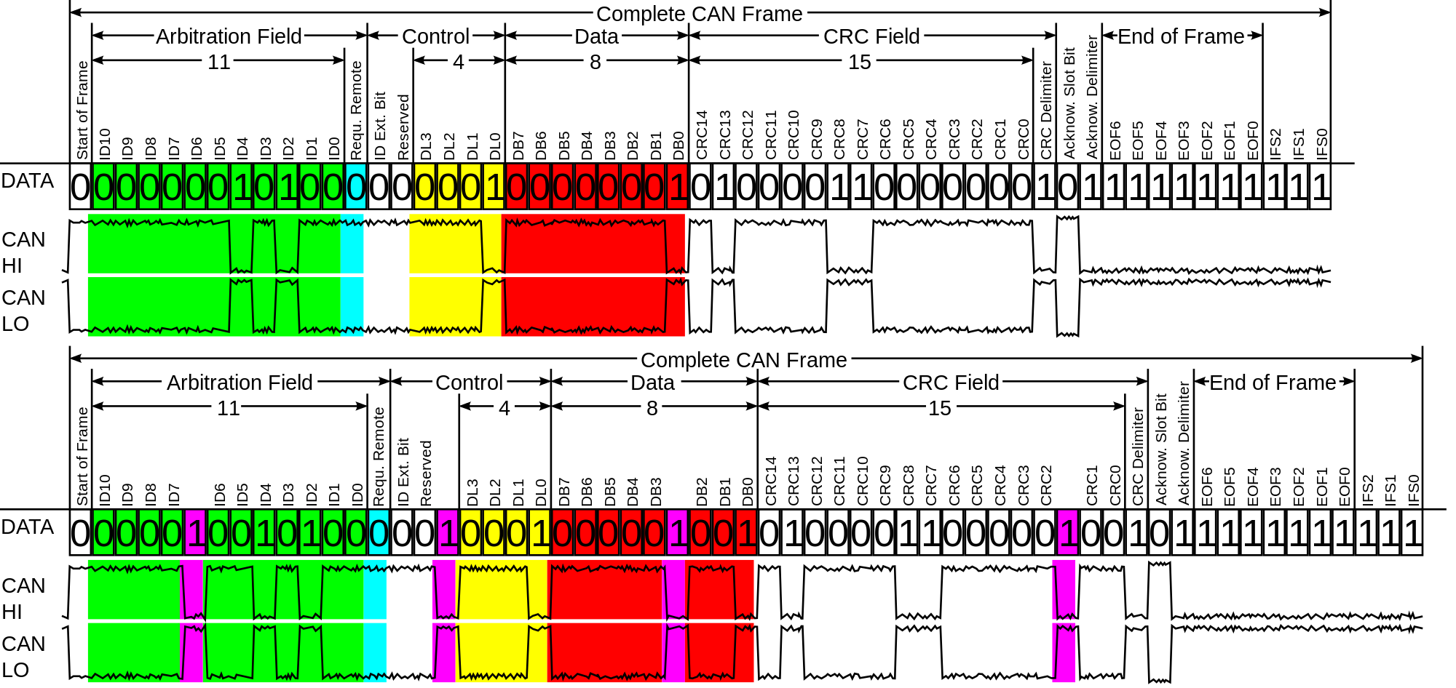
Bit Stuffing and CAN frame

Slide 17
The Acknowledgement (ACK)
CAN is a BROADCAST BUS
All nodes will assert the ACK to 0
  If no one ACKs, transmitter will retransmit the frame
What if a “destined” node doesn’t ACK?
  Transmitter will consider the message successful because others’ may have ACK’d
  Remember: CAN is a BROADCAST BUS!
What is ACK really useful for?
  Transmitter’s message is sent on the BUS successfully
  As long as one or more nodes out there send the ACK

Slide 18
Is there a NACK?
CAN BUS has 3 states (automatically managed by the CAN peripheral):
  Error Active, Error Passive, BUS OFF
Error Active
  Node could identify an error, and will assert 6 zeroes, breaking the bit-stuffing rule. This is called an “error frame”
  Transmitter will now be forced to retransmit as it will notice this “Error Frame”
Error Passive
  After the insertion of 16 error frames, the node asserting the error frames will enter this state to no longer “mess” with the BUS since maybe it is the only problematic node.
  This node can still attempt to receive, but in this state, it is not allowed to send anymore ERROR FRAMES
Bus OFF
  After 255 errors, node can enter this state to completely isolate itself from the BUS
Transmit error counters increment faster than receive error counters
  In the end, CAN bus is considered to be immune from one or more faulty nodes.
  With N good nodes, and 1 bad node (on a different baud rate maybe), only the faulty node will isolate itself from the CAN Bus

Slide 19
How do we know message reached destination?
You don’t!
You only know if the message is successfully transmitted on the BUS.
Alternatives:
  Periodic heart-beat message from each operational node
  SW sending a manual “ACK” frame (NOT ACK bit)!!
    Completely separate frame

Slide 20
CAN Error Counters
TX node increments TX error counter upon detecting errors during the transmission
  No ACK
  Error Frames
TX error counter increments faster than RX error counter
  8 Error points for TX error
  1 Error point for RX error
Correct transmission or reception decrements the error counters by 1
When either RX or TX error counter reaches the value of 127, the node enters “Error Passive” mode
When TX error counter reaches the value of 255, the node will enter “Bus Off” mode

Slide 21
From Kvaser:
When the Transmit Error Counter raises above 127 (i.e. after 16 attempts), node A goes Error Passive. The difference is that it will now transmit Passive Error Flags on the bus. A Passive Error Flag comprises 6 recessive bits, and will not destroy other bus traffic – so the other nodes will not hear A complaining about bus errors. However, A continues to increase its Transmit Error Counter. When it raises above 255, node A finally gives in and goes Bus Off.
What does the other nodes think about node A? – For every active error flag that A transmitted, the other nodes will increase their Receive Error Counters by 1. By the time that A goes Bus Off, the other nodes will have a count in their Receive Error Counters that is well below the limit for Error Passive, i.e. 127. This count will decrease by one for every correctly received message. However, node A will stay bus off.

Slide 22
More info from the Internet
http://www.port.de/cgi-bin/CAN/CanFaqErrors
Error active Both of its error counters are less than 128. It takes part fully in bus communication and signals an error by transmission of an active error frame. This consists of sequence of 6 dominant bits followed by 8 recessive bits, all other nodes respond with the appropriate error flag, in response to the violation of the bit stuffing rule.
Error passive A node goes into error passive state if at least one of its error counters is greater than 127. It still takes part in bus activities, but it sends a passive error frame only, on errors. Furthermore, an error passive node has to wait an additional time (Suspend Transmission Field, 8 recessive bits after Intermission Field) after transmission of a message, before it can initiate a new data transfer. The primary passive error flag consists of 6 passive bits and thus is "transparent" on the bus and will not "jam" communications.
Bus Off If the Transmit Error Counter of a CAN controller exceeds 255, it goes into the bus off state. It is disconnected from the bus (using internal logic) and does not take part in bus activities anymore. In order to reconnect the protocol controller, a so-called ?Bus Off? recovery sequence has to be executed. This usually involves the re-initialisation and configuration of the CAN controller by the host system, after which it will wait for 128 * 11 recessive bit times before it commences communication.

Slide 23
CAN is highly robust Fault Containment
Faulty nodes always take themselves off the Bus
Good nodes will stay on the bus without entering Bus Off
CAN will handle all possible scenarios of a bad node by entering the “Bus Off” mode on the faulty node:
  A node with incorrect baud rate
  A node with faulty hardware
  A node with faulty reception

Slide 24
Each node can be addressed
Multi-node bus
  2K (11bit message ID) or many more message IDs (29bit)
  A car may have several tens of controllers though, so up to 50 nodes are probably okay at lower speeds with special electrical design considerations.
One controller would use a specific message ID to communicate with another controller.
Note:
  All nodes will “ACK” a good frame in HW, and CAN peripheral can “accept” only the desired message IDs destined for us.

Slide 25
CAN Bus Reliability
CAN Bus is designed to take a faulted node off the bus automatically
While transmitting, it might never get an ACK, and the CAN Bus peripheral will enter “Bus Off” state after 128 transmission errors
While receiving, a faulted CAN node will first assert error frames, but after sending 128 error frames, it will enter “Error Passive” state and stop “messing” with the Bus

Slide 26
CAN Communication
Each node will “ACK” all good transmissions.
  However, usually specific nodes listen to specific message IDs.
No two nodes shall transmit a message with the same ID:
  Arbitration depends on unique message IDs.
  Lower message ID = Higher Priority.
  “Zeroes” on the BUS forces the “One’s” transmitter to back off.
120 ohm
termination
120 ohm
termination
N1
N2
N3
N4
N5

Slide 27
Typical CAN Bus Design
Requirements :
  Every node shall use unique message ID.
  A Node’s message ID should not collide with someone else
But :
  If a Node X accepts ID 0x123, how can multiple nodes send a CAN frame with ID 0x123?
  Remember: “No two nodes shall send the same message ID”
We can introduce our own ID standard :
SRC
MType
← 3 →
← 8 →

Slide 28
An Addressed CAN BUS
Node 1 “acceptance filter”
  Our address is 0x3
  Our acceptance filter is …
  0x300 – 0x3FF
  011.xxxx.yyyy = 011.####.#### = 0x300 – 0x3FF
Node 2 with address 0x5
  Acceptance filter is: 0x500 – 0x5FF
Important Note:
  All nodes “ACK” a successful message (done by HW).
  But your software can set the “acceptance filter” to only accept certain message IDs and this is purely optional if we do not want the CAN hardware to capture all of the CAN messages from the bus.
SRC
MType
← 3 →
← 8 →

Slide 29
An Addressed CAN BUS (cont’d)
We can adopt the concept for 29-bit IDs
  More possible source, and even “destination” addresses, and message types.
When a Node X receives a message ID: 0x412 :
  It knows who sent the message
  It knows what type of message was sent :
  Maybe MType=1 means “Lights Command”
  Or MType=2 has 8 data bytes that mean something
SRC
MType
← 3 →
← 8 →

Slide 30
Microcontroller CAN Interface
Typical interface is “CAN Mailbox”
Mailbox is an overloaded term, but in this context it is just a RAM buffer of the microcontroller
The µC CAN Mailbox is configured as either a receive or a transmit RAM space

Slide 31
Typical Microcontroller Software
CAN registers are written to send out a frame.
  Hardware takes over, and will send the frame when possible.
  It may have to “back-off” until it goes through.
Interrupt on Rx
  Receive all frames (in Bypass mode) – not good ☹
  Receive specific frames (CAN Acceptance filter).
Acceptance filter is also known as “Mailboxes”
  “Mailboxes” can be programmed for specific CAN message IDs.
  Dedicated memory for CAN reception.
  HW can pass these “accepted” messages to your SW.

Slide 32
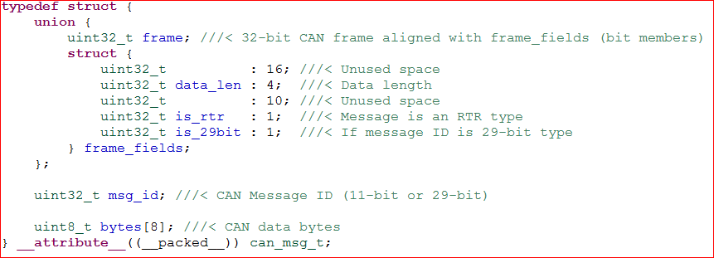
All the hard work is done
By the CAN peripheral
Your SW only deals with “CAN frames”
No need to worry about arbitration or bit stuffing

Slide 33
Microcontroller Receive Mailboxes
Instructs the CAN peripheral which CAN messages to receive
  The CAN peripheral will still ACK regardless if you configure the receive functionality or not
  The moment CAN peripheral is initialized, it will participate with the ACKs
Typical Mailbox Receive control fields
  Message ID
  Message ID Mask
Example:
  MID = 0x123
  MASK = 0x7F0
  This will match bits 4-10 and ignore bits 0-3
  Hence, it will match: 0x120 – 0x12F

Slide 34
Microcontroller Transmit Mailboxes
MPC57xx has 96 mailboxes
User is free to partition them for either Rx or Tx
Transmit mailbox priority can be configured as either:
    True CAN arbitration, where lower MID mailbox will transmit first
    Lowered numbered mailbox will transmit first

Slide 35
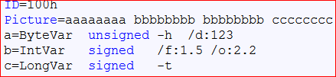
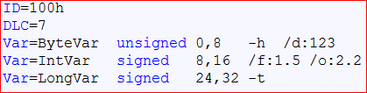
DBC Format
DBC defines the communication protocol
  One of the popular standards, but one can define the protocol in any way
PCAN old format
PCAN new format

Slide 36
DBC File Format
BO_ 101 MOTOR_CMD: 1 DRIVER
SG_ MOTOR_CMD_steer : 0|4@1- (1,-5) [-5|5] "" MOTOR
SG_ MOTOR_CMD_drive : 4|4@1+ (1,0) [0|9] "" MOTOR
Wiki has details for each field, but to summarize:
  BO_ is the message ID followed by the name
  : 3 is the length of the message in bytes, followed by “who” will send this message; there can only be ONE sender
  Then follow the “signals” of the message which define the bit-length, offset, scaling, min/max, units
  SG_ end with the recipient list (1 or more)

Slide 37
Auto-Generated DBC to C Code

Slide 38
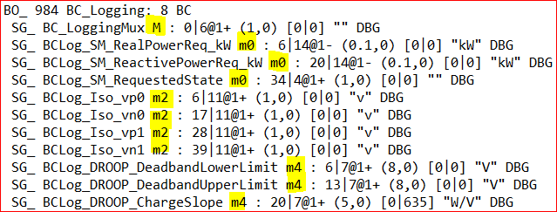
Multiplexed Messages
Message IDs run out really fast
11-bit address spaces only gives you 2048 message IDs
Part of the 8-byte of data can be compromised for a “MUX”
Message ID remains the same, and based on the MUX value, the data can be interpreted differently

Slide 39
LPC17xx CAN BUS
FullCAN Mode
  Setup dedicated 11-bit frames that are ACK’d and go straight into specific RAM without CPU intervention.
  Good for “read-only” message data.
    We can have a 10Hz task always read and update the odometer gauge without having to explicitly read an incoming message.
    We assume someone is sending periodic data to update the RAM.
Standard ID and Extended ID filter (including groups)
  HW will accept, but an RX interrupt should queue the data.
  Your SW should then de-queue the data and process it.

Slide 40
More Applications of CAN BUS
J1939 standard for trucking.
OBDII standard for cars
  All cars after 2005 in the USA are required to have CAN BUS.
Any multi-drop, reliable system
  Military Vehicles
  Local Sensor networks

Slide 41
Where is the future headed?
Is CAN bus dying?
  Probably not…
Rumors of latest BMW X5 using Ethernet . . . But:
  CAN bus is more deterministic.
  Takes VERY little to get it up and running when compared to Ethernet hardware, followed by complex TCP/IP software stack.
  Even the simplest TCP/IP stack (LWIP) consumes many tens of kilobytes to function correctly (at least 50Kbytes)

Slide 42
Questions ?
Knowledge check :
  What happens if two nodes transmit same message ID?
  If two nodes uses ID 0x100 and 0x200, which message would go through first?
  How many nodes could you have on an 11-bit based CAN BUS network if they all wish to speak to each other?

