Slide 1
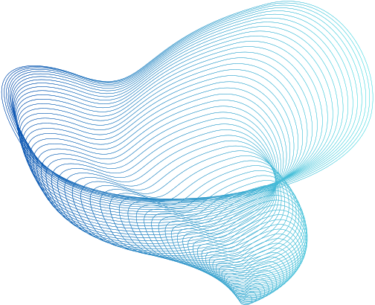

VISUAL TRANSFORMERS: TOKEN-BASED IMAGE REPRESENTATION AND PROCESSING FOR
COMPUTER VISION
Bichen Wu1, Chenfeng Xu3, Xiaoliang Dai1, Alvin Wan3, Peizhao Zhang1
Zhicheng Yan2, Masayoshi, Tomizuka3, Joseph Gonzalez3, Kurt Keutzer3, Peter Vajda1
1 Facebook Reality Labs, 2 Facebook AI, 3 UC Berkeley
fwbc, xiaoliangdai, stzpz, zyan3, vajdapg@fb.com
fxuchenfeng, alvinwan, tomizuka, jegonzal, keutzerg@berkeley.edu

Slide 2
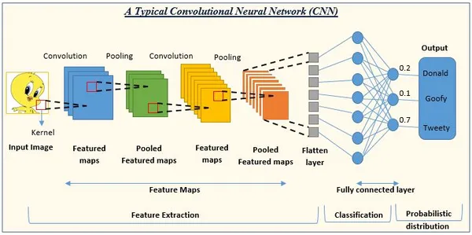
WHY WE NEED A NEW METHOD
Traditional Convolutional Neural Networks (CNNs) have problems:
Treat all pixels equally (foreground & background same importance)
Apply all filters to all images → waste when features don’t exist
Cannot capture long-distance relationships easily
This is shown in the intro text on page 1 where the authors list three challenges

Slide 3
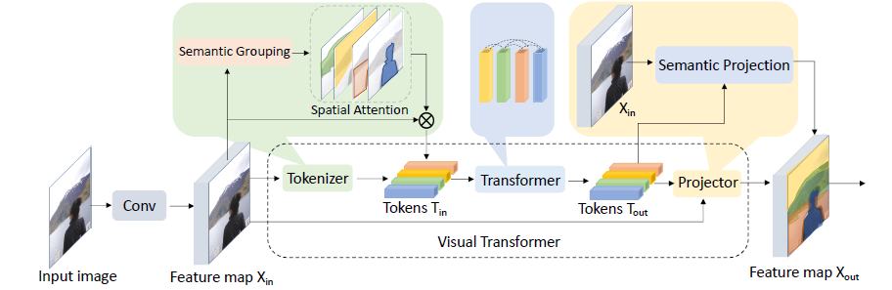
WHAT ARE VISUAL TRANSFORMERS?
VTs solve these problems by:
Converting feature maps → visual tokens (meaningful groups like ‘person’, ‘sky’, ‘tree’)
Using transformers to relate these tokens (like words in a sentence)
Projecting tokens back to pixel space for segmentation
The diagram on page 2 (Figure 1) clearly shows this flow:

Slide 4
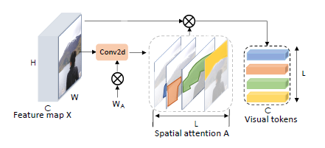

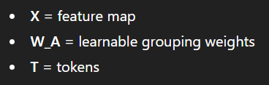
HOW TOKENIZATION WORKS
1. Filter-Based Tokenizer
Uses convolution filters to group similar pixels
Creates visual tokens using attention

Slide 5
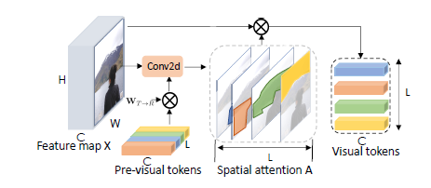

HOW TOKENIZATION WORKS
2. Recurrent Tokenizer
Uses tokens from earlier layers to improve current tokens
More content-aware

Slide 6

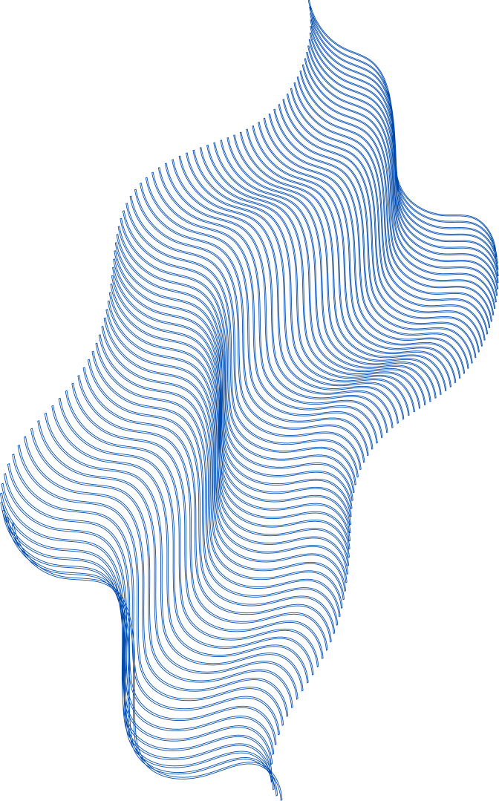

TRANSFORMER MODULE AND PROJECTOR MODULE
TRANSFORMER MODULE
Tokens interact using self-attention.
PROJECTOR MODULE
This equation shows how visual tokens are projected back to pixels.

Slide 7
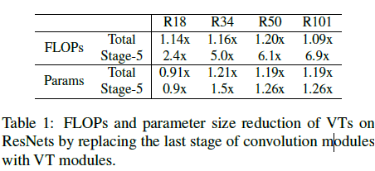
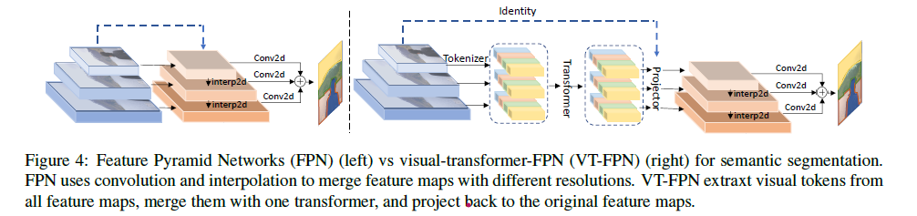
VISUAL TRANSFORMER IN RESNET
VT is added by replacing the last stage of ResNet.
VISUAL TRANSFORMER IN FPN

Slide 8
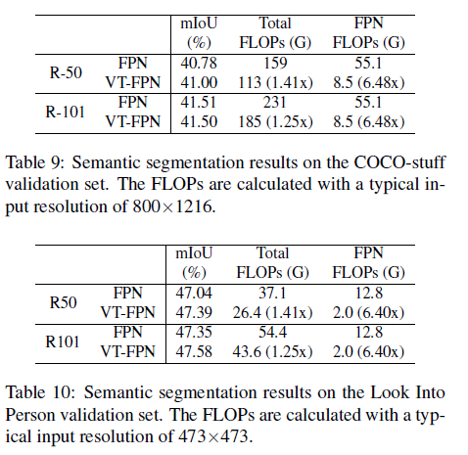
SEGMENTATION RESULTS

Slide 9
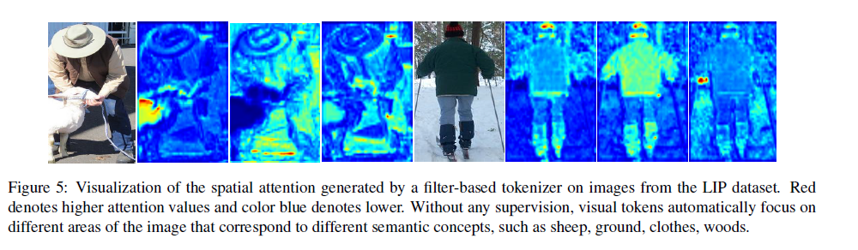
VISUALIZATION OF ATTENTION
The heatmaps on page 8 (Figure 5) show:
Tokens automatically focus on specific objects (sheep, clothes, legs, sky)
No supervision needed
Shows semantic meaning is captured by tokens

Slide 10
WHY VT WORKS (MAIN IDEA)
Compress pixels into tokens → fewer computations
Only learn what is present in the image
Transformers capture long-range relations
Project tokens back for pixel-level tasks

Slide 11
CONCLUSION
The paper proves:
Visual Transformers are more efficient than convolutions
Increase accuracy on ImageNet by 4.6 to 7%
Reduce FLOPs in segmentation pipelines by 6.5×
Provide strong semantic understanding through tokens
VTS ARE A NEW COMPUTER VISION PARADIGM REPLACING REDUNDANT PIXEL-CONVOLUTION OPERATIONS.

Slide 12
THANKYOU!!

