Slide 1
Hydroelectric Power Plant
BY – Tanmay Ingle
&
Om Shinde

Slide 2
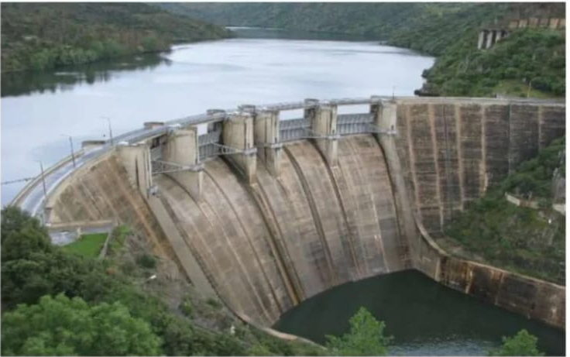

Slide 3
Index
How Hydropower Works
The Indian Scenario
Dam Types
Environmental Impact
Case Study
Methods to alleviate the negative impact

Slide 4
How Hydropower Works!
Water from the reservoir flows due to gravity to drive the turbine.
Turbine is connected to a generator.
Power generated is transmitted over power lines.

Slide 5
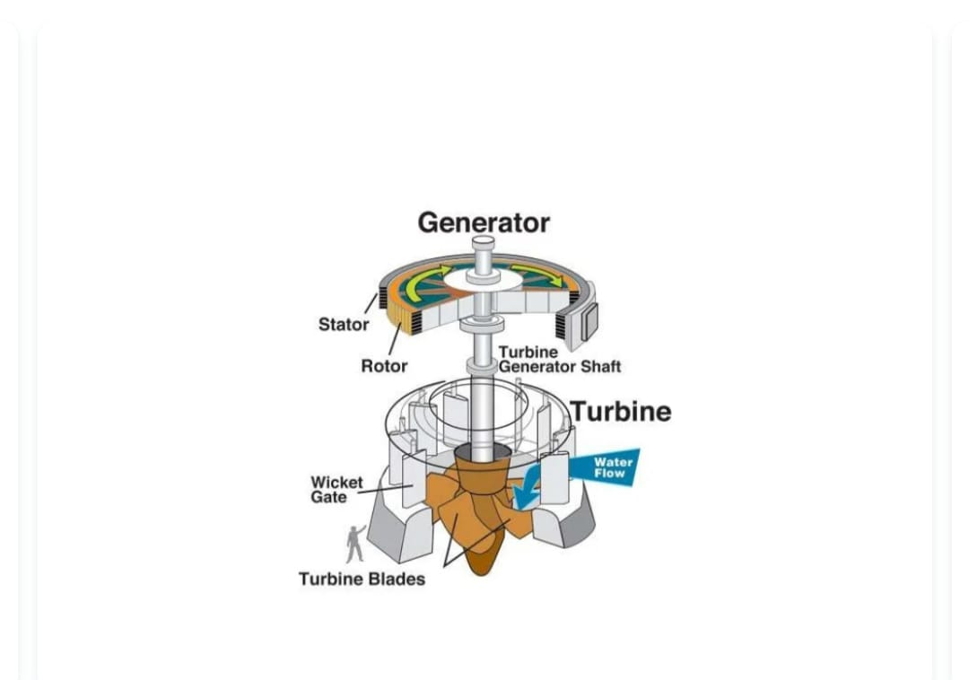

Slide 6
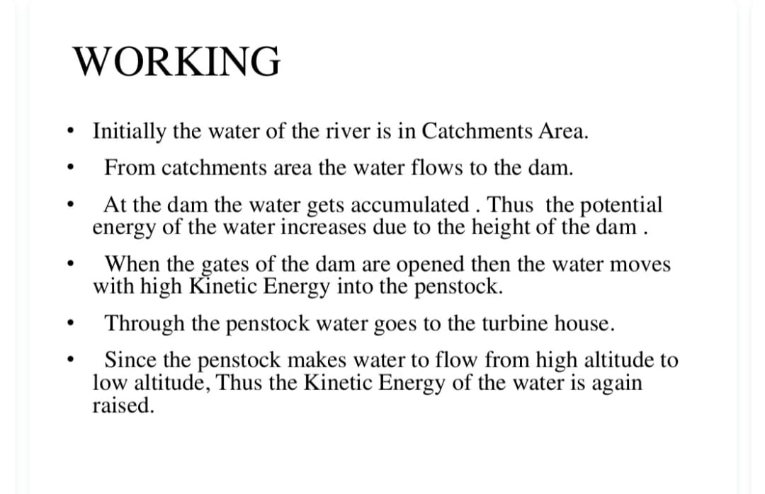

Slide 7
The Indian Scenario
The potential is about 84000 MW at 60% load factor spread across six major basins in the country.
Pumped storage sites have been found recently which leads to a further addition of a maximum of 94000 MW.
Annual yield is assessed to be about 420 billion units per year though with seasonal energy the value crosses600 billion mark.
The possible installed capacity is around 150000 MW (Based on the report submitted by CEA to the Ministry of Power)

Slide 8
Dam Types
Arch
Gravity
Buttress
Embankment or Earth

Slide 9
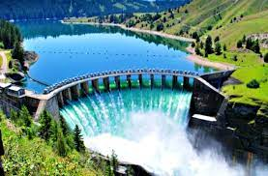
Arch Dams
Arch shape gives strength
Less material (cheaper)
Narrow sites
Need strong abutments

Slide 10
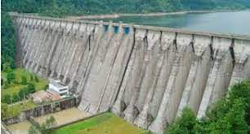
Concrete Gravity Dams
Weight holds dam in place
Lots of concrete (expensive)

Slide 11
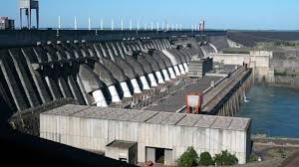
Buttress Dams
Face is held up by a series of supports
Flat or curved face

Slide 12
Embankment Dams
Earth or rock
Weight resists flow of water

Slide 13
Case Study- Volta Lake, Ghana
Volta lake was formed as a result of the construction of the Akosombo Dam.
It was aimed at providing much needed power needs for domestic consumption and for the production of Aluminium.
Even though much study was conducted prior to the construction, many favorable and adverse environmental changes took place.

Slide 14
ENVIRONMENTAL IMPACT

Slide 15
Benefits…
Environmental Benefits of Hydro
• No operational greenhouse gas emissions
• Savings (kg of CO2 per MWh of electricity):
– Coal 1000 kg
– Oil 800 kg
– Gas 400 kg
• No SO2 or NOX
Non-environmental benefits
– flood control, irrigation, transportation, fisheries and
– tourism.

Slide 16
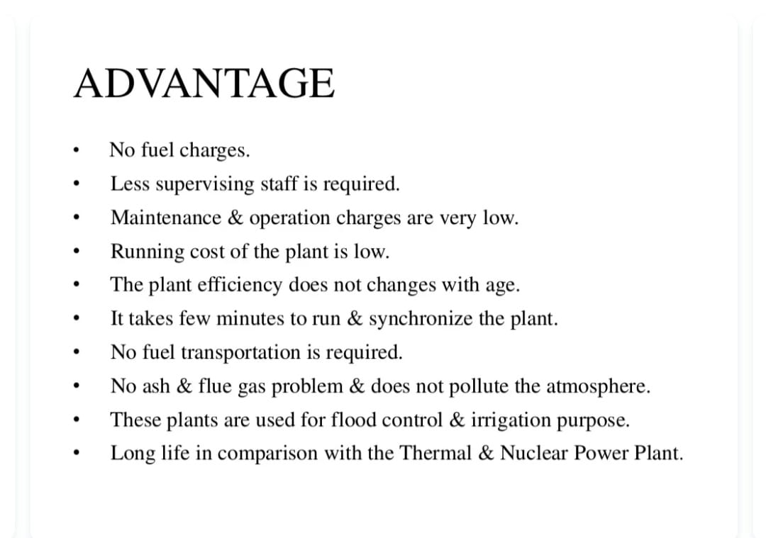

Slide 17
Disadvantages
The loss of land under the reservoir.
Interference with the transport of sediment by the dam.
Problems associated with the reservoir.
Climatic and seismic effects.
Impact on aquatic ecosystems, flora and fauna.

Slide 18
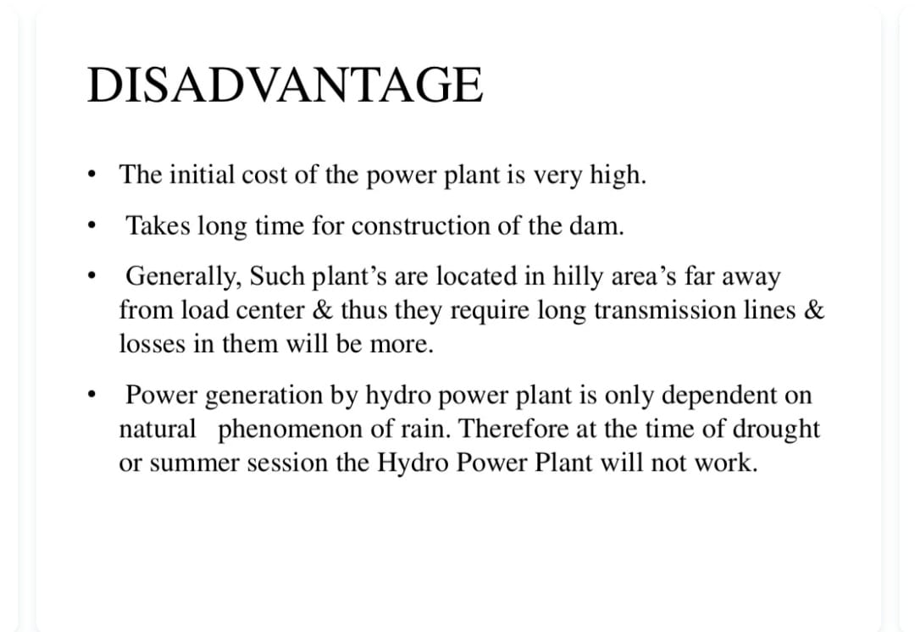

Slide 19
Other problems
Many fishes require flowing water for reproduction and cannot adapt to stagnant resulting in the reduction in its population.
Heating of the reservoirs may lead to decrease in the dissolved oxygen levels.
The point of confluence of fresh water with salt water is a breeding ground for several aquatic life forms. The reduction in run-off to the sea results in reduction in their life forms.
Other water-borne diseases like malaria, river-blindness become prevalent.

Slide 20
Methods to alleviate the negative impact
Creation of ecological reserves.
Limiting dam construction to allow substantial free flowing water.
Building sluice gates and passes that help prevent fishes getting trapped.

Slide 21
THANK YOU

