Slide 1


Pharmacy Drug Management System
Tanmay Jadav
20C21017

Slide 2

Title
Introduction
Objective
Purpose
Features
Working
Future work
Conculusion

Slide 3
Introduction
The project, Pharmacy store Management System is a web-based application that allows the Pharmacy store manager to handle all Pharmacy store activities online. Interactive GUI and the ability to manage various shopping stores make this system very flexible and convenient. The shop manager is a very busy person and does not have the time to sit and manage the entire activities manually on paper. This web application gives him the power and flexibility to manage the entire system from a single online system. The system allows the manager to post available medicines in the system. Customers can view and shop online. Admin has the power of either approving or disapproving the customer’s booking request. The system is hence useful for both customers and managers to for managing the shopping activities

Slide 4
Objective
The mission is to facilitate easy management and administration of a small business like Pharmacy store with capabilities to do Booking or shopping of the items, Cancellation of the items, Cash billing, service, return service, Billing, Total Billing, Travels arrangement etc. using the automated shopping web application. One can Keep detailed records or info on an unlimited amount of customers. The system lets the user Know which all items are available of medicine at any point of time. This makes the ordering considerably faster. And thus helps the Pharmacy store in better management and reduce a lot of paper work as well as manpower.

Slide 5
Purpose
The Pharmacy store management system provides the quality service to the end user. This project aims at creating on Pharmacy store Management System which can be used by Admin and Customers. The admin to advise/publish the availability of itemss in different Pharmacy stores and customers are checking the availability of items in required Pharmacy store. Customers should be able to know the availability of the itemss on a particular date to reserve in Pharmacy store. They should be able to reserve the available itemss according to their need in advance. To make their stay comforitems. The Admin hands the booking information of customers. The users can register and log into the system. The administrator will know the details of revnue and daily income.

Slide 6
Feature
1) Operational Feasibility
2) Technical Feasibility
3) Economical Feasibility

Slide 7
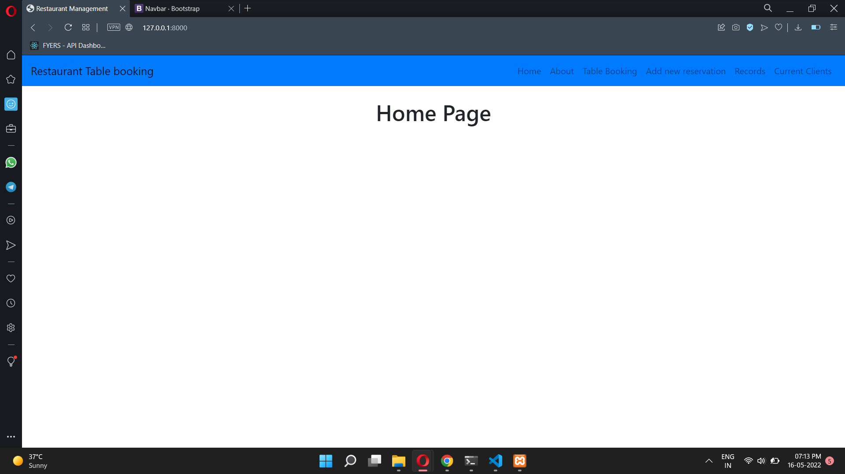
Home Page

Slide 8
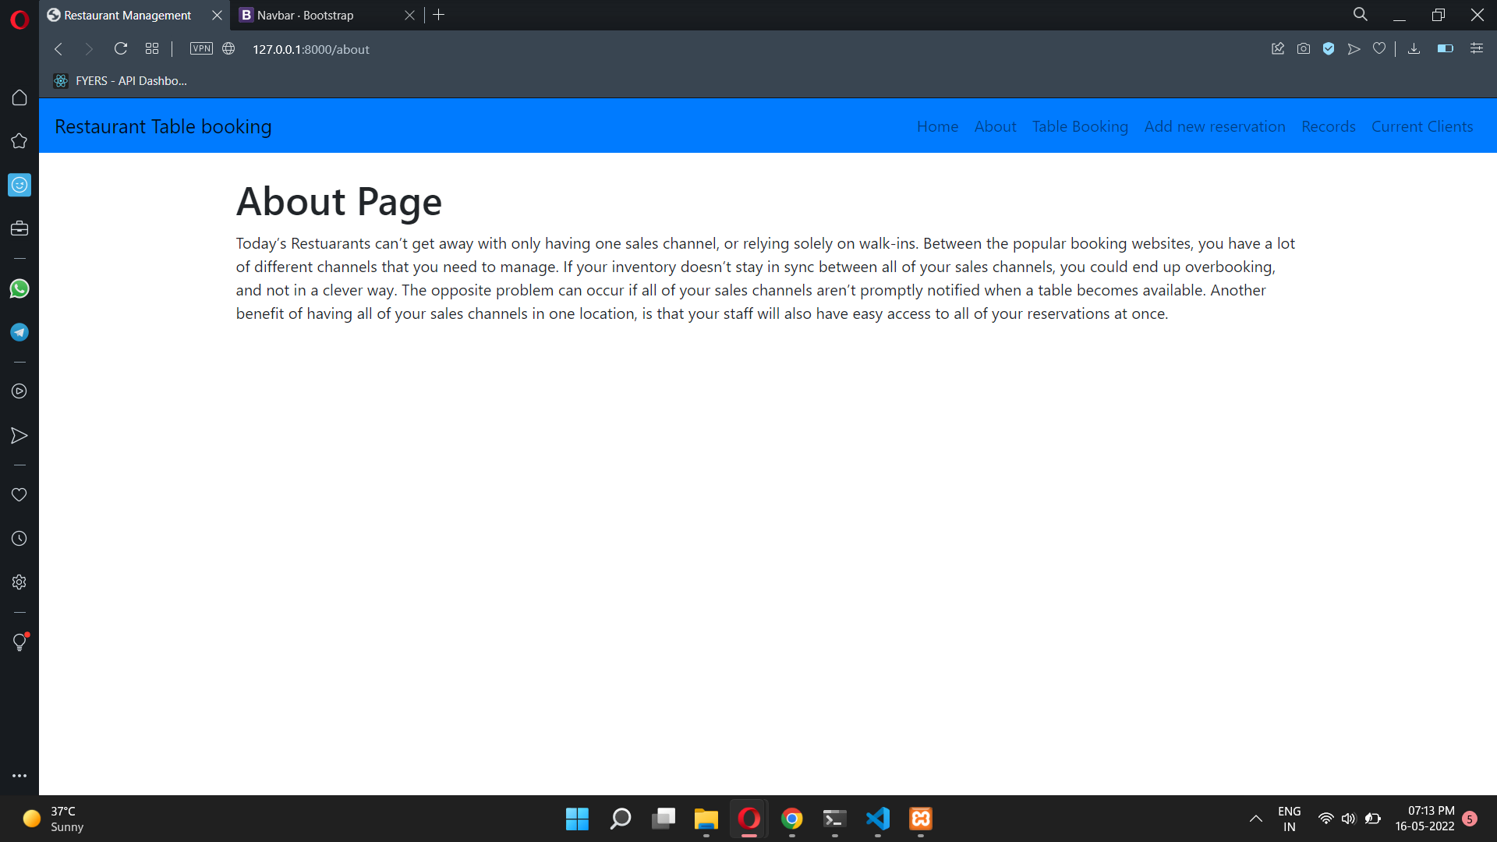
About page

Slide 9
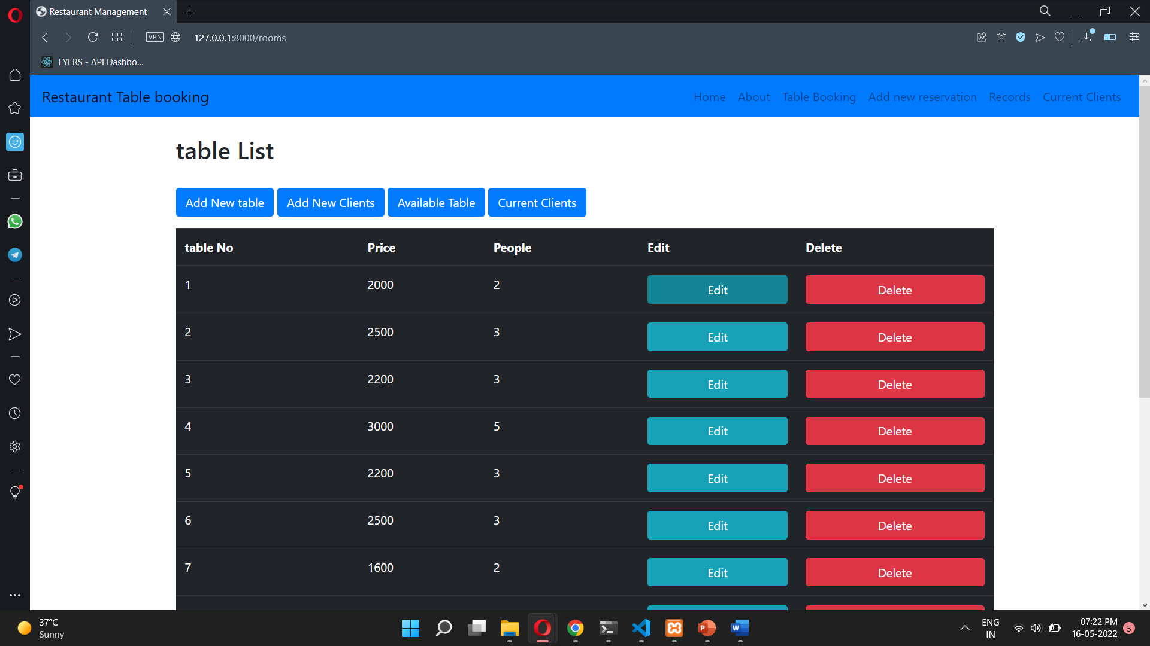
Table Booking page (with table list)

Slide 10
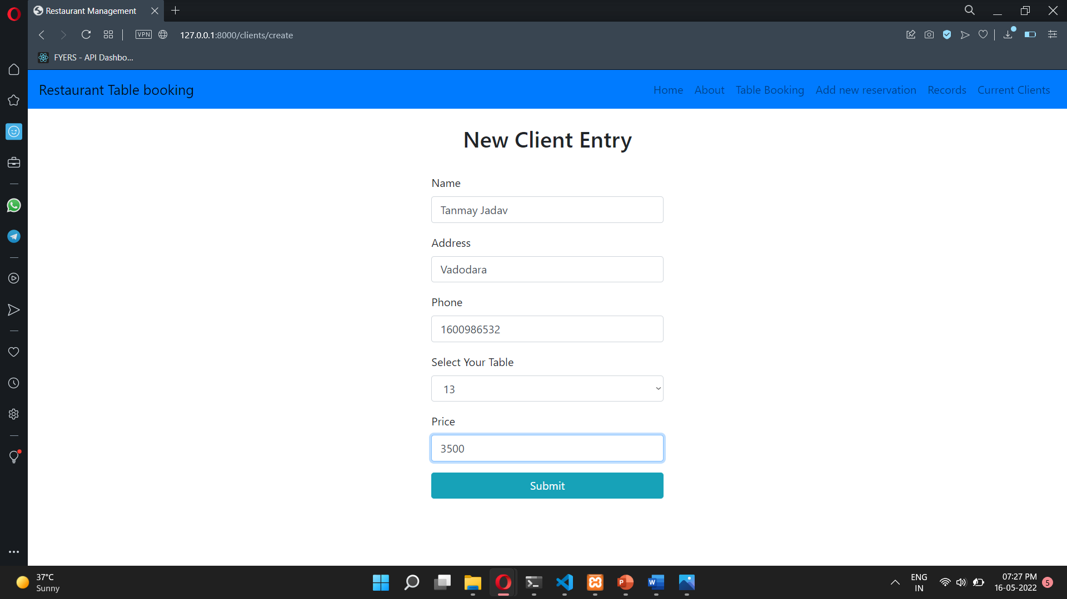
Add new client page

Slide 11
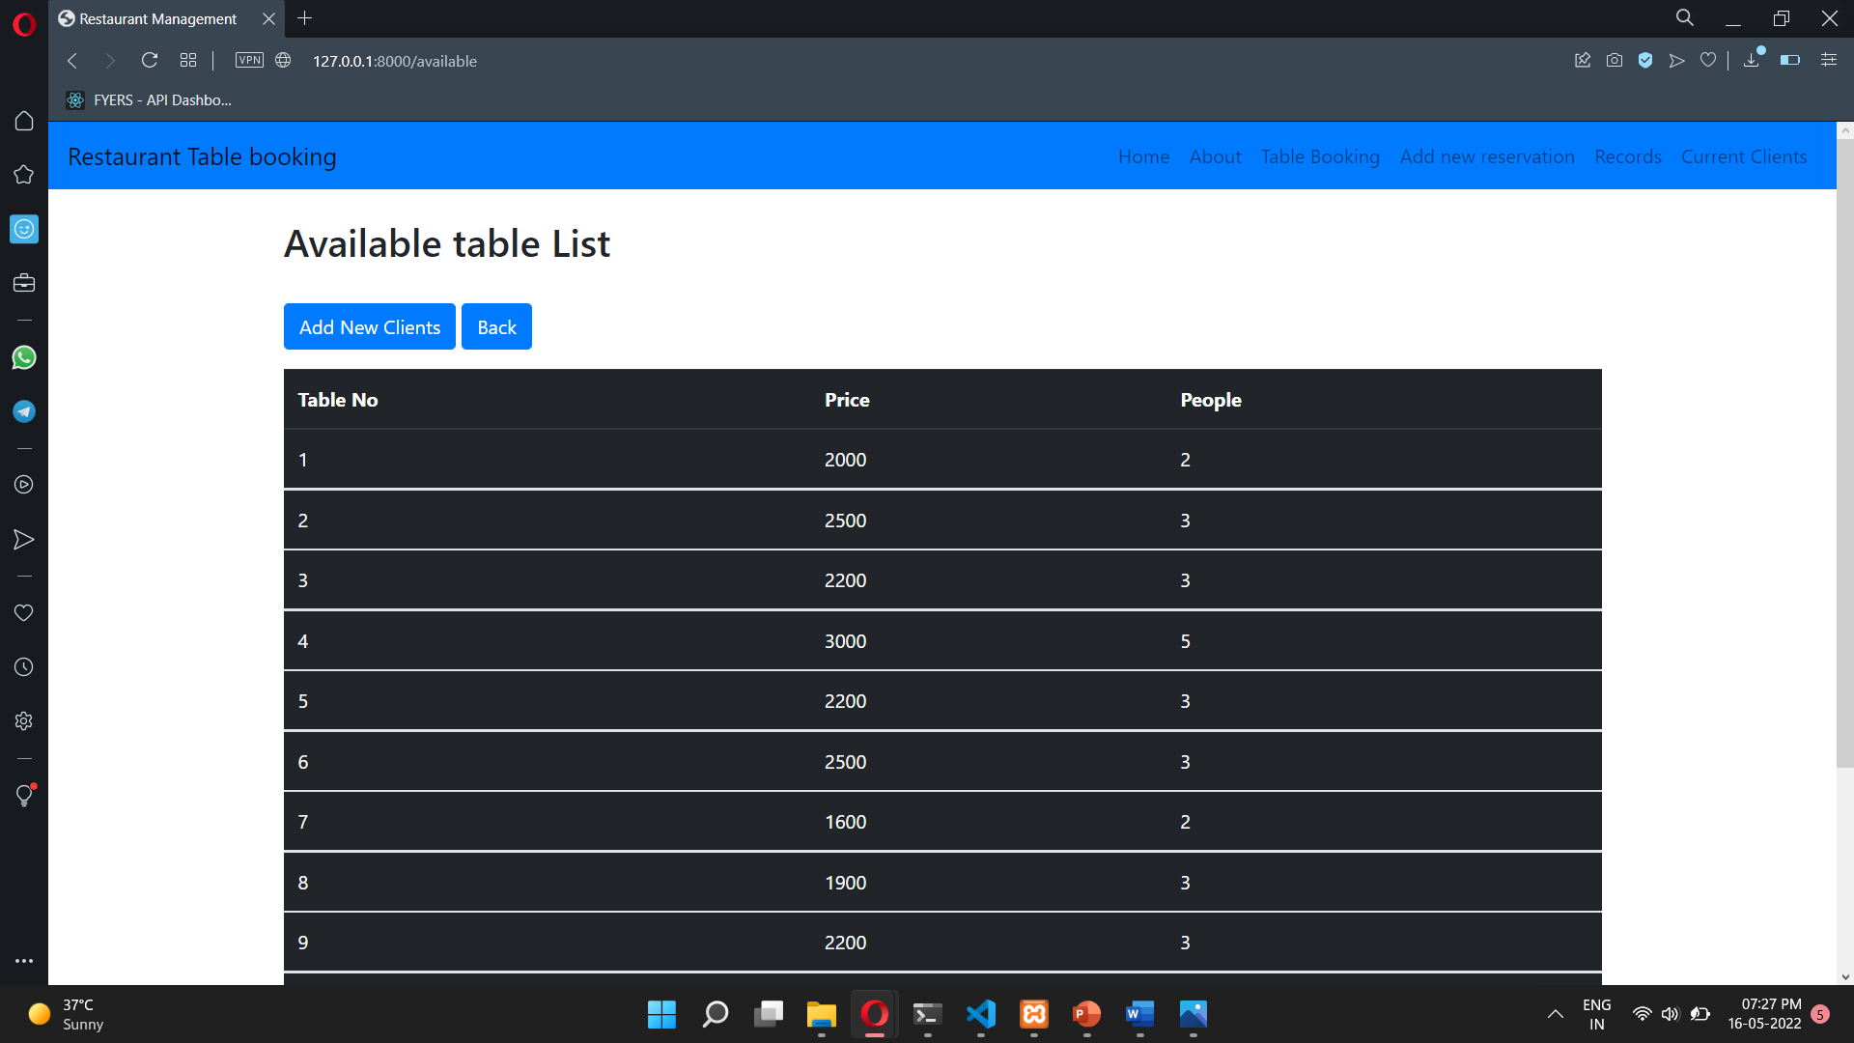
Records (available table list)

Slide 12
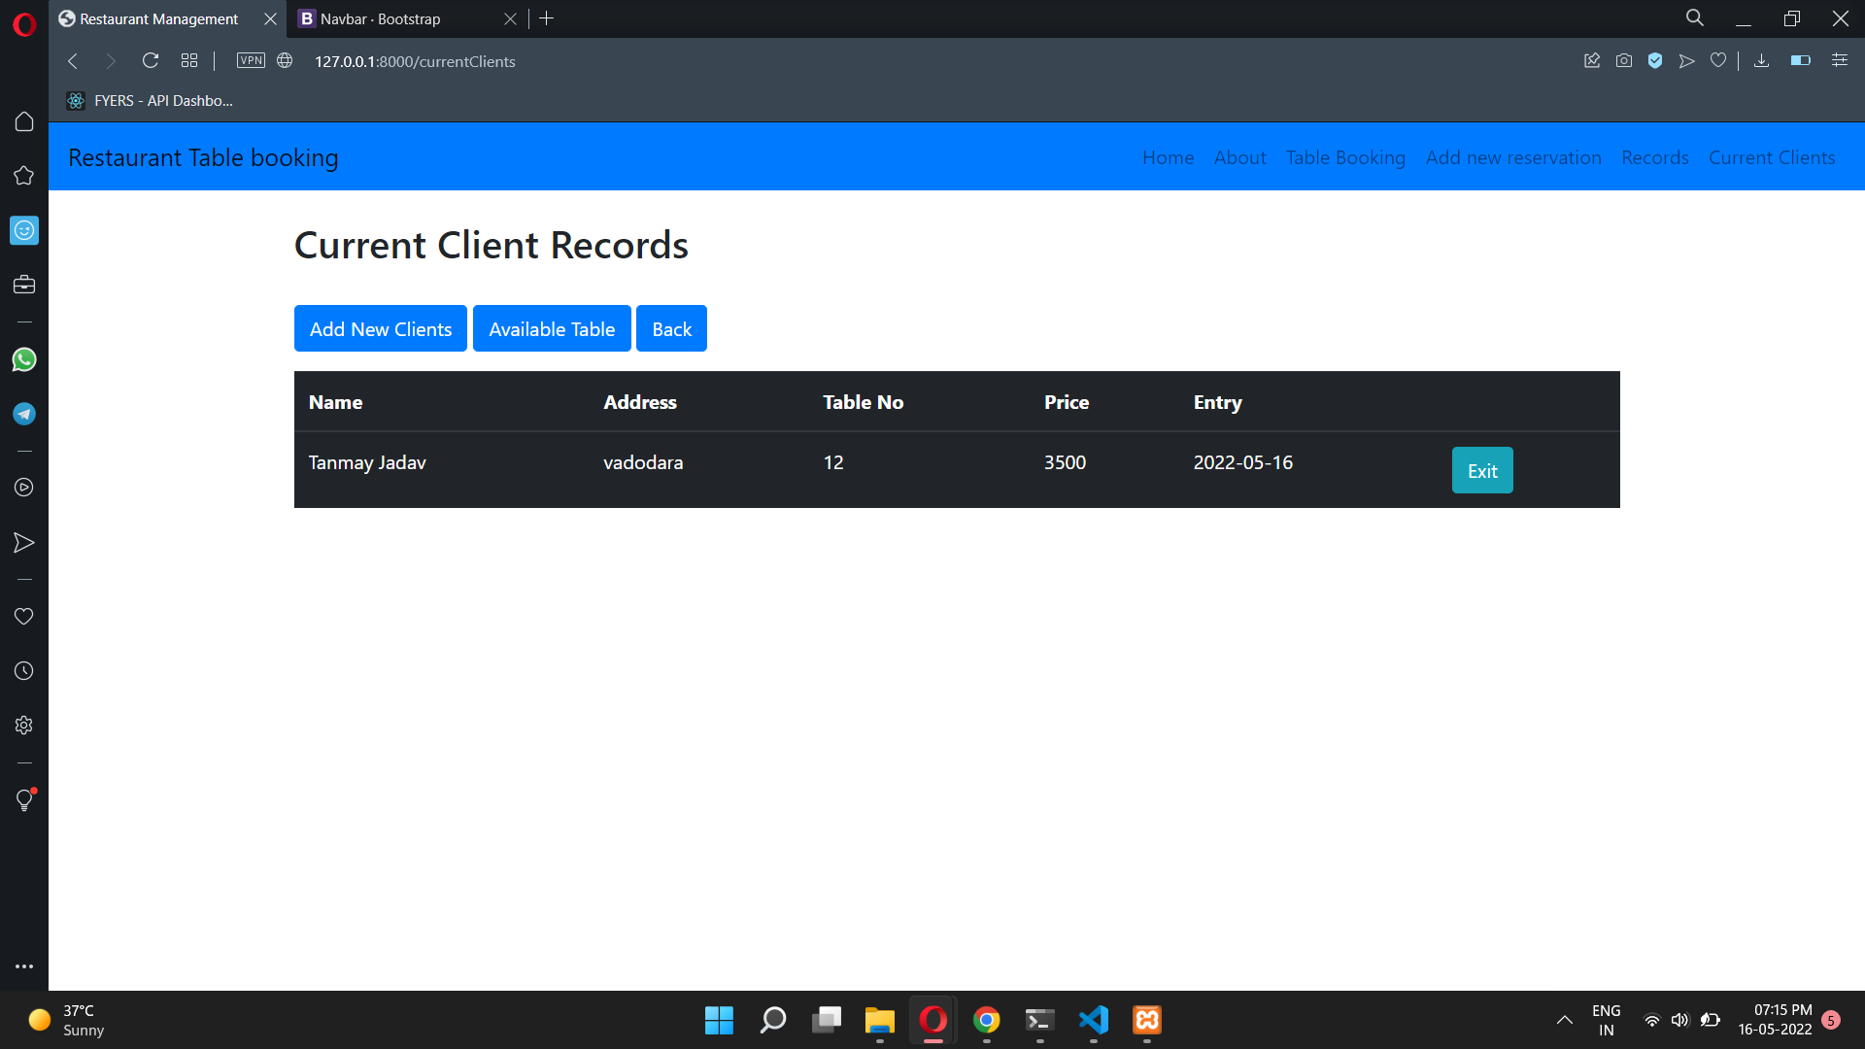
Current client records (with all recent entries)

Slide 13
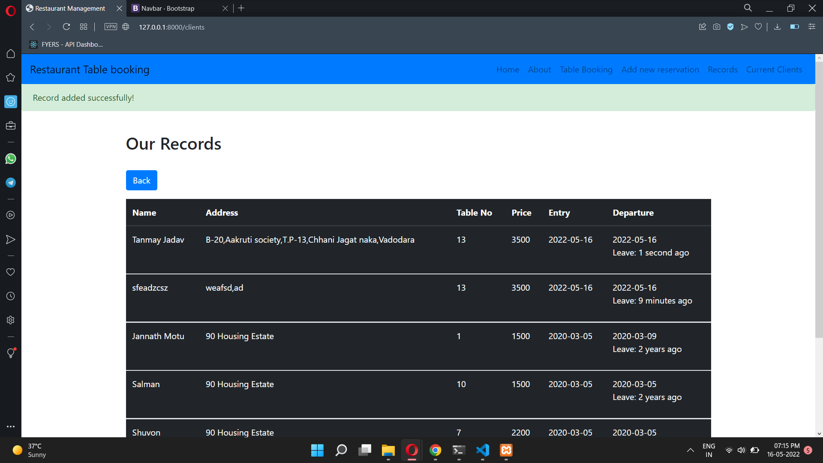
Our records page

Slide 14
Future Work
As I mentioned before it not complete yet , there are lots of other components to be added in website
As this is partially for admin and customer both but it can be still be more enhanced.
The other thing which could be added is menu and booking chief

Slide 15
Conclusion
The conclusion of this project is A Pharmacy store management system is a computerized management system. This system keeps the records of hardware assets besides software of this organization. The proposed system will keep a track of Workers, Recidents, Accounts and generation of report regarding the present status. This project has GUI based software that will help in storing, updating and retrieving the information through various user-friendly menu-driven modules.The project “Pharmacy store Management System” is aimed to develop to maintain the day-to-day state of admission/Vacation of Residents, List of Workers , payment details etc. Main objective of this project is to provide solution for Pharmacy store to manage most there work using computerized process.

Slide 16
THANK YOU

