Slide 1
310241: Theory of Computation

Slide 2
Theory of Computation
Course Objectives:
  To Study abstract computing models
  To learn Grammar and Turing Machine
  To learn about the theory of computability and complexity

Slide 3
Theory of Computation
  Course Outcomes: On completion of the course, student will be able to–
  design deterministic Turing machine for all inputs and all outputs
  subdivide problem space based on input subdivision using constraints
  apply linguistic theory

Slide 4
Unit - 1
  Introduction to Formal language,
  introduction to language translation logic, Essentials of translation,
  Alphabets and languages, Finite representation of language,
  Finite Automata (FA): An Informal Picture of FA, Finite State Machine (FSM), Language accepted by FA,
  Definition of Regular Language, Deterministic and Nondeterministic FA(DFA and NFA), epsilon- NFA,
  FA with output: Moore and Mealy machines -Definition, models, inter-conversion.
  Case Study: FSM for vending machine, spell checker Unit

Slide 5
Introduction to Theory of Computation
  One of the most fundamental course of Computer Engineering.
  Help to understand how people have thought about computer science as a science in past 50 years.
  Its is mainly about what kind of things can you compute mechanically with machines , how fast and how much space does it take to do so.

Slide 6
Example -1
  Lets consider a machine that accepts all binary strings that ends with ‘0’ and reject all other strings that do not end with ‘0’
  Eg. 11010010 [Accepts]
  10011001 [Rejects]

Slide 7
Example-2
  Lets consider a machine that accepts all valid java codes.
  Java code → Binary Equivalent of code -> Valid ? [Accepts]
  Invalid [Rejects]
  Can We design such a system ?????

Slide 8

Example-2 (Cont..)
  Yes……
  Eg. Compiler
  We know compile only accepts valid code and if it is not written correctly ,then it gives error and says It’s invalid.
  By now u must have got slight a hint of
  TOC and Compiler relation.

Slide 9
Basic Definitions
1. Alphabet - a finite set of symbols.
  Notation: Σ .
  Examples: Binary alphabet {0,1},
  English alphabet {a,...,z,!,?,...}
2. String over an alphabet Σ - a finite sequence of symbols
from Σ.
  Notation: (a) Letters u, v, w, x, y, and z denote strings.
  (b) Convention: concatenate the symbols. No parentheses or commas used.
  Examples: 0000 is a string over the binary alphabet.
  a!? is a string over the English alphabet.

Slide 10
Definitions (contd.)
3. Empty string: e or ε denotes the empty sequence of symbols.
4. Language over alphabet Σ - a set of strings over Σ.
  Notation: L.
  Examples:
    {0, 00, 000, ...} is an "infinite" language over the binary alphabet.
    {a, b, c} is a "finite" language over the English alphabet.

Slide 11
Definitions (contd.)
5. Empty language - empty set of strings. Notation: Φ.
6. Binary operation on strings: Concatenation of two strings u.v - concatenate the symbols of u and v.
  Notation: uv
  Examples:
    00.11 = 0011.
    ε.u = u.ε = u for every u. (identity for concatenation)

Slide 12
Languages
MESCOE
Notes:
07/28/20

Slide 13
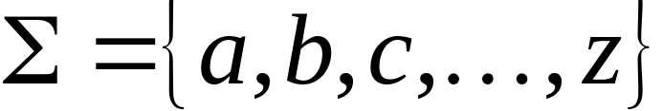
Language: a set of strings
String: a sequence of symbols
from some alphabet
Example:
Strings: cat, dog, house
Language: {cat, dog, house}
Alphabet:
Fal 206
MESCOE
Notes:
07/28/20

Slide 14

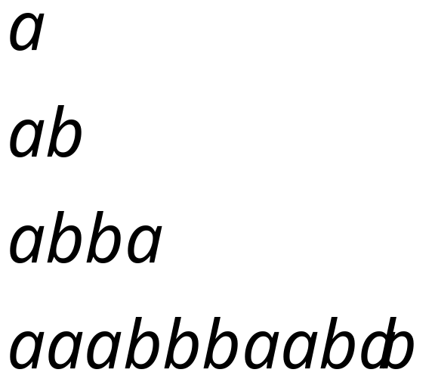
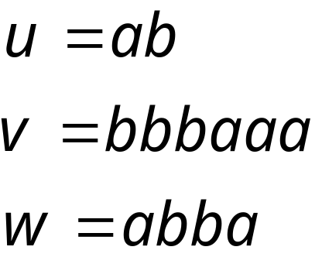
Alphabets and Strings
An alphabet is a set of symbols
Example Alphabet:
A string is a sequence of
symbols from the alphabet
Example Strings
MESCOE
Notes:
07/28/20

Slide 15
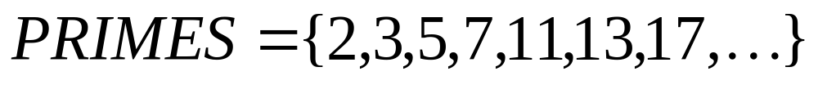
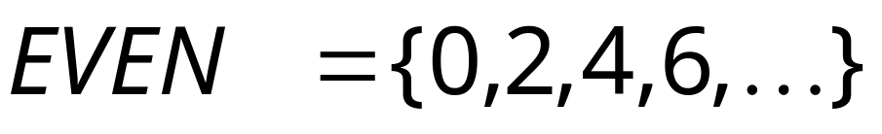
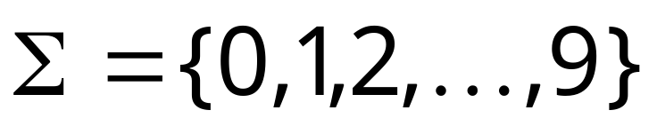
Languages are used to describe
computation problems:
Alphabet:
MESCOE
Notes:
07/28/20

Slide 16
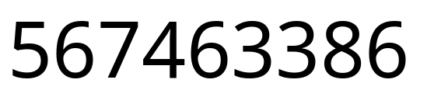
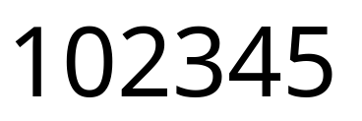
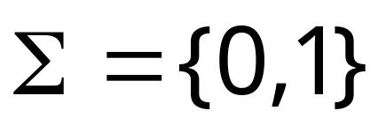


Decimal numbers alphabet :
Decimal String :
Decimal numbers alphabet :
Binary numbers alphabet :
Decimal String :
MESCOE
Notes:
07/28/20

Slide 17
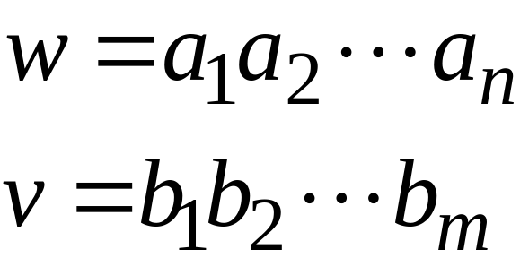
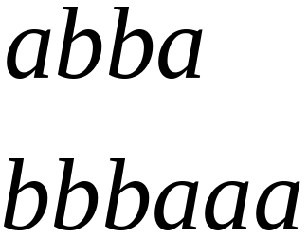
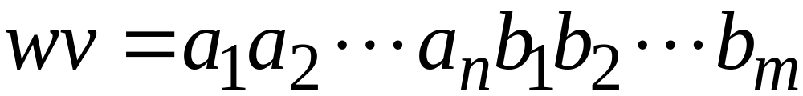

String Operations
Concatenation
MESCOE
Notes:
07/28/20

Slide 18




Reverse
MESCOE
Notes:
07/28/20

Slide 19


String Length
Length:
Examples:
MESCOE
Notes:
07/28/20

Slide 20


Length of Concatenation
Example:
MESCOE
Notes:
07/28/20

Slide 21
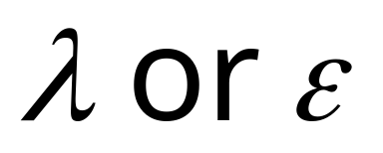
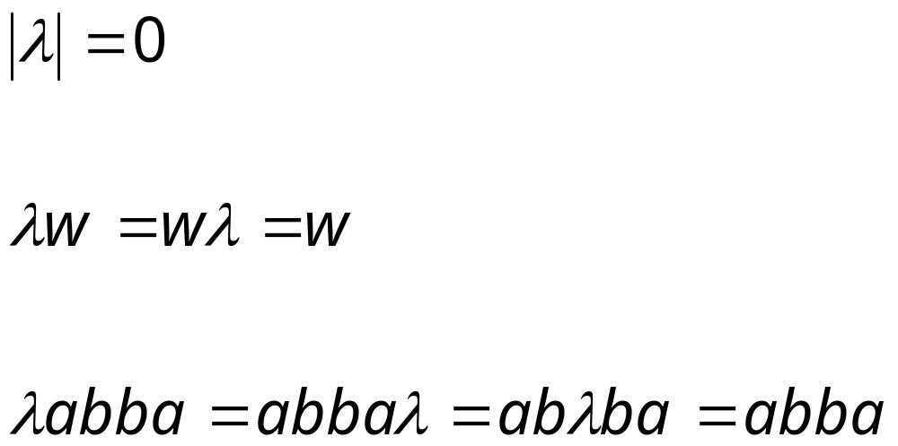
Empty String
A string with no letters is denoted:
Observations:
MESCOE
Notes:
07/28/20

Slide 22


Substring
Substring of string:
  a subsequence of consecutive characters
String Substring
MESCOE
Notes:
07/28/20

Slide 23




Prefix and Suffix
Prefixes Suffixes
prefix
suffix
MESCOE
Notes:
07/28/20

Slide 24




Another Operation
Example:
Definition:
MESCOE
Notes:
07/28/20

Slide 25



The * Operation
: the set of all possible strings from
alphabet
MESCOE
Notes:
07/28/20

Slide 26


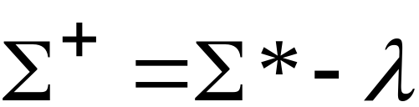
The + Operation
: the set of all possible strings from
alphabet except
MESCOE
Notes:
07/28/20

Slide 27


Languages
A language over alphabet
is any subset of
Examples:
Language:
Language:
Language:
MESCOE
Notes:
07/28/20

Slide 28
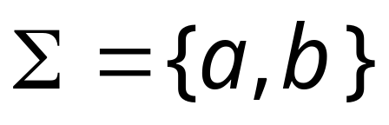




More Language Examples
An infinite language
Alphabet
MESCOE
Notes:
07/28/20

Slide 29
Prime numbers
Alphabet
Language:
MESCOE
Notes:
07/28/20

Slide 30
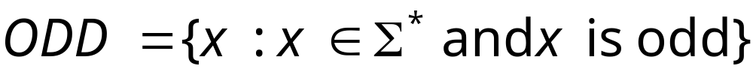

Even and odd numbers
Alphabet
MESCOE
Notes:
07/28/20

Slide 31




Note that:
Sets
Set size
Set size
String length
MESCOE
Notes:
07/28/20

Slide 32


Operations on Languages
The usual set operations
Complement:
MESCOE
Notes:
07/28/20

Slide 33



Reverse
Definition:
Examples:
MESCOE
Notes:
07/28/20

Slide 34


Concatenation
Definition:
Example:
MESCOE
Notes:
07/28/20

Slide 35



Another Operation
Definition:
Special case:
MESCOE
Notes:
07/28/20

Slide 36



Star-Closure (Kleene *)
MESCOE
Notes:
07/28/20

Slide 37
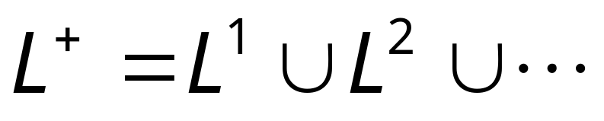
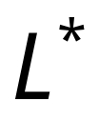


Positive Closure
Definition:
Same with but without the
MESCOE
Notes:
07/28/20

Slide 38
Questions ???

