Slide 1
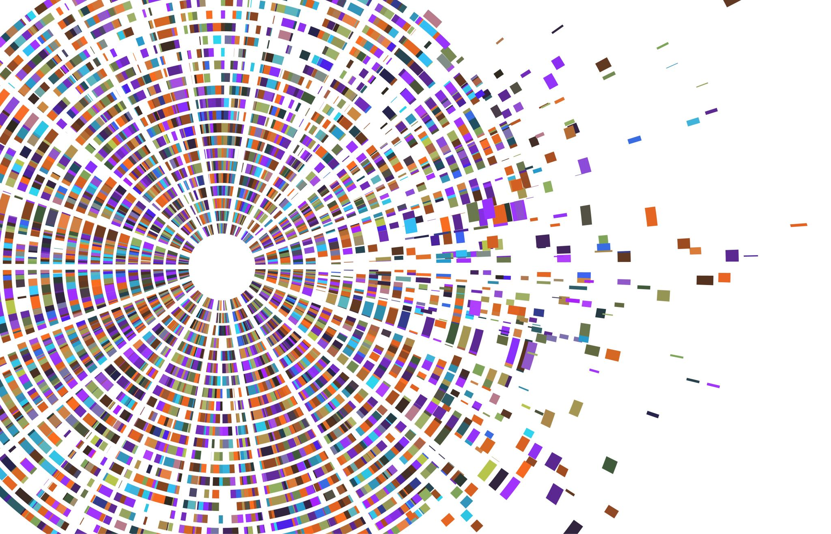
Fake News Detection
Presented by:
Dhanashree Gaikwad - 205B023
Kumar Kolhe - 205B039
Kunal Patil – 205B040
Savani Khutale - 205B037
Tanmay Jagtap – 205B030
Guide:
Prof. S.S.Pawar

Slide 2
Problem Statement
To design a Fake News Detector using Natural Language Processing (NLP).

Slide 3
Motivation
With increase in mobile market and internet usage, accessing news requires nothing more than a fingertip.
This may have increased awareness among people but also has become a perfect way to spread fake news.
Spreading fake information brings instability to the society and thus any information we receive must be checked.

Slide 4
Objective
The system should be able to predict whether the news is real or fake.
It will take title and content of news article as input and predict whether the news is real or fake.

Slide 5
Literature Survey
Title of the paper | Author | Publication | Year | Methods/ Techniques/ Algorithms | Finding /Limitation | Scope of Research
Fake News Detection Using ML approaches | Syed Ishfaq Manzoor; Jimmy Singla; Nikita | IEEE | 2019 | Classification Methods used | Determination of algorithms used for fake news detection | Analysis of Various Machine Algorithms
Fake news Detection | M. Irfan Uddin | Hindawi Journal | 2020 | VM, KNN, Wang-CNN, and Wang-Bi-LSTM | Used to find the fake news | One direction for future work is to make these methods more
Media-Rich Fake News Detection: A Survey | S. B. Parikh and P. K. Atrey | IEEE | 2018 | SVM | Survey of Algorithms done | Survey of ML Algorithms

Slide 6
Machine Learning Approach
Algorithm used :-
Supervised Learning Approach
Logistic Regression
MultinomialNB Classifier

Slide 7
Research Gap
Prediction largely depends on the dataset and the news data may differ according to the region and timeline.
There is no specific way to predict whether the news is fake or real. The outcome completely depends on the program stategy and model used.

Slide 8
Data Set Used
The data set used for this project is taken from Kaggle
We have used two sets of data labeled as True and False.
Our dataset consist of 4 attributes and 21417 instances(in case of true data) and 23507 instances(in case of false data).
Attributes in the dataset are-
(I)Title
(II)Text
(III)Subject
(IV)Date

Slide 9
Features
The proposed system detects two types of news (Real or Fake).
01
As the proposed system will use Logistic Regression having accuracy 99.67% for news prediction.
02

Slide 10
End user
Common people
Researcher

Slide 11
Functional requirements
Add title of the news article.
Add text in the news article.

Slide 12
Non-Functional Requirements
Response Time – The system provides an acknowledgement within seconds.
Capacity- The system needs to support one news at a time.
User interface-An acknowledgement need to be given by user interface as fast as possible.
Availability-The system will be available all the time.

Slide 13
System Requirements
Developer System Requirements
User System Requirements
Software Requirements
OS: Windows 10
Editor: Jupyter Notebook
Language: Python
Hardware Requirements
Minimum Intel Core i5
RAM: 8GB
Software Requirements
OS: No OS required as it is a web application.
Hardware Requirements
Platform: Any Device with a net access.

Slide 14
System Architecture
True Dataset
Data Cleaning
Feature Selection
Pre-Processing
Train Test Split
Fake Dataset
Train Data
Test Data
Logistic Regression Model
Validate Model(Score)
Model Deployment
Improve Model
Open Notebook

Slide 15
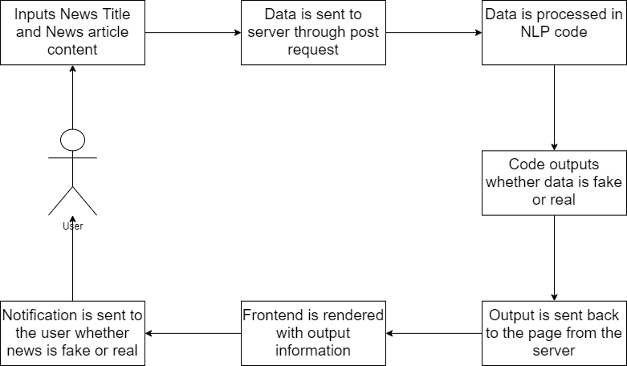
System Architecture - Deployment
Open App

Slide 16
Risk Prioritization
Risk Identification | Risk Analysis | Risk Prioritization | Risk Management
Technical Risk | Anonymous input | Low | Model removes such words
Project Risk | Change of requirements | Medium | We need to consider this situation
Testing Risk | Bug in any module | High | Ensure to design product as user requirement

Slide 17
Timeline Chart
Activites | March | April | May
Searching for dataset | 8-21
Data cleaning and analysis | 22 | 9
Model design and training |  | 10-23
Interface |  | 24-30
Deployment |  |  | 1-11
Testing |  |  | 12-20
Documentation |  |  | 11-31

Slide 18
Conclusion
In this system, our main aim is to design fake news detection system that will predict whether the news is real or fake.
This system will be helpful to create a better society.

Slide 19
Thank you

