Slide 1
Rainfall Prediction
Machine Learning I
Tanmay Vivek Kshirsagar
Sudhanshu Deshpande
Shreyas Sunku Padmanabha

Slide 2
Objective
Predict next-day rain by training classification models on the target variable ‘RainTomorrow’ using the weather observations made on the current day.

Slide 3
Background
Predicting whether it will rain tomorrow is important for multiple reasons such as safety, agriculture, business, and personal planning. It helps make daily decisions and reduce risk of failure due to unexpected rain.
Observations were drawn from numerous weather stations. The daily observations are available from Climate Data Online - Map search.
An example of latest weather observations in Canberra: Canberra, Australian Capital Territory March 2023 Daily Weather Observations
Definitions adapted from http://www.bom.gov.au/climate/dwo/IDCJDW0000.shtml
Data source: http://www.bom.gov.au/climate/dwo/ and http://www.bom.gov.au/climate/data.

Slide 4
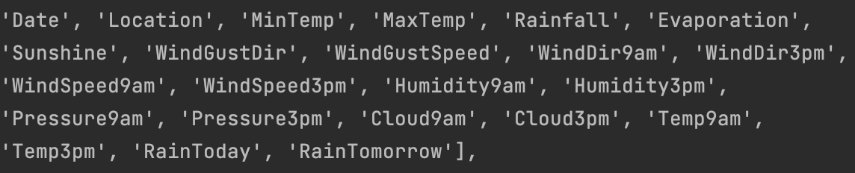
Dataset Description
This dataset contains about 10 years of daily weather observations from many locations across Australia.
145,460 observations and 23 columns.
Source: Kaggle.

Slide 5
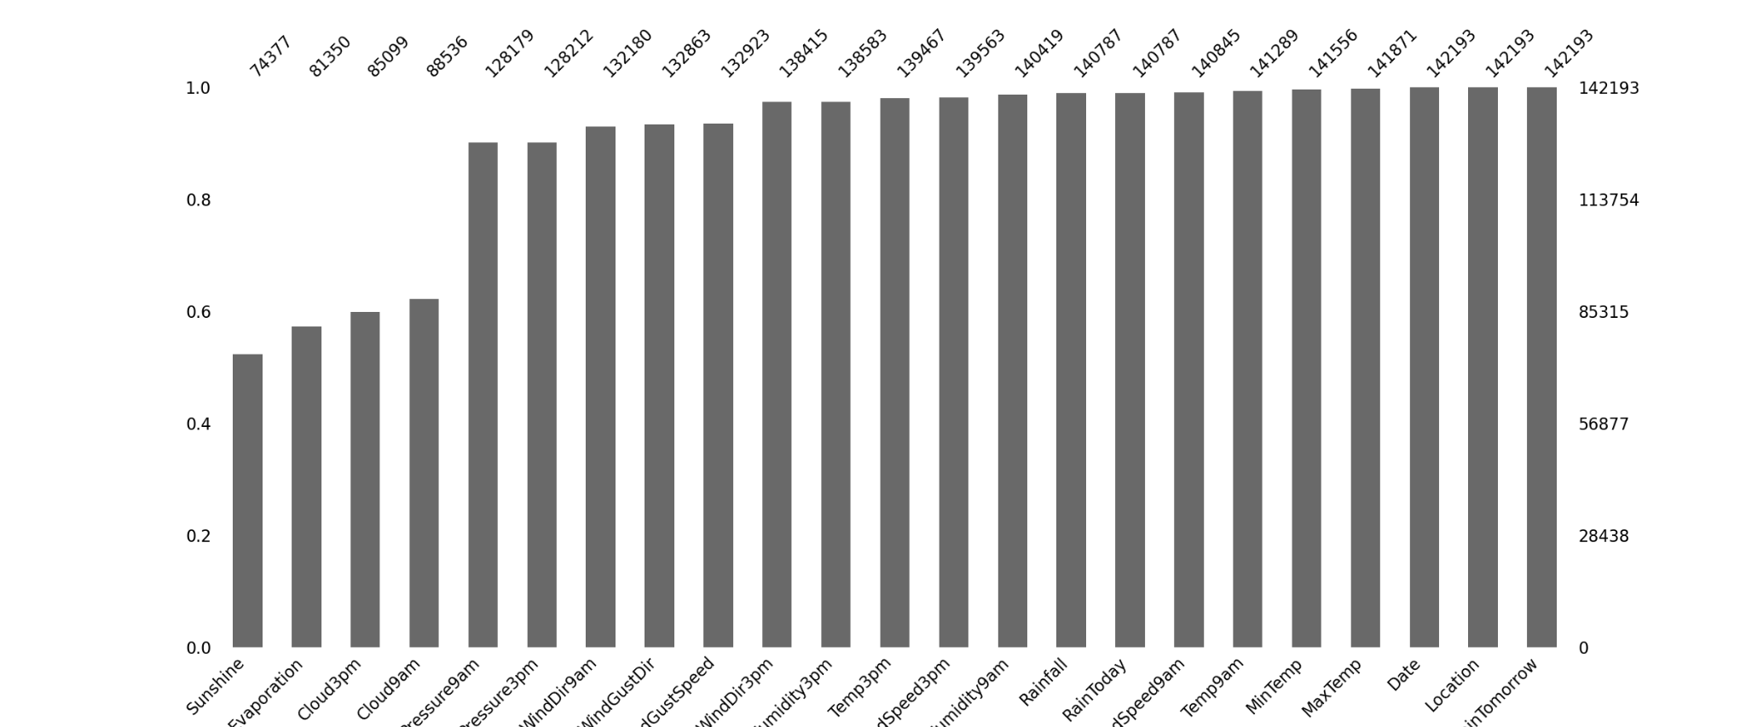
Missing Data
Data Imputation
Numerical: mean
Categorical: mode

Slide 6
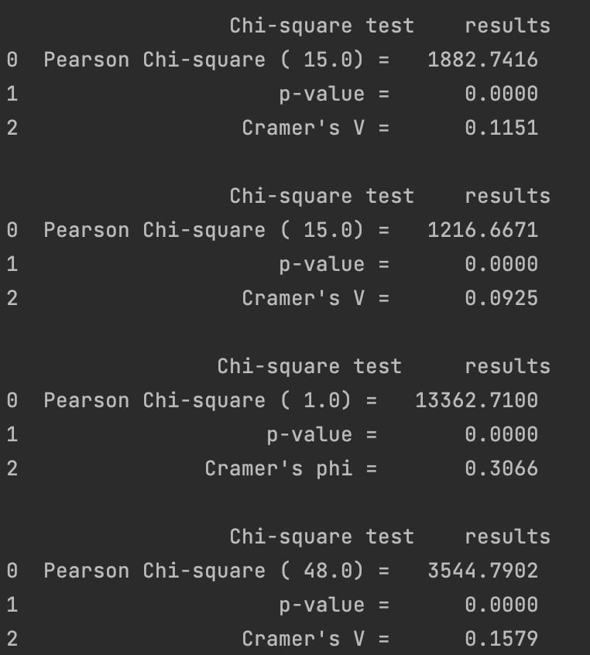
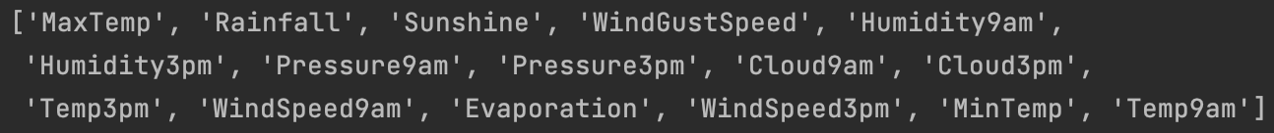
Feature Importance
Chi-Square - Categorical Features
SelectKBest - Numerical Features

Slide 7
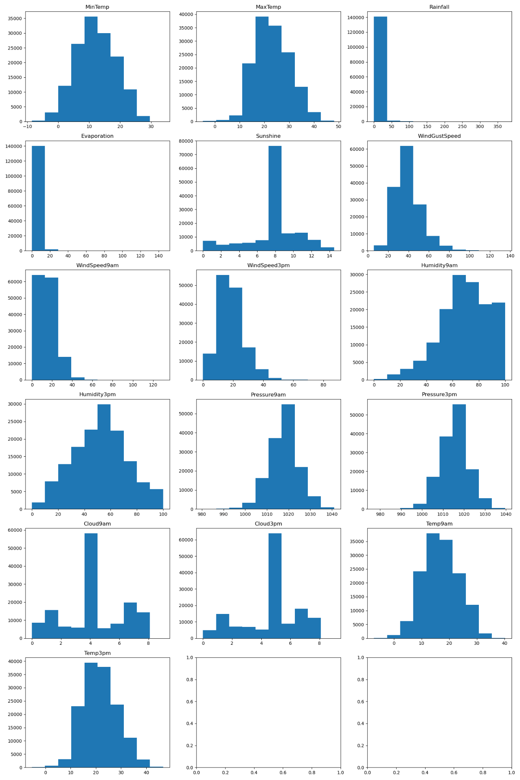
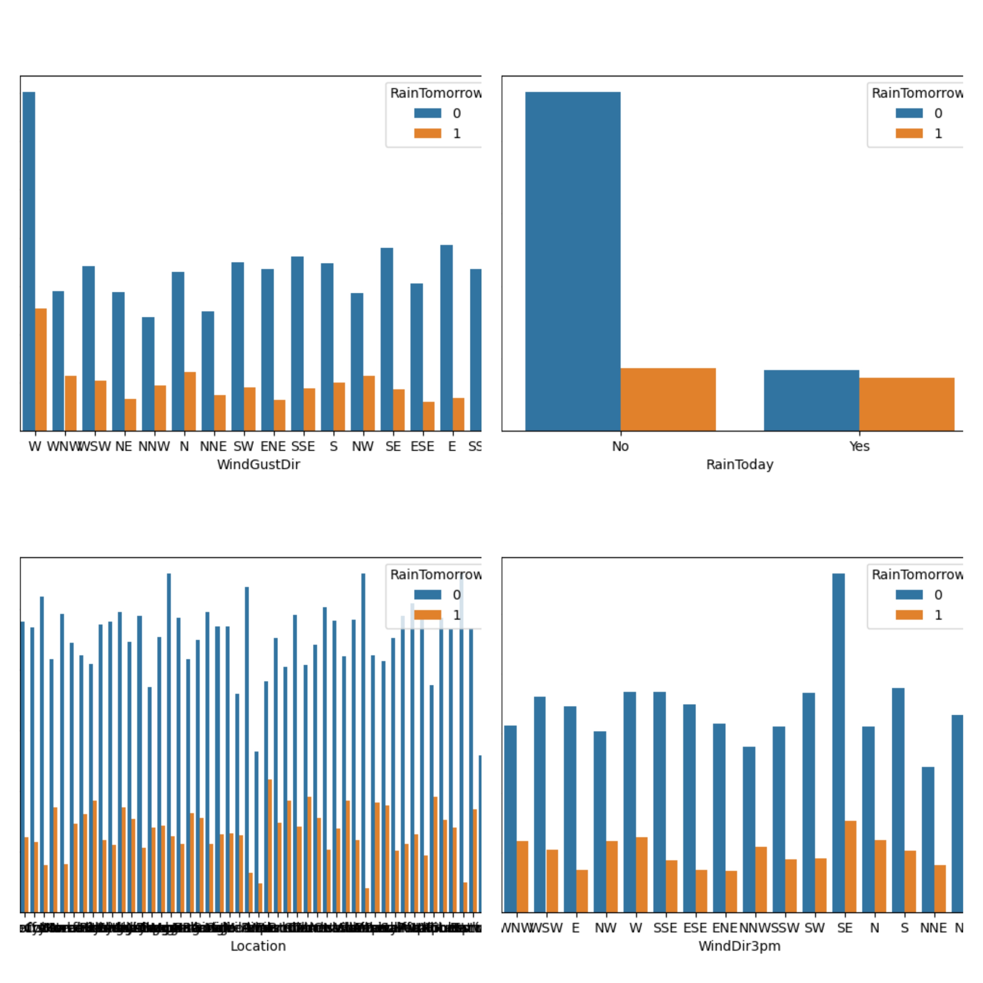
Data Distribution

Slide 8
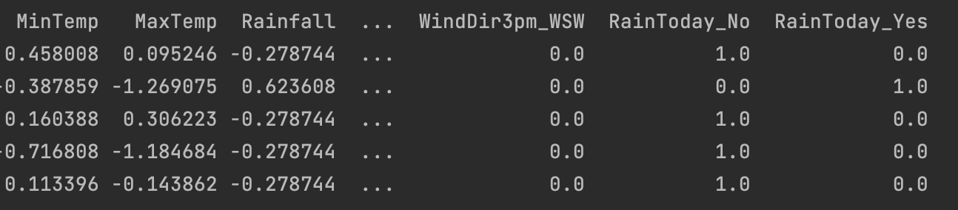
Feature Handling
Standard Scaling for numerical data
One-hot Encoding for categorical data

Slide 9
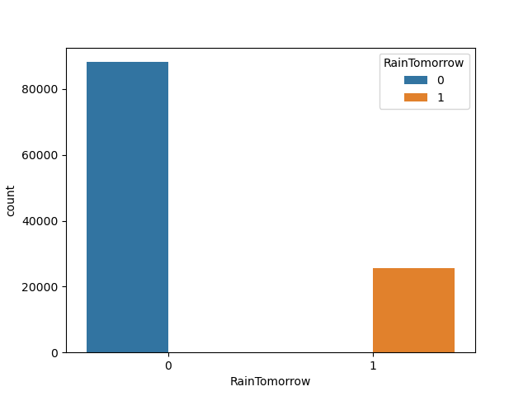
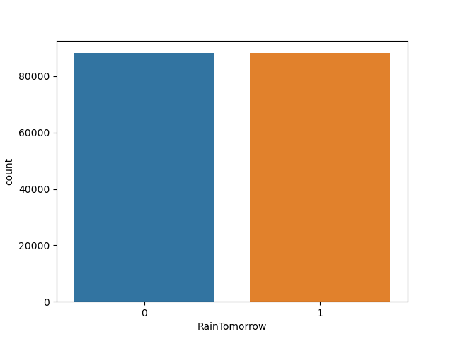
Data Imbalance - SMOTE

Slide 10
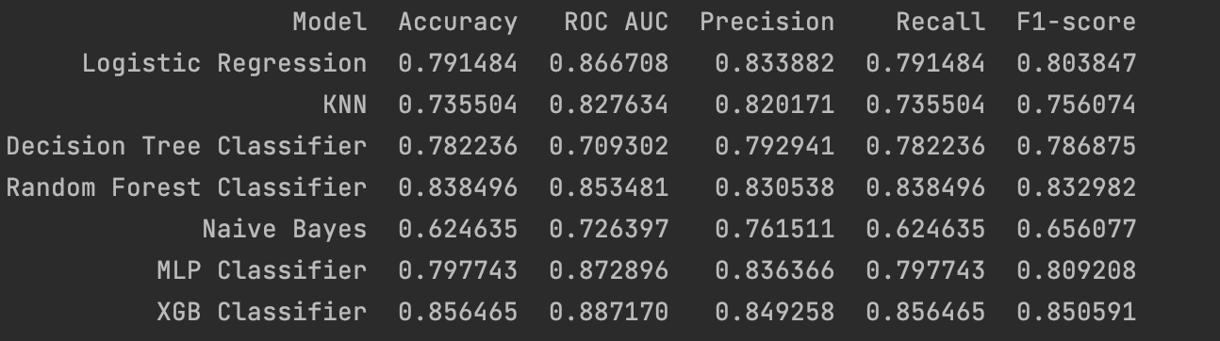
Model Performance

Slide 11
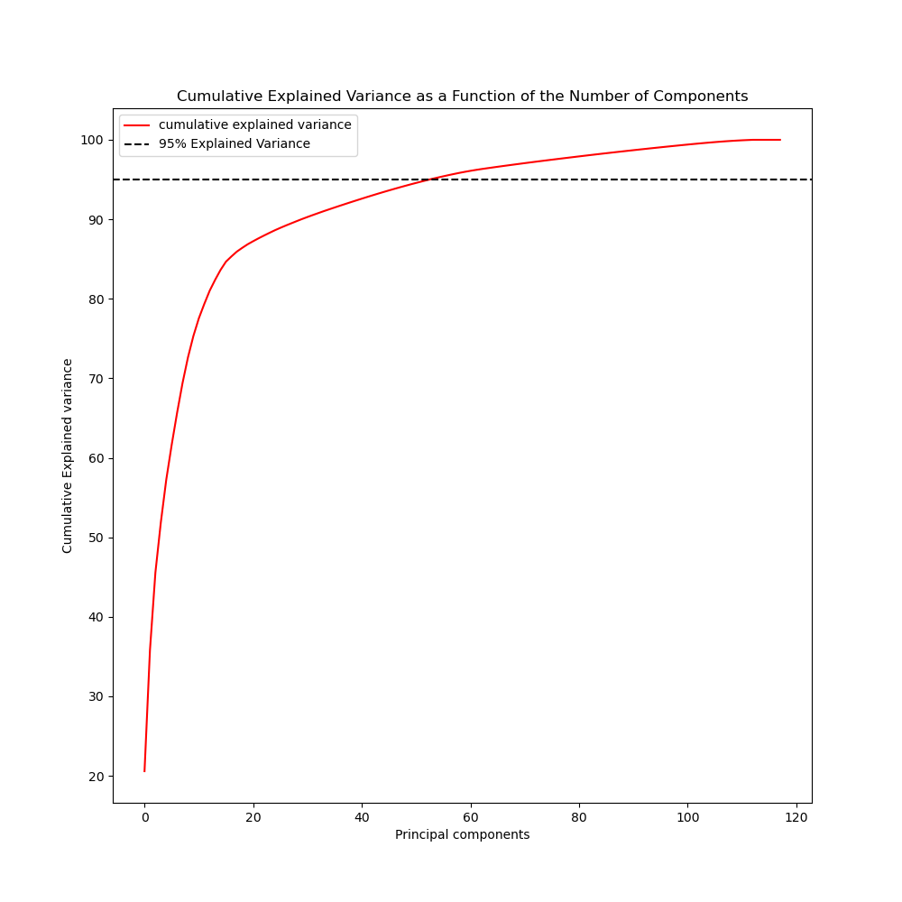
Principal Component Analysis

Slide 12
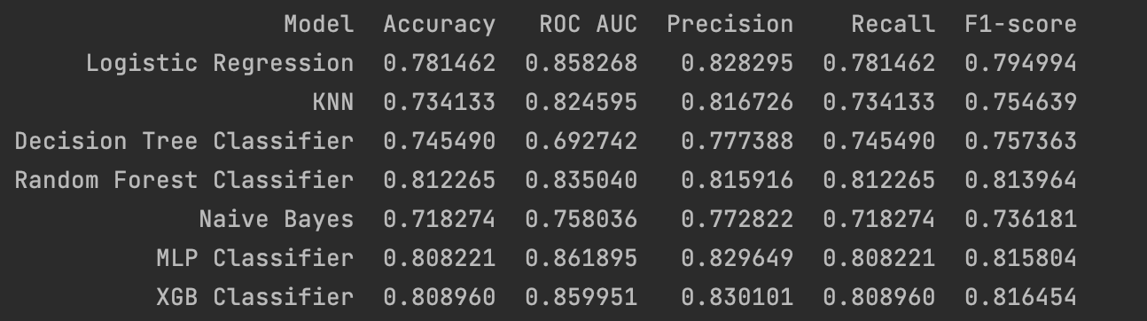
Model Performance after PCA

Slide 13

K-Fold Cross Validation

Slide 14
Conclusion
We successfully build training classification models on the target variable ‘RainTomorrow’ to predict next-day rain using the weather observations made on the current day.
XGBoost Classifier model gave the best F-1 score followed by Random Forest Classifier and MLP Classifier.

Slide 15
Questions?

Slide 16
Thank You!

