Slide 1

SARCASTIC NEWS HEADLINE DETECTION
GROUP BY 6:
SHIKHA SHARMA
TANMAY KSHIRSAGAR
PURVI JAIN
Notes:
"Ever read a headline and wondered, 'Is this serious or just cleverly sarcastic?' Well, that's exactly the puzzle we've been tackling!"
Good Evening Everyone, I am Purvi and I'm thrilled to introduce my colleagues, Shikha and Tanmay .
Today, we're excited to walk you through our project on sarcasm detection in news headlines."

Slide 2
OBJECTIVE
Develop a nuanced NLP model capable of accurately classifying news headlines as sarcastic or non-sarcastic.
Utilize a mix of classical ML algorithms (Naive Bayes, MLP, LR) and advanced neural networks (LSTM, BERT, Roberta) for effective sarcasm detection.
Implement transformer-based models, specifically the T5-small-headline-generator, to create summaries that can potentially mimic sarcasm in news headlines.
Notes:
In our project, we aimed to develop an advanced NLP model capable of accurately classifying news headlines as sarcastic or non-sarcastic. Utilizing LSTM networks and BERT, we delved deep into the complexities of language to identify sarcasm. Additionally, we implemented transformer-based models like the T5, designed to not only detect but also mimic sarcasm in news summaries.

Slide 3
DATA SOURCE
Dataset Selection: 'News Headlines Dataset For Sarcasm Detection' from Kaggle.
Volume & Sources:
Contains 55,328 headlines with articles.
Compiled from two distinct websites to reduce noise and ambiguity.
Composition & Reliability:
Sarcastic headlines from TheOnion's satirical news sections.
Non-sarcastic headlines from HuffPost for serious news content.
Dataset Attributes:
is_sarcastic: Binary indicator (1 for sarcastic, 0 for non-sarcastic).
headline: Text of the news headline.
article_link: URL to the original news article.
Web Scraping for sarcastic news from TheOnion website.
Notes:
"For our project, we sourced our data available on Kaggle.
The dataset contains 55,328 headlines, offering a rich and varied set of data points for training our models.
We used headlines from two distinct sources - TheOnion for sarcastic content, and HuffPost for genuine news headlines, providing a balance of humorous and serious tones.
Structured Data: Each record comes with two key attributes - the sarcasm label indicating whether it's sarcastic or not, and the headline text itself,analysis.'article_link': A URL pointing to the original news article. Now to perform text summarization task we scrapped the sarcastic data from The Onion website for text summarization.

Slide 4
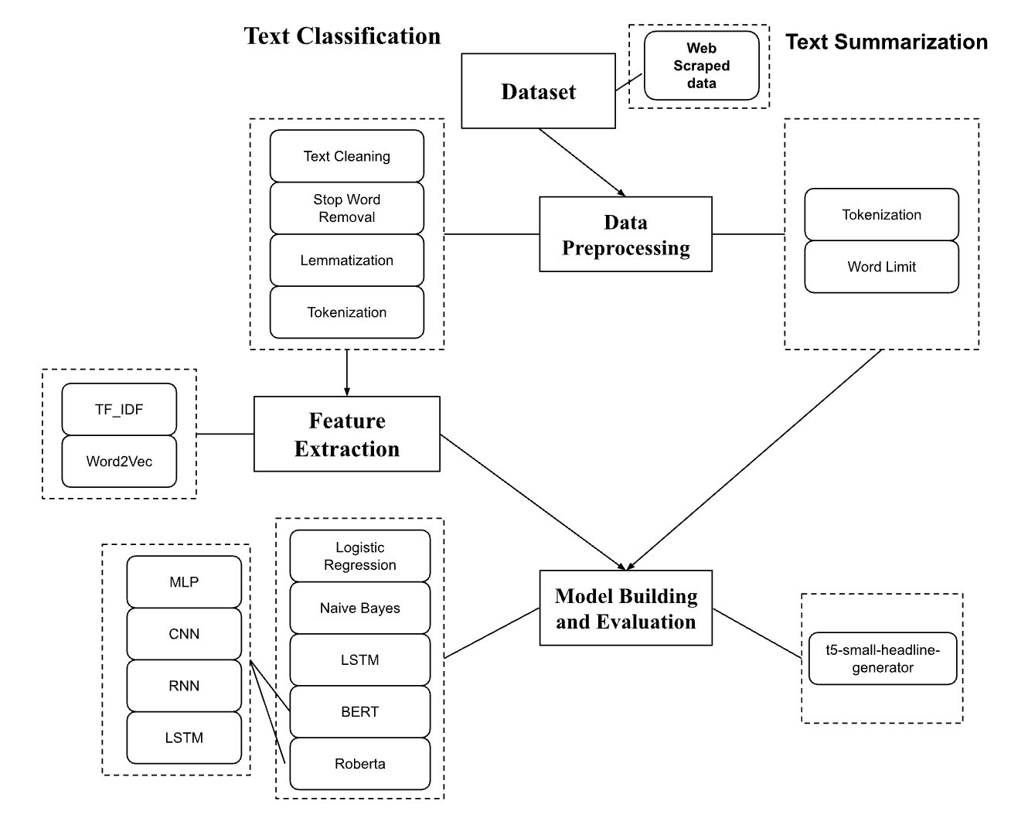

Slide 5
PREPROCESSING
Data Cleaning: Applied regular expressions to eliminate numbers, punctuations, and extraneous characters; transformed text to lowercase for uniformity.
Stop Words Removal: Utilized NLTK package to filter out stop words, streamlining the dataset for more efficient processing.
Text Normalization: Conducted lemmatization to consolidate word variants to their dictionary form, enhancing the consistency of the dataset.
Notes:
Our first step in preprocessing is Data Cleaning. Here, we use regular expressions tool to remove unnecessary elements like numbers, punctuations, and unnecessary characters from our text data."
We also transform all the text to lowercase. This ensures uniformity, making our data more easier to analyze."
"Next, we perform Stop Words Removal to filter out common words like 'the', 'is', and 'in', which are frequent but don't add significant meaning to the text"
"The final step in our preprocessing is Text Normalization."
Here, we perform lemmatization. It's a technique where we convert words to their base or dictionary form."
For instance, 'running', 'ran', and 'runs' are all transformed to 'run'."
This enhances the consistency of our dataset

Slide 6
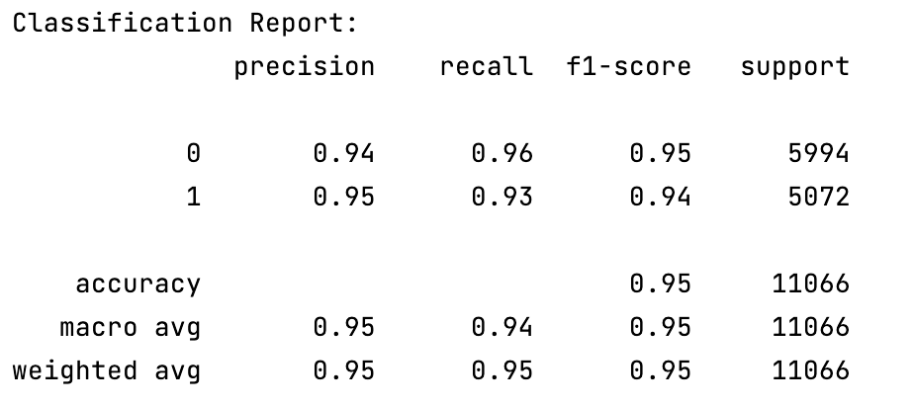
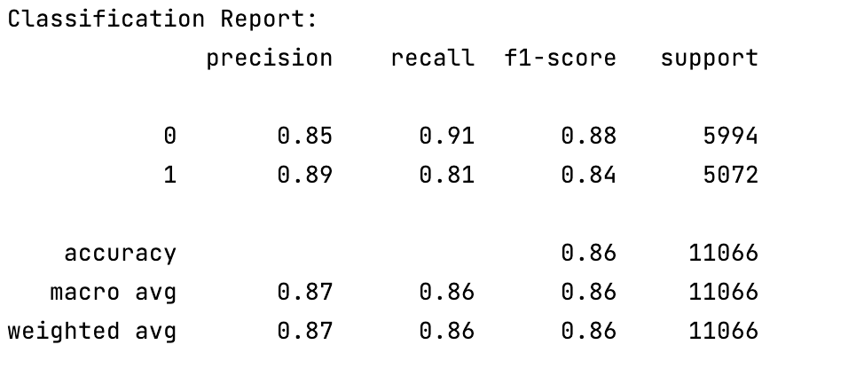
CLASSIFICATION Classical Models
Used unprocessed data for baseline model performance.
Segregated data into training and testing sets without preprocessing.
Transformed text into feature vectors using TF IDF.
Evaluated Logistic Regression and Naive Bayes with scikit-learn.
Notes:
"First, we established a baseline for our model's performance using unprocessed data."
It's important to see how the models perform with raw data,
We then segregated our dataset into training and testing sets,
"For our feature extraction, we utilized the TF-IDF technique."
It's a used to evaluate how important a word is to a document in a collection or corpus."
"We evaluated two popular models Logistic Regression and Naive Bayes."
"Let's look at the classification report. For Logistic Regression, we observed high precision, recall, and F1-scores across both classes."
Specifically, we achieved an accuracy of 95%, with precision and recall both around 94-95%."
In opposite side, the Naive Bayes model showed a slightly lower performance with an accuracy of 86%, and precision and recall around 85-89%."

Slide 7
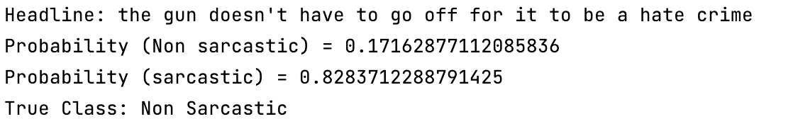
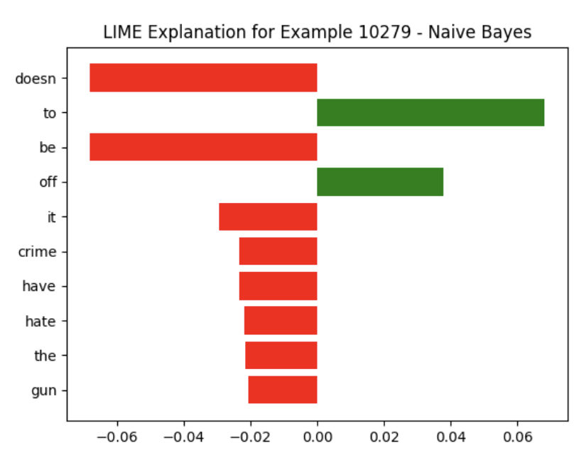
Model Explainability : LIME
Uses LIME to shed light on the predictions made by complex models.
Words 'doesn't', 'it', 'crime', 'have', 'hate', 'gun' negatively influence the prediction.
Words 'be' and 'off' positively affect the model's outcome.
Bar length indicates the magnitude of each word's impact on the classification.
LIME clarifies model reasoning, revealing keywords that lead to the Naive Bayes decision.
Notes:
Start with, "To understand how our Naive Bayes classifier makes decisions, we've applied a technique called LIME."
"LIME Local Interpretable Model-agnostic Explanations provides us with local interpretable explanations for any prediction, by highlighting which features are most influential."
let's Consider the example of this headline: 'The gun doesn't have to go off for it to be a hate crime.'"
"Our model predicted this as sarcastic with a high probability. However, the true class is non-sarcastic, indicating a discrepancy in the model's understanding."
"This bar chart illustrates the words that impacted the model's prediction."
"Words like 'doesn't,' 'it,' 'crime,' 'have,' 'hate,' and 'gun' negatively influenced the prediction, pushing the model towards a sarcastic classification."
the positive influencers, "Conversely, 'be' and 'off' pushed the model towards the correct non-sarcastic classification."
"The length of each bar indicates the magnitude of the impact. The longer the bar, the stronger the influence on the model's decision."

Slide 8
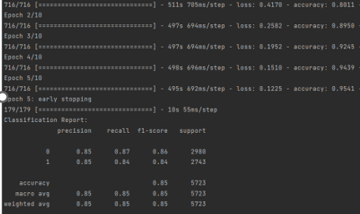
CLASSIFICATION LSTM
Training accuracy progressed from 80.11% to 95.41% across five epochs.
Validation accuracy peaked at 86.13%, reflecting high model performance.
The model demonstrated a consistent decrease in loss, showing effective learning.
Early stopping after the 5th epoch suggests the model's robustness in generalization without overfitting.
Notes:
Next, LSTM (Long Short-Term Memory) networks, a type of Recurrent Neural Network (RNN), are designed to process sequences of data and these networks are particularly effective in sarcasm detection as they consider the entire context of a sentence or phrase. This ability to remember and utilize past information helps in understanding the tone and implied meaning, which are crucial for identifying sarcasm.
Embedding Layer:Our first step is to transform tokenized words into meaningful vector spaces with 64 dimensions, giving us a dense representation of each word's features.
Spatial Dropout (30%): Reduces overfitting.
Bidirectional LSTM (64 units): Captures forward and backward context.
Dense Layers: One for feature processing with 'relu' activation, and another for binary output using 'sigmoid'.
We used Adam Optimizer: Manages efficient learning.
Early Stopping: Applied after 3 epochs without improvement to prevent overfitting.
Training accuracy of 95 and Validation Accuracy: Achieved ~85%.

Slide 9
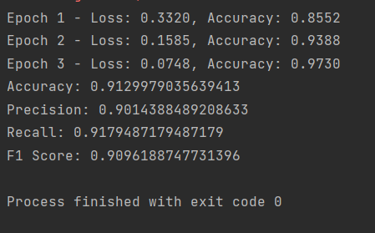
CLASSIFICATION BERT
Training showcased consistent improvement, with constant decrease in training loss.
The model achieved an impressive accuracy of 97.30% on training and 91.47% on validation data.
Notes:
BERT (Bidirectional Encoder Representations from Transformers), a cutting-edge transformer model renowned for its deep contextual understanding of language nuances. BERT's architecture is uniquely suited to pick up on the contextual clues that define sarcasm. By processing text bidirectionally, BERT understands both the preceding and following context of each word, a critical factor in detecting sarcastic undertones.
We crafted a specialized dataset class, ensuring that the headlines were tokenized and formatted to meet BERT's input standards, complete with attention masks for targeted processing.
we utilized PyTorch DataLoaders, we efficiently managed batch processing, significantly improving our model's training time and resource After fine-tuning the model over 5 epochs, we achieved an accuracy of 91.47% on our validation set.

Slide 10
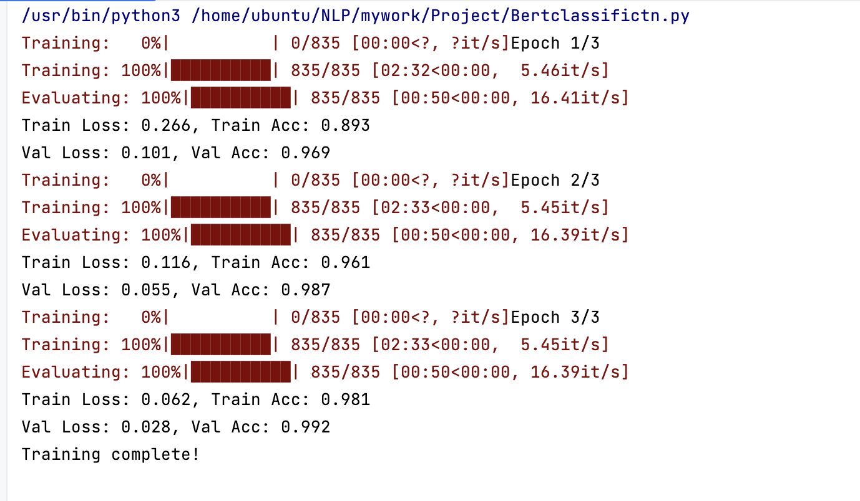
CLASSIFICATION Transformers - BERT + LSTM
Training accuracy improved from 89.3% to 98.1% over three epochs.
Validation accuracy increased from 96.9% to 99.2%.
Both training and validation losses significantly decreased, indicating effective learning.
High validation accuracy suggests strong model generalization without overfitting.
Notes:
By synthesizing BERT's contextual embeddings with LSTM's memory of past inputs, our model can detect sarcasm with nuanced precision.
The model showcased a significant learning curve, with training accuracy soaring from 89.3% to a remarkable 98.1%, illustrating the model's ability to adapt and learn from complex sarcasm patterns in the data.
Validation accuracy reached an outstanding 98%, underscoring the model's robustness and its capability to generalize well on unseen data.
Both training and validation losses diminished substantially, signaling that the model was learning effectively without overfitting—a common challenge in deep learning models.
The incorporation of dropout at a rate of 0.5 helped prevent overfitting, ensuring that the model remains accurate and stable when exposed to new, varied data.

Slide 11
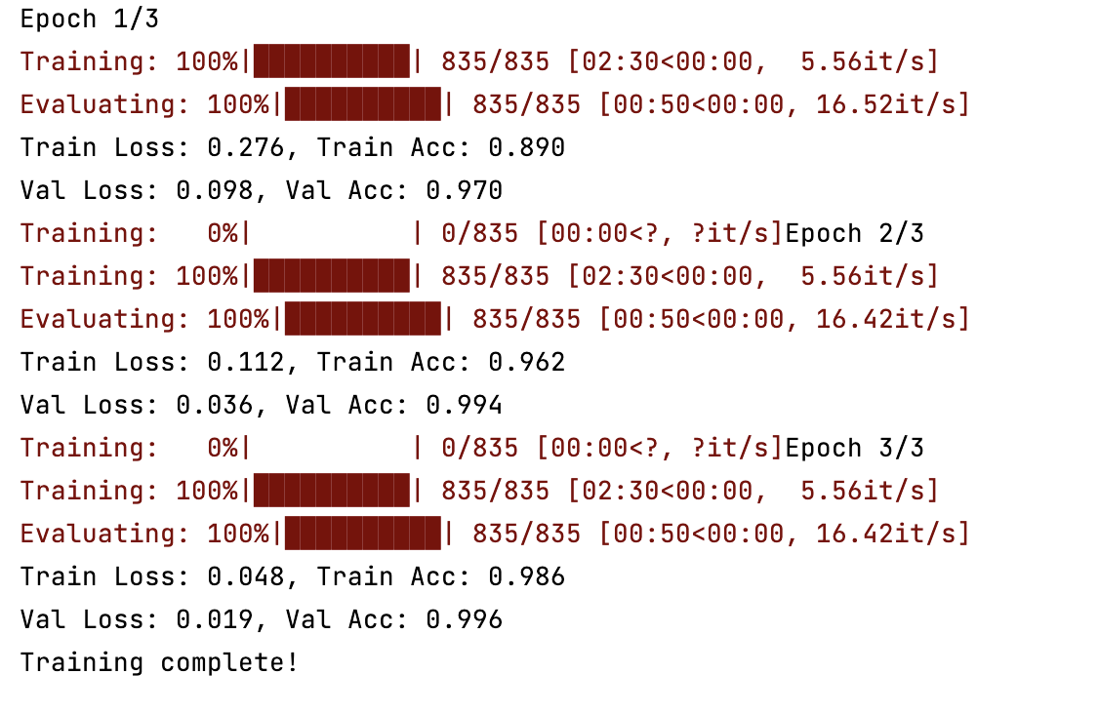
CLASSIFICATION Transformers - BERT + MLP
BERT+MLP reached 99.6% validation accuracy.
Consistent gains over three epochs.
Well-tuned model with reduced losses.
Notes:
Begin by explaining the model, "We've implemented a sophisticated text classification system using BERT combined with a Multi-Layer Perceptron,
as my friend already explain the functioning of bert so ill add one more point in that "bert reads text in both directions, left-to-right and right-to-left, which allows it to capture context more effectively than previous models."
"Once BERT has processed the text, the MLP takes over. It's a type of neural network with layers of neurons that learn to map the features extracted by BERT to our target classifications."
Introduce the concept, "The BERT + MLP Head refers to the additional neural network layers on top of the pre-trained BERT model. These layers are tailored to our specific classification task.
Move on to the training process, "We trained our model in three epochs. With each epoch, the model learned and improved, as evidenced by the decreasing training and validation loss."
"Our evaluation metrics here are accuracy and loss for both training and validation. As training progresses, we want the training loss to decrease and the accuracy to increase, which is exactly what we observe."
By the end of the third epoch, our BERT+MLP model achieved an impressive validation accuracy of 98%."Note the consistency in gains over the epochs, indicating a well-tuned model with reduced losses."

Slide 12
CLASSIFICATION
Model | Accuracy | Epochs | Max Length | Learning Rate | Batch Size | Optimizer
Naive Bayes | 0.86
Logistic Regression | 0.94
LSTM | 0.95 | 4 | 120 |  |  | Adam
CNN | 0.97 | 4 | 120 |  |  | Adam
BERT | 0.97 | 3 | 120 | 2e-5 | 32 | AdamW
BERT + LSTM | 0.98 | 3 | 128 | 2e-6 | 32 | AdamW
BERT + CNN | 0.82 | 5 | 128 | 2e-5 | 32 | AdamW
BERT+MLP | 0.98 | 3 | 128 | 5e-5 | 32 | AdamW
Notes:
Begin with an introduction, "Let's look into the parameters that play a critical role in the training and performance of our project models."
"We'll cover what epochs, max length, learning rate, batch size, and optimizer mean and how they impact our model's learning process."
—"More epochs mean the model has more opportunities to learn and adjust its weights. However, too many epochs can lead to overfitting
Setting the right max length is crucial for capturing sufficient context without wasting computational resources on padding"
—, "A smaller learning rate means the model updates its weights more slowly, which can be good for fine-tuning but too small can make training inefficient. A larger rate speeds up training but can overshoot the optimal values."
"A smaller batch size provides a more granular update to weights but can be noisy and take longer to train, while a larger batch size can be more stable and efficient but requires more memory."
"Adam and AdamW are advanced optimizers that adapt the learning rate for each weight of the model. AdamW is a variant of Adam with better weight regularization."
now we compare the performance of several machine learning models on our text classification task."
"First, we have our baseline models. Naive Bayes showed an accuracy of 86%, while Logistic Regression performed better with 94%."
"Next, The LSTM achieved 95% accuracy over 4 epochs, and the CNN surpassed it slightly with 97% accuracy,
"Moving to the more advanced transformer models, BERT alone reached 97% accuracy
"Combining BERT with LSTM or MLP boosted the accuracy to 98%, but interestingly, BERT with CNN decreased to 82% despite more epochs and the same learning rate as BERT alone."
These results show us that while transformer models have high potential, their performance is heavily dependent on the right combination of hyperparameters and architecture."
In conclusion, our best-performing model was the BERT+MLP, with an accuracy of 98% over just 3 epochs. This indicates a well-tuned model suitable for our classification needs."
epoch s,learning rate or sb change kita to
Suppose you have the BERT+MLP model with an accuracy of 0.98, trained over 3 epochs with a learning rate of 5e-5, a batch size of 32, and using the AdamW optimizer.
If you increase the epochs to 5, the model might start overfitting, leading to a potentially higher training accuracy but possibly lower validation accuracy.
If you increase the learning rate to 1e-4, the model might converge faster, but it could start to overshoot the optimal solution, which could reduce accuracy.
If you increase the batch size to 64, the training might become faster, but the model might not generalize as well due to convergence to sharper minima.
If you switch the optimizer from AdamW to SGD, you might see a slower convergence and potentially worse performance unless you also adjust the learning rate and introduce momentum.

Slide 13
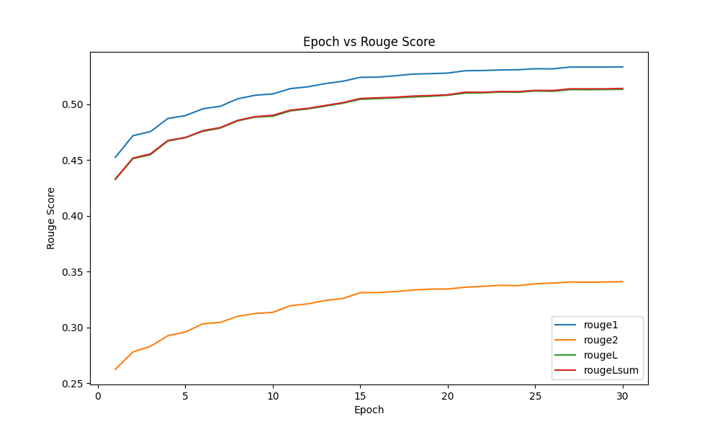
SUMMARIZATION
Model: t5-small-headline-generator (Text-to-Text Transfer Transformer)
Evaluation Metric:
ROUGE scores provide insights into the quality of the generated summaries concerning the ground truth.
Notes:
The T5 (Text-to-Text Transfer Transformer) is a transformer-based neural network architecture designed for a unified text-to-text approach. Particularly, we have used the pre-trained t5-small-headline-generator model and trained it on our set of training data to generate sarcastic headlines.
To evaluate our model performance, we have used ROUGE (Recall-Oriented Understudy for Gisting Evaluation) metrics to evaluate how well the generated summary captures the key information present in the reference summary or document.
ROUGE-1 measures unigram overlap between the generated text and reference text,
ROUGE-2 evaluates bigram,
ROUGE-L assesses the longest common subsequence,
and ROUGE-Lsum considers unigrams, bigrams, and longest common subsequence in automatic text summarization evaluation.
A ROUGE score of over 0.5 means that the model is capturing most of the required features.
Here we have trained our model over 30 epochs and most of the ROUGE scores are over 0.5. This suggests that the generated summaries are capturing the content and context well, but the ROUGE-2 is relatively lower. ROUGE-2 focuses on bigrams, which involve the structure and ordering of words. So one potential explanation for this is that the generated summaries preserve content but rearrange or rephrase words.

Slide 14
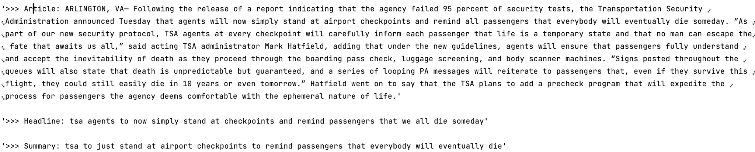
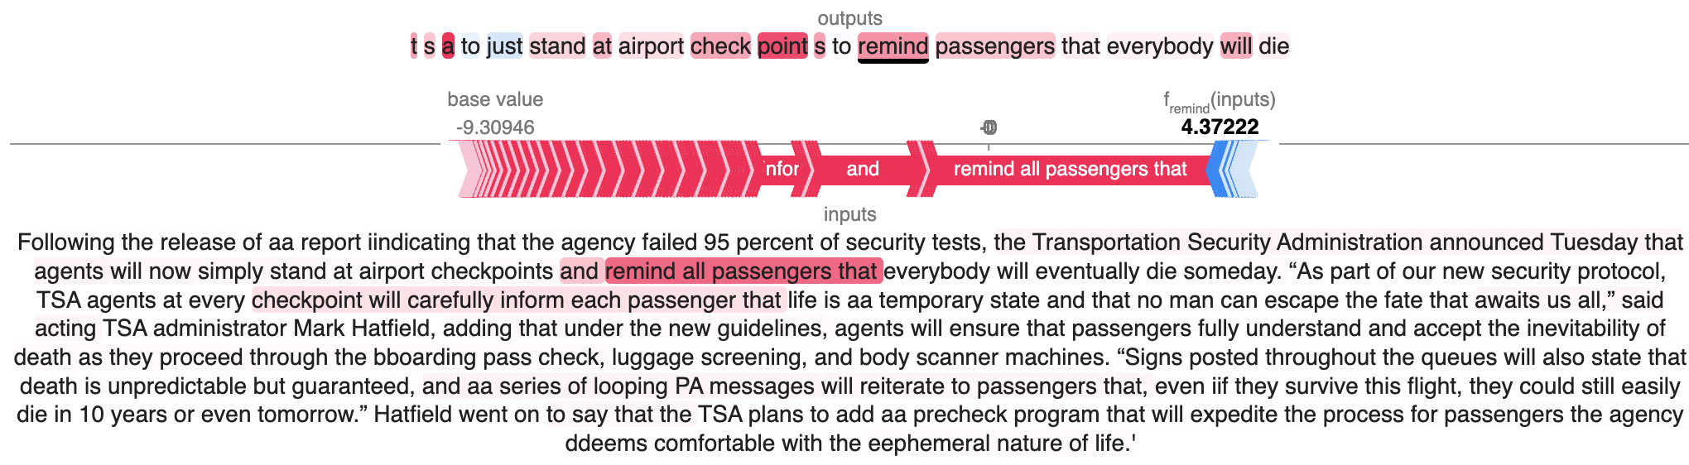
SUMMARIZATION-Prediction
Model Explainability using SHAP (SHapley Additive exPlanations)
Notes:
Understanding how the model summarized the text is a very complex task. We tried to use SHAP to interpret the summarized text and how the model interpreted the words.
SHAP (SHapley Additive exPlanations) is a model-agnostic framework for interpreting the output of machine learning models. It assigns fair contributions to individual input features, allowing for a nuanced understanding of a model's decision process.
Here, we can see that the word with higher red intensity indicates that this token significantly increased the model's prediction for the specific summary. While, there are some words with blue intensity indicating that these tokens slightly decreased the model's prediction for the specific summary. This suggests that the model identified "airport", “checkpoint”, “remind” as a key words for summarizing the article.

Slide 15
CONCLUSION
The integration of BERT with other neural network architectures has proven highly effective for sarcasm detection, surpassing traditional models and even outperforming other advanced neural network-based classifiers.
The text summarization model achieved commendable ROUGE scores, reflecting its proficiency in generating concise and meaningful summaries.
Notes:
The integration of BERT with other neural network architectures has proven to be highly effective for sarcasm detection, outperforming traditional models and even other advanced neural network-based classifiers. The text summarization model gave a good ROUGE score & provided some good results.
However, we observed a number of things that can be improved in future:
Dataset Expansion: Incorporation of more diverse datasets to improve the model's robustness and applicability across different contexts.
Model Optimization: Further refinement of hyperparameters for transformer models to enhance their ability to detect sarcasm.
Summarization Improvement: Development of a more sophisticated approach for the t5-small-headline-generator to improve its performance in generating contextually relevant sarcastic summaries.

Slide 16
We all really really love this class!
Thank you!

