Slide 1

SARCASTIC NEWS HEADLINE DETECTION
GROUP BY 6:
SHIKHA SHARMA
TANMAY KSHIRSAGAR
PURVI JAIN

Slide 2
OBJECTIVE
Develop a nuanced NLP model capable of accurately classifying news headlines as sarcastic or non-sarcastic.
Utilize a mix of classical ML algorithms (Random Forest, MLP, LR) and advanced neural networks (LSTM, BERT, Roberta) for effective sarcasm detection.
Implement transformer-based models, specifically the T5-small-headline-generator, to create summaries that can potentially mimic sarcasm in news headlines.
Focus on model explain ability to ensure transparency in how the models discern and generate sarcastic content.

Slide 3
DATA SOURCE
Dataset Selection: 'News Headlines Dataset For Sarcasm Detection' from Kaggle.
Volume & Sources:
Contains 55,328 headlines with articles.
Compiled from two distinct websites to reduce noise and ambiguity.
Composition & Reliability:
Sarcastic headlines from TheOnion's satirical news sections.
Non-sarcastic headlines from HuffPost for serious news content.
Dataset Attributes:
is_sarcastic: Binary indicator (1 for sarcastic, 0 for non-sarcastic).
headline: Text of the news headline.
article_link: URL to the original news article.
Web Scraping for sarcastic news.

Slide 4
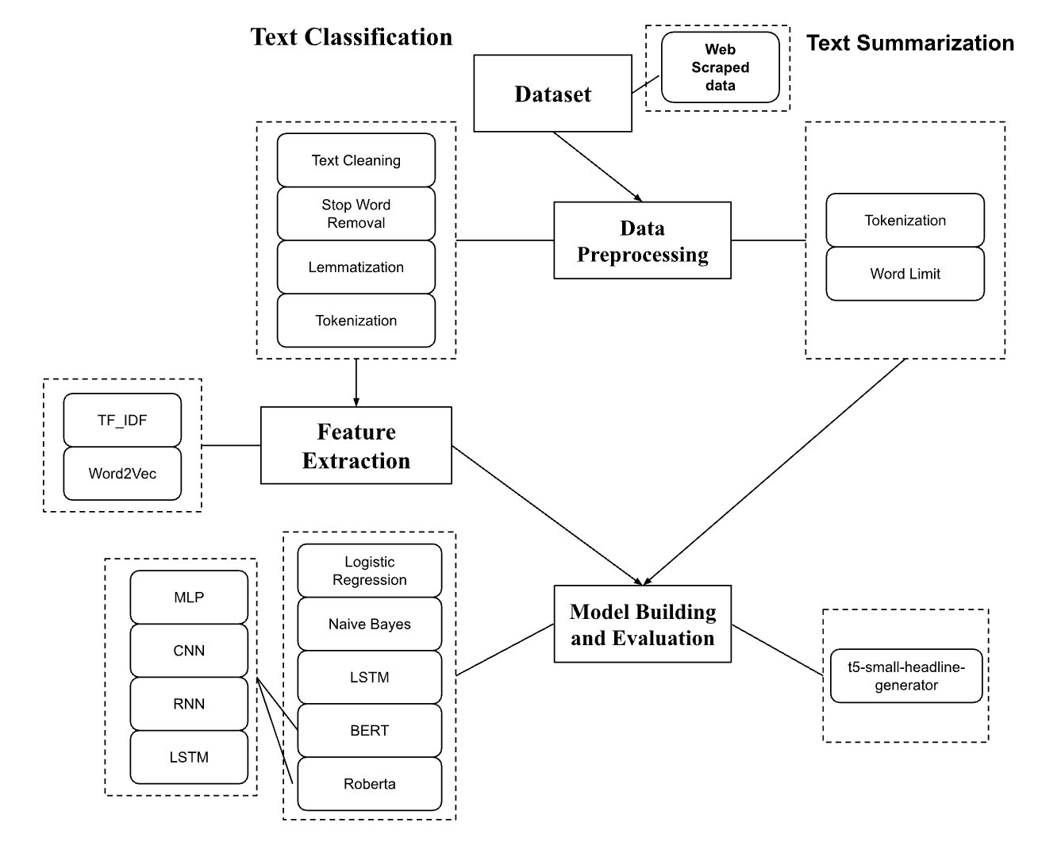

Slide 5
PREPROCESSING
Data Cleaning: Applied regular expressions to eliminate numbers, punctuations, and extraneous characters; transformed text to lowercase for uniformity.
Stop Words Removal: Utilized NLTK package to filter out stop words, streamlining the dataset for more efficient processing.
Text Normalization: Conducted lemmatization to consolidate word variants to their dictionary form, enhancing the consistency of the dataset.

Slide 6
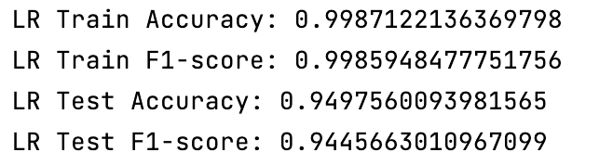
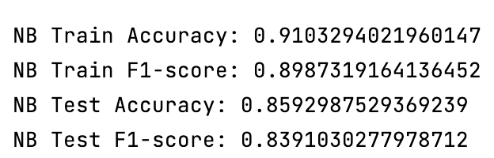
CLASSIFICATION Classical Models
Used unprocessed data for baseline model performance.
Segregated data into training and testing sets without preprocessing.
Transformed text into feature vectors using TF IDF.
Evaluated Logistic Regression and Naive Bayes with scikit-learn.

Slide 7
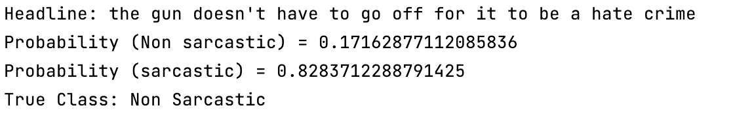
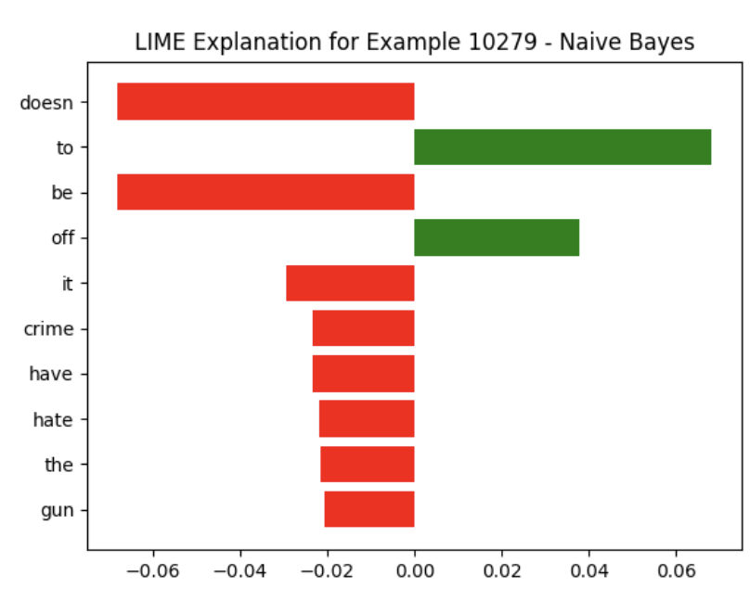
Model Explainability : LIME
Uses LIME to shed light on the predictions made by complex models.
Words 'doesn't', 'it', 'crime', 'have', 'hate', 'gun' negatively influence the prediction.
Words 'be' and 'off' positively affect the model's outcome.
Bar length indicates the magnitude of each word's impact on the classification.
LIME clarifies model reasoning, revealing keywords that lead to the Naive Bayes decision.

Slide 8
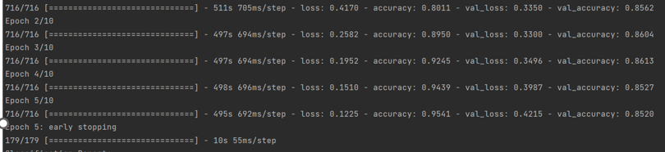
CLASSIFICATION LSTM
Training accuracy progressed from 80.11% to 95.41% across five epochs.
Validation accuracy peaked at 86.13%, reflecting high model performance.
The model demonstrated a consistent decrease in loss, showing effective learning.
Early stopping after the 5th epoch suggests the model's robustness in generalization without overfitting.

Slide 9
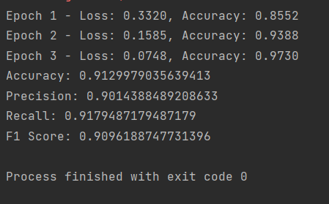
CLASSIFICATION BERT
Training showcased consistent improvement, with constant decrease in training loss.
The model achieved an impressive accuracy of 97.30% on training and 91.47% on validation data.

Slide 10
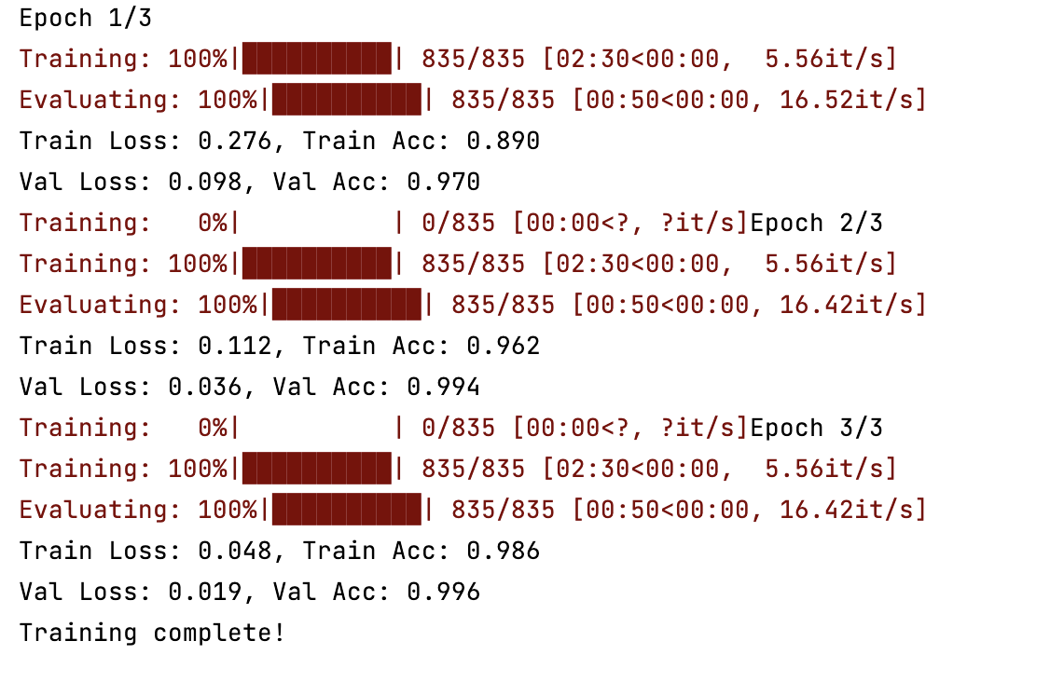
CLASSIFICATION Transformers - BERT + MLP
BERT+MLP reached 99.6% validation accuracy.
Consistent gains over three epochs.
Well-tuned model with reduced losses.

Slide 11
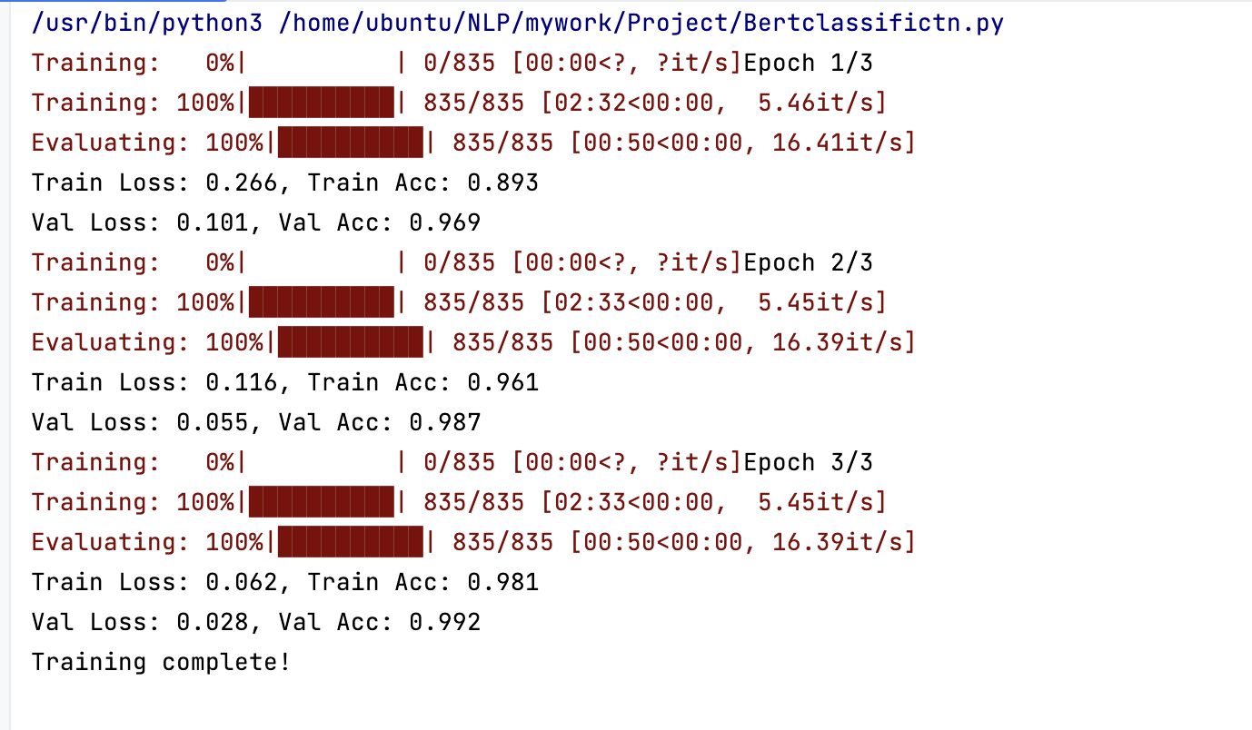
CLASSIFICATION Transformers - BERT + LSTM
Training accuracy improved from 89.3% to 98.1% over three epochs.
Validation accuracy increased from 96.9% to 99.2%.
Both training and validation losses significantly decreased, indicating effective learning.
High validation accuracy suggests strong model generalization without overfitting.

Slide 12
CLASSIFICATION
Model | Accuracy | Epochs | Max Length | Learning Rate | Batch Size | Optimizer
Naive Bayes | 0.86
Logistic Regression | 0.94
LSTM | 0.95 | 4 | 120 |  |  | Adam
CNN | 0.98 | 4 | 120 |  |  | Adam
BERT | 0.97 | 3 | 120 | 2e-5 | 32 | AdamW
BERT + LSTM | 0.98 | 3 | 128 | 2e-6 | 32 | AdamW
BERT + CNN | 0.82 | 5 | 128 | 2e-5 | 32 | AdamW
BERT+MLP | 0.98 | 3 | 128 | 5e-5 | 32 | AdamW
RoBERTa | 0.76 | 10 | 256 | 1e-5 | 32 | Adam

Slide 13
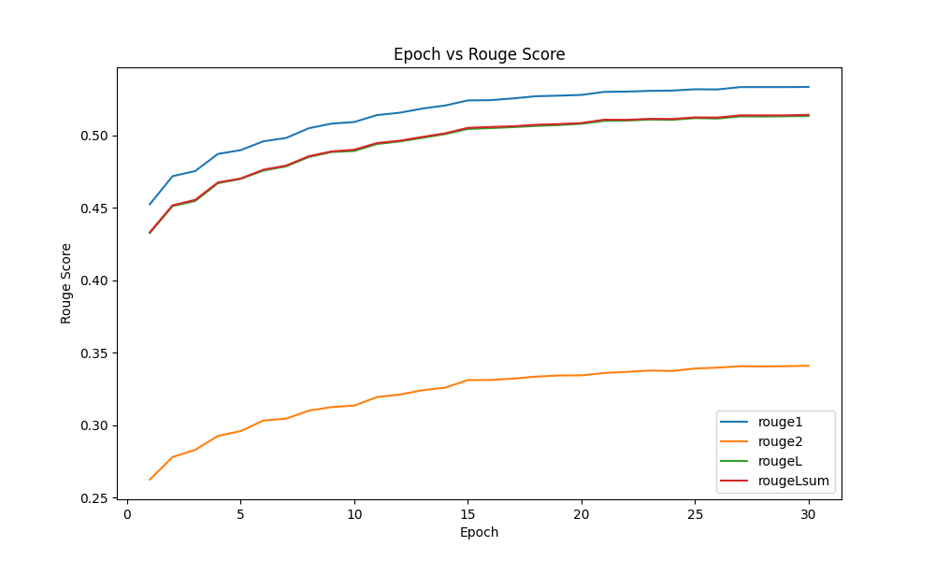
SUMMARIZATION
Model: t5-small-headline-generator (Text-to-Text Transfer Transformer)
Evaluation Metric:
ROUGE scores provide insights into the quality of the generated summaries concerning the ground truth.
Notes:
ROUGE-1 measures unigram overlap, ROUGE-2 evaluates bigram overlap, ROUGE-L assesses the longest common subsequence, and ROUGE-Lsum considers unigrams, bigrams, and longest common subsequence in automatic text summarization evaluation.

Slide 14
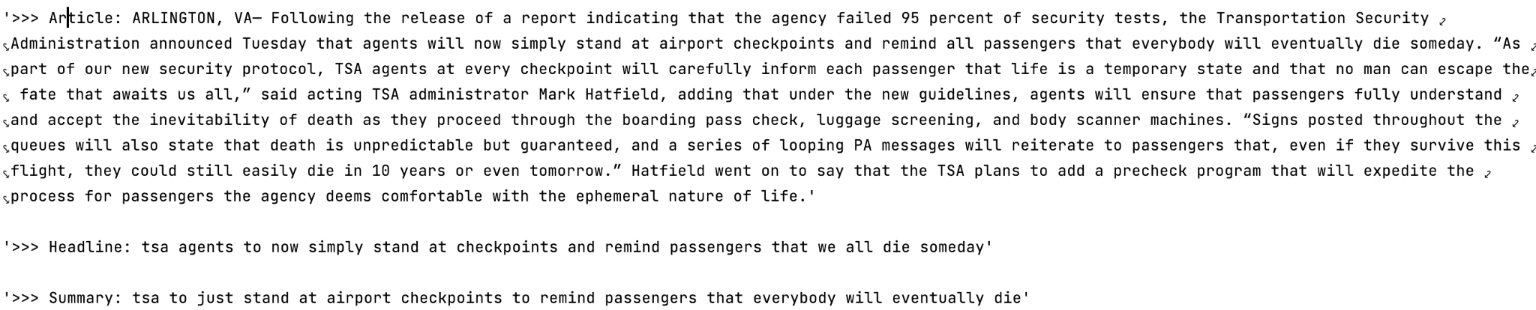
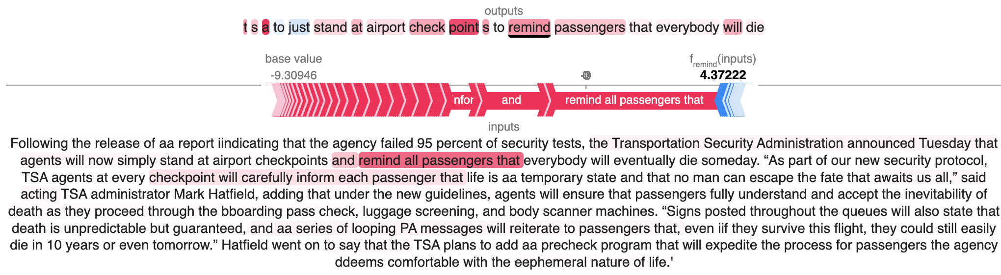
SUMMARIZATION-Prediction
Model Explainability using SHAP (SHapley Additive exPlanations)

Slide 15
CONCLUSION
The integration of BERT with other neural network architectures has proven highly effective for sarcasm detection, surpassing traditional models and even outperforming other advanced neural network-based classifiers.
The text summarization model achieved commendable ROUGE scores, reflecting its proficiency in generating concise and meaningful summaries.

Slide 16
Prof is really impressed by our project !!
Thank you!

