Slide 1
NOVA
Personal Offline Always-On AI Companion
Speech and personal memory
processed on your own device
Local voice models. Persistent SQLite memory.
Explicit tools and visible microphone controls.
Hackathon prototype evaluation / 10 October 2026
01
Notes:
Opening, 25 seconds: Introduce Nova as a local voice companion with persistent personal memory. Explain that the implementation combines established models rather than training a new one. The Windows prototype and automated policies have evidence. Pi5 is a deployment target with implemented preparation and GPIO code, but its physical operation remains unverified. Do not use always-on to imply uninterrupted full-duplex recording.
Repository evidence: scripts/always_on_assistant.py; config.py; docs/DEVELOPMENT_STATUS.md
Audit snapshot: 10 October 2026. Historical results and unverified hardware are identified explicitly.

Slide 2
NOVA
Problem statement
Everyday need
Design requirement
A voice interface that stays useful
without an Internet connection
Saved preferences, notes and tasks
that survive a restart
Personal context stays local
by default
Microphone permission is visible
and can be revoked
02
Notes:
35 seconds: Frame these as design motivations, not validated market statistics. Personal assistants should remain useful when the external network is unavailable. Repeatedly restating personal information is inconvenient. Continuous sensing needs understandable controls. Nova attempts to address these needs locally. The repository does not provide user research or quantified market validation.
Repository evidence: project description in pyproject.toml; core/privacy.py; memory/database.py
Audit snapshot: 10 October 2026. Historical results and unverified hardware are identified explicitly.

Slide 3
NOVA
Proposed solution and uniqueness
What Nova does
What makes it distinctive
Wake-prefixed voice commands
Local conversation and recall
Persistent notes, tasks and reminders
Optional passive observations
Confirmed facts outrank observations
Evidence grounds personal recall
Deterministic tools control mutations
Mute gates reject stale input
03
Notes:
40 seconds: Explain the complete local integration. Emphasize confirmed facts versus unidentified passive observations, deterministic tools, transactional memory changes and shared privacy gates. Optional passive extraction defaults off. This is integration innovation rather than a new foundation model. Online weather/news are a clearly separate opt-in branch.
Repository evidence: core/assistant.py; memory/passive_processor.py; memory/management.py; tools/lifecycle.py
Audit snapshot: 10 October 2026. Historical results and unverified hardware are identified explicitly.

Slide 4
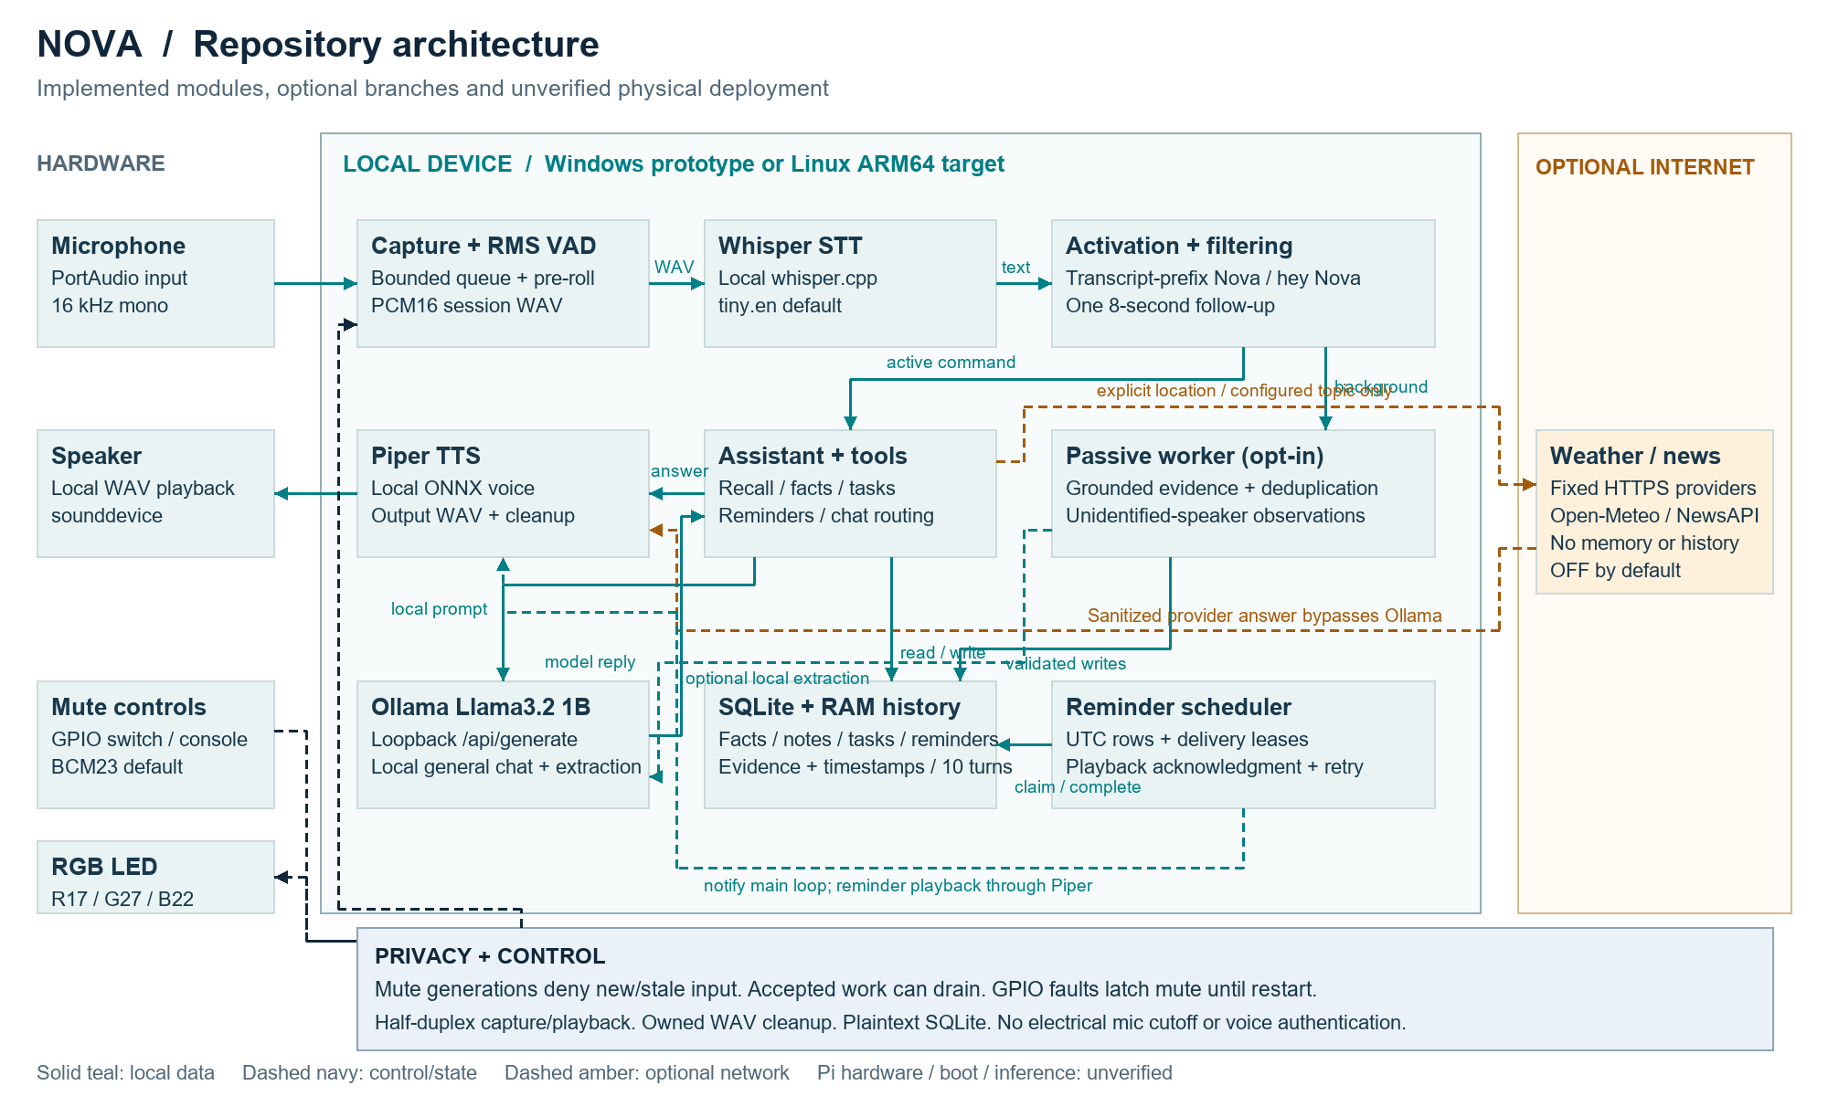
NOVA
System architecture
04
Notes:
60 seconds: Walk the top row from mic through RMS VAD to whisper.cpp and transcript activation. Follow active commands to Assistant, local memory or loopback Ollama, then Piper and speaker. Background speech enters only the optional passive worker. Explain reminders route through the main output loop. The amber boundary is explicit weather/news, not cloud inference. Navy dashed arrows are control. GPIO supplies software permission and reflects state. Plaintext storage and unverified Pi hardware are visible limitations.
Repository evidence: scripts/always_on_assistant.py:70; src/offline_ai_companion/audio/continuous_recorder.py:23; src/offline_ai_companion/audio/vad.py:5; src/offline_ai_companion/stt/whisper.py:15; src/offline_ai_companion/core/wake_detector.py:20; src/offline_ai_companion/core/assistant.py:31; src/offline_ai_companion/core/hardware.py:164; src/offline_ai_companion/core/pi_deployment.py:50; src/offline_ai_companion/core/systemd_units.py:1; src/offline_ai_companion/tools/online_tools.py:1; src/offline_ai_companion/memory/hybrid_retriever.py:1; src/offline_ai_companion/core/privacy_policy.py:1; src/offline_ai_companion/main.py:7
Audit snapshot: 10 October 2026. Historical results and unverified hardware are identified explicitly.

Slide 5
NOVA
Technology stack
Layer | Repository choice | Purpose
Audio | sounddevice / soundfile / NumPy | Capture, RMS VAD and playback
Speech | whisper.cpp tiny.en / Piper lessac | Local speech recognition and synthesis
Reasoning | Ollama / llama3.2:1b | Loopback, non-streaming generation
Memory | SQLite / concept ranking | Persistent records and grounded recall
Runtime | Python3.13 / Linux ARM64 / GPIO | Orchestration and Pi deployment target
05
Notes:
35 seconds: All stack choices come from adapters and configuration. Clarify that the declared application runtime is Python3.13, while bundled Python3.12 is used only for artifact authoring and qualified audit checks. tiny.en and lessac are platform defaults. GPIO uses local gpiozero/LGPIOFactory rather than remote pins. No embeddings are in this implementation.
Repository evidence: pyproject.toml; config.py; core/platform_config.py; core/hardware.py; deployment/raspberry-pi/nova.env.example
Audit snapshot: 10 October 2026. Historical results and unverified hardware are identified explicitly.

Slide 6
NOVA
Working flow
01 Capture a bounded utterance and run local STT
02 Match Nova at the transcript prefix
03 Resolve grounded recall, a tool or local chat
04 Generate local speech and play the answer
05 Clean owned audio and resume listening
Wake-only follow-up: 8 seconds. Normal operation is sequential and half-duplex.
06
Notes:
40 seconds: A typical utterance ends after one second of silence. STT precedes wake handling. Wake+command activates directly, and wake-only permits a single eight-second follow-up. Most tool/recall paths avoid general model generation. Capture resumes after output and0.3-second settling. Background speech does not receive an answer. The flow is half-duplex, so users should wait for listening before speaking again.
Repository evidence: audio/continuous_recorder.py; stt/whisper.py; core/activation_controller.py; scripts/always_on_assistant.py
Audit snapshot: 10 October 2026. Historical results and unverified hardware are identified explicitly.

Slide 7
NOVA
Implementation and memory integrity
Implemented safeguards
Verification boundary
Separate confirmed and passive memory
Evidence, timestamps and deduplication
Scoped corrections and deletions
Reminder leases and acknowledgments
Historical checkpoint: 1,278 tests passed
Voice/GPIO boundaries often use mocks
Pi hardware and sustained run pending
Fresh audit result in verification.md
07
Notes:
45 seconds: SQLite holds separate facts, notes, tasks, reminders and evidence-bearing passive records. Conversation history stays in RAM with ten-turn and4,000-character bounds. Hybrid recall uses a bounded concept lexicon, not embeddings. Management confirmations expire and recheck rows within a transaction. Do not say every creation requires confirmation: legacy name, explicit note/task and reminder creation are direct-write exceptions. Historical1,278-pass checkpoint is not the new audit result. Read verification.md before presenting updated checks.
Repository evidence: memory/database.py; memory/hybrid_retriever.py; core/conversation.py; memory/management.py; tools/lifecycle.py; docs/DEVELOPMENT_STATUS.md
Audit snapshot: 10 October 2026. Historical results and unverified hardware are identified explicitly.

Slide 8
NOVA
Hardware integration and Pi deployment
GPIO implementation
Deployment target
RGB: BCM17 / 27 / 22
Mute input: BCM23
20 ms polling, 100 ms release debounce
Faults latch mute until restart
Raspberry Pi5, Linux64-bit ARM
Python3.13 and local models
Guarded launch and non-root systemd
Physical validation remains pending
The switch controls software permission. It does not electrically disconnect the microphone.
08
Notes:
45 seconds: Explain intended wiring and fail-closed permission behavior, not a proven hardware demo. Default BCM17/27/22 drive RGB and BCM23 reads the switch. Listening green, processing/speaking blue and mute red. Restart starts muted and needs deliberate stable switch cycling. GPIO faults latch mute. Headless production requires LinuxARM64 with local lgpio. Provisioning/setup and systemd templates exist, but actual GPIO, ALSA, boot and model performance are unverified. The switch does not disconnect mic power.
Repository evidence: core/hardware.py; core/service_runtime.py; core/pi_deployment.py; deployment/raspberry-pi/README.md
Audit snapshot: 10 October 2026. Historical results and unverified hardware are identified explicitly.

Slide 9
NOVA
Live demonstration
Core jury sequence
Visible privacy control
Local question with network disconnected
Save a synthetic preference
Restart and recall the same fact
Create a task and deliver a reminder
Mute input and show the state
Verify muted speech creates no task
Optional passive path only with consent
Label text-mode and mock fallbacks
09
Notes:
Demonstration, about two minutes within the pitch if time permits: Use a synthetic isolated SQLite path and preloaded models. Say Nova explain a solar eclipse in one sentence. Save Alex via name command and pizza via proposed favorite+yes. Add a one-minute water reminder. Restart with same DB and recall name/favorite. Show a task and its displayedID. Mute withM and verify muted speech creates no task. Explain exact wording can vary. Use the actual always_on_assistant script, not the startup-only packagedCLI. If the interpreter/device fails, label the text-mode fallback honestly.
Repository evidence: scripts/always_on_assistant.py; scripts/assistant_test.py; demo-script.md; tools/memory_tools.py
Audit snapshot: 10 October 2026. Historical results and unverified hardware are identified explicitly.

Slide 10
NOVA
Challenges and current limitations
Technical constraints
Evaluation limits
Noise-sensitive energy VAD
STT runs before wake activation
Sequential capture and model latency
Small context and shared CPU budget
Physical Pi and multi-hour run pending
Plaintext memory and no speaker identity
No AEC or electrical microphone cutoff
Packaging and public docs incomplete
10
Notes:
45 seconds: Disclose limits concretely. RMSVAD is susceptible to venue noise and transcript-based activation incursSTT cost before wake. Sequential processing has capture gaps. Small model context can constrain memory prompts. SQLite is plaintext, speaker identity is absent and electrical cutoff is absent. NoAEC/full-duplex exists. Pi, provider and multi-hour physical evidence need validation. The audit found StorePython/venv inaccessible in this environment, empty root docs and a nonportable Windows freeze. These must be addressed before claiming easy deployment.
Repository evidence: audio/vad.py; core/wake_detector.py; core/hardware.py; core/assistant.py; docs/DEVELOPMENT_STATUS.md; requirements.txt
Audit snapshot: 10 October 2026. Historical results and unverified hardware are identified explicitly.

Slide 11
NOVA
Future scope
Next validation milestone
Next product capabilities
Real Pi installation and boot recovery
Headless audio and GPIO fault checks
Multi-hour thermal/resource measurements
Portable setup and voice entry point
Dedicated acoustic wake detection
Better noise handling and echo control
Authenticated actions and encrypted memory
Token-bounded context and archive tests
11
Notes:
35 seconds: These are recommendations, not completed features. Prioritize physical Pi validation and repeatable packaging before expanding scope. Measure thermal/resource/latency and long-running reliability. Then consider acoustic wake/VAD, authenticated voice commands, consent/retention controls, encrypted storage and true electrical mic disconnect. Full-duplex and broader integrations require their own implementation. No invented milestones, user metrics or promised model performance.
Repository evidence: repository-evaluation.md recommendations; docs/LONG_RUNNING_VALIDATION.md; deployment/raspberry-pi/README.md
Audit snapshot: 10 October 2026. Historical results and unverified hardware are identified explicitly.

Slide 12
NOVA
Conclusion
Local voice assistance with
persistent, evidence-aware memory
Implemented orchestration, tools and privacy controls
A clear path to physical Pi validation
Repository evidence defines the claims. Live hardware defines the next milestone.
12
Notes:
Closing,25 seconds: Nova demonstrates a coherent local voice architecture with persistent memory, deterministic tools and software privacy gates. The repository contains substantial automated test coverage and bounded recovery policies. State clearly that target hardware and sustained physical reliability are next validation gates. Invite questions and keep jury-cross-questions.md nearby. Avoid promising encrypted, authenticated or uninterrupted listening behavior.
Repository evidence: scripts/always_on_assistant.py; docs/DEVELOPMENT_STATUS.md; repository-evaluation.md
Audit snapshot: 10 October 2026. Historical results and unverified hardware are identified explicitly.

