Slide 1
MediTrack AI
Pharmacy Inventory and Demand Forecasting System
Node.js · MongoDB · Python
Tanmay Kumar · Reg. No. 12310424 · CSE, K4P23HK
CSE494 Intelligent NoSQL Databases · Guided by Dr. Ashu
Lovely Professional University
Notes:
Introduce yourself and the project: a MongoDB-based pharmacy system with batch-wise stock, FEFO dispensing, alerts, analytics and a Python demand forecast.

Slide 2
Why pharmacy stock is hard to manage
1
Batch-wise tracking
2
Safe dispensing
One medicine sits in several batches with different expiry dates. A single stock number hides the real position.
Sell only unexpired stock, and sell the batch that expires first (FEFO).
3
Alerts and insight
4
Demand estimation
Expired, expiring in 30 days, low stock, revenue trends and top sellers should be visible without searching.
Use sales history to estimate each medicine's demand for the next 7 and 30 days.
Notes:
Expired stock is a financial loss and a safety risk; a medicine that runs out sends the customer away. Notebooks and spreadsheets cannot show batch-level expiry, low stock and expected demand together.

Slide 3
Why MongoDB fits this data
A sale has a variable number of line items
Each line points to a medicine and a batch
A forecast holds predictions, each with a list of daily values
Fixed tables would need many joins for this nested, evolving data
// one sale = one document
{
saleNumber: "S-0001",
soldAt: ISODate("..."),
items: [
{ medicineId, batchId,
quantity: 2,
unitPrice: 25,
lineTotal: 50 },
{ ... }
],
totalAmount: 125,
status: "completed"
}
Simplified sketch of a sale document
Notes:
The code box is a simplified sketch of the Sale document, using the field names from the report's data model (items[], saleNumber, soldAt, totalAmount, status). One insert stores the whole sale.

Slide 4
Key features
Medicines and batches
FEFO sales
Stock adjustments
Add and edit medicines; receive batches with expiry dates and purchase cost.
Multi-item sales that take the earliest-expiring unexpired batch first.
Record received, damaged, expired write-off, correction and return.
Inventory alerts
Sales analytics
AI demand forecast
Expired, expiring within 30 days and low-stock medicines.
7, 30 and 90 day revenue, top products and category split.
7 or 30 day demand per medicine with a suggested reorder.
Notes:
The six working areas of the app, matching the API routes: medicines, batches, sales, stock adjustments, alerts, sales analytics and forecasts. Access is behind a pharmacist login.

Slide 5
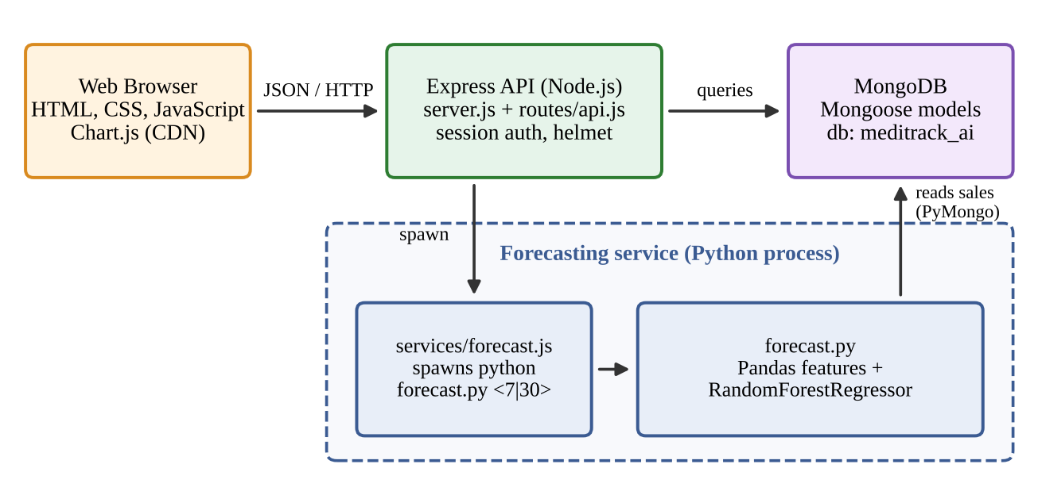
The browser never talks to MongoDB or Python
The API spawns forecast.py; it reads sales via PyMongo and the result is stored as a forecast run.
Notes:
Frontend: HTML, CSS, JavaScript, Chart.js. Backend: Node.js 18+, Express 4, Mongoose 8, express-session, bcryptjs, helmet. Forecasting: Python with Pandas, scikit-learn, PyMongo. Inventory and sales pages work without Python; only the forecast page needs it.

Slide 6
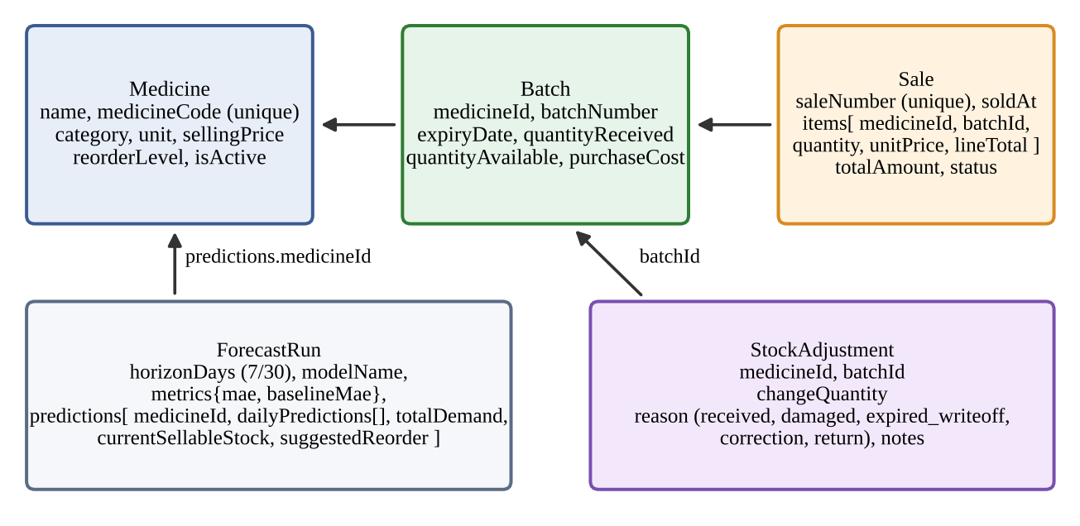
Five collections, linked by references
Database meditrack_ai: medicines, batches, sales, stockadjustments, forecastruns
Notes:
The main modelling question in MongoDB is embed versus reference. The next slide shows the choice for each relationship.

Slide 7
Embed what is read together, reference the rest
Relationship | Approach | Reason
Sale → line items | Embedded items[] | Read and written as one unit; variable number of lines
Item → name, price, batch no. | Copied into the item | Old sales stay correct if the catalogue or price changes
Batch → medicine | Reference (medicineId) | Batch quantities change independently as stock is sold
Sale item → batch | Reference (batchId) | Shows from which batch each unit was sold
Forecast run → predictions | Embedded arrays | A run is always displayed as one report
Stock adjustment → batch | Reference (batchId) | The adjustment log grows independently of the batch
Notes:
Table 1 of the report. Copying name and price into each sale item means history is never rewritten by later catalogue changes.

Slide 8
Indexes that match the queries
Collection | Index | Purpose
medicines | text (name, medicineCode); unique medicineCode | Search and duplicate-code prevention
batches | unique (medicineId, batchNumber); medicineId; expiryDate | No duplicate batches; expiry ordering for FEFO and alerts
sales | unique saleNumber; soldAt; (items.medicineId, soldAt) | Recent sales; sales history of one medicine
forecastruns | generatedAt | Latest forecast lookup
Unique indexes also protect data quality: a duplicate code, batch or sale number raises MongoDB error 11000, which the API returns as HTTP 409.
Notes:
Indexes are defined in the Mongoose schemas for the queries the app repeats.

Slide 9
FEFO sales with atomic stock updates
1
Find batches with stock, sorted by expiryDate
const result = await Batch.updateOne(
{ _id: line.batch._id,
quantityAvailable:
{ $gte: line.quantity } },
{ $inc: { quantityAvailable:
-line.quantity } });
if (result.modifiedCount !== 1) {
// restore earlier lines
// return 409
}
2
Skip expired batches; take from the earliest until the request is covered
3
Not enough unexpired stock: reject the sale
4
Decrement each batch only if enough is still available
5
If any update fails, restore earlier ones and return 409
The sale document is created only after every decrement succeeded.
Notes:
The filter and $inc run as one atomic step on the document, so two simultaneous sales cannot take the same units. Limitation: this is guarded updates plus a manual restore, not a multi-document transaction.

Slide 10
Reports are built inside MongoDB
Pipeline | Stages | Result
Dashboard revenue (30 days) | $match, $group | Revenue and number of transactions
Daily revenue chart (7 days) | $match, $group ($dateToString), $sort | One revenue value per day
Sales analytics (7/30/90 days) | $match, $addFields, $facet | Totals, trend, top products, categories
Top products | $unwind, $group, $sort, $limit | Eight best-selling medicines
Category revenue | $unwind, $lookup, $group, $sort | Revenue by medicine category
One $facet pass over the current and previous period replaces several queries and avoids loading sales into Node.js.
Notes:
Table 4 of the report. The analytics route computes units per sale with $sum over items.quantity, unwinds items, and uses $lookup on medicines to get the category.

Slide 11
Demand forecasting with Python
Read
Aggregate
Features
Train
Predict
Completed sales and active medicines via PyMongo
Daily quantity per medicine, including zero-sale days
Calendar and lag features
RandomForest, 120 trees per medicine; checked against a weekly-lag baseline (MAE)
Next 7 or 30 days, one day at a time
Suggested reorder = predicted demand − current unexpired stock
Only medicines with a positive reorder are kept
The run is stored in forecastruns as one document with embedded predictions
Notes:
The API starts forecast.py for a 7 or 30 day horizon. Because the demo data is synthetic, the forecast metrics only show that the pipeline works; they say nothing about real pharmacies.

Slide 12
Data used to train the model
204
1,440
180
31,008
medicine SKUs
sales
days of history
data rows
51 × 4 pack sizes
6,480 line items
8 sales per day
152 per medicine
Daily quantity per medicine, with zero-sale days included: 204 × 180 = 36,720 medicine-days
The first 28 days are lost to lag features, leaving 152 rows per medicine
Chronological split per medicine: 122 days to train, the last 30 days to test
Notes:
The data is synthetic, generated by npm run seed. 204 models are trained, one per medicine, each on its own 152 rows. The test set is the last 30 days, never shuffled, so the model is never tested on the past.

Slide 13
Model and input features
RandomForestRegressor
9 input features
scikit-learn, one model per medicine
Calendar
Trees (n_estimators) | 120
Max depth | 8
Min samples per leaf | 2
Random state | 42
Target | Units sold per day
Horizon | 7 or 30 days
day of week, day of year
Past sales (lags)
1, 2, 7, 14 and 28 days ago
Rolling averages
mean of the last 7 and 28 days
Notes:
Settings are copied from forecast.py. The nine features are dow, day_of_year, lag_1, lag_2, lag_7, lag_14, lag_28, mean_7 and mean_28. For the future, each predicted day is appended to the history so the next day can use it as a lag.

Slide 14
Why we used Random Forest
1
Small data per medicine: only 152 daily rows each, too few for deep learning
2
Picks up non-linear weekday and lag patterns without hand-written formulas
3
Needs no scaling and copes with series that are mostly zeros
4
Light enough to retrain all 204 models each time the forecast button is pressed
5
Always compared with a simple weekly-lag baseline, so the model must prove itself
Notes:
This is our design reasoning for choosing the model. The last point matters: the next slide shows the comparison with that baseline.

Slide 15
Results: forecast vs weekly-lag baseline
94 / 204
medicines where the model has a lower MAE than the baseline
RMSE is about 25% lower: fewer large misses
MAE is about 10% higher: slightly worse on a typical day
Demo sales come from a fixed formula, so there is little real pattern to learn. These numbers show the pipeline works, not how it would do on a real pharmacy.
Notes:
Averages across 204 medicines, each tested on its own last 30 days. Mean daily demand per medicine is only 0.43 units, so percentage accuracy is unstable and not meaningful; errors are reported in units per day. MAE: model 0.94 vs baseline 0.85. RMSE: model 1.19 vs baseline 1.58. Model has the lower MAE for 94 of 204 medicines. These figures come from running the project's own forecast.py functions (prepare_sales_data, create_features, train_model) on a reconstruction of the seed data; a live run on your database may differ slightly because the seed dates are relative to today.

Slide 16
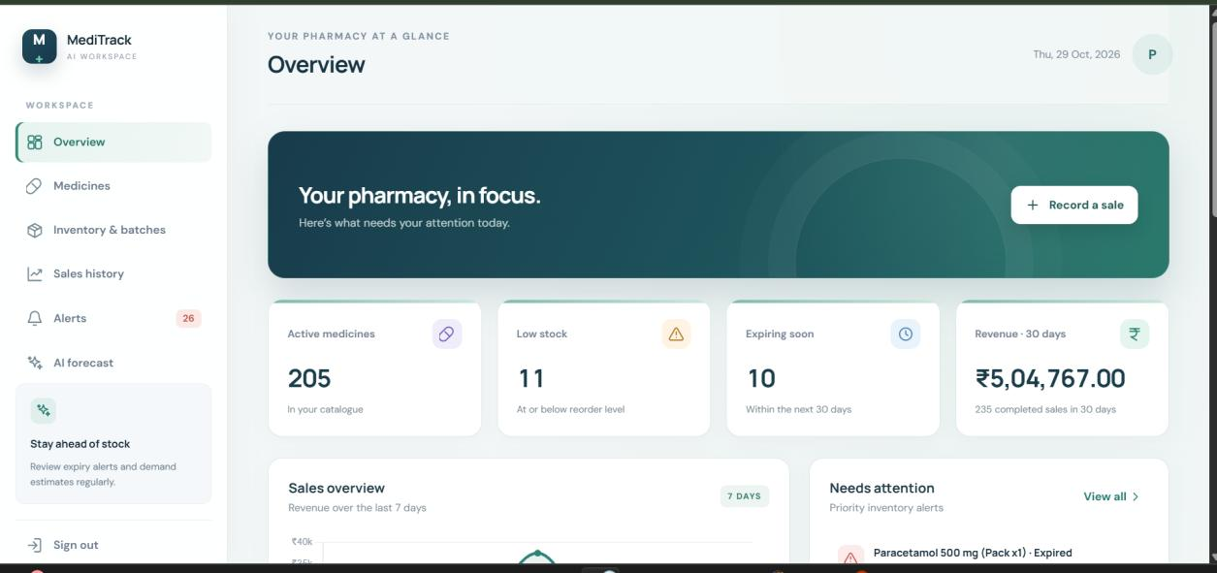
Overview page
At a glance
Active medicines, low stock, expiring soon and 30-day revenue, plus a 7-day sales chart and items needing attention.
Notes:
Good place to switch to the live app and record a sale to show FEFO.

Slide 17
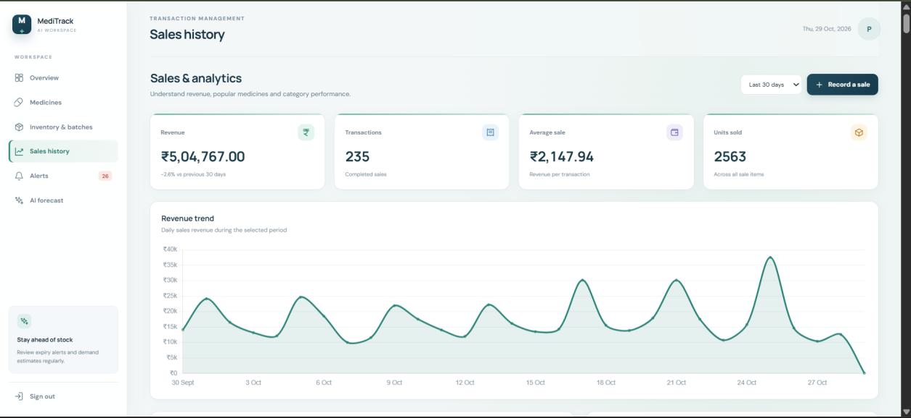
Sales and analytics
One pipeline
Revenue, transactions, average sale and units sold, with the daily revenue trend, all from the $facet aggregation.
Notes:
Compare against the previous period of the same length.

Slide 18
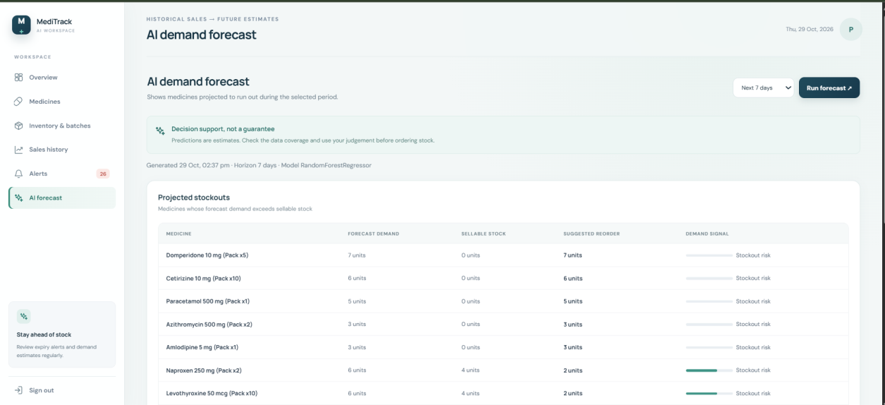
AI demand forecast
Decision support
Projected stockouts: forecast demand, sellable stock and suggested reorder for the chosen 7 or 30 day horizon. Shown as an estimate, not a guarantee.
Notes:
Metrics are from synthetic data, so they only show the pipeline works.

Slide 19
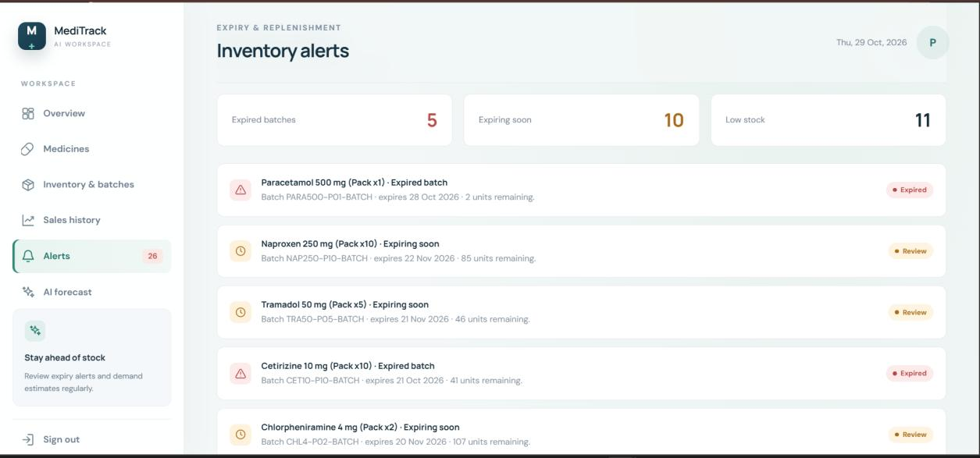
Inventory alerts
Derived, never stale
Expired batches, batches expiring within 30 days and low-stock medicines, calculated from current batches on every request.
Notes:
Alerts are not stored; they are computed from the batches at request time.

Slide 20
Limitations and next steps
Synthetic data
No multi-document transaction
Single login, in-memory sessions
Forecast metrics only show the pipeline works.
A sale uses guarded updates and a manual restore, so a rare failure could leave inconsistent stock.
One account from .env and the default session store.
Next: Test on real pharmacy data
Next: Use transactions on a replica set
Next: Per-user accounts and a persistent session store
It is a coursework demonstration, not a validated dispensing system.
Notes:
Limitations are from section 3.8 of the report; the next steps follow directly from each one.

Slide 21
Thank you
Questions?
Source code: github.com/tanmaykumar3506/MediTrack-AI
Notes:
Repository link is also on the report's last page.

