Slide 1
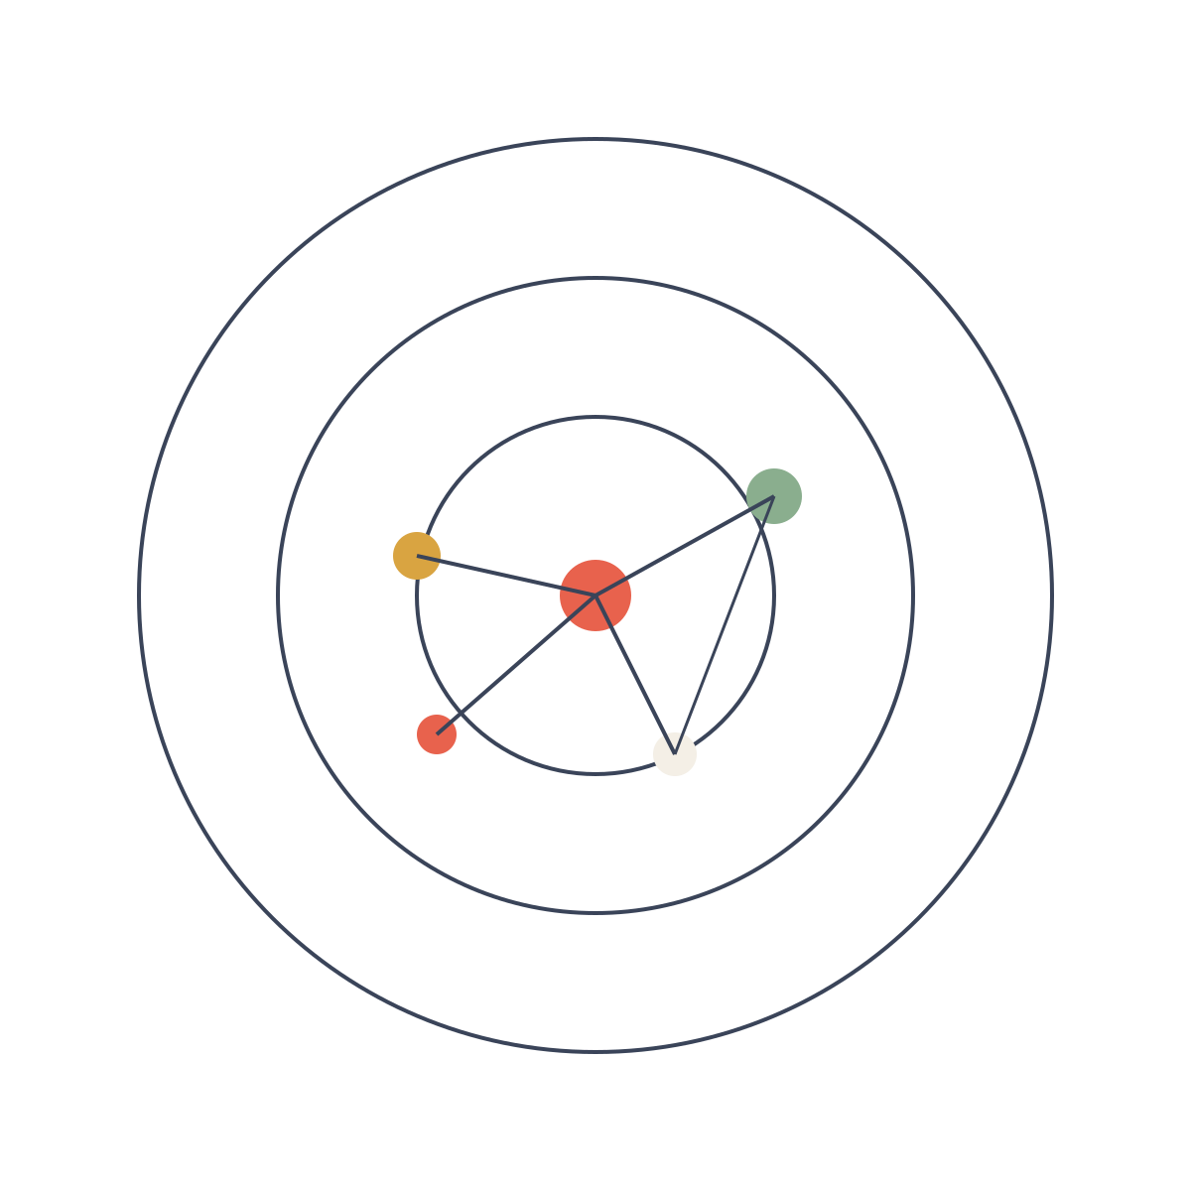
DESIGN & ANALYSIS OF ALGORITHMS
UNIT · SHORTEST PATHS
SHORTEST PATH
Dijkstra's
Algorithm
Finding the shortest path in a weighted graph — efficiently and correctly.
DAA LECTURE
GRAPH ALGORITHMS

Slide 2
01 · AGENDA
02 / 10
01
What is Dijkstra's Algorithm?
05
Worked Example
Core idea & intuition
Trace on a small graph
02
Problem Statement
06
Complexity Analysis
Single-source shortest path
Time & space bounds
03
How the Algorithm Works
07
Applications & Limitations
Greedy selection & relaxation
Where it shines & where it fails
04
Pseudocode
08
Key Takeaways
Clear step-by-step procedure
Summary for exams & interviews
DIJKSTRA'S ALGORITHM
AGENDA

Slide 3



02 · DEFINITION
03 / 10
In one sentence —
Dijkstra's algorithm finds the shortest path from a single source vertex to all other vertices in a weighted graph with non-negative edge weights.
Greedy Algorithm
Single-Source SSSP
Non-negative Weights
Always expands the closest unsettled vertex. Locally optimal choices lead to a globally optimal solution.
Computes distances from one starting node to every reachable node in the graph.
Requires edge weights ≥ 0. Negative edges break the greedy proof of correctness.
DIJKSTRA'S ALGORITHM
WHAT IT IS

Slide 4
03 · PROBLEM
04 / 10
Single-Source Shortest Path (SSSP)
INPUT
OUTPUT
• Weighted directed or undirected graph G = (V, E)
• Non-negative edge weights w(u, v) ≥ 0
• Source vertex s ∈ V
• Distance δ(s, v) for every vertex v
• Shortest-path tree (predecessor pointers)
• Path from s to any v can be reconstructed
Why non-negative weights matter
Once a vertex is settled (its distance is finalized), it is never revisited. A negative edge could later offer a shorter path, violating this invariant. Use Bellman-Ford when negative weights are possible.
DIJKSTRA'S ALGORITHM
PROBLEM STATEMENT

Slide 5
04 · MECHANICS
05 / 10
Core Idea: Greedy Expansion + Edge Relaxation
1
Initialize
dist[s] = 0; dist[v] = ∞ for all other v. Put all vertices in a priority queue keyed by distance.
2
Extract-Min
Repeatedly extract the unsettled vertex u with the smallest current distance.
3
Relax Neighbors
For every edge (u, v): if dist[u] + w(u,v) < dist[v], update dist[v] and decrease-key in the queue.
4
Settle
Once extracted, u is permanently settled — its shortest-path distance is final.
5
Terminate
When the priority queue is empty, all reachable vertices have their correct distances.
DIJKSTRA'S ALGORITHM
HOW IT WORKS

Slide 6
05 · PSEUDOCODE
06 / 10
Dijkstra(G, w, s)
1 for each vertex v ∈ V do
2 dist[v] ← ∞ ; pred[v] ← NIL
3 dist[s] ← 0
4 Q ← V // priority queue keyed by dist
5 while Q is not empty do
6 u ← Extract-Min(Q)
7 for each vertex v adjacent to u do
8 if dist[v] > dist[u] + w(u, v) then
9 dist[v] ← dist[u] + w(u, v)
10 pred[v] ← u
11 Decrease-Key(Q, v)
DIJKSTRA'S ALGORITHM
PSEUDOCODE

Slide 7
06 · EXAMPLE
07 / 10
Trace on a 5-vertex graph (source = A)
Step
Settled
A
B
C
D
E
Init
—
0
∞
∞
∞
∞
1
A
0
4
2
∞
∞
2
C
0
3
2
8
6
3
B
0
3
2
7
5
4
E
0
3
2
7
5
5
D
0
3
2
7
5
Final distances: A=0, B=3, C=2, D=7, E=5
DIJKSTRA'S ALGORITHM
WORKED EXAMPLE

Slide 8
07 · ANALYSIS
08 / 10
Time Complexity depends on the Priority Queue
Array / List
Binary Heap
Fibonacci Heap
O(V²)
O((V+E) log V)
O(E + V log V)
Simple array of distances. Good for dense graphs.
Standard binary heap. Practical default choice.
Amortized best theoretical bound. Rarely used in practice.
Space Complexity
O(V) for distance and predecessor arrays, plus the space required by the priority queue (typically O(V)). Overall space is linear in the number of vertices.
DIJKSTRA'S ALGORITHM
COMPLEXITY

Slide 9


08 · USE CASES
09 / 10
Applications
Limitations
▸ GPS & road-network routing
▸ Fails with negative edge weights
▸ Network routing protocols (OSPF)
▸ Not ideal for all-pairs (use Floyd-Warshall)
▸ Social-network distance metrics
▸ Dense graphs → O(V²) still costly
▸ Robot path planning
▸ Does not handle dynamic graphs well
▸ Flight / logistics optimization
▸ Priority-queue overhead can dominate
▸ IP packet forwarding tables
▸ Needs Bellman-Ford for negatives
DIJKSTRA'S ALGORITHM
APPLICATIONS & LIMITS

Slide 10
09 · SUMMARY
10 / 10
Remember these points
01
Greedy algorithm that always settles the closest unsettled vertex.
02
Works only with non-negative edge weights; use Bellman-Ford otherwise.
03
Time complexity: O((V+E) log V) with binary heap — the practical choice.
04
Produces both distances and a shortest-path tree via predecessor pointers.
05
Widely used in routing, navigation, and network protocols.
DIJKSTRA'S ALGORITHM
KEY TAKEAWAYS

