Slide 1
Take Infinity Ray Tracer
Uthara, Himanshu, Tanmay, Anil, Srikanth

Slide 2


Motivation
Visually stunning images
Ray tracing is elegant
Slower than other techniques
Room for optimization
Ray Tracer pipeline: working prototype replete with important features

Slide 3
Requirement Description
Functional
Ray tracing, multiple lights, geometry based shading, obj parsing, reflection, refraction, texturing, noise generation
Non-Functional
Cross Platform: Runs on OS X, Windows, Linux
SW Architecture based development:
Best Practices
0 warnings, lint checked, git based distributed workflow

Slide 4
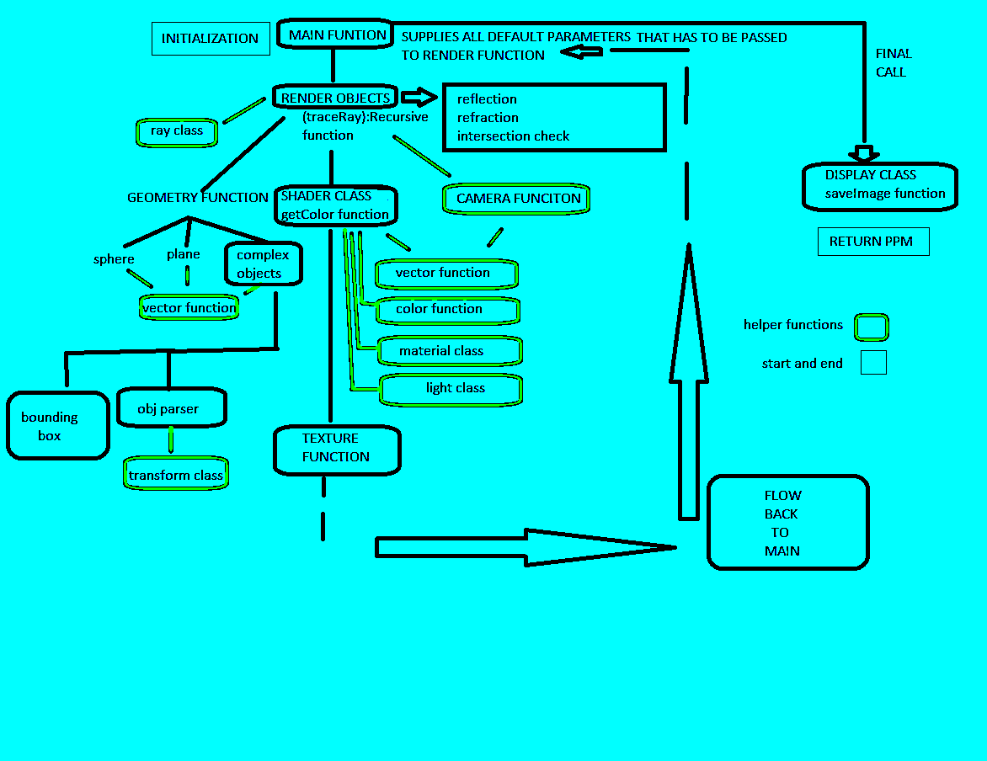

Slide 5













Ray Tracer Implementation
BSP
PPM/TGA
Prepare scene
Main Loop
Output
SW overrides
Init
Send Ray
Get Color
Put Display
Send Ray
Send Ray

Slide 6
Object Parser
Typically not demonstrated with RayTracer
We wanted a generic solution
Parser parses triangles
Oct Tree Optimization

Slide 7

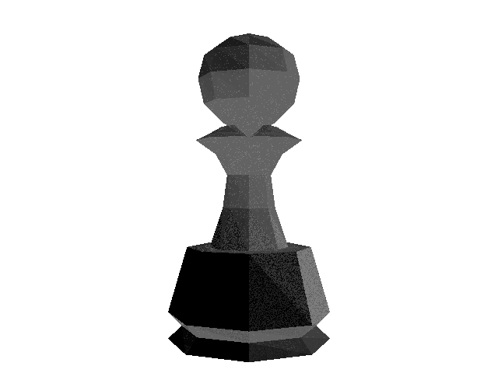

Time Taken before optimization
12 faces: 2 minutes
400 faces: 2 minutes
1000 faces: 55 minutes

Slide 8
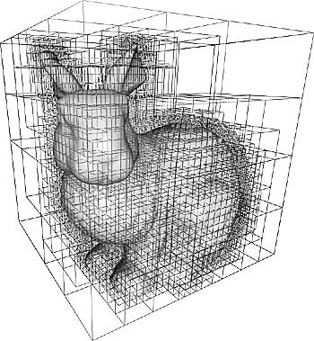

Oct Tree Optimization

Slide 9
Oct tree optimization render time graph

Slide 10
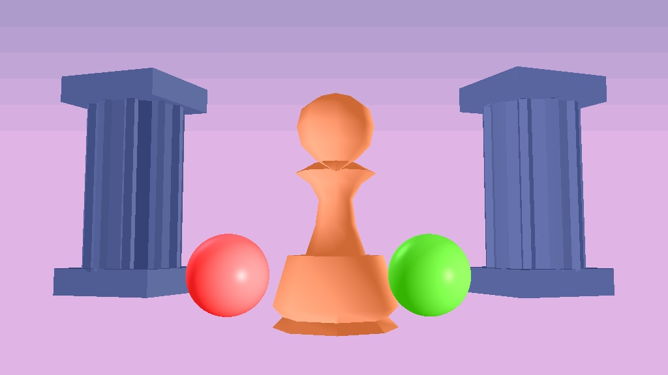
Basic Shader

Slide 11
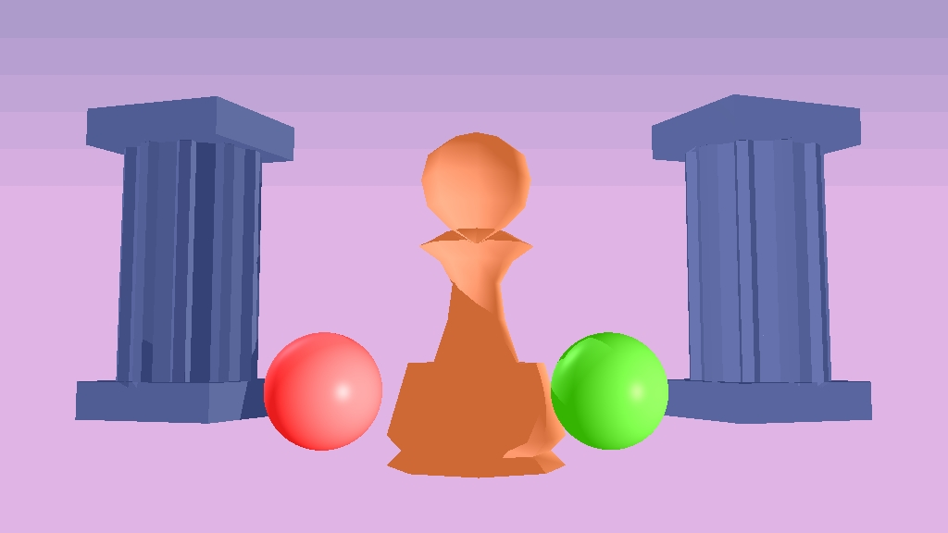
Shadows

Slide 12
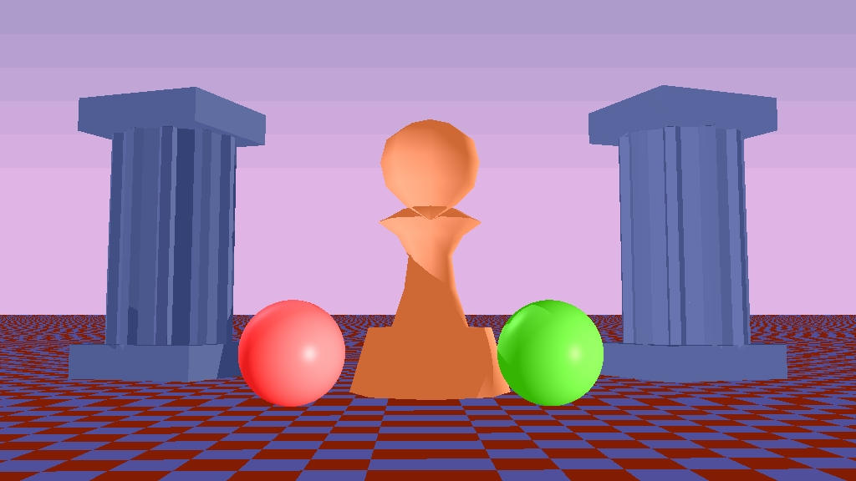
Plane - Checkerboard

Slide 13
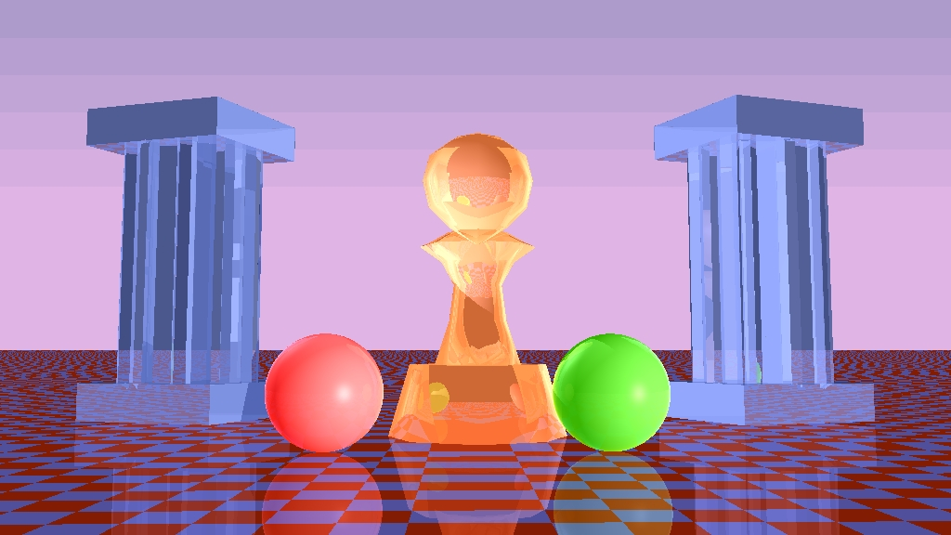
Reflections

Slide 14
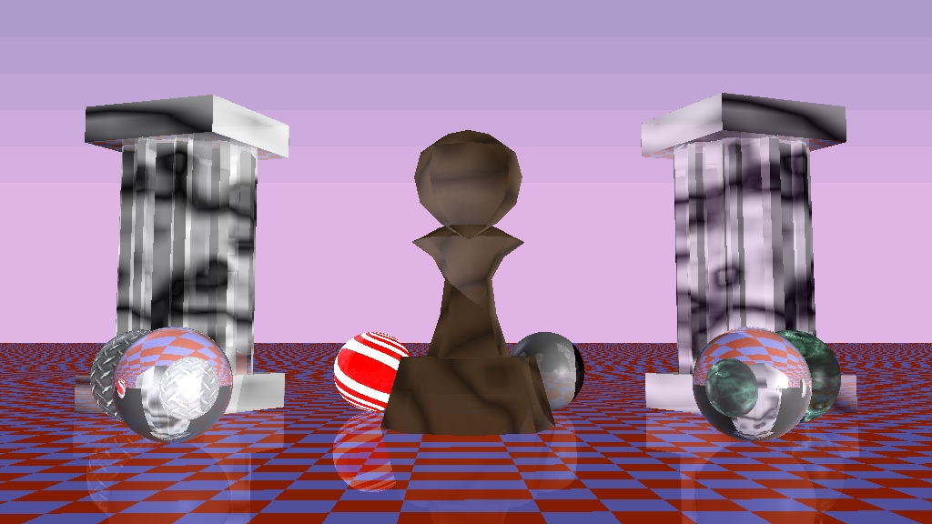
Procedural Textures

Slide 15
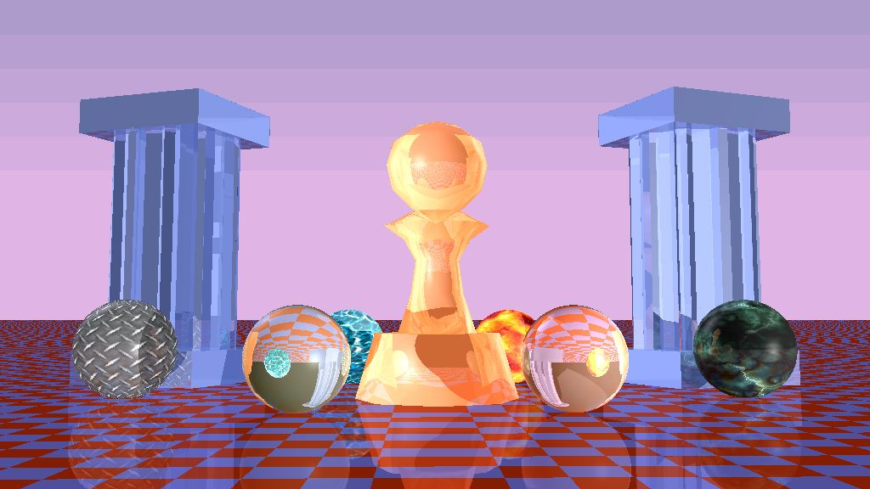
Final Scene with Refraction and Textures

Slide 16
Summary & Challenges
Ray Tracer implementation
Object Parser, Shadows, Reflection, Refraction & textures
Associated optimizations bring down render time from ~60 mins to ~5 mins
Challenges
Choosing the right problem is half the battle
Asynchronous distributed workflow
Multiplatform development
Rendering explicit objects

Slide 17
Future Work
Graphics related work
Refraction for explicit/complex objects
Distributed Raytracing
Caustics
Optimization related work
Integer arithmetic libraries
Multithreading and parallelizing the main loop
Thinking in terms of computational elements helps optimize

