Slide 1
Take Infinity Ray Tracer
Uthara, Himanshu, Tanmay, Anil, Srikanth

Slide 2


Motivation
Visually stunning images
Ray tracing is elegant
Slower than other techniques
Room for optimization
Ray Tracer pipeline: working prototype replete with important features

Slide 3
Requirements
Functional
Ray tracing, multiple lights, geometry based shading, obj parsing, reflection, refraction, texturing, noise generation
Non-Functional
Cross Platform: Runs on OS X, Windows, Linux
SW Architecture based development:
Best Practices
0 warnings, lint checked, git based distributed workflow

Slide 4
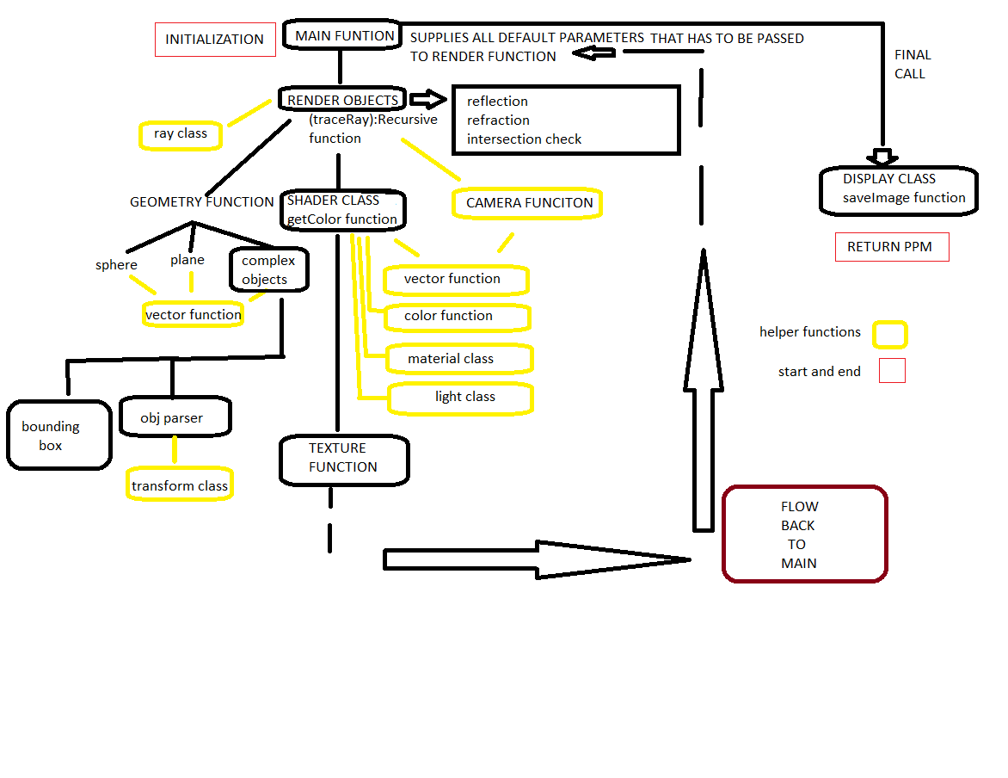

Slide 5













Ray Tracer
BSP
PPM/TGA
Prepare scene
Main Loop
Output
SW overrides
Init
Send Ray
Get Color
Put Display
Send Ray
Send Ray

Slide 6
Object Parser
Typically not demonstrated with RayTracer
We wanted a generic solution
Parser parses triangles
Oct Tree Optimization

Slide 7
Ray Tracer Loop

Slide 8
Reflection & Refraction

Slide 9
Texturing & Antialiasing

Slide 10


Slide 11
Conclusions
A Ray Tracer was implemented with optimizations
Cross platform, good development processes followed: distributed dev, source control, lint free.
Next Steps: Best work in CG ahead,
Explore multithreading, numerical libraries etc.
Thinking in terms of computational elements helps optimize.

