Slide 1
Innovative Monitoring System for TeleICU Patients Using Video Processing and Deep Learning

Slide 2
Unique Idea Brief (Solution)
The Patients in Critical condition need intense monitoring and care, but with ICU we can provide this type of care.
In remote locations, it is not possible to give such intensive care to the critical patients.
This problem is overcome with the help of TeleICU.
With the help of TeleICU control center, one can monitor the patients in Critical Care unit and can assist the person or doctor available at the physical location.
With our trained model, face detection or face recognition is faster and it also detects if the patient is stable or unstable in very less time.

Slide 3
Features Offered
Fast detection
Stable or unstable patient detection
Accuracy and precision
Detection of critical aspects

Slide 4
Process flow
The very first step is understanding of the problem statement and its requirements.
In the next step Data collection and its processing(Video selection form YouTube)
Selection of appropriate model/ libraries(OpenCV, Yolov8, TensorFlow, etc.)
Train, Validate and Test

Slide 5
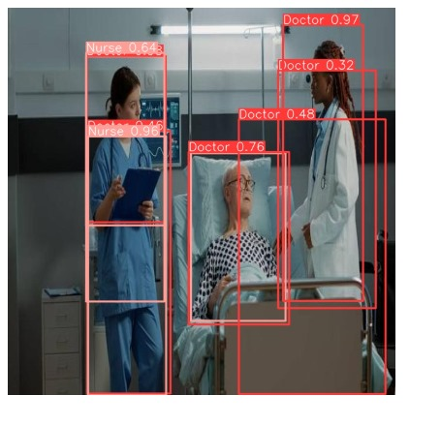
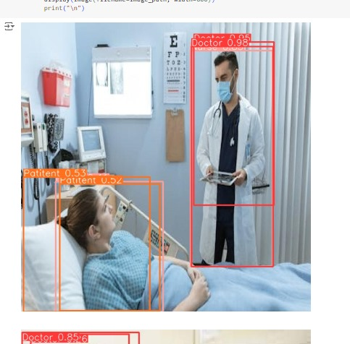
Process flow

Slide 6
Architecture Diagram
Input video
Processing the frames
Person type detection
Output
Stable or unstable Patient
Motion detection

Slide 7
Technologies used
Yolov8 model
Roboflow(Computer Vision tool)
Ultraedit

Slide 8
Team members and contribution:
Mithilesh Dudhankar- Coding
Tanmay Pranjale- Data Collection and Processing
Shrushti Dixit- Documentation and GitHub repository

Slide 9
Conclusion
Innovative monitoring system for TeleICU patients using video processing and deep learning optimizes patient monitoring and care delivery also leads to improved healthcare outcomes and operational efficiency.

