Slide 1
Java

Slide 2
MultiThreading
http://www.javatpoint.com/multithreading-in-java

Slide 3
Mutitasking
Process based (Multiprocessing)
  Heavyweight
  Costly communication between processes
  Own address space (memory)
  Slower Context switch
Thread based (Multithreading)
  Lighweight
  Communication cost less
  Shared address space
  Faster context switch
  Independent
  Own call stack
Note : At a time only one thread executes

Slide 4
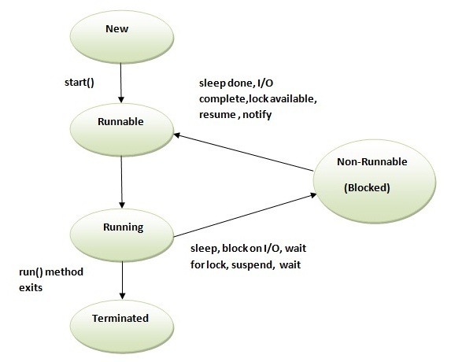
Thread Lifecycle

Slide 5
Setting a thread as daemon means making it background thread
Thread Scheduler part of JVM
  Uses preemptive (high priority always) and time slicing
Cannot start a thread again -> IllegalThreadStateExecution Exception
Invoking the run() method from main thread, the run() method goes onto the current call stack rather than at the beginning of a new call stack.
Thread.yield() method on a thread causes the currently executing thread object to temporarily pause and allow other threads to execute.
  A yielding thread tells the virtual machine that it’s willing to let other threads be scheduled in its place.
  It’s only a hint, though, and not guaranteed to have any effect at all
IsAlive() method on thread tests if the thread is alive.
If join() is called on a Thread instance, the currently running thread will block until the Thread instance has finished executing.

Slide 6
objectname.wait() v/s Thread.sleep()
Call on:
  wait(): Call on an object; current thread must synchronize on the lock object.
  sleep(): Call on a Thread; always currently executing thread.
Synchronized:
  wait(): when synchronized multiple threads access same Object one by one.
  sleep(): when synchronized multiple threads wait for sleep over of sleeping thread.
Hold lock:
  wait(): release the lock for other objects to have chance to execute.
  sleep(): keep lock for at least t times if timeout specified or somebody interrupt.
Wake-up condition:
  wait(): until call notify(), notifyAll() from object
  sleep(): until at least time expire or call interrupt().
Usage:
  sleep(): for time-synchronization and;
  wait(): for multi-thread-synchronization.

Slide 7
Daemon Thread (background thread) :
  Its sole role is to provide service to user threads
  All user threads die => JVM terminates daemon automatically
  Low priority thread
  If you want to make a user thread as Daemon, it must not be started otherwise it will throw IllegalThreadStateException.
  Difference between Daemon thread and user thread -> JVM does not wait for Daemon thread before exiting while it does not exit until unless all the user threads finish their execution.

Slide 8
Thread Pool :
  Group of fixed size threads are created
  A thread from the thread pool is pulled out and assigned a job by the service provider
  After completion of the job, thread is contained in the thread pool again.
  Adv : saves time of creating thread everytime
  Uses : By servlets and JSPs to process a request
Thread Group :
  To group multiple threads together to interrupt, suspend or resume them all together

Slide 9
The JVM shuts down when:
  user presses ctrl+c on the command prompt
  System.exit(int) method is invoked
  user logoff
  user shutdown etc.

Slide 10
Multitasking in Multithreading :
  Single task Multiple threads -> 1 run method, many threads
  Multiple tasks Multiple threads -> many run method, many threads
Factory Method -> The method that returns the instance of a class.
  eg., Runtime r = Runtime.getRuntime();

Slide 11
Garbage Collection :
  Memory efficient
  Automatically done by JVM's garbage collector
  Removes unreferenced objects which are formed by
    By nulling the reference
    By assigning a reference to another
    By annonymous object etc.
  Object class' finalize() method called before garbage collection of the object.
  System class' gc() method called to invoke garbage collector
  Garbage collects only objects created by new
  Daemon thread GC calls finalize
  Neither finalization nor garbage collection is guaranteed.

Slide 12
Runtime class :
  To interact with java runtime environment
  Singleton class : Only one instance per java application

Slide 13
Unique Points
String is immutable and final in java.
Operator overloading is not supported.
Multiple inheritance is not allowed.
No pointers
No pass by reference

