Slide 1
OOP Concepts

Slide 2
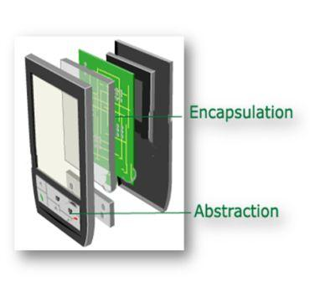

Slide 3
Abstraction
Abstraction is the concept of hiding irrelevant details.In other words make complex system simple by hiding the unnecessary detail from the user.
Abstraction is implemented in Java using interface and abstract class.
Information Hiding
Programming for interface than implementation
Giving just the abstract view ... no need to know how it works ...
Functional abstraction -> use a method without worrying about its implementation
Data abstraction -> data types, user defined data types

Slide 4
Encapsulation
Encapsulation is a process of binding or wrapping the data and the codes that operates on the data into a single entity. This keeps the data safe from outside interface and misuse.
Encapsulation is implemented using private, package-private and protected access modifier.
Data Hiding
Encapsulate whatever changes
Useful when we have to make some changes in our class yet not affect others.

Slide 5
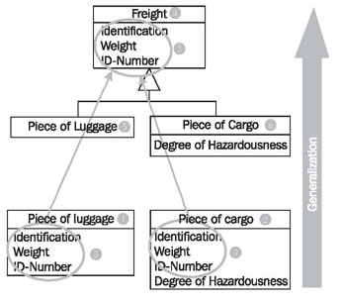
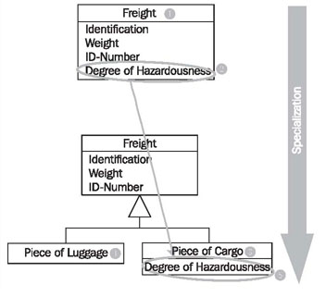
Generalisation and Specialisation
Generalization is the process of extracting shared characteristics from two or more classes, and combining them into a generalized superclass.
In contrast to generalization, specialization means creating new subclasses from an existing class. If it turns out that certain attributes, associations, or methods only apply to some of the objects of the class, a subclass can be created.

Slide 6
Forms of Generalisation
Hierarchy -> In the case of hierarchy, the commonalities are organized into a tree structured form.
Genericity -> In this case, the commonality is expressed with the aid of a parameter.
Polymorphism -> Polymorphism captures commonality in algorithms.
Patterns -> A pattern expresses a general solution (the key components and relationships) to a commonly occurring design problem.

Slide 7
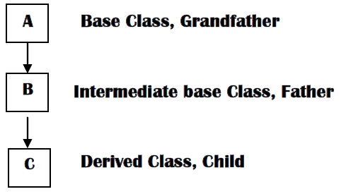
Inheritance
Inheritance is the implementation mechanism for the generalization/specialization relationship.

Slide 8
Inheritance
https://docs.oracle.com/javase/tutorial/java/IandI/subclasses.html
Subclass/derived/extended/child
Superclass/base/parent
Reusability
Multiple inheritance not allowed in java (Object class is by default parent of all classes)
A subclass inherits all the members (fields, methods, and nested classes) from its superclass.
Constructors are not members, so they are not inherited by subclasses, but the constructor of the superclass can be invoked from the subclass.
A subclass inherits all of the public and protected members of its parent, no matter what package the subclass is in. If the subclass is in the same package as its parent, it also inherits the package-private members of the parent.
Object obj = new MountainBike(); (Allowed as implicit cast)
MountainBike myBike = (MountainBike)obj; (Explicit cast...not allowed without cast)
if (obj instanceof MountainBike)
Dynamic binding means the JVM will decide at runtime which method implementation to invoke based on the class of the object. Polymorphism means you can use a variable of a superclass type to hold a reference to an object whose class is the superclass or any of its subclasses.
Inheritance is also sometimes said to provide "weak encapsulation," because if you have code that directly uses a subclass, such as Apple, that code can be broken by changes to a superclass, such as Fruit.

Slide 9
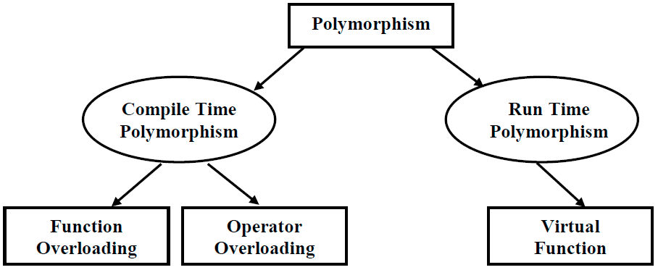
Polymorphism

Slide 10
Polymorphism
Polymorphism is the ability of an object to take on many forms.
Any Java object that can pass more than one IS-A test is considered to be polymorphic.
In Java, all Java objects are polymorphic since any object will pass the IS-A test for their own type and for the class Object.
Virtual method invocation ... virtual methods. All methods in Java are virtual.
Method overloading -> static polymorphism
Method overriding -> dynamic polymorphism.
Because, in case of overloading, at compile time the compiler knows which method to link to the call. However, it is determined at runtime for dynamic polymorphism.

Slide 11
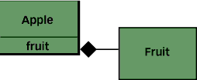
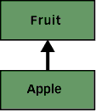
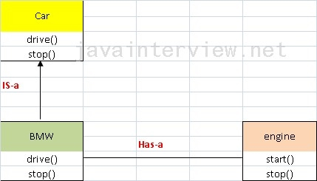
Composition v/s Inheritance
For code reuse
Composition (Has-a) : Inheritance (Is-a) :

Slide 12
Composition v/s Inheritance
http://www.artima.com/designtechniques/compoinh.html
Comp -> strong encapsulation ... because a change to a back-end class needn't break any code that relies only on the front-end class. For example, changing the return type of Fruit's peel() method from the previous example doesn't force a change in Apple's interface and therefore needn't break Example2's code.
Inh -> weak encapsulation
Is-a means "A is a type of B", A inherits B.
Has-a means "A has B" , and strongly associated.
Inh -> superclass, subclass
Comp -> Front end class, Back end class
With inheritance, a subclass automatically inherits an implementation of any non-private superclass method that it doesn't override. With composition, by contrast, the front-end class must explicitly invoke a corresponding method in the back-end class from its own implementation of the method. This explicit call is sometimes called "forwarding" or "delegating" the method invocation to the back-end object.

Slide 13
Composition v/s Inheritance
A change to the interface of a back-end class necessitates a change to the front-end class implementation, but not necessarily the front-end interface.
By contrast, a change to a superclass's interface can not only ripple down the inheritance hierarchy to subclasses, but can also ripple out to code that uses just the subclass's interface.
Composition -> dynamic binding (run time binding)
Inheritance -> static binding (compile time binding)
Don't use inheritance just to get code reuse (If there is no is-a relationship).
Don't use inheritance just to get at polymorphism (If there is no is-a relationship).
Composition -> easier to change interface of front end and back end class.
Inheritance -> easier to add new subclasses
Both -> easy to chanfe implementation (not interface) of any class

Slide 14
Aggregation vs Composition
A "owns" B = Composition : B has no meaning or purpose in the system without A
A "uses" B = Aggregation : B exists independently (conceptually) from A
In composition, when the owning object is destroyed, so are the contained objects. In aggregation, this is not necessarily true.

Slide 15
Association, Aggregation and Composition
Association (Using Relationship )
  No owner
  Have their own lifetime
  Child objects all are independent
Aggregation (Using with Parent)
  Single owner
  Have their own lifetime
  Child objects belong to a single parent
Composition (Death Relationship)
  Single owner
  Owner's life time
  Child objects belong to a single parent
http://www.codeproject.com/Articles/330447/Understanding-Association-Aggregation-and-Composit

Slide 16
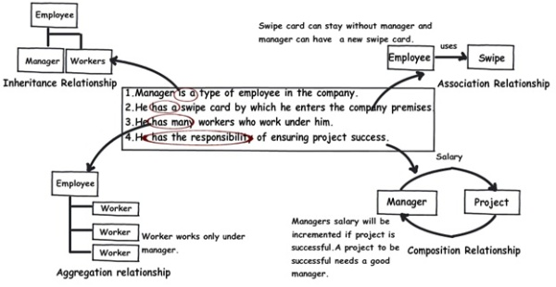
Association, Aggregation and Composition

Slide 17
Association, Aggregation, Composition and Inheritance
Association: uses a
  Ex:a Class Man uses a Class Pen
Aggregation: has a
  Ex:a Class Man has a Class Car ( Car is still there when Man die )
Composition: owns a
  Ex:a Class Man owns a Class Heart ( When Man die, Heart die)
Inheritance: is a
  Ex:a Class Man is a Class Human ( Man is a Human )

