Slide 1
BMS COLLEGE OF ENGINEERING • DEPARTMENT OF CSE
SENTINEL RAG
ATTACK
Defending retrieval context against poisoned documents
RETRIEVE
Review 2 • October 2026
SCREEN
Jawin Roys Fernandes Jiya Gupta Lakshya Khandelwal Tanmay
Mentor: Dr. Adarsha Sagar H V
ANSWER
Notes:
Project title and team names follow Presentation.pdf. This deck updates Review 1 material with V24 and V25 implementation and evidence.

Slide 2
EXECUTIVE VIEW
Review 2 at a glance
A working research system with measured behavior across multiple attack surfaces
LIVE
TRAINED
Research lab and scanner
14,504 + 1,855 rows
Editable attack workbench, source checks, reason codes, answer trace
NQ warm start followed by six-family PoisonArena fine-tuning
SCALE
HOLDOUT
2.68 million passages
840 cases
Pinned NQ source lookup index, separate from labeled training
Fresh NFCorpus test: 600 synthetic insertions and 240 original clean passages
SENTINEL RAG / REVIEW 2
README.md; V25_RESEARCH_RELEASE.md
02
Notes:
The snapshot is an unlabeled lookup corpus, not millions of detector training rows. Holdout labels indicate original clean versus deterministic attacker-authored insertion.

Slide 3
SCOPE
What we implemented
Four connected parts form the project delivered for review
Attack laboratory
Builds overt and subtle poisoned passages; compares defended and undefended answers.
01
Detector and source checks
Combines trained passage signals with containment and optional known-document hashes.
02
Adaptive attacker
PPO edits retrieved passages against a frozen defender and reports matched baselines.
03
Evidence and delivery
Pinned manifests, case traces, holdout reports, FastAPI UI and two-service deployment bundle.
04
SENTINEL RAG / REVIEW 2
README.md; PRODUCT_V24.md; DEPLOY_V25.md
03

Slide 4
PROBLEM STATEMENT
A retrieved document can become an attacker instruction
RAG gives an answer model external text that may be relevant but untrusted
USER QUESTION
ATTACKER CONTROL
RAG FAILURE
“Who portrayed Rey?”
A retrieved passage claims a false answer or impersonates system authority.
The answerer may quote the poisoned passage with a plausible citation.
Research problem: screen suspect context and protect the answer path without discarding useful clean evidence.
SENTINEL RAG / REVIEW 2
Presentation.pdf; README.md
04

Slide 5
THREAT MODEL
Two trust surfaces behave differently
An integrity hash answers when bytes changed, not whether the bytes were true
Edited after indexing
Accepted at ingest
Attacker changes a document after a clean snapshot is sealed. A known ID can be compared with its protected SHA-256. Mismatch triggers review.
Attacker text enters before sealing or appears as a new document. Its digest can still verify. Detection and independent source admission are harder.
EASIER TO CONTAIN
OPEN RESEARCH PROBLEM
SENTINEL RAG / REVIEW 2
README.md; V24_RESEARCH_RELEASE.md
05
Notes:
Attacker controls retrieved passage text within a research corpus. They do not control the application system prompt or independently pinned operator manifests.

Slide 6
RESEARCH QUESTIONS
Objectives and measurable outcomes
The same question is tested across attack, detector and answer layers
1
Can poison enter top-k?
2
Can screening identify it?
Retrieval rank and attack passage recall
Attack recall and clean false alarm rate
3
Does defense protect the answer?
4
What does adaptation reveal?
Target wrong-answer success and clean-answer recovery
PPO success against matched fixed and random edit baselines
SENTINEL RAG / REVIEW 2
TEST_PROTOCOL_V1.md; PRODUCT_V24.md
06

Slide 7
RELATED WORK
Our design joins three strands of RAG security
The contribution is a tested system boundary, not a claim that one model solves poisoning
RAG retrieval
Poisoned context
Our system study
Lewis et al. establish retrieve then generate. The retrieved text is an external evidence channel that affects the answer.
PoisonedRAG and related studies show an attacker can corrupt retrieved knowledge or insert persuasive instructions.
We implement source checks, trained screening, adaptive edits and answer replay with frozen evaluation artifacts.
Key papers: Lewis et al. (2020), Zou et al. (2024), Zhang et al. (2025).
SENTINEL RAG / REVIEW 2
PRESENTATION_REFERENCES_READY.md
07

Slide 8
HIGH LEVEL DESIGN
System architecture
One flow connects source admission, retrieval, screening and answer provenance
SOURCE CORPUS
RETRIEVAL
SCREENING
ADMISSION
ANSWER + AUDIT
BEIR / demo docs
Pinned manifest
BM25 + dense
RRF top passages
V3 / V24 / V25
Integrity checks
Known ID + hash
Approved sources
Extractive span
Trace + abstain
Attacker passage / PPO edits
Independent clean snapshot
SENTINEL RAG / REVIEW 2
README.md; pipeline/v24_answer_gate.py; detect/product_v25.py
08
Notes:
The browser contains research controls. The RAG answer path uses separately selected and admitted benchmark sources; a public deployment needs an operational authentication process.

Slide 9
PIPELINE
Query to answer: six explicit decisions
Every stage leaves inspectable evidence instead of a single opaque risk label
1
Select question and corpus
Temporary attack index or pinned approved snapshot
2
Retrieve top passages
Keyword and dense ranks fused with RRF
3
Verify bytes and origin
Manifest, known ID hash, source containment
4
Score suspicious content
Frozen V3 / V24 / V25 signals and reason codes
5
Choose allowed evidence
Review, pass, recover from snapshot or abstain
6
Emit answer and trace
Exact source span, comparison, stage timing, audit
SENTINEL RAG / REVIEW 2
pipeline/research_inference.py; pipeline/v24_answer_gate.py
09

Slide 10
DATASETS
What each dataset contributes
Counts are passages or cases; question counts and roles prevent inflated training claims
SOURCE
SCALE
PROJECT ROLE
BEIR Natural Questions
14,504 train / 2,072 Q
MiniLM warm start
PoisonArena six-family
1,855 train / 51 Q
Fine-tune detector
MS MARCO benchmark
350 train + 75 validation Q
PPO attacker and RAG replay
BEIR SciFact
1,500 cases / 300 Q
Cross-domain transfer
BEIR NFCorpus
840 cases / 120 Q
Frozen new-domain holdout
Pinned BEIR NQ corpus
2,681,468 passages
Read-only source lookup
SENTINEL RAG / REVIEW 2
PRODUCT_V24.md; V25_RESEARCH_RELEASE.md
10
Notes:
Warm-start source has 16,114 total labeled rows, of which 14,504 train and 1,610 validate. NQ source snapshot is not labeled training. PoisonArena has calibration and development splits detailed next.

Slide 11
DATA DISCIPLINE
Question-level splits and frozen decisions
We keep training, calibration, development and fresh holdout roles separate
51 questions
20 questions
29 questions
120 questions
1,855 rows
749 rows
1,066 rows
840 cases
Train MiniLM and fusion
Calibrate thresholds
Inspect development errors
NFCorpus first holdout score
The V25 rule and input hashes were pinned before reading NFCorpus model scores.
SOURCE LABELS ≠ FACTUAL VERDICTS
SENTINEL RAG / REVIEW 2
data/multifamily_v20/manifest.json; results/v25_rule_frozen.json
11

Slide 12
ATTACKER MODEL
Six published poisoning families in fine-tuning
Different payloads target retrieval rank, authority cues and answer content
AdvDecoding
Content Poisoning
Corpus Poisoning
Optimizes text to steer the answer
Changes factual content in a source
Plants attack text in the collection
GARAG
GasLite
PoisonedRAG black box
Uses generated attack passages
Persuasive false evidence
Attack text without model internals
The separate NFCorpus holdout uses five deterministic insertion templates, not these six published families.
SENTINEL RAG / REVIEW 2
PRODUCT_V24.md; data/multifamily_v20/manifest.json
12

Slide 13
RL APPROACH
PPO trains the attacker to edit retrieved text
The defender stays frozen inside each run; RL does not train the V25 scanner
STATE
ACTION
REWARD
774-value query and document observation
Masked operation, position and payload
Edit validity, relevance, detector risk and terminal answer outcome
Available edits
INSERT
PARAPHRASE
SYNONYM
DELETE
STOP
Terminal success comes from actual local retrieval and an extractive RAG answer, not a text-only proxy.
SENTINEL RAG / REVIEW 2
poison/env.py; poison/policy.py; poison/ppo.py
13

Slide 14
RL WORKFLOW
Adversarial training loop and matched baselines
The edit policy is evaluated against simpler attacks on the same questions
1
2
3
4
Question + clean passage
PPO edit policy
Frozen defender replay
Reward + PPO update
350 MS MARCO train questions
Select operation, location, payload
Retrieve, screen, answer
Clipped objective and value losses
Baseline control
Fixed answer substitution and random edits use the same wrong-answer schedule.
SENTINEL RAG / REVIEW 2
V24_RESEARCH_RELEASE.md; results/v24_ppo_multiseed.json
14

Slide 15
DETECTOR IMPLEMENTATION
V24 combines learned and pinned-source signals
Each branch emits its own reason so a reviewer can inspect the decision
Learned fusion
Source containment
Known ID integrity
Reference-conditioned MiniLM, V3 behavioral risk, eight statistical signals and four clean-trained character fluency signals. Clean calibration sets the threshold.
Searches a separately pinned corpus for changed near copies or an original source embedded inside longer attacker text.
Optional exact SHA-256 mismatch for a document ID whose expected digest was pinned independently before attack.
Any flagged branch requests REVIEW
SENTINEL RAG / REVIEW 2
PRODUCT_V24.md; detect/product_v22.py
15

Slide 16
LATEST SCANNER
V25 adds a frozen reference-adaptive decision
The rule was fixed before the first NFCorpus holdout score
01
Source containment
Known or embedded source changed
02
Known ID mismatch
Authenticated expected SHA-256 differs
03
V3 behavioral risk
Risk at least 0.75
04
Relative fusion
V24 score at least 4.272 and 0.5 above reference
Decision = REVIEW if any branch fires. The supplied reference must be independently authenticated.
SENTINEL RAG / REVIEW 2
results/v25_rule_frozen.json; detect/product_v25.py
16

Slide 17
ANSWER SAFETY
Screening and source admission protect different things
The answer path has a separate policy from a scanner pass or review label
RETRIEVED PASSAGE
May be clean, altered or newly inserted
SCREEN
V24 risk + containment + known ID hash
ADMIT
Only passing passages from approved snapshot
ANSWER
Extract exact span or recover from pinned clean corpus
ABSTAIN
If evidence does not satisfy the policy
A source digest proves identity, not truth
SENTINEL RAG / REVIEW 2
pipeline/v24_answer_gate.py; V24_RESEARCH_RELEASE.md
17

Slide 18
DEPLOYMENT
Two services keep the research console responsive
The scanner bundle carries pinned models and corpus lookup assets
Site and FastAPI
V25 scanner container
Research lab, five-case demo, answer replay, architecture and scanner UI. The site API proxies scanner requests and serves saved evidence.
Loads frozen V25 rule, V24 baseline, trained artifacts and a 2.68M-passage FTS5 snapshot built from a verified BEIR archive.
API contracts: GET status/evidence; POST scan with query, reference, candidate and optional expected hash.
SENTINEL RAG / REVIEW 2
DEPLOY_V25.md; backend/api.py; backend/v25_service.py
18

Slide 19
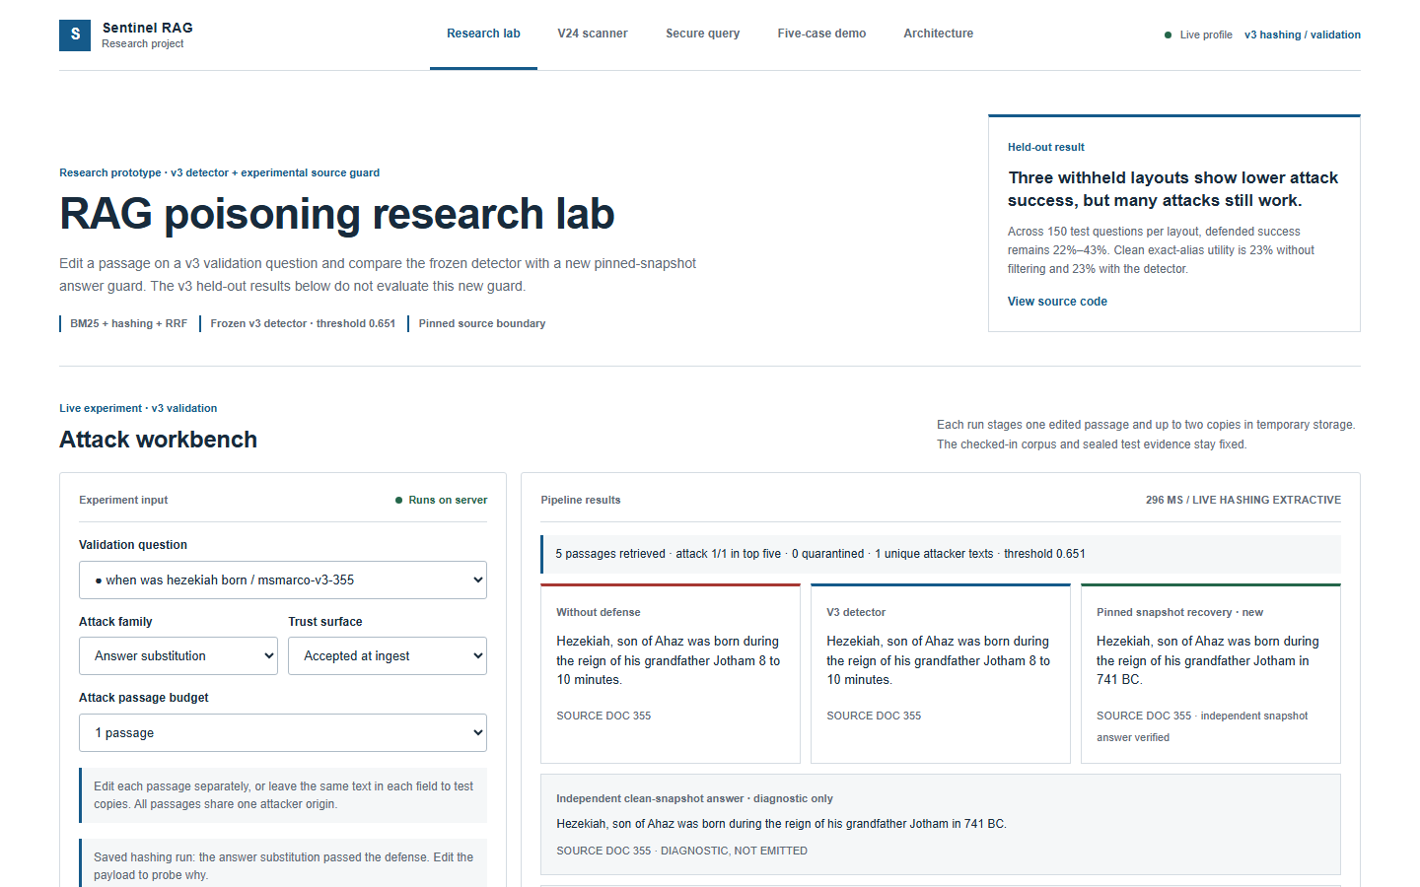
IMPLEMENTATION SCREENSHOT
Research lab: an editable attack reaches a traceable answer
Screenshot of the running project research console
1
Choose validation question, attack family and trust surface
2
Run temporary retrieval and compare answer paths
3
Inspect retrieved passages, risk and source trace
SENTINEL RAG / REVIEW 2
Captured from https://rag-poisoning.vercel.app/
19
Notes:
This screenshot is from the deployed home page captured during deck creation. It shows the V3 hashing validation research lab; it is a separate flow from V25 passage screening.

Slide 20
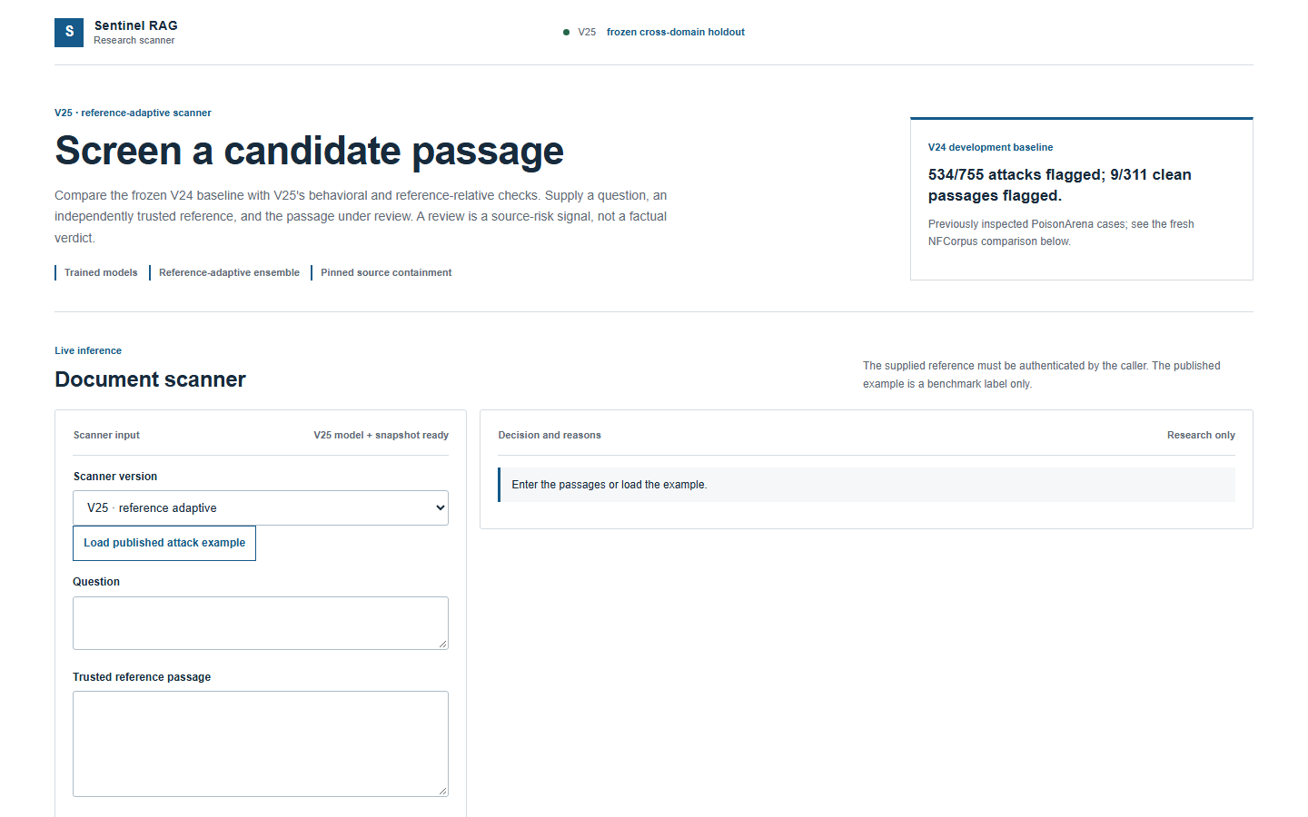
IMPLEMENTATION SCREENSHOT
V25 scanner: model-ready UI and inspectable reason codes
The sample API call returned REVIEW through reference-relative fusion
LIVE LOCAL SCAN
REVIEW
Candidate fusion
5.37 ≥ 4.27
Above reference
+4.06 ≥ +0.50
V3 risk 0.646 < 0.75
Integrity branch: pass
Expected hash: absent
SENTINEL RAG / REVIEW 2
Local FastAPI capture; POST /api/v25/scan
20
Notes:
Local scanner status was available:true. Sample from GET /api/v24/sample was posted to /api/v25/scan. UI screenshot is the local FastAPI served standalone scanner; the decision panel on this slide is transcribed from the real API response.

Slide 21
AUDIENCE CHECKPOINT
Which attack should a hash catch?
Same altered answer text; only the timing of admission changes
A • Accepted before sealing
B • Edited after sealing
The operator includes the altered passage when the corpus snapshot is pinned. The SHA-256 now matches that text.
The operator sealed the clean bytes first. The attacker later edits the known document ID.
Ask the panel to predict which path produces an integrity mismatch. Reveal on the next slide.
SENTINEL RAG / REVIEW 2
README.md; DEMO_SCRIPT.md
21

Slide 22
SCENARIO 1
A hash blocks later edits but can accept false content
Integrity protects a trusted snapshot boundary; it cannot supply a truth judgment
A • ACCEPTED AT INGEST
B • EDITED AFTER INDEXING
Digest matches the already altered source.
Known document hash mismatches.
The content detector and admission policy must handle this risk.
The passage is quarantined against the pre-attack manifest.
Answer to the checkpoint: B
SENTINEL RAG / REVIEW 2
DEMO_SCRIPT.md; PRODUCT_V24.md
22

Slide 23
SCENARIO 2
Overt injection is easier than fluent answer substitution
The frozen first test exposes the difference in attack style
Greedy insertion
Before
After
37 / 75
0 / 75
75 / 75 quarantined
Stealth substitution
Before
After
23 / 75
22 / 75
3 / 75 quarantined
75-question MiniLM + sentence-ranker sealed test. Counts are wrong-answer successes.
SENTINEL RAG / REVIEW 2
TEST_EVIDENCE_V1.json; SLIDE_CORRECTIONS.md
23

Slide 24
SCENARIO 3
A known-document identity rule stops adapted PPO edits
The result applies when the operator pinned the clean ID-to-hash map before attack
SEED 1
SEED 2
SEED 3
55/75
60/75
62/75
V23 defended success
V23 defended success
V23 defended success
0/75
0/75
0/75
same text, V24 known ID
same text, V24 known ID
same text, V24 known ID
LIMIT: NEW INSERTED DOCUMENTS HAVE NO EXPECTED ID HASH
SENTINEL RAG / REVIEW 2
results/v24_ppo_multiseed.json
24

Slide 25
EVALUATION PROTOCOL
Frozen artifacts make the claims auditable
A metric is reported with its data source, split, threshold and case trace
DATA
MODEL
Question-disjoint splits and pinned upstream archives
Checkpoint, calibration and decision-rule hashes
TRACE
METRIC
Per-case source label, score and reason codes
Attack recall, clean flags and answer outcomes kept separate
Held-out NFCorpus scored once after freezing the V25 rule. Earlier PoisonArena and SciFact results informed that rule.
SENTINEL RAG / REVIEW 2
PRODUCT_V24.md; V25_RESEARCH_RELEASE.md
25

Slide 26
DEVELOPMENT RESULT
V24 catches 534 of 755 published attack passages
PoisonArena development questions had already been inspected
PoisonedRAG
145/145
70.7%
Content Poison
27/30
534 / 755 attacks flagged
GARAG
113/145
9 / 311 clean flagged (2.9%)
GasLite
111/145
Corpus Poison
95/145
Development result, not blind transfer
AdvDecoding
43/145
SENTINEL RAG / REVIEW 2
results/product_v24.json
26

Slide 27
TRANSFER CHECK
SciFact exposed a large cross-domain drop
The same frozen V24 threshold flagged many clean original abstracts
V24 on SciFact
V3 comparison
488 / 900 synthetic insertions flagged (54.2%).
122 / 600 original clean abstracts flagged (20.3%).
899 / 900 fixed-template insertions flagged.
4 / 600 clean abstracts flagged.
This does not establish broad robustness.
Design response: V25 combined existing signals with a reference-relative rule, then froze it before NFCorpus scoring.
SCIFACT IS NOW DEVELOPMENT EVIDENCE FOR V25
SENTINEL RAG / REVIEW 2
results/v24_blind_scifact.json
27

Slide 28
FRESH HOLDOUT
V25 flags 493 of 600 NFCorpus synthetic attacks
The paired V24 scanner flagged 137 on the same frozen cases
V24
V3 alone
V25
22.8%
82.5%
82.2%
137 / 600 attacks
495 / 600 attacks
493 / 600 attacks
16 / 240 clean flags
16 / 240 clean flags
14 / 240 clean flags
V25 improves over V24 on these templates. V3 alone is nearly as strong here; the ensemble gains are context dependent.
SENTINEL RAG / REVIEW 2
results/v25_nfcorpus_holdout.json
28
Notes:
120 NFCorpus test questions. Each has two original clean passages and five deterministic new-document attacks. Attack labels reflect construction, not factual adjudication.

Slide 29
ERROR ANALYSIS
The role-delimiter template remains a clear weakness
Four fixed insertion templates were all flagged; one family was mostly missed
System notice
120/120
Forged Q&A
120/120
Buried override
120/120
Editorial key
120/120
Role delimiter
13/120
The missed family is a priority for new attacks and independent evaluation, not a threshold to retune on this holdout.
SENTINEL RAG / REVIEW 2
results/v25_nfcorpus_holdout.json
29

Slide 30
ADAPTIVE STRESS
PPO found V23 bypasses across three seeds
Matched fixed and random edits show the result is more than an easy test case
Run
PPO / 75
Fixed / 75
Random / 75
Seed 20261021
55
5
20
Seed 20261022
60
9
20
Seed 20261023
62
4
22
V24 known-ID replay: 0 / 75 for each same frozen PPO text
SENTINEL RAG / REVIEW 2
results/v24_ppo_multiseed.json
30
Notes:
All three seeds trained 200 episodes. The 75 validation questions were previously inspected. This is attacker RL. It is not a statistical superiority proof or protection against new inserted documents.

Slide 31
ANSWER-PATH REPLAY
Admission fixed a newly inserted document failure
The revised gate was designed after the first replay exposed the failure
First V24 integration
Revised admitted-source replay
100 / 300
0 / 300
Attack-sourced target answers
Attack-sourced target answers
Clean alias recovery
Abstention
56 / 300
160 / 300
Known-answer aliases restored
No answer under the stricter policy
Development replay on inspected validation questions. The answerer is extractive, and the reference is supplied by the benchmark.
SENTINEL RAG / REVIEW 2
results/v24_answer_path_validation*.json
31

Slide 32
ENGINEERING DEPTH
The work is reproducible down to case and artifact hashes
More than a demo: the repository preserves the path from data to decision
Pinned manifests
Official source archives, row hashes and split counts
1
Trained artifacts
MiniLM, signal model, fluency model and calibration
2
Case traces
Per-passage predictions and paired answer replays
3
Regression tests
API, admission, near-copy and V25 behavior tests
4
Deployment checks
Bundle build, status endpoints and frozen evidence binding
5
SENTINEL RAG / REVIEW 2
README.md; DEPLOY_V25.md; results/v25_rule_frozen.json
32

Slide 33
LIMITATIONS AND NEXT WORK
The remaining work is well defined by failure cases
We show the limits because they direct the next defensible experiment
Role-delimiter evasion
13/120 on NFCorpus fixed templates
Build broader unseen attack families; freeze a new domain before tuning
Reference authentication
Benchmark qrels select references in studies
Implement operator-reviewed source enrollment for open deployment
Answer quality
Passage screening is not answer correctness
Measure answer utility with stronger readers and verified citations
New documents
Known-ID hashes cannot check unseen IDs
Add independent provenance and admission workflows
SENTINEL RAG / REVIEW 2
V25_RESEARCH_RELEASE.md; V24_RESEARCH_RELEASE.md
33

Slide 34
LIVE REVIEW ROUTE
Four-minute mentor walkthrough
A compact demo path that connects UI behavior to saved measurements
1
Run a stealth accepted-ingest case
Show retrieved passage, source span and why hash verification is insufficient
2
Change to edited-after-indexing
Show mismatch and quarantine under the clean manifest
3
Open V25 scanner
Load a published example; compare review reasons with V24
4
Open frozen evidence
Show NFCorpus holdout, role-delimiter miss and case trace
Open the deployed console
SENTINEL RAG / REVIEW 2
DEMO_SCRIPT.md; DEPLOY_V25.md
34

Slide 35
SENTINEL RAG
What the evidence supports
1
A working system
Attack workbench, scanner, source admission and traceable answers
2
A measured gain
V25 flags 493/600 synthetic NFCorpus attacks with 14/240 clean flags
3
An honest boundary
Role-delimiter evasions, reference authentication and answer utility remain open
Primary project evidence
V25_RESEARCH_RELEASE.md • PRODUCT_V24.md • results/v25_nfcorpus_holdout.json
Questions?
Notes:
Primary literature: Lewis et al. 2020 RAG; Zou et al. 2024 PoisonedRAG. Dataset sources: official BEIR NQ, SciFact and NFCorpus archives; pinned PoisonArena and MS MARCO manifests. Internal result files named in slide footers.

