Slide 1
KHULNA UNIVERSITY OF ENGINEERING AND TECHNOLOGY
Project on Employee Database and Payroll Management System
Presented By:
Tanmay Sarkar Tonu
Roll:-1909040
01

Slide 2
Introduction
The proposed project “Employee Database and Payroll Management System” has been developed to overcome the problems faced in the practicing of manual system.
This software is built to eliminate and in some cases reduce the hardships faced by the existing system.
Moreover this system is designed for particular need of the company to carry out its operations in a smooth and effective manner.
02

Slide 3
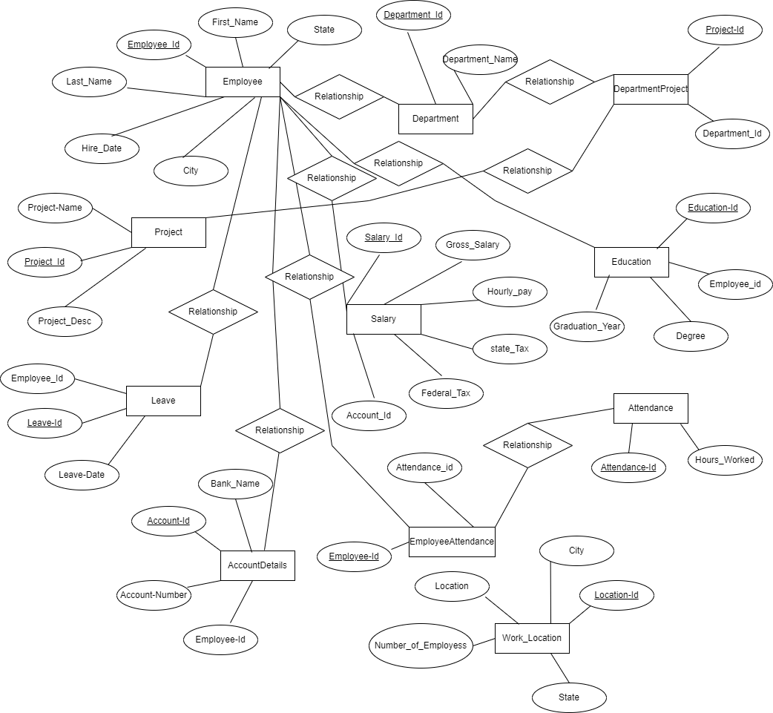
E-R Diagram

Slide 4
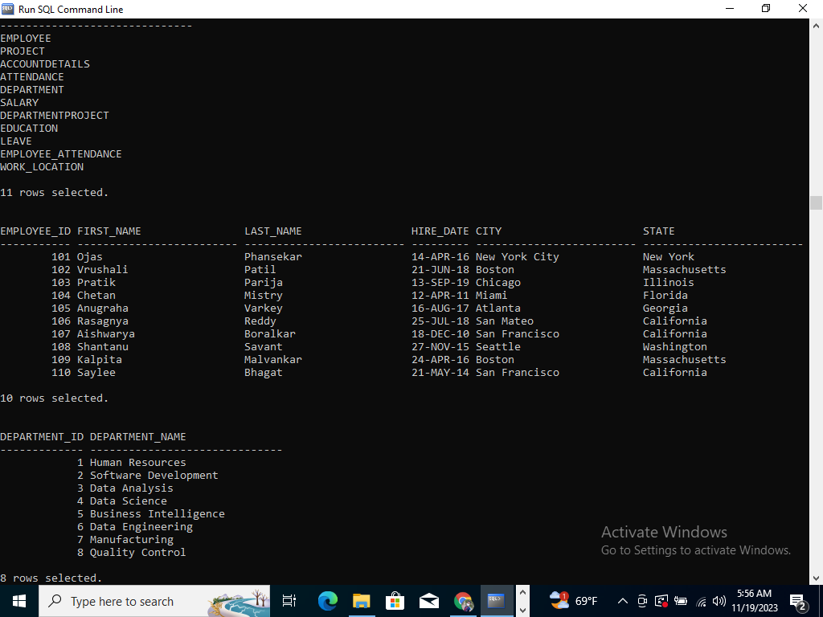
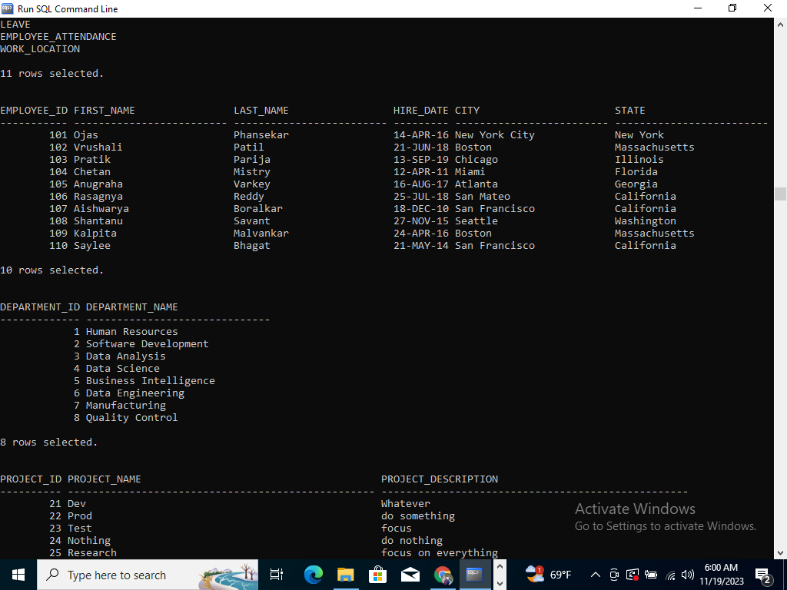
Tables
Table-01: Employee Table
Table-02: Department Table
04

Slide 5
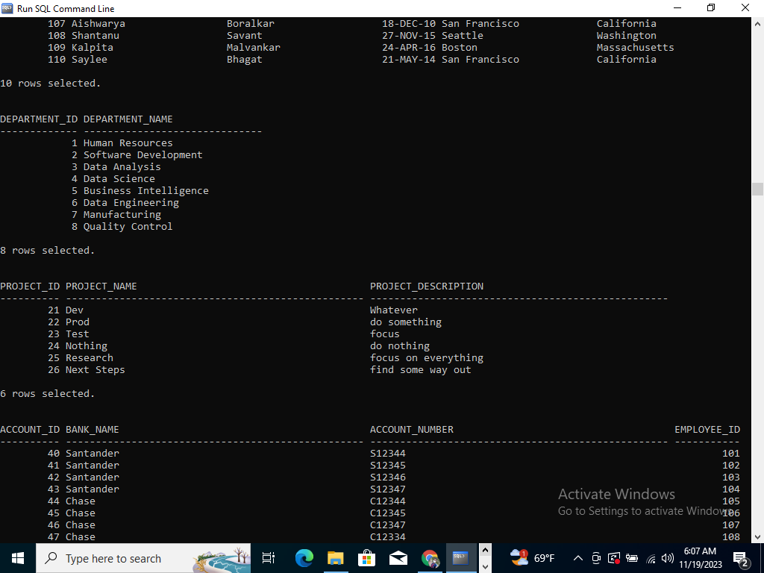
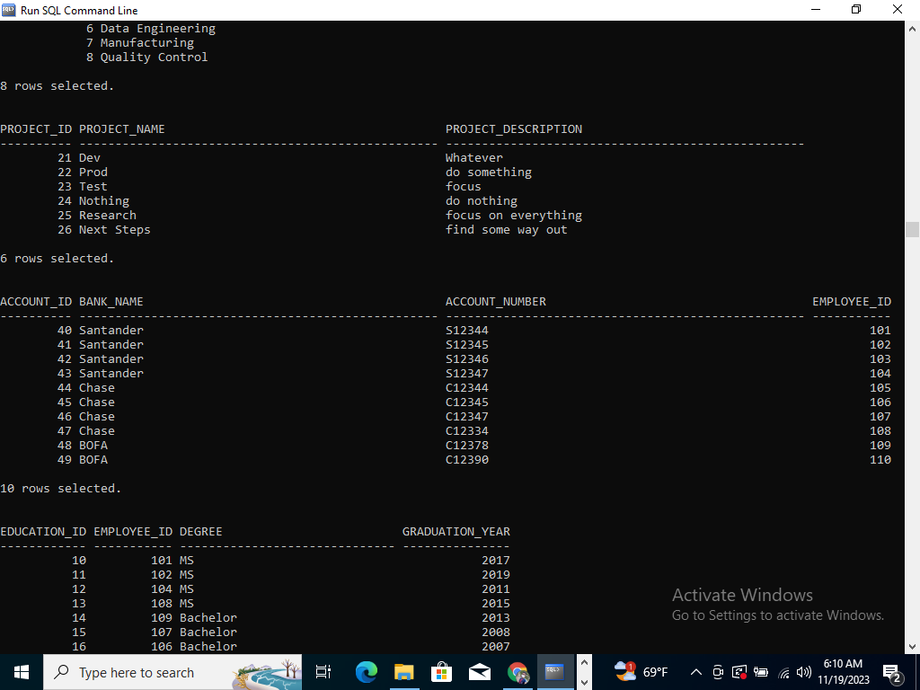
Tables(cont…)
Table-03: Project Table
Table-04: AccountDetails Table
05

Slide 6
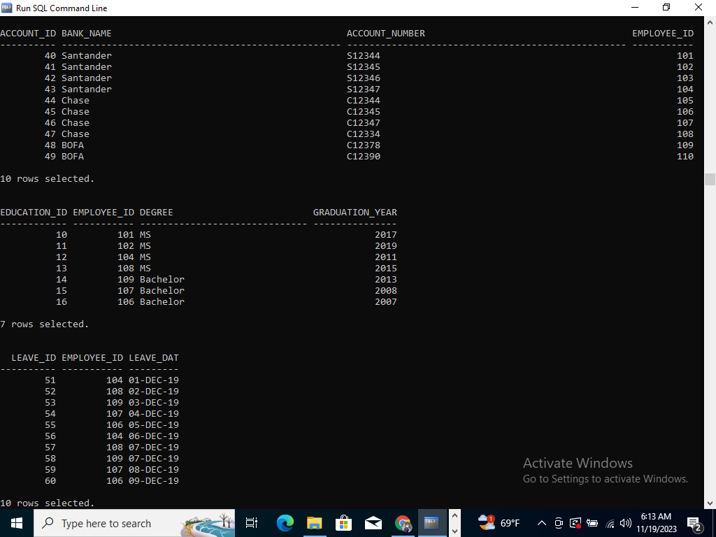
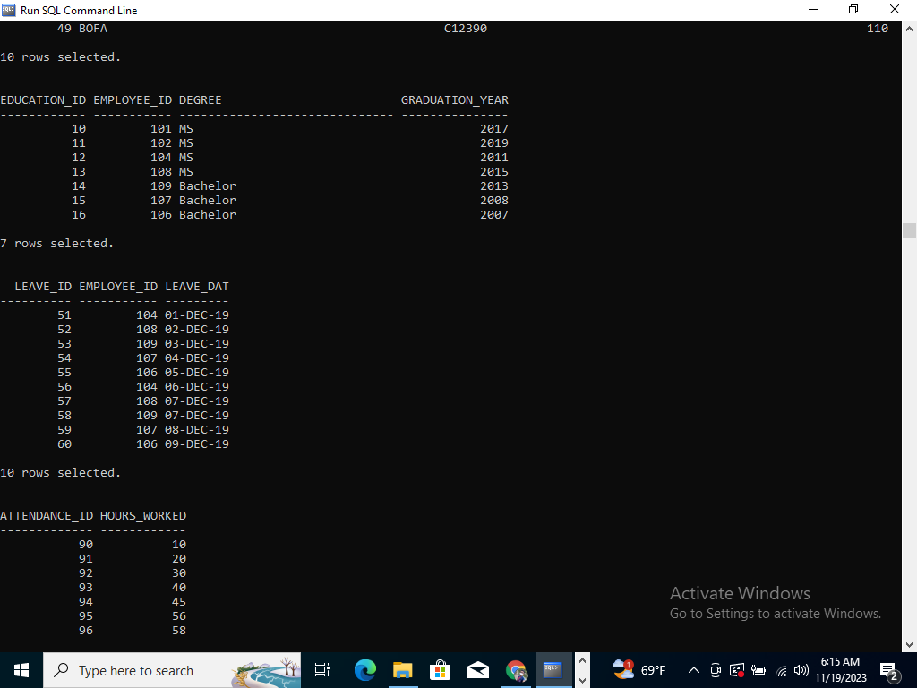
Tables(cont…)
Table-05: Education Table
Table-06: Leave Table
06

Slide 7
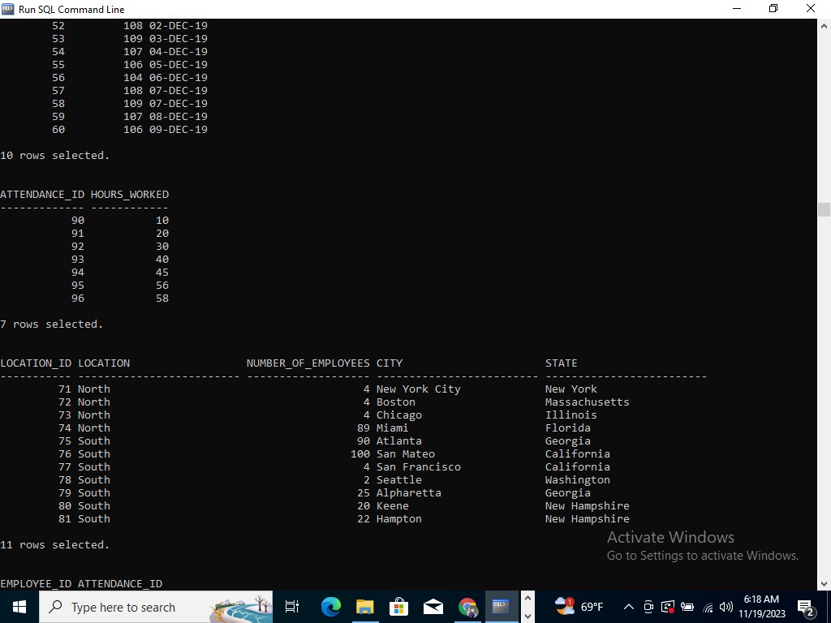
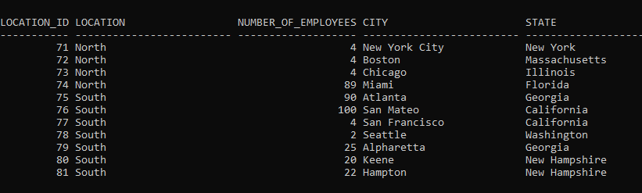
Tables(cont…)
Table-07: Attendance Table
Table-08: Work_Location Table
07

Slide 8
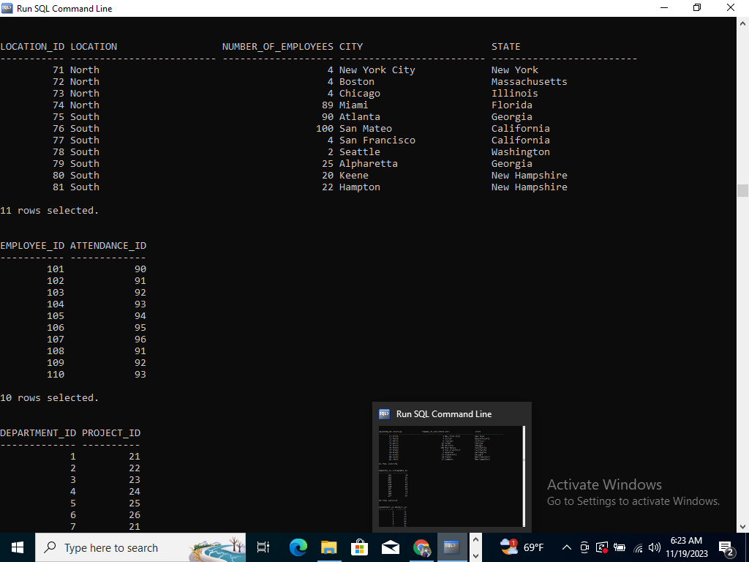
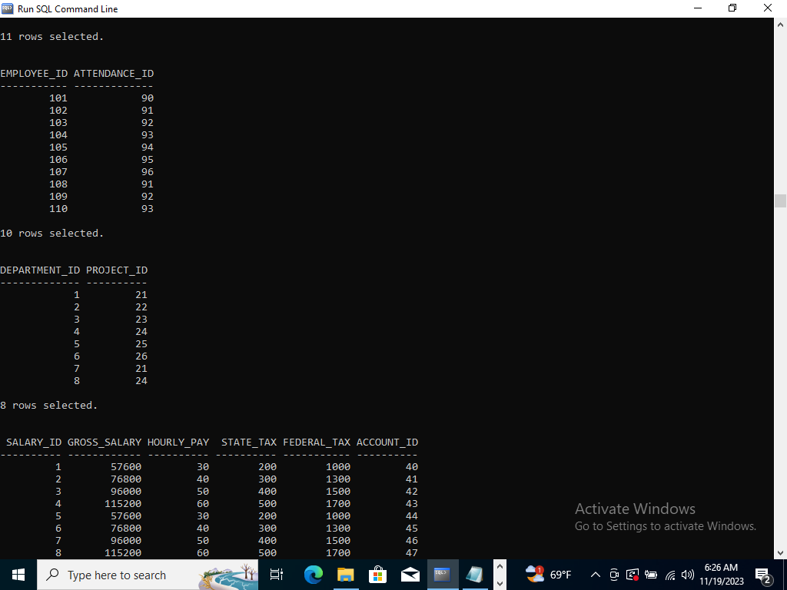
Tables(cont…)
Table-09: Employee_Attendance Table
Table-10: DepartmentProject Table
08

Slide 9
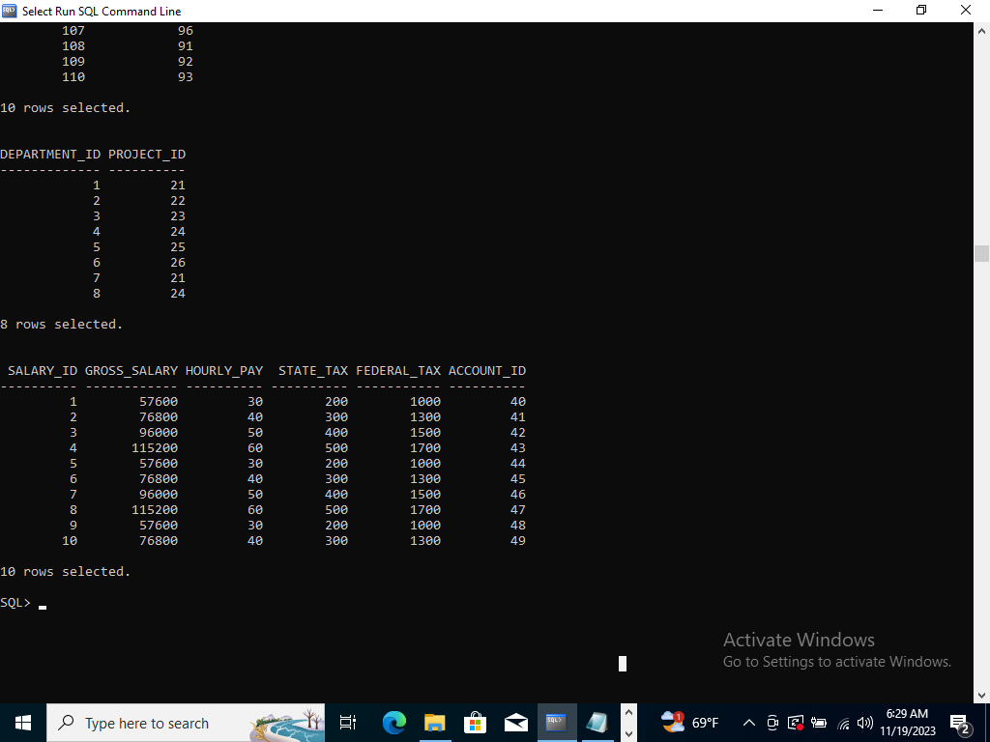
Tables(cont…)
Table-11: Salary Table
09

Slide 10
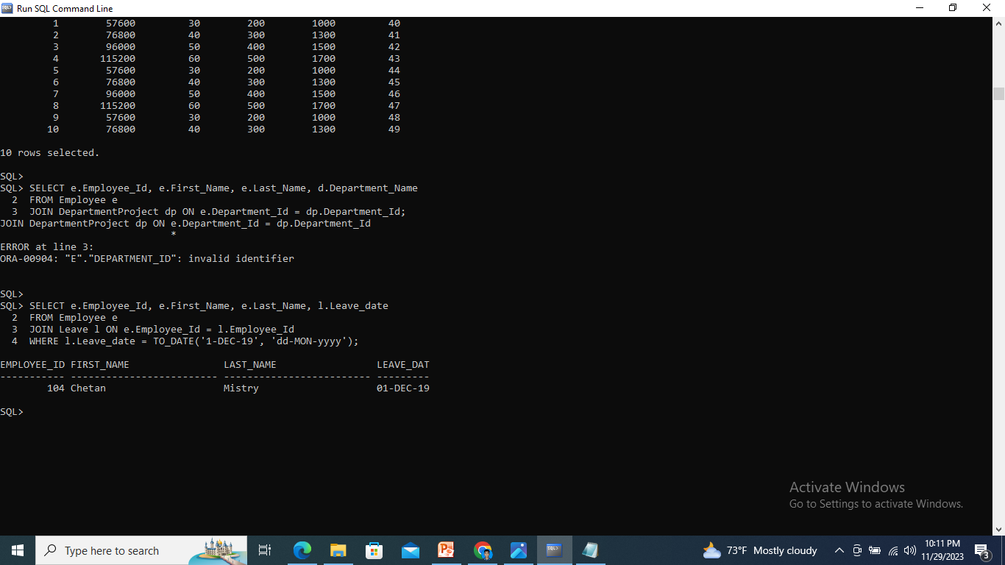
Some Query
Query-01:- Retrieve employees who took leave on a specific date:-

Slide 11
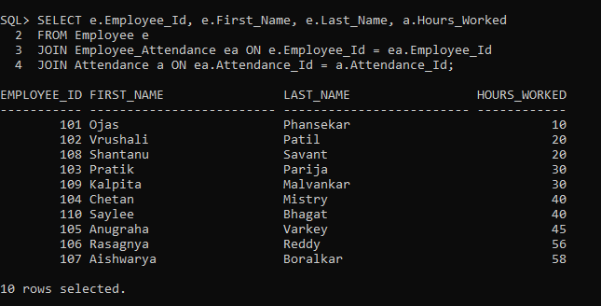
Some Query(Cont…..)
Query-02:- Retrieve employees and their corresponding attendance records:-

Slide 12
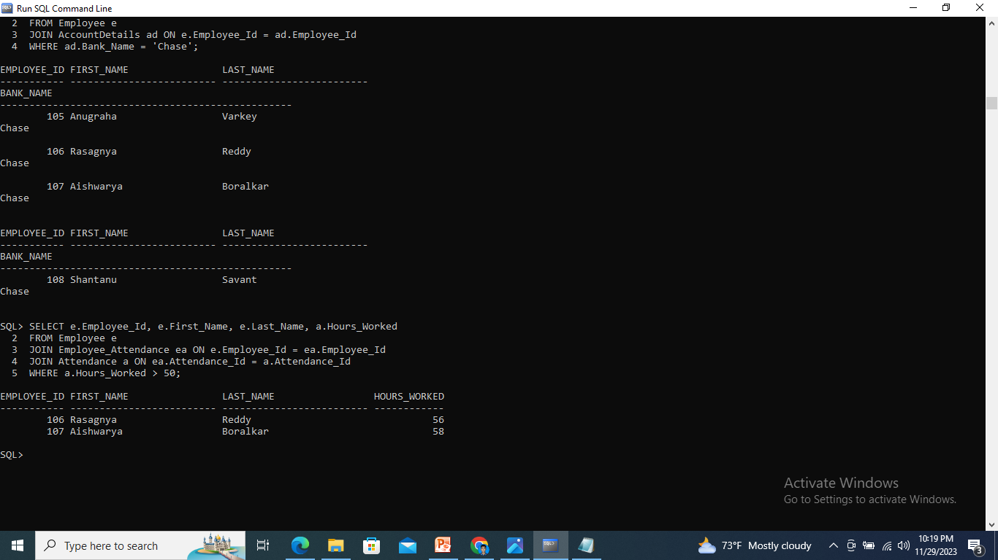
Some Query(Cont…..)
Query-03:-Retrieve employees who have worked more than 50 hours:-

Slide 13

Some Query(Cont…..)
Query-04:- Retrieve employees who are on leave:-

Slide 14
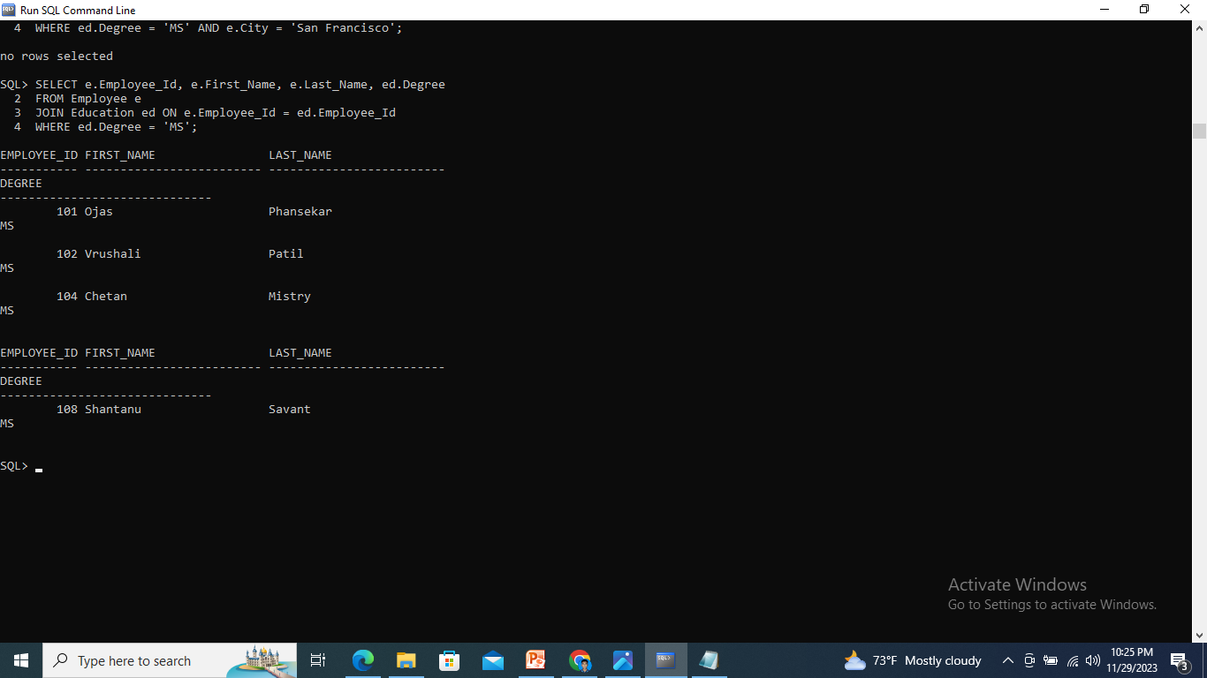
Some Query(Cont…..)
Query-05:- Retrieve employees who have a specific degree:-

Slide 15

Thank You

