Slide 1

Vulnerability Assessment and Penetration Testing
Week 5 practical: Nmap, Nikto and Burp Suite
Tanmay Sarkar
B.Tech Computer Science Engineering, Tezpur University | 2 October 2026
Notes:
Introduce the practical: a basic VAPT workflow with Nmap, Nikto and Burp Suite. Mention that all testing was on authorized or student-owned systems.

Slide 2



Scope and authorization
Nmap
Nikto and Burp Suite
testphp.vulnweb.com
DVWA at http://127.0.0.1/dvwa/
Acunetix public test site, the authorized target for this practical.
Installed on my own Kali Linux machine (student-owned environment).
Out of scope: other domains or IPs, denial of service, brute force, exploitation, changing or deleting data.
Environment: Kali Linux | Nmap 7.98 | Nikto 2.6.0 | Burp Suite Community 2026.7.2 | Apache 2.4.68 | MariaDB 11.8.8
Notes:
Nmap was run against the designated target. Nikto and Burp Suite were run against a locally hosted DVWA instance on my own machine. No unrelated systems were scanned.

Slide 3






VAPT workflow used
1
2
3
4
5
6
Plan
Discover
Scan
Validate
Rate
Report
Confirm targets, tools and limits
Ports, services, local stack
Nikto and Burp Suite
Re-run, confirm with curl
Impact, likelihood, evidence
Evidence and fixes
A scanner result is a lead, not proof. Each item is validated before it is rated.
Notes:
Walk through the six stages. Emphasize validation: a missing header or a listed folder is not automatically a vulnerability.

Slide 4
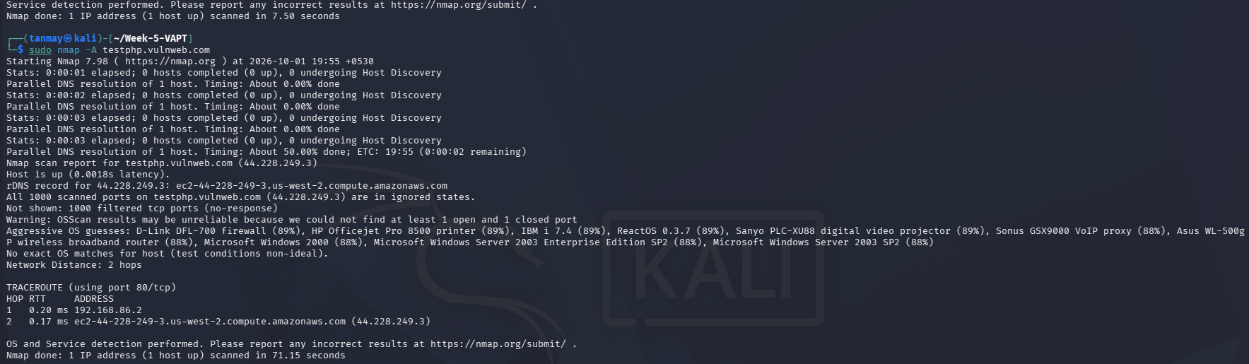
Nmap: no ports answered
1000
0
OS?
TCP ports scanned, all filtered
open ports, so no service versions
guesses unreliable (no open port)
Notes:
Target testphp.vulnweb.com (44.228.249.3). Five scans with -sS, -sV and -A all returned 1000 filtered ports. A filtered port does not mean vulnerable. Round-trip times of 0.17 to 0.31 ms to a distant cloud host suggest filtering on the local path, so the result should be repeated from another network with -Pn -p 80,443.

Slide 5
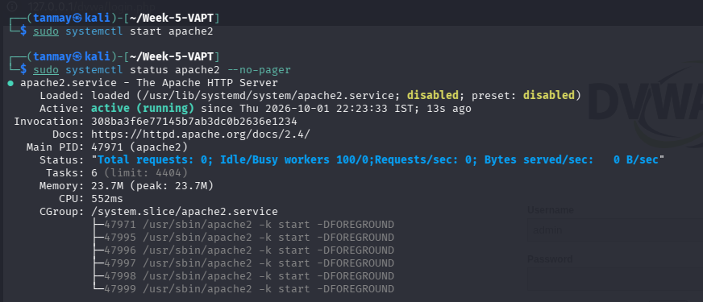


Local test lab: DVWA
Apache 2.4.68
Service active (running)
MariaDB 11.8.8
Listens on 127.0.0.1:3306 only
curl -I shows the Server header: Apache/2.4.68 (Debian), no security headers.
DVWA + Burp proxy
Browser via 127.0.0.1:8080
Notes:
Apache and MariaDB were started with systemctl and verified. The database listens only on localhost, which is a good control. The Apache AH00558 ServerName warning is a minor notice.

Slide 6
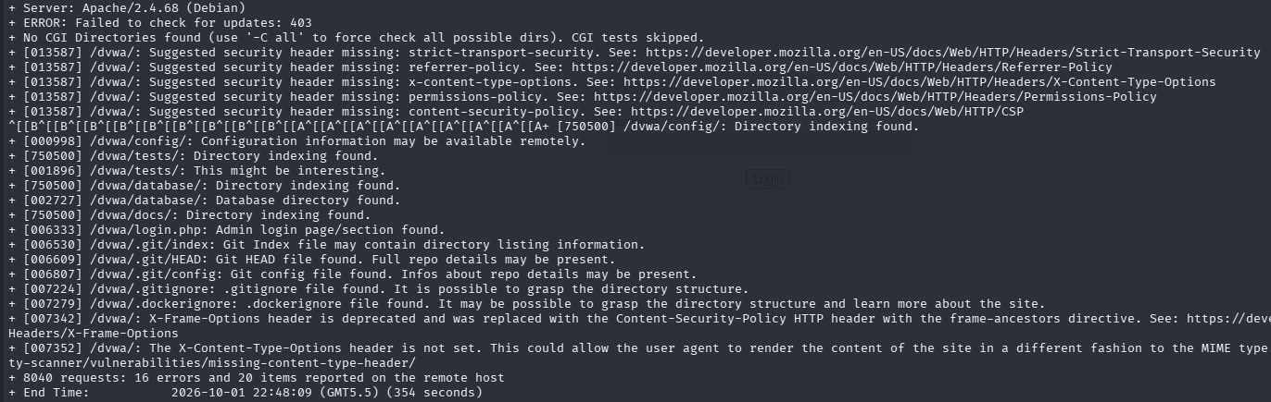
Nikto: 20 items reported
8,040
requests sent
20
items reported
2
Nikto output is scanner evidence, not proof of exploitation. Each item needs validation, and Apache 2.4.68 was not in Nikto's database.
identical runs (354 s, 351 s)
Notes:
Command: nikto -h http://127.0.0.1/dvwa/. Second run saved with tee to nikto-dvwa.txt. Both runs gave 8040 requests, 16 errors and 20 items, so the results are repeatable.

Slide 7



What Nikto found
F-04
F-01
Missing security headers (5)
Directory indexing (4)
CSP, HSTS, X-Content-Type-Options, Referrer-Policy, Permissions-Policy
/config/, /tests/, /database/, /docs/
F-02
Exposed repo files (5)
Needs manual validation
.git/index, .git/HEAD, .git/config, .gitignore, .dockerignore
Open each URL, confirm HTTP 200, then finalize the rating
Notes:
Group Nikto results by theme. Header gaps were confirmed with curl. Directory indexing and exposed .git files were reported twice by Nikto but not manually retrieved, so they remain scanner-reported.

Slide 8
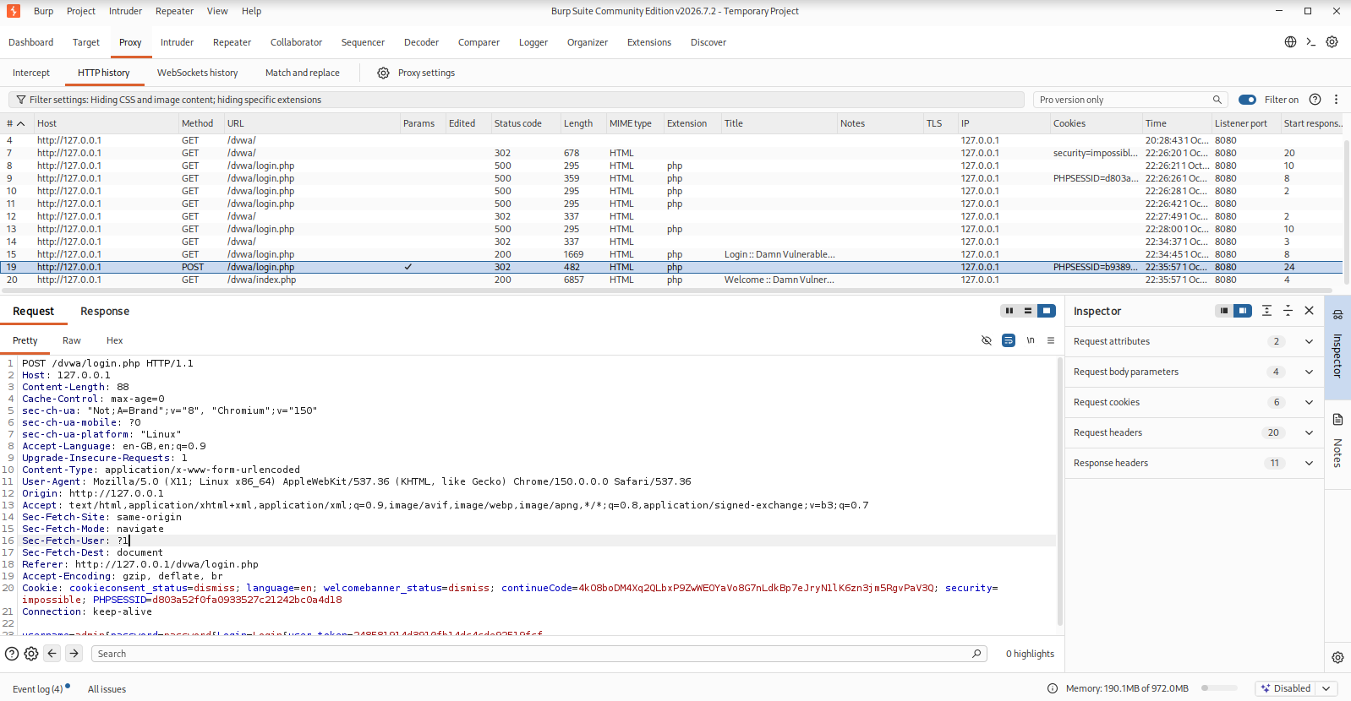
Burp Suite: capturing the login
Request #19
POST /dvwa/login.php
302 redirect to index.php
Plain HTTP, no TLS
4 body parameters, one is an anti-CSRF token
Request #20
GET /dvwa/index.php
200 OK, 6857 bytes
200 success
302 redirect
500 server error
The 500s appeared while MariaDB was stopped.
Notes:
Burp proxy listener 127.0.0.1:8080. Request 19 is the login POST, request 20 the page loaded after the redirect. The TLS column is empty, so credentials travelled over plain HTTP, which is low risk on loopback but high on a real network. Passwords are not shown in this deck.

Slide 9
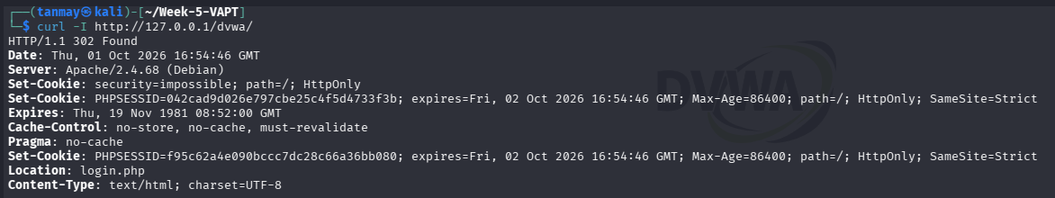
Headers and cookies: curl -I
Not returned
Cookie | HttpOnly | SameSite | Secure
PHPSESSID | Yes | Strict | No
security | Yes | Not set | No
Content-Security-Policy, Strict-Transport-Security, X-Content-Type-Options, Referrer-Policy, Permissions-Policy
Secure is absent because the lab runs on plain HTTP.
Notes:
curl -I confirmed what Nikto reported: none of the recommended security headers are returned. Cookies have HttpOnly; PHPSESSID has SameSite=Strict; neither has Secure. Two PHPSESSID values were issued in one response, worth reviewing but not a vulnerability by itself.

Slide 10
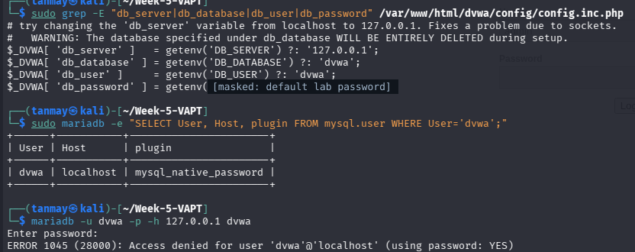


Configuration and log review
Default DB credentials
config.inc.php uses the publicly known default (F-03)
Database kept local
MariaDB reachable on 127.0.0.1 only: a good control
Default lab password masked in this slide.
Verbose error logs
PHP stack traces with file paths while the DB was down (F-08)
Notes:
As owner of the lab machine I reviewed config.inc.php locally with sudo. This shows the impact if the file leaked; remote readability was not demonstrated. A first MariaDB login attempt was rejected (ERROR 1045); a later attempt succeeded, consistent with the configured credentials being valid.

Slide 11
Nine findings, none High
ID | Finding | Severity
F-01 | Directory indexing | Medium
F-02 | Exposed .git and ignore files | Medium
F-03 | Default database credentials | Medium
F-04 | Missing security headers | Low
F-05 | Login over unencrypted HTTP | Low
F-06 | Cookie attribute gaps | Low
F-07 | Server version disclosure | Low
F-08 | Server errors, verbose logs | Info
F-09 | No open ports seen (filtered) | Info
Notes:
Three Medium, four Low, two Informational. DVWA is deliberately vulnerable, so the ratings describe each issue as if the same configuration were exposed in production. F-01 and F-02 are scanner-reported and still need manual retrieval.

Slide 12

Remediation priorities
1 First
2 Next
3 Then
Close the doors
Protect transport
Harden the server
Remove or deny /config, /tests, /database, /docs and .git. Replace the default database password.
Enable HTTPS, then HSTS, Secure and SameSite cookie settings.
Add security headers, set ServerTokens Prod, turn display_errors off.
Notes:
Fix what exposes data first, then protect transport and cookies, then reduce information leakage.

Slide 13
Conclusion
What I learned
Limitations
Running a tool is the start: results must be interpreted, validated and rated.
Manual checks with curl confirmed headers, cookies and the server banner.
Testing must stay within permission and scope.
Nmap result may reflect lab network filtering; repeat from another network.
Nikto and Burp ran on a local, deliberately vulnerable app.
F-01 and F-02 still need manual retrieval to confirm.
Thank you. Questions?
Notes:
Close by restating that findings are evidence-based and that testing was authorized. Invite questions.

