Slide 1

WEEK 4 — CYBER SECURITY INTERNSHIP
Virtual Lab Setup · Web Server Deployment · Network Scanning & Traffic Analysis
Tanmay Sarkar
B.Tech Computer Science Engineering — Cyber Security Internship, Week 4 — September 2026

Slide 2
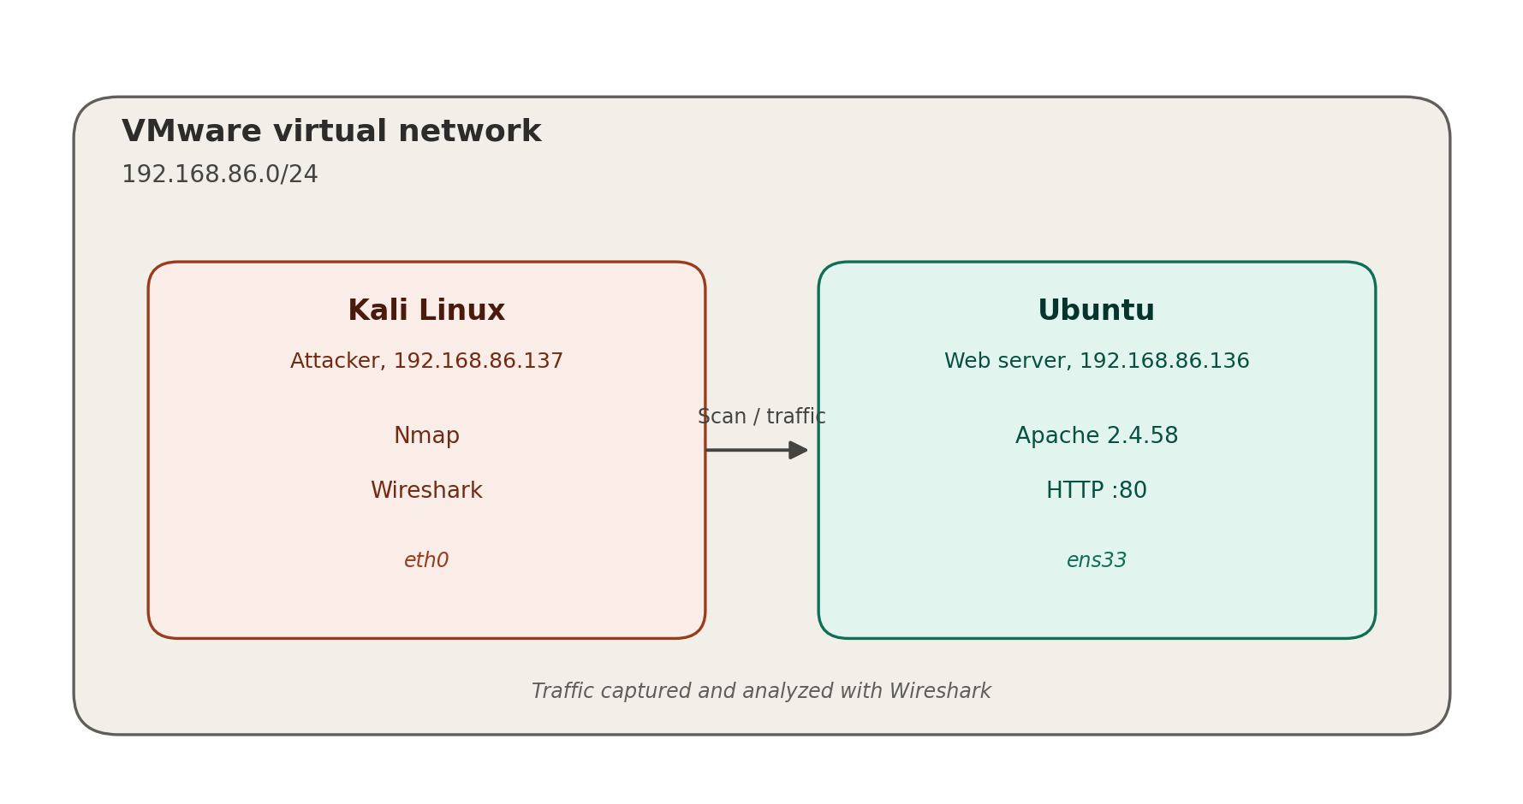
Project overview
A two-machine VMware lab used to practice the end-to-end flow of a network security assessment.
Set up an isolated attacker/target lab
VMware, Kali Linux and Ubuntu on 192.168.86.0/24
Deploy a real service to test
Apache HTTP Server on the Ubuntu target
Scan for open ports and services
Nmap: basic, version, and default-script scans
Capture and read live traffic
Wireshark: ICMP, HTTP and DNS analysis
Lab network — 192.168.86.0/24
Work only in an authorized, isolated environment
Kali (attacker, .137) ↔ Ubuntu (web server, .136)
Ethical, non-destructive reconnaissance
NAT mode — isolated from external networks
Week 4 – Cyber Security Internship
2

Slide 3





Tools & environment
Five pieces of software carried the whole exercise, from virtualization to packet-level inspection.
VMware Workstation
Nmap
Virtualization platform hosting both isolated VMs
Port scanning and service / version enumeration
Kali Linux — 192.168.86.137
Wireshark
Attacker / scanner machine (eth0)
Live packet capture and protocol analysis
Ubuntu + Apache 2.4.58 — 192.168.86.136
Target web server (ens33)
Week 4 – Cyber Security Internship
3

Slide 4
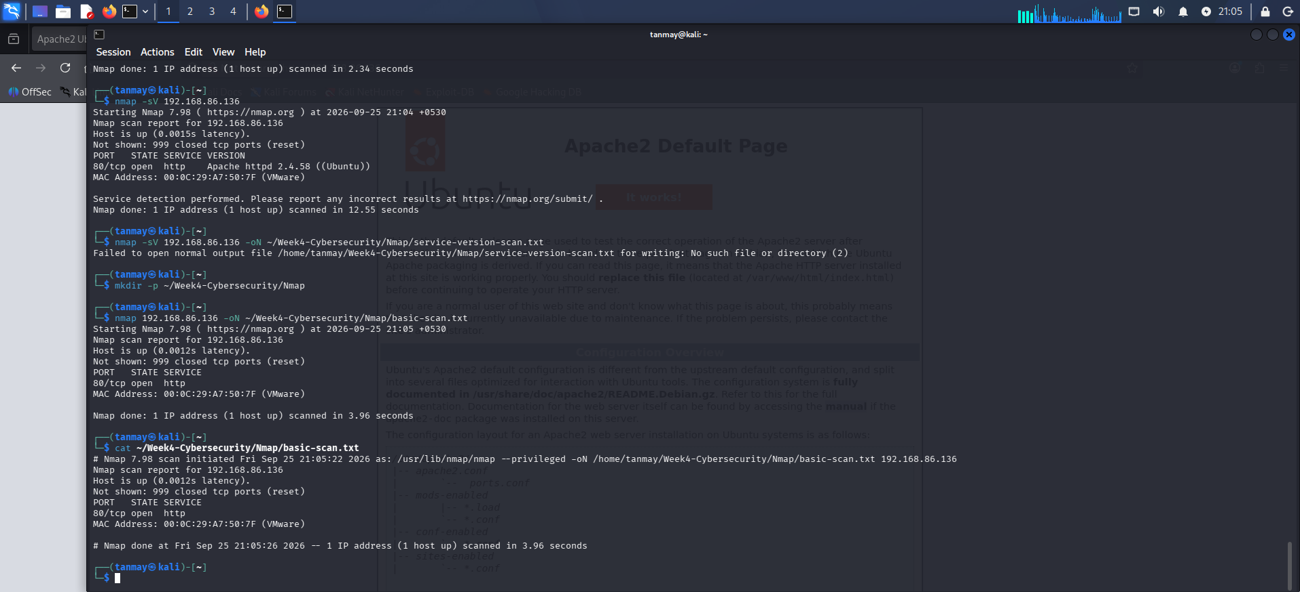
Key finding — Nmap scan results
Port | State | Service | Version
80/tcp | Open | HTTP | Apache httpd 2.4.58 (Ubuntu)
999 of 1,000 scanned TCP ports came back closed — only port 80 is exposed
Default NSE scripts recovered the HTTP title and server header without any exploitation
An open, identified port is a starting point for research — not proof of a vulnerability
Bottom line
Kali terminal — basic, -sV, and saved Nmap scans against 192.168.86.136
A single, justified HTTP service was found exposed — exactly what the lab was built to run, and nothing more.
Week 4 – Cyber Security Internship
4

Slide 5
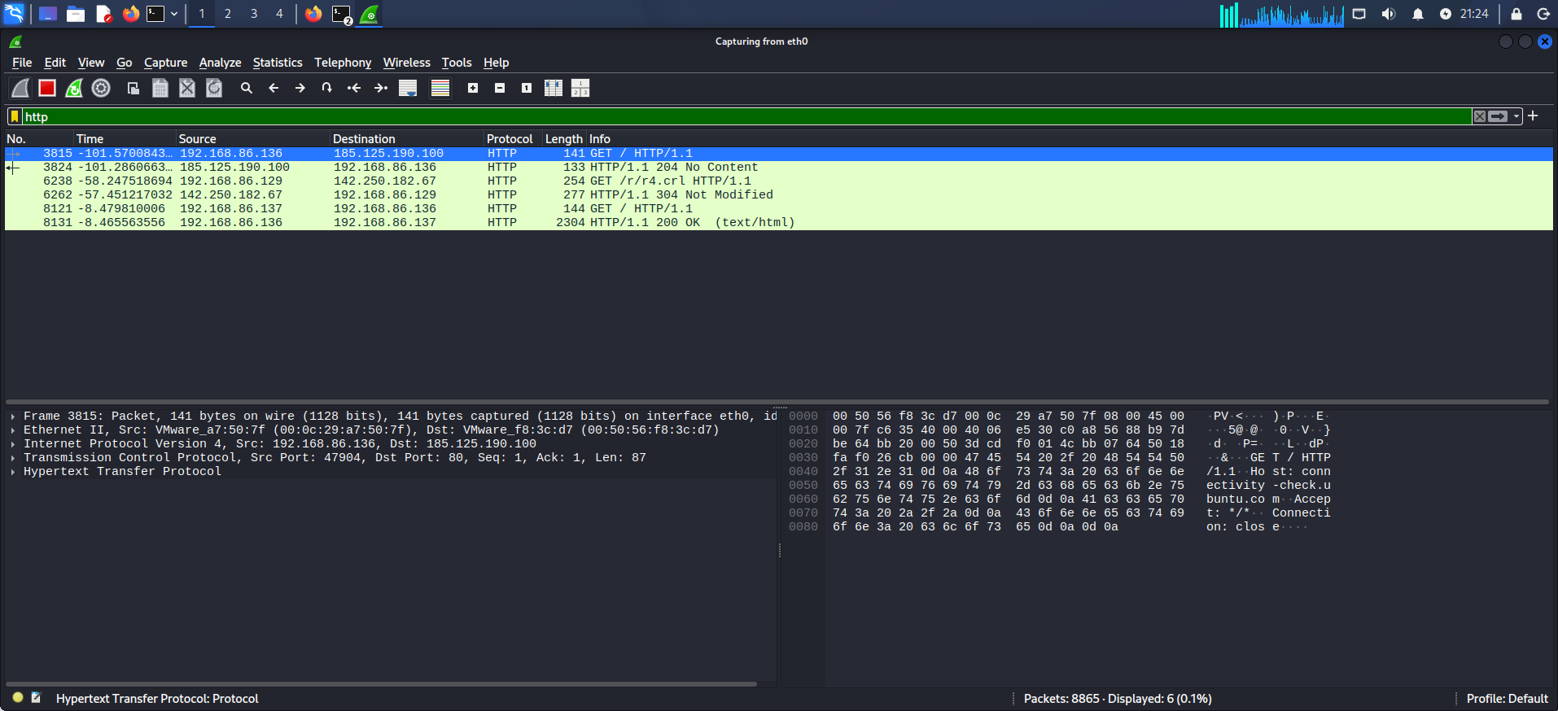

Key finding — Wireshark traffic analysis
Protocol | Filter | Observation
ICMP | icmp | Echo request/reply seen between Kali and Ubuntu, 0% loss
HTTP | http | GET / → HTTP/1.1 200 OK, server header Apache/2.4.58
DNS | dns | Query/response traffic for Kali's own name resolution
HTTP traffic was captured in plaintext — the full request and response were readable in Wireshark, including the server header.
Recommendation
Wireshark — HTTP GET / and 200 OK between Kali and Ubuntu
Production deployments of this same service should run behind HTTPS (TLS) to keep requests and responses confidential in transit.
Week 4 – Cyber Security Internship
5

Slide 6
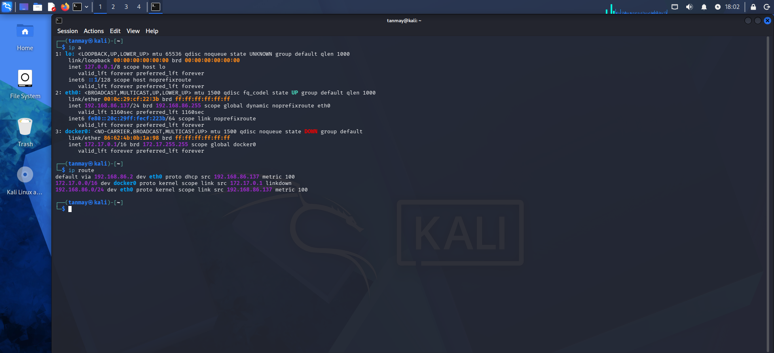
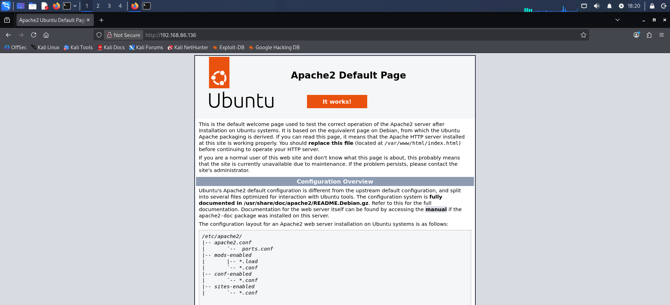
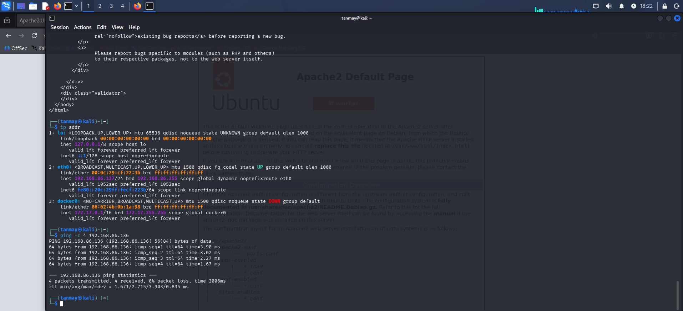
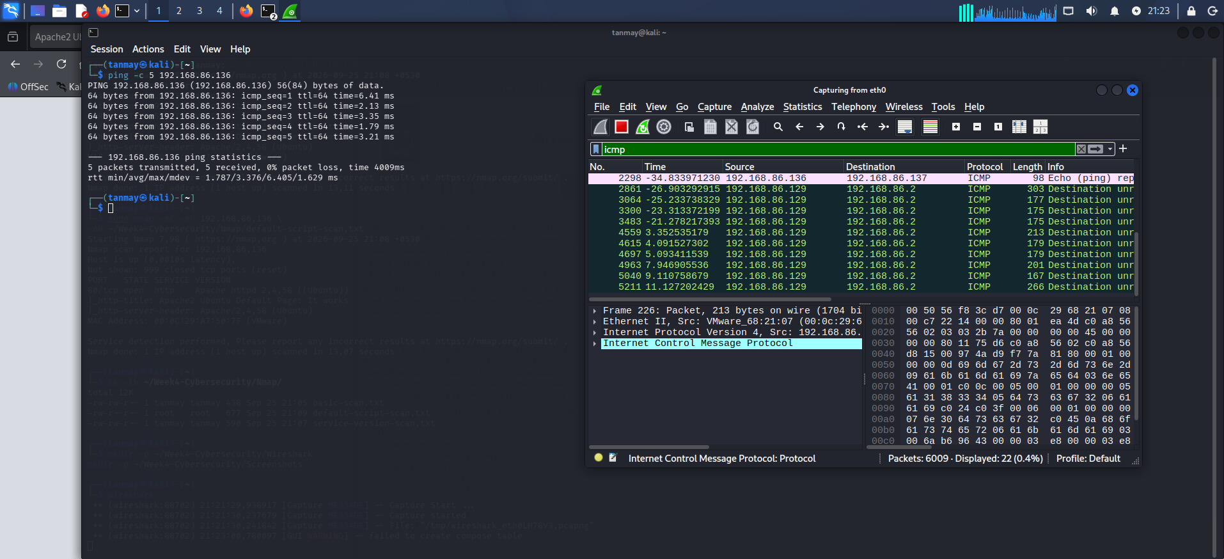
Evidence captured
A sample of the screenshots documenting each stage of the exercise.
Kali IP configuration — eth0, 192.168.86.137
Apache default page served from Ubuntu
Ping connectivity test — 0% packet loss
Wireshark — ICMP echo request/reply capture
Week 4 – Cyber Security Internship
6

Slide 7



Security observations
What the scan and capture results mean for a service like this one in production.
Attack surface
Information disclosure
Every open port is a possible entry point; port 80 here should be the only one justified by business need.
Version banners (Apache 2.4.58) help defenders patch — but also help attackers target known issues.
Unencrypted transport
Monitoring & hardening
Plaintext HTTP exposes requests, responses and headers to anyone with network access.
Firewalling unused ports, enabling HTTPS, and logging traffic are the natural next steps.
Full recommendations in the report: minimize attack surface, enforce HTTPS, harden server headers, add firewall rules, and monitor continuously.
Week 4 – Cyber Security Internship
7

Slide 8
Conclusion
2
1
3
0%
Isolated VMs
Open port found
Protocols analyzed
Packet loss
This exercise demonstrated the full arc of a network security assessment — isolated setup, a real deployed service, reconnaissance with Nmap, and traffic analysis with Wireshark — performed ethically within an authorized lab.
Next steps: firewall configuration, HTTPS/TLS deployment, and NSE vulnerability scripts.
Tanmay Sarkar — B.Tech CSE — Cyber Security Internship, Week 4

