Slide 1
Predicting rent pricing in Mumbai

Slide 2
Problem Statement
In Mumbai, people prefer to rent homes instead of buying as employees usually keep changing jobs.
This model tries to predict rent pricing in the city of Mumbai.
This model tries to find which factors have a major impact on the pricing.

Slide 3
Dataset
The dataset named ‘Flats for Rent in Mumbai’ is taken from Kaggle.
The link of the dataset is https://www.kaggle.com/jedipro/flats-for-rent-in-mumbai
The dataset contains 23 columns but only 8 of them are used in the study, namely, ‘area’, ‘bedroom_num’, ‘bathroom_num’, ‘floor_num’, ‘floor_count’, ‘locality’, ‘user_type’ and ‘furnishing’.

Slide 4
Data Preprocessing
Missing data is managed by dropping the entire row.
The datatype of each column is set properly.
Categorical data is handled using One-Hot Encoding.
All continuous values are normalized so that the model is not biased.

Slide 5
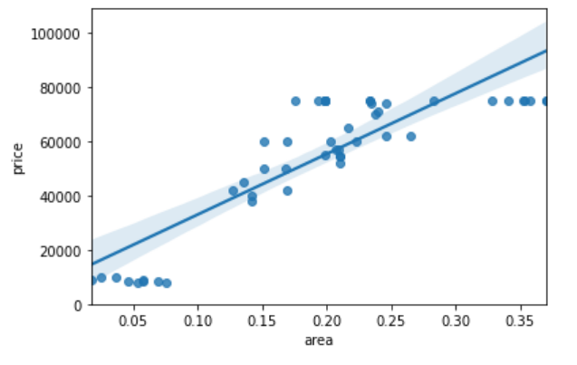
Relation of Area and Price
There is positive linear correlation between area and price.
This concludes that as area increases the price will also increase.

Slide 6
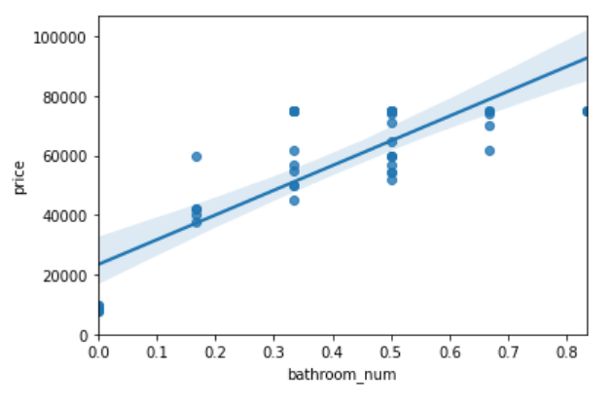
Relation of Bathroom_num and Price
There is positive linear correlation between bathroom_num and price.
This concludes that as number of bathrooms increase the price will also increase.

Slide 7
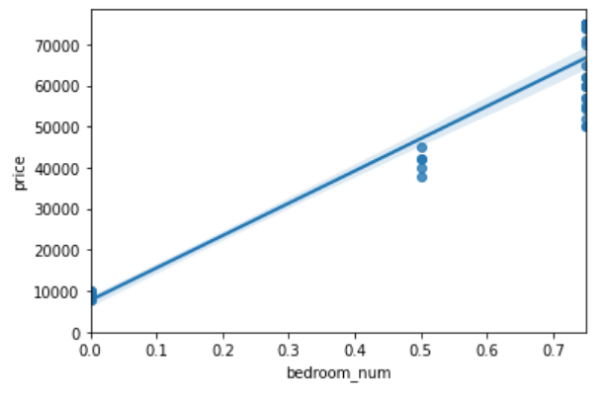
Relation of Bedroom_num and Price
There is positive linear correlation between bedroom_num and price.
This concludes that as number of bedrooms increase the price will also increase.

Slide 8
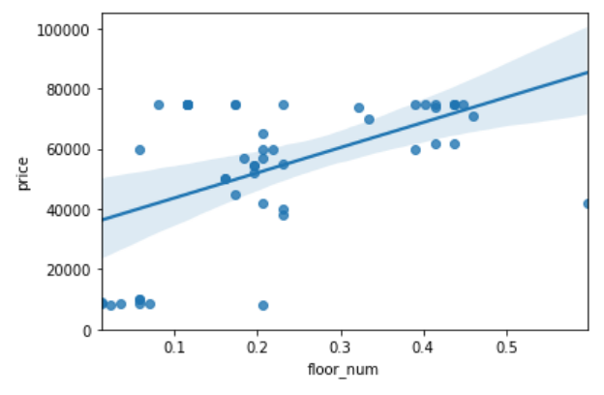
Relation of Floor_num and Price
There is a weak positive linear correlation between floor_num and price.
This concludes that floor_num might not be relevant to predict price.

Slide 9
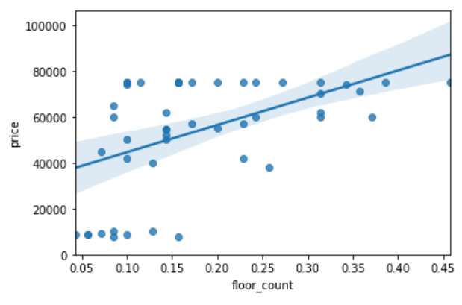
Relation of Floor_count and Price
There is weak positive linear correlation between floor_count and price.
This concludes that floor_count might not be a significant factor in predicting price.

Slide 10
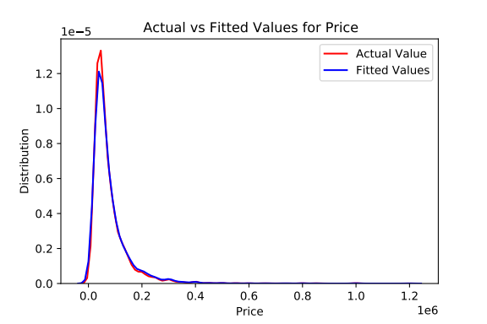
Model Evaluation
The datasplit for train/test is 60/40.
The model fits the dataset with very high accuracy.

Slide 11
Conclusion
The model deployed can predict rent pricing with the features selected.
The study shows that the feature which has a major impact on the pricing is ‘Area’.
The study reveals many insights on the factors affecting pricing which can be studied by anyone planning to rent a house in the city of Mumbai.

