Slide 1
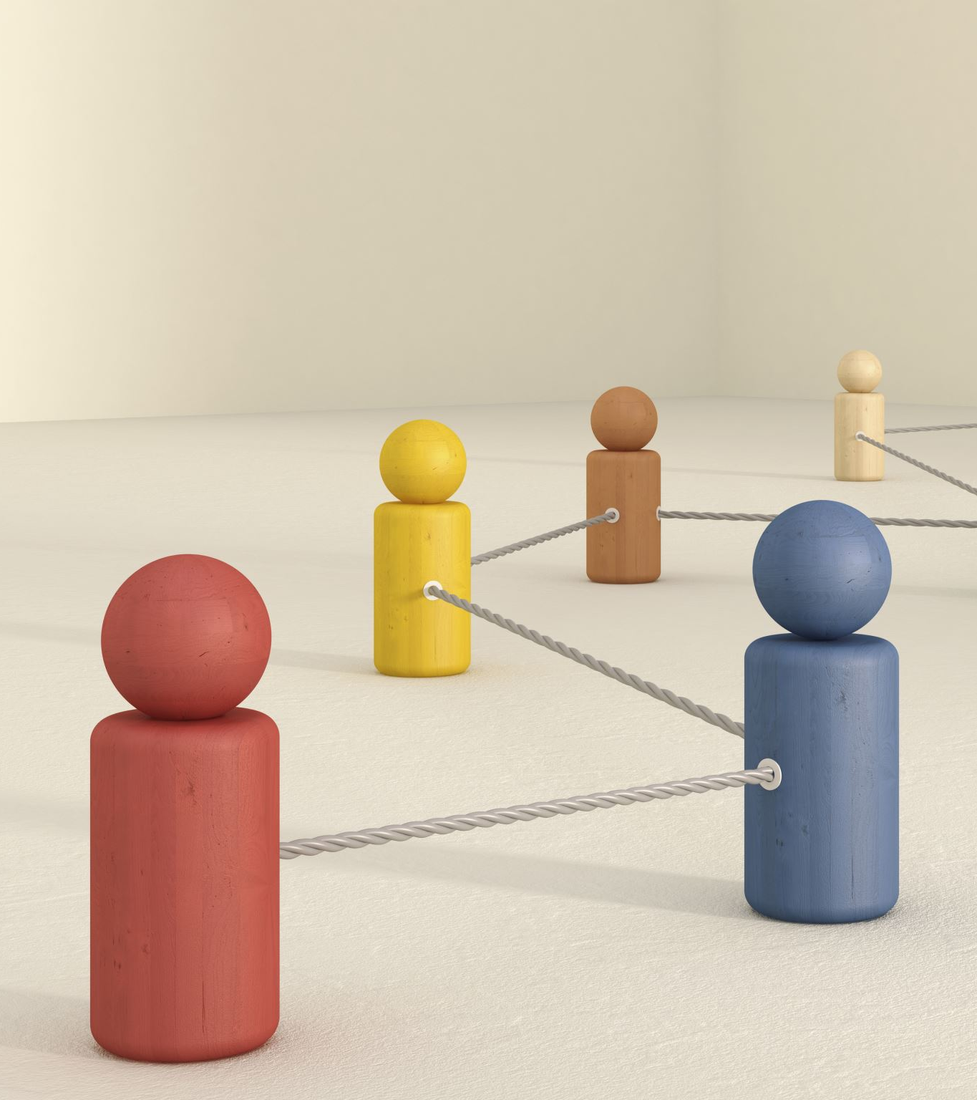

Data Insights and Financial Reporting Automation (DIFRA)
Tanmay Sharma
3rd October 2023

Slide 2

Agenda
Problem Statement
DIFRA project
Exploratory Data Analysis (EDA)
System High Level Design (HLD)
System Attributes
Report
Code Deep Dive
Roadmap
Conclusion

Slide 3

Problem Statement
Manual and error-prone process.
Inefficiencies and delays in financial reporting.
Need for data science driven solutions.

Slide 4

Data Insights And Financial Reporting Automation (DIFRA)
Eliminate manual work and errors in cloud spend reporting.
Accurately allocate spending among vendors and derive insights.
Improve financial reporting efficiency and reduce delays.

Slide 5
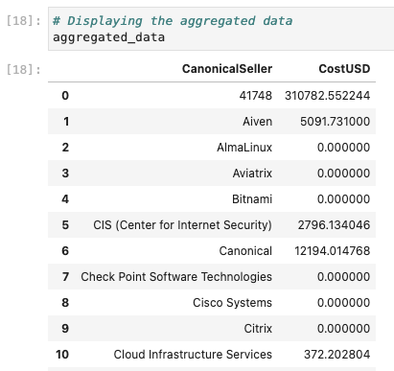
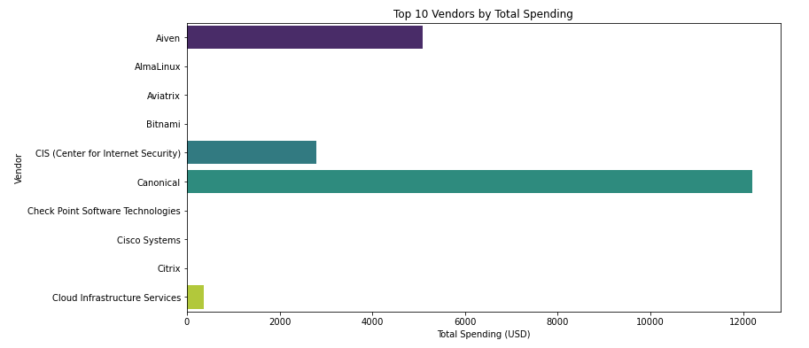
Exploratory Data Analysis (EDA)
Private Repo: https://github.com/tanmaysharma19/DIFRA/blob/main/eda/eda.ipynb
Notes:
Grafana
Prometheus
Dash App
Tableau
PowerBI
Lookr
Any other visualization technique currently used

Slide 6
DIFRA System HLD
Notes:
Data Lake Storage: The central repository for storing raw and processed data.
Data Ingestion Scheduler: Manages the scheduling and coordination of data ingestion tasks.
Data Ingestion Component: Responsible for collecting and ingesting data from various sources into the data lake.
Data Aggregator: Aggregates and combines data from different sources within the data lake.
Data Repository: Stores processed and aggregated data for further analysis.
Reporting and Visualization: Generates reports and provides visualization of the data.
Notification Service: Sends notifications and alerts based on predefined events or triggers.
Tests: Includes various tests to validate the functionality and performance of the system.

Slide 7
System attributes
Frequency: Align with business needs, optimize cost
Extensibility: Modular, standardized, connectors
Scalability: Cloud-based, auto-scaling, proactive
Resilience: Redundancy, backup, distributed
Latency & SLA: Optimize, monitor, cache

Slide 8
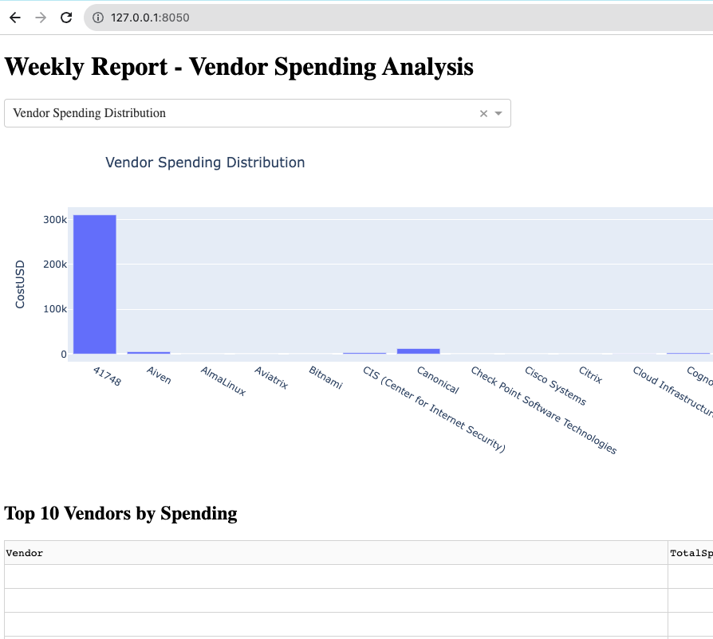
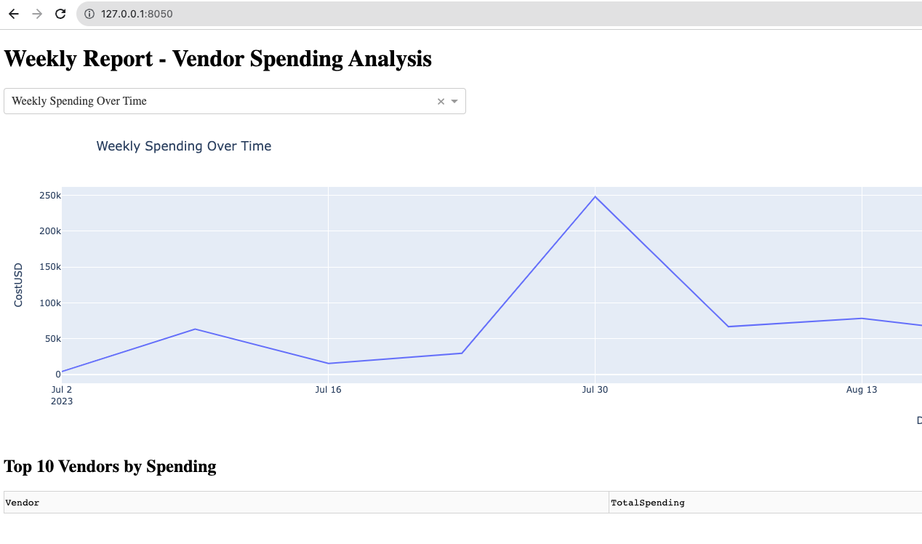
Report Visualizations
Notes:
Grafana
Prometheus
Dash App
Tableau
PowerBI
Lookr
Any other visualization technique currently used

Slide 9
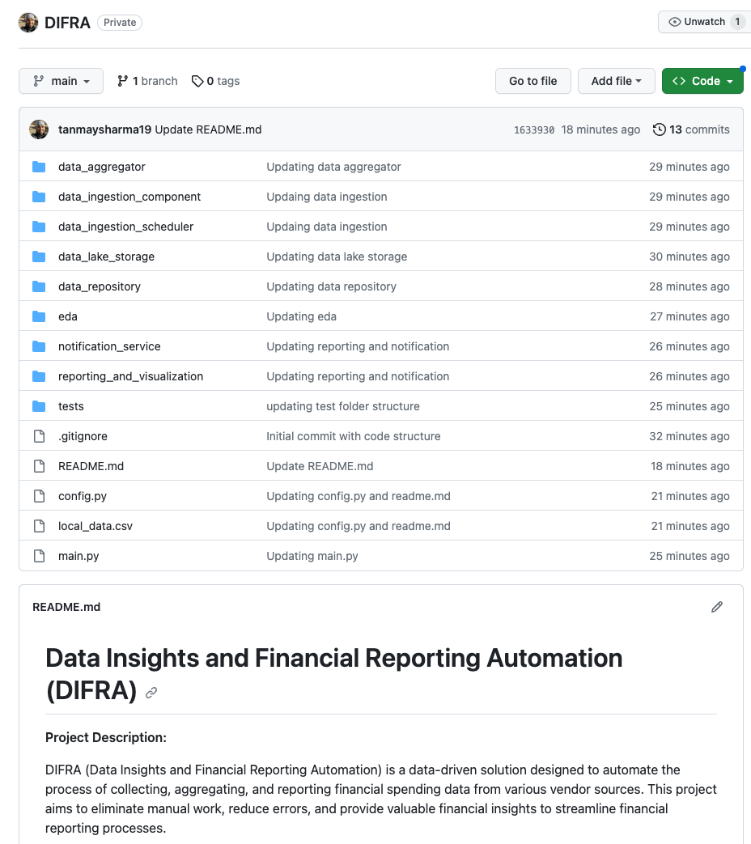


Code Deep Dive
Private Repo: https://github.com/tanmaysharma19/DIFRA

Slide 10

Roadmap
Data Lake Storage: AWS S3, Google Cloud Storage (GCS), or Azure Data Lake Storage (ADLS).
Data Ingestion: Luigi, Apache Airflow.
Data Aggregation: Python (pandas) or Apache Spark.
Report/Visualization: Dash Enterprise, Tableau, Power BI, Matplotlib, Seaborn, Altair.
Data Repository: Snowflake, AWS S3, GCS, ADLS.

Slide 11

Thank you

Slide 12

Appendix

