Slide 1

CS 6110 Software Correctness, Spring 2022 Lec5
Ganesh Gopalakrishnan
School of Computing
University of Utah
Salt Lake City, UT 84112
URL: bit.ly/cs6110s22

Slide 2
Slides for Lec5 : Agenda
Bugs matter (loss of lives, property, wasted time, poor user experience..)
Therac incident https://en.wikipedia.org/wiki/Therac-25
Patients killed
Heartbleed https://dwheeler.com/essays/heartbleed.html
A huge mistake
Protocols baked into code are inscrutably complex (hard to debug at that level)
Build models (like executable blueprints – or like scale model of an airplane in a wind tunnel)
Error-prone but can be gotten right – readable rigorous specification!
You’ll see the styles that matter + the extras (checks in SPIN) that help
Murphi’s rule-style shines! – will later show the power of Table-based transition systems! (like Excel sheets)
Then auto-generate C or protocols – have MULTIPLE models (so we can check all vantage-points)
After tuning/tweaking, switch to C-level verification
Asg-2 is to take you through these paths
We will experience typing a model
We will sow a bug in Distributed Termination (work channel slack)
And experience how verification goes

Slide 3
Take it from the experts!
Paul E. McKenney
Top Linux Developer at IBM (now works for Facebook)
Has authored a free book on parallel programming that he maintains
A fantastic collection on (shared memory) parallel programming
https://mirrors.edge.kernel.org/pub/linux/kernel/people/paulmck/perfbook/perfbook.2021.12.22a.pdf
Look at its table of contents (next slide)

Slide 4
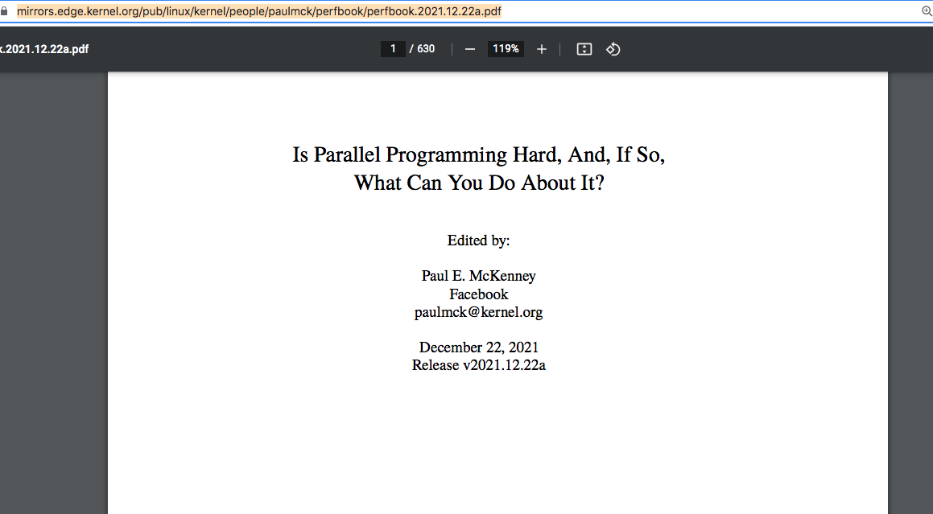
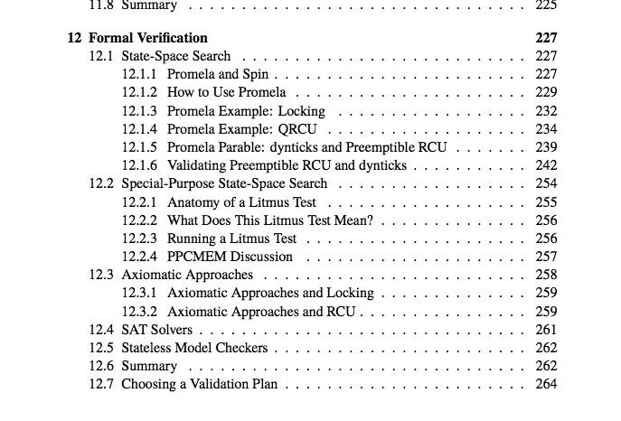
Take it from the experts!

Slide 5
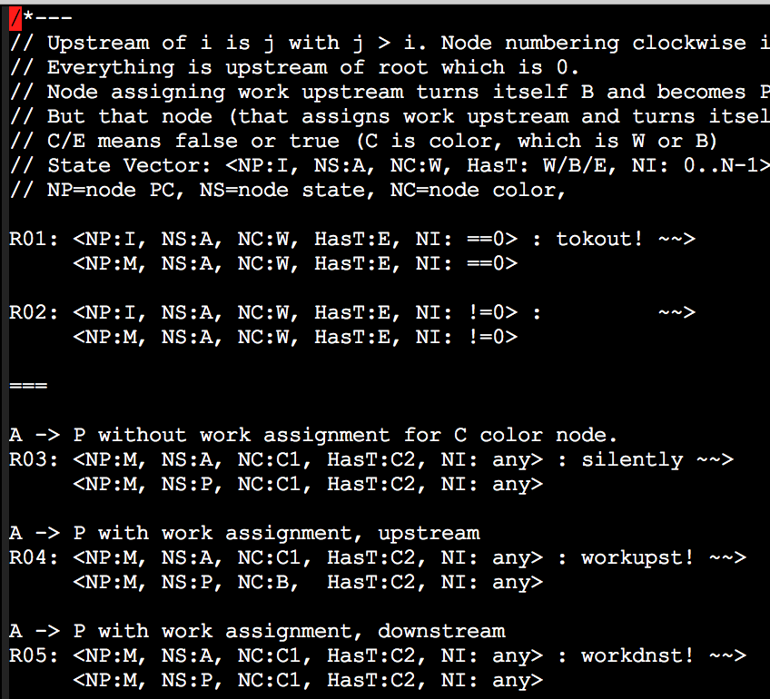
Dist Term

Slide 6
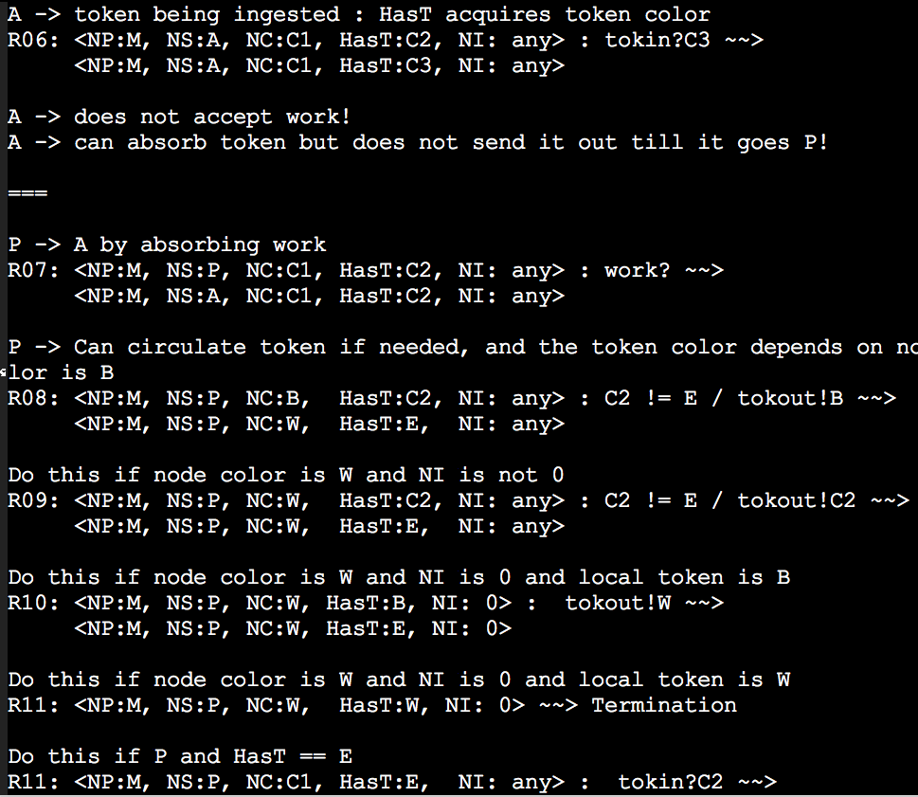
Dist Term

Slide 7
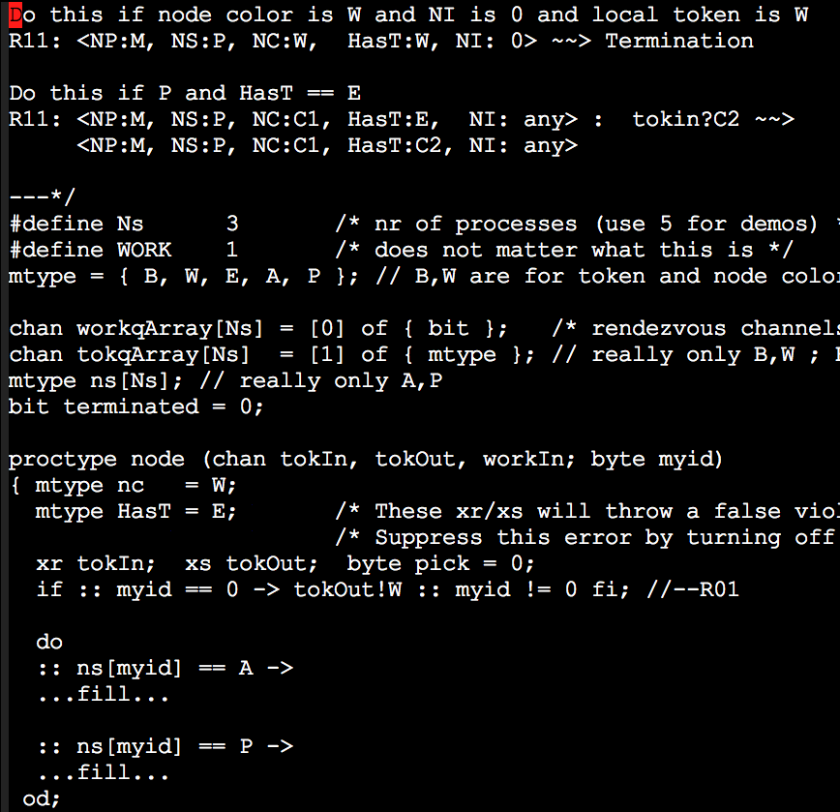
Dist Term

Slide 8
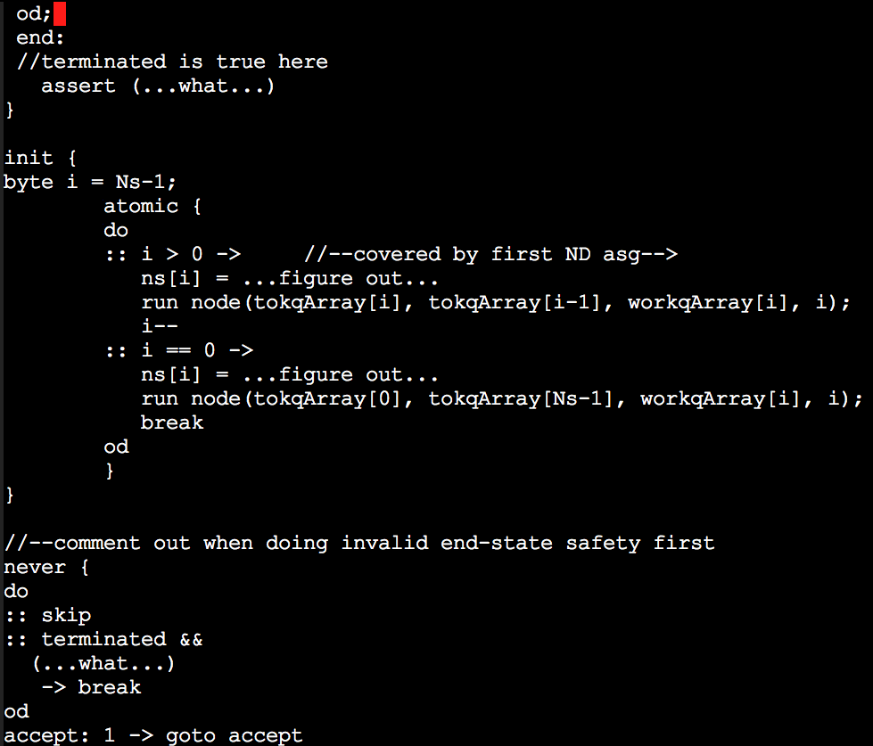
Dist Term

