Slide 1

CS 6110 Software Correctness, Spring 2022 Lec6
Ganesh Gopalakrishnan
School of Computing
University of Utah
Salt Lake City, UT 84112
URL: bit.ly/cs6110s22

Slide 2
Slides for Lec6 : Agenda
Rozier’s paper
An amazing intro to FV, model-checking, LTL, CTL, …
The fact that Kripke Structures stand out so nicely with the air-traffic example is COOL !!
U of Rochester has (had?) an UG speciality in SW Engg
Model-checking is a required UG class

Slide 3
Scary new world at the edge (with Science of FM, it will be the Exciting New World!)
Exact quote from paper
We assert there is as yet no ``science’’ for debating and systematically answering basic questions for how to best facilitate broad, flexible, and effective use of multiple accelerators.
https://cacm.acm.org/magazines/2021/12/256949-accelerator-level-parallelism/fulltext

Slide 4
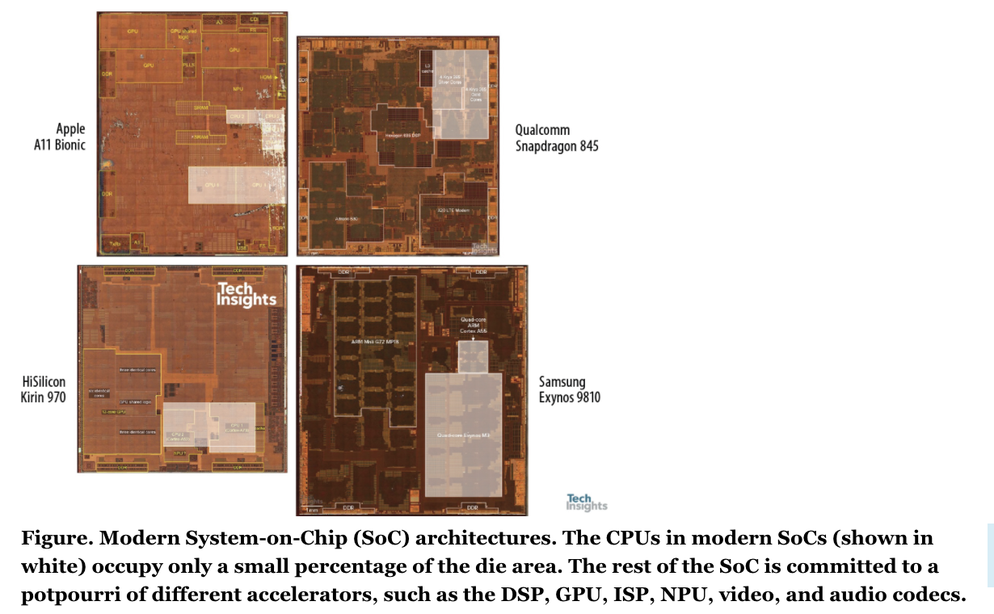
Scary new world at the edge (with Science of FM, it will be the Exciting New World!)
Exact quote from paper
We assert there is as yet no ``science’’ for debating and systematically answering basic questions for how to best facilitate broad, flexible, and effective use of multiple accelerators.
https://cacm.acm.org/magazines/2021/12/256949-accelerator-level-parallelism/fulltext
Our
New proposal:
SPACE
Safe
Pervasive
Accelerator
Concurrency
at the Edge

Slide 5
But let’s get back to work!
Dist termination!
Used to know when water-flow ceases
Hardy-Cross method (told to me by a Civil Engineer + FM person
Courtesy Dr. John Baugh
Also in Monte-Carlo simulations in HPC
When is the simulation over?
We used it for dist. Model-checking!
Study + design the protocol now!

Slide 6
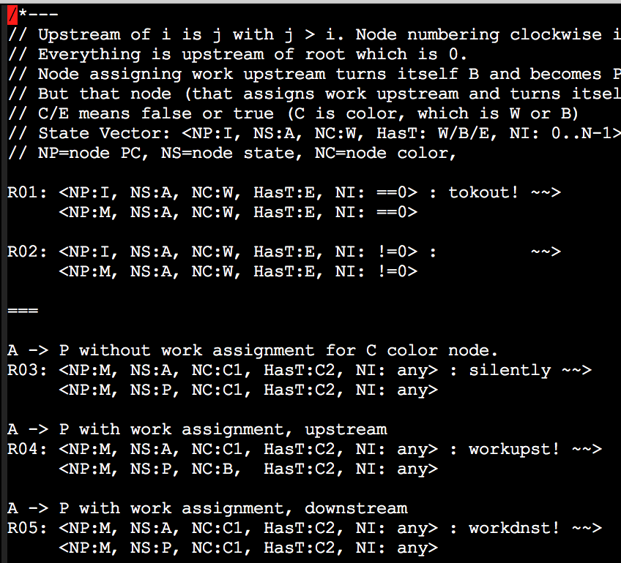
Dist Term

Slide 7
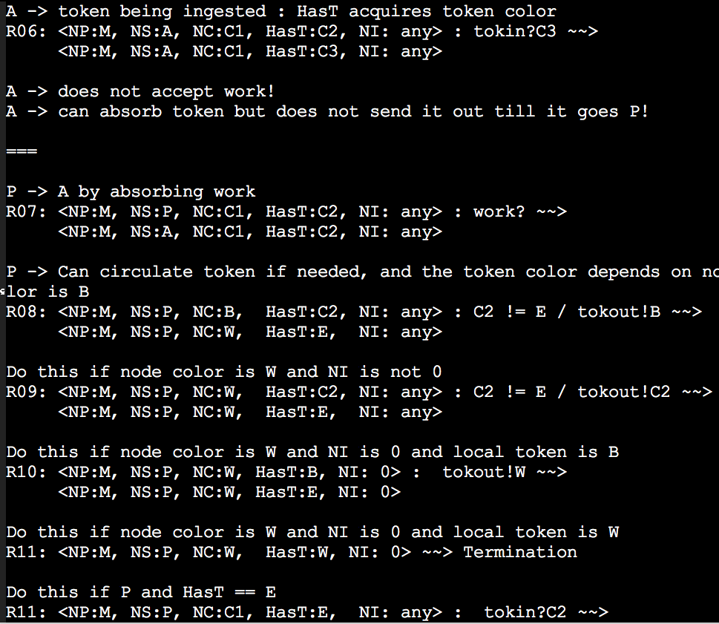
Dist Term

Slide 8
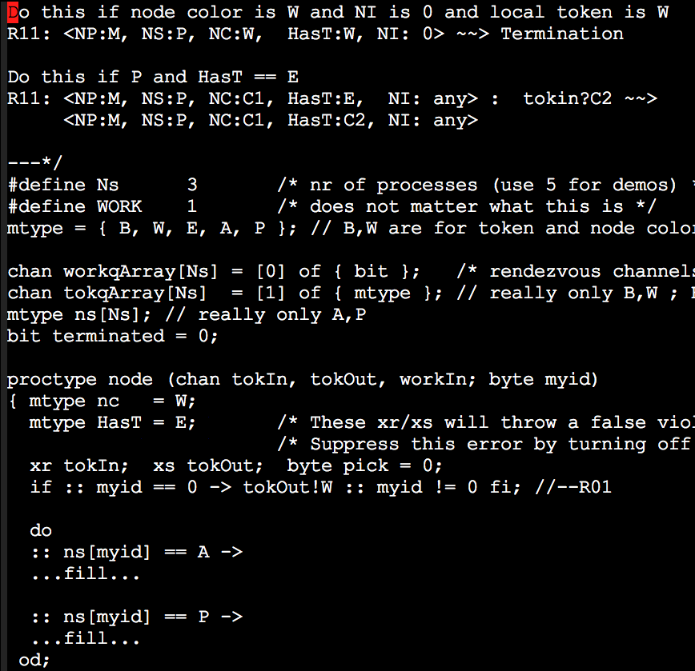
Dist Term

Slide 9
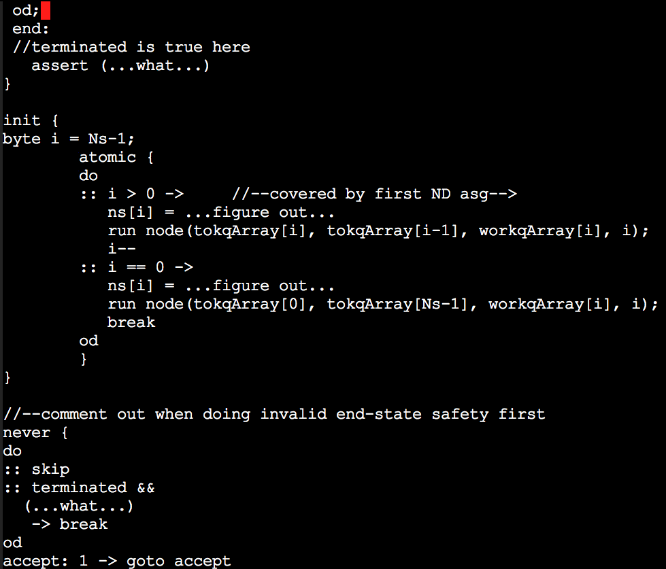
Dist Term

