Slide 1

TrueNeighbour
Building Stronger Communities- Unite Locally ,Grow Globally
Mutual Aid
Community Help
Merit System
Mobile-First
ABSTRACT COGNITORS • FOSS HACK• 2026

Slide 2
The Problem & Our Solution
😕 THE PROBLEM
✅ OUR SOLUTION
Neighbours don't know who needs help nearby
Hyper-local community help request feed
No trusted platform for local mutual aid
OTP-verified trusted identities
➜
Hard to find reliable community members
Claim & confirm request fulfillment
No accountability for commitments made
Merit score system for accountability
Community bonds are weakening in cities
Community posts, history & badges

Slide 3
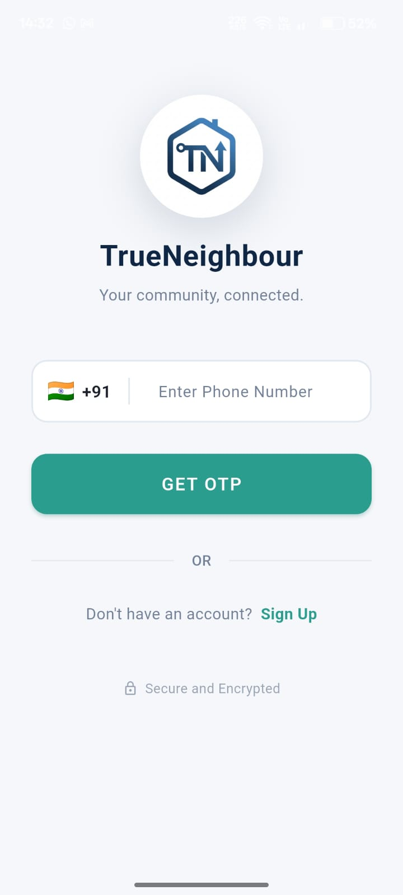
User Authentication — OTP Login
How It Works
🔐
Phone Number Registration
Enter your mobile number to get started — no email needed
📩
OTP Verification
Receive a 6-digit OTP via SMS — no passwords, ever
✅
Verified Identity
Account is tied to your real phone number for trust
🛡️
Community Trust
Only verified users can post or claim requests

Slide 4
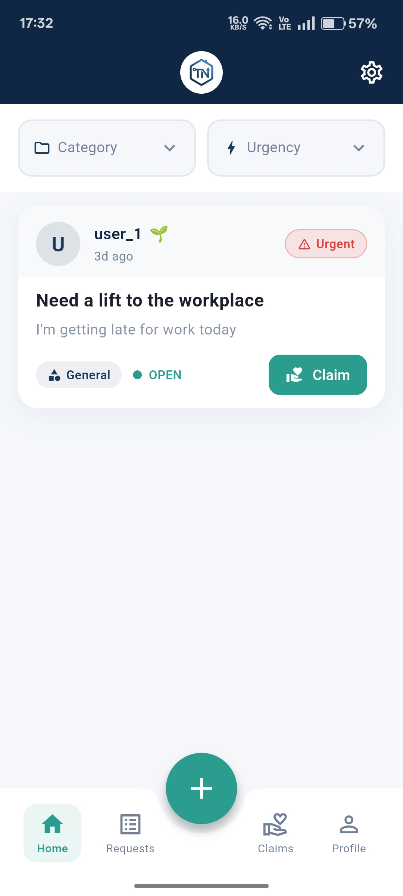
Main Feed — Community Requests
[ Screenshot: Main Feed ]
Feed Features
📋
Request Cards
Each post shows requester name, merit score, time posted, and a brief description
🏷️
Category Tags
Home, Tools, Transport, Education, Grocery, Medical — filterable
🚨
Urgency Levels
LOW / MEDIUM / HIGH urgency clearly visible on each card
🤝
Claim to Help
One tap to claim a request and notify the requester instantly
➕
Post a Request
Quick-access button to create a new help request from the feed

Slide 5
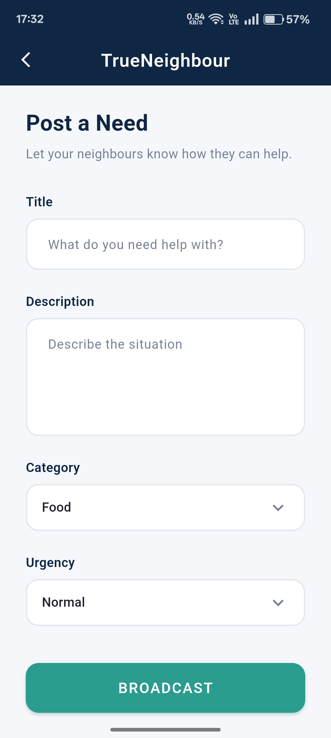
Posting a Request
Request Form Fields
✏️
Title
Short summary of what you need
📝
Description
Detailed explanation - context helps helpers respond faster
🏷️
Category
EMERGENCY · GENERAL · FOOD · MEDICAL
🚨
Urgency
LNORMAL · URGENT · CRITICAL — sets priority visibility in feed

Slide 6
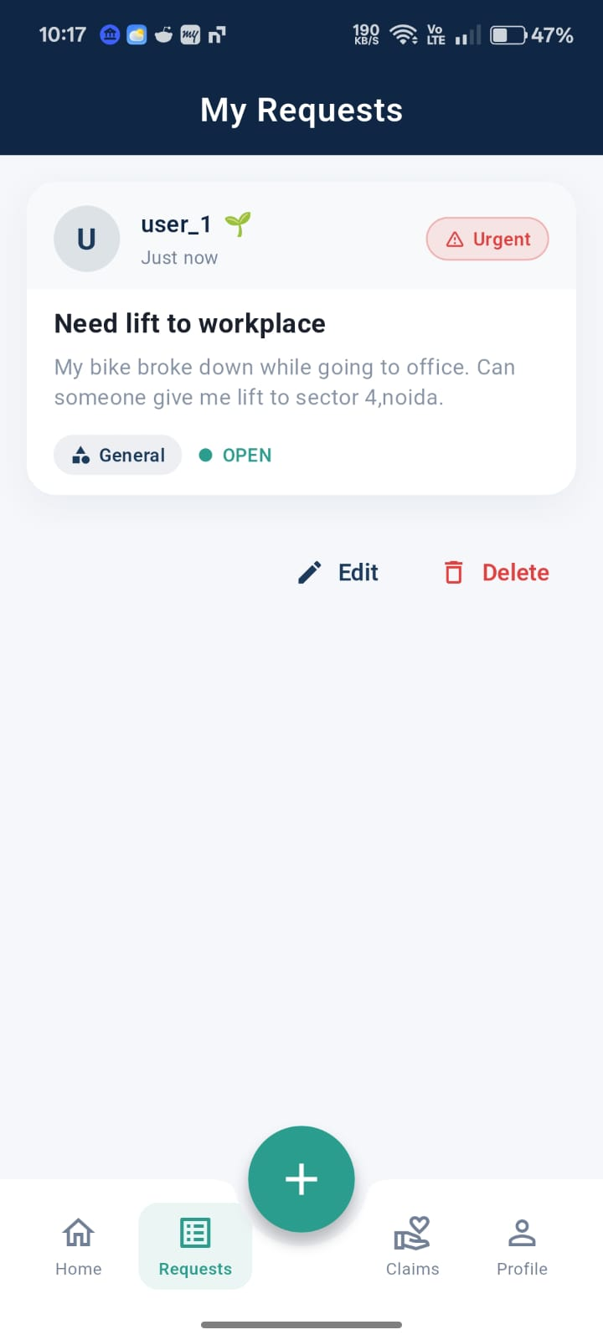
My Requests
Request Lifecycle
OPEN
No one has claimed it yet - visible to community
CLAIMED
Someone has stepped up - their name is shown
DONE
You confirmed the help was received successfully
✅ Confirm Completion Flow
Once your request is CLAIMED, you can see who claimed it and their merit score. After help is received, tap "Confirm Completed" — this closes the request and updates both users' history.

Slide 7
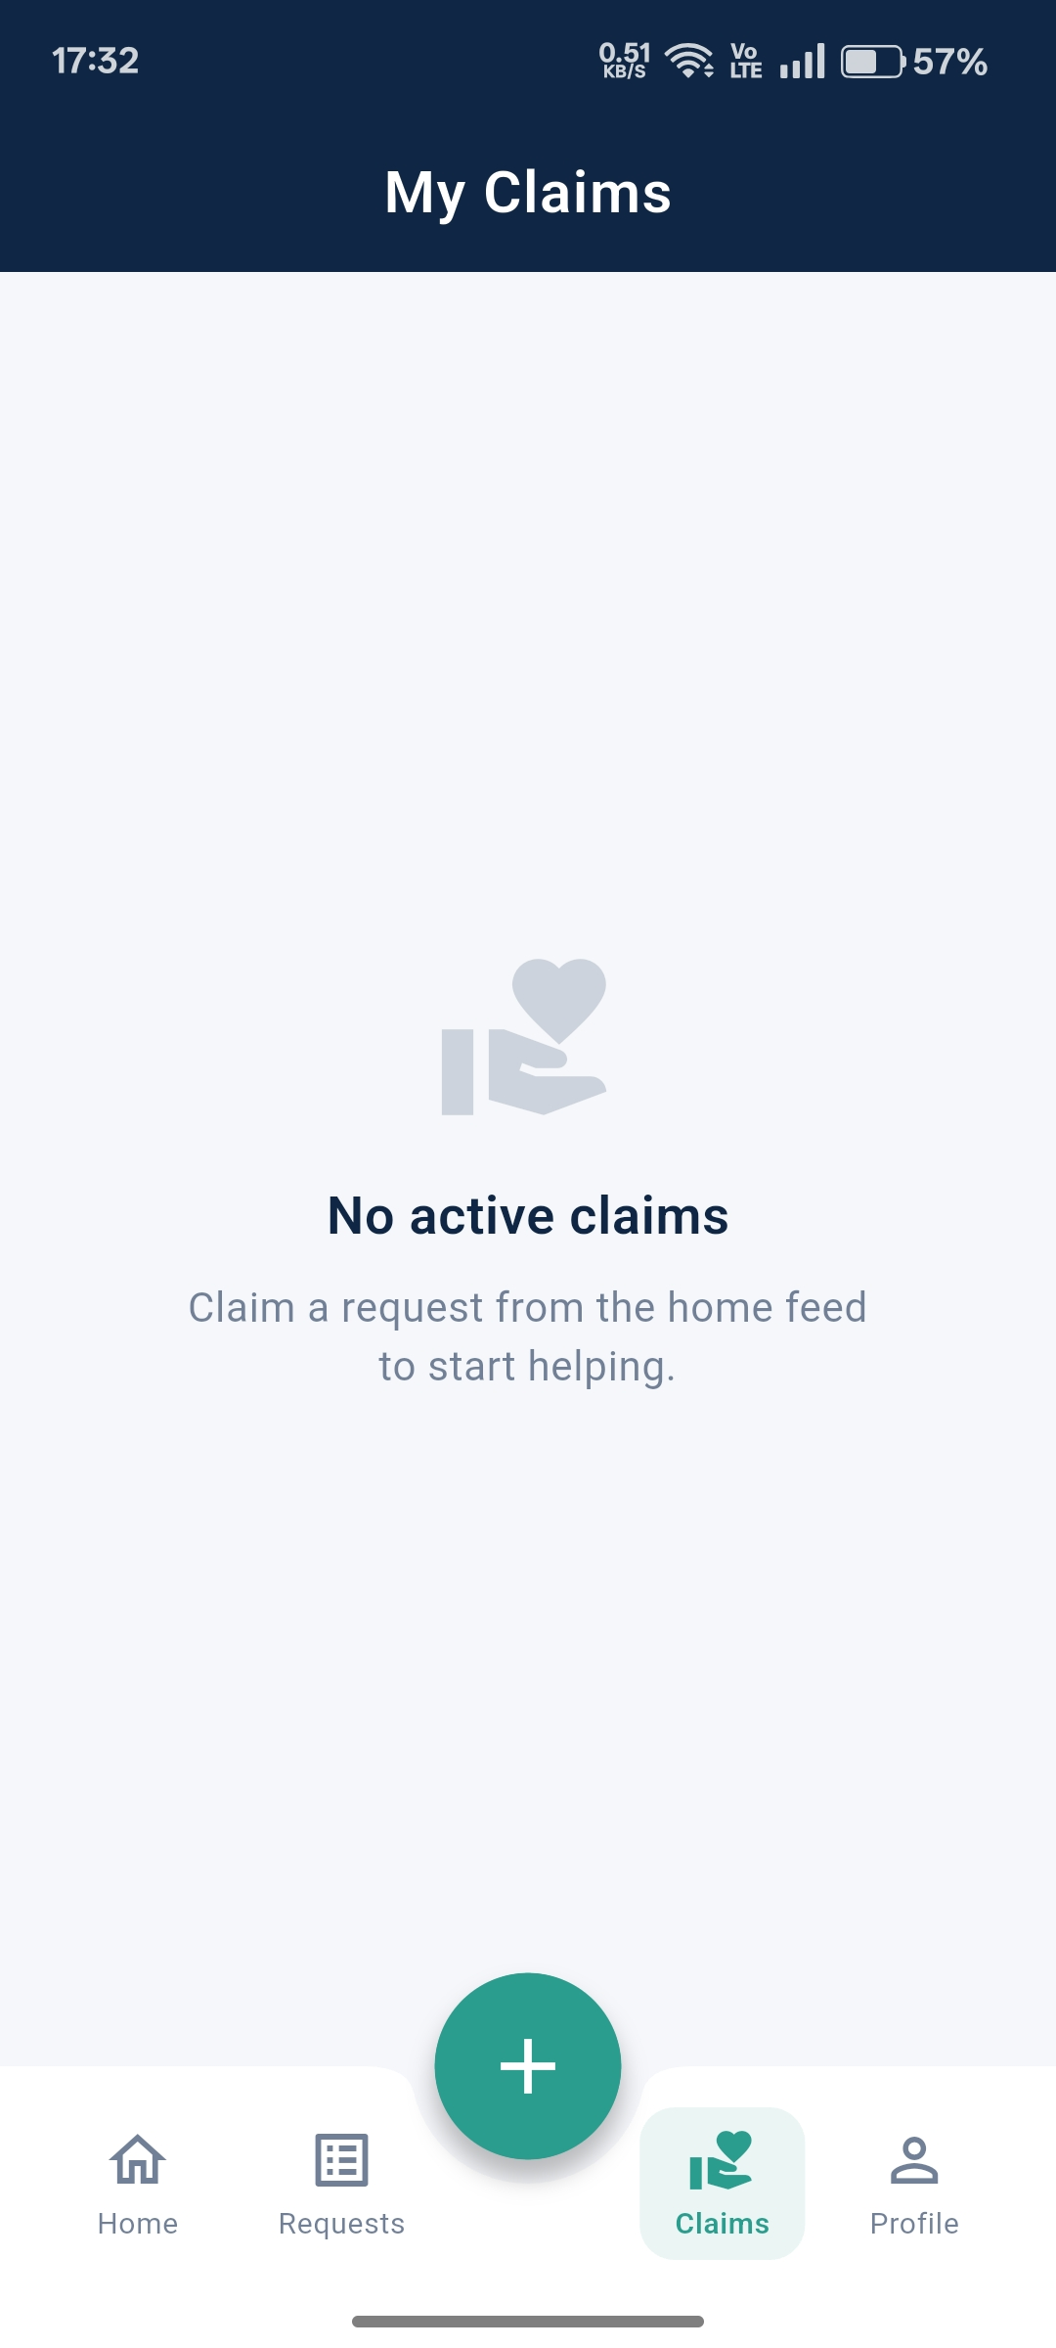
My Claims
What You See Here
🤝
Requests You've Claimed
All requests where you stepped up to help are listed here
👤
Requester Details
See the requester's name, merit score, and contact info
⏳
Awaiting Confirmation
After helping, you wait for the requester to confirm completion
✅
Completed Claims
Successfully confirmed helps appear here with merit earned
🌟
Merit Impact
Each confirmed help boosts your merit score visible to all

Slide 8
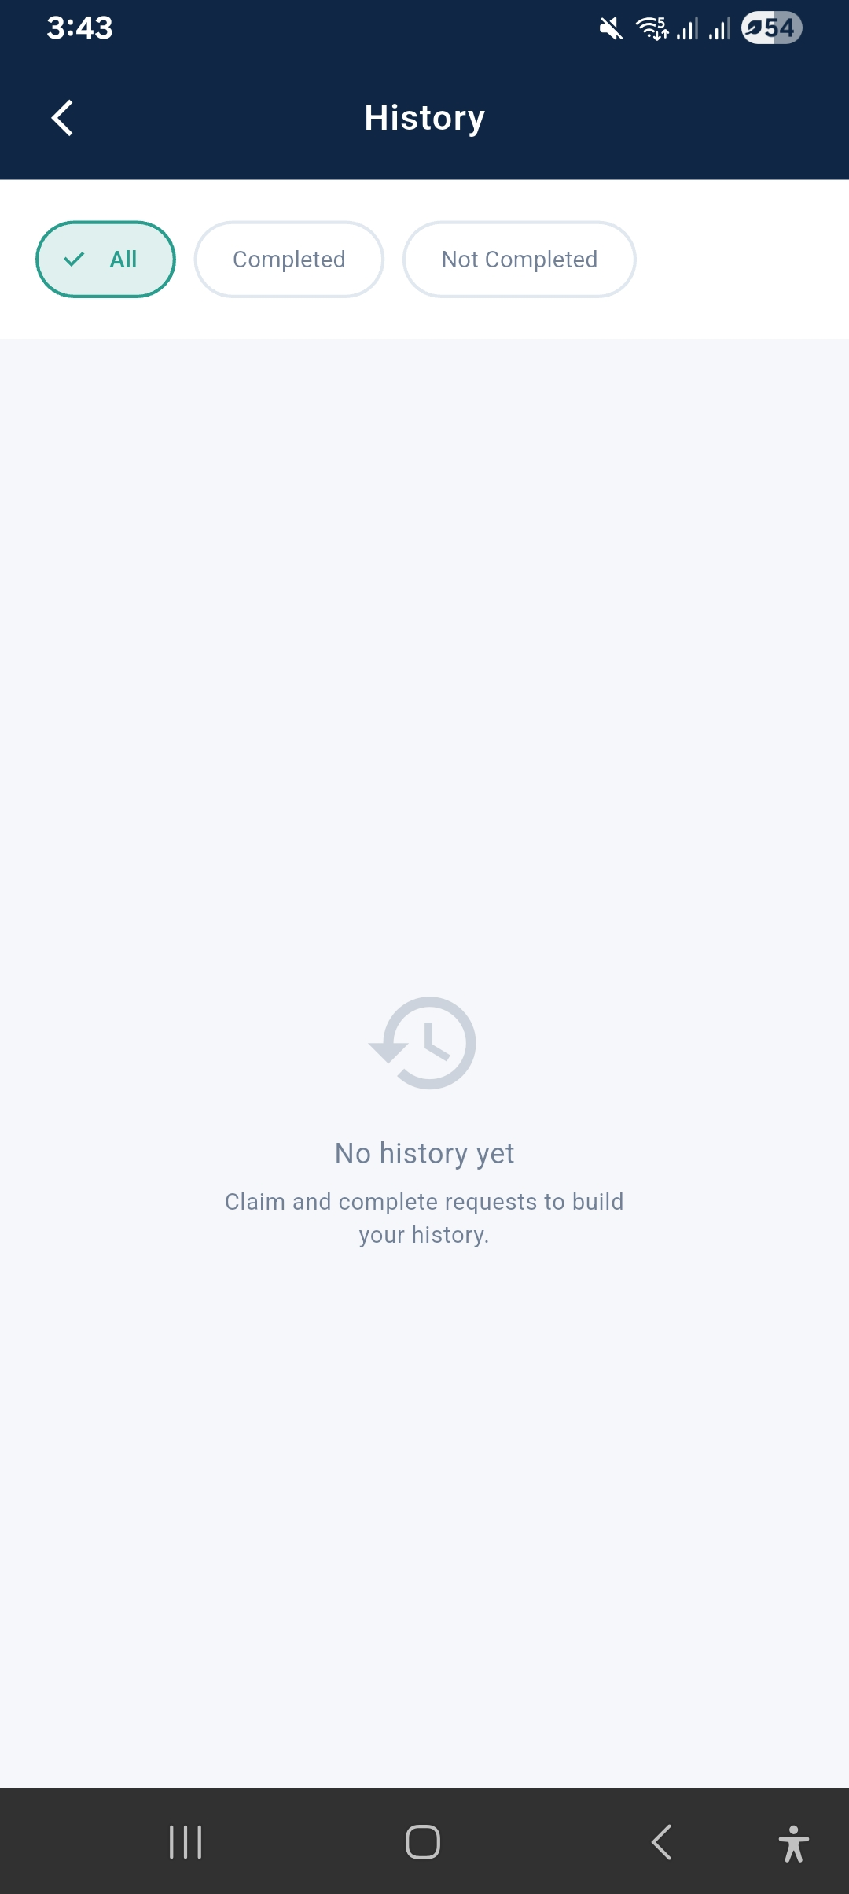
History
[ Screenshot: History Screen ]
Everything in One Place
✅
Requests You Made
Every request you posted — open, claimed, and completed
🤝
Help You Provided
All the times you stepped in for community members
⭐
Merit Changes
+/- points logged for every activity — full transparency
⚠️
Missed Commitments
Claimed but didn't follow through — shown in red with penalty

Slide 9
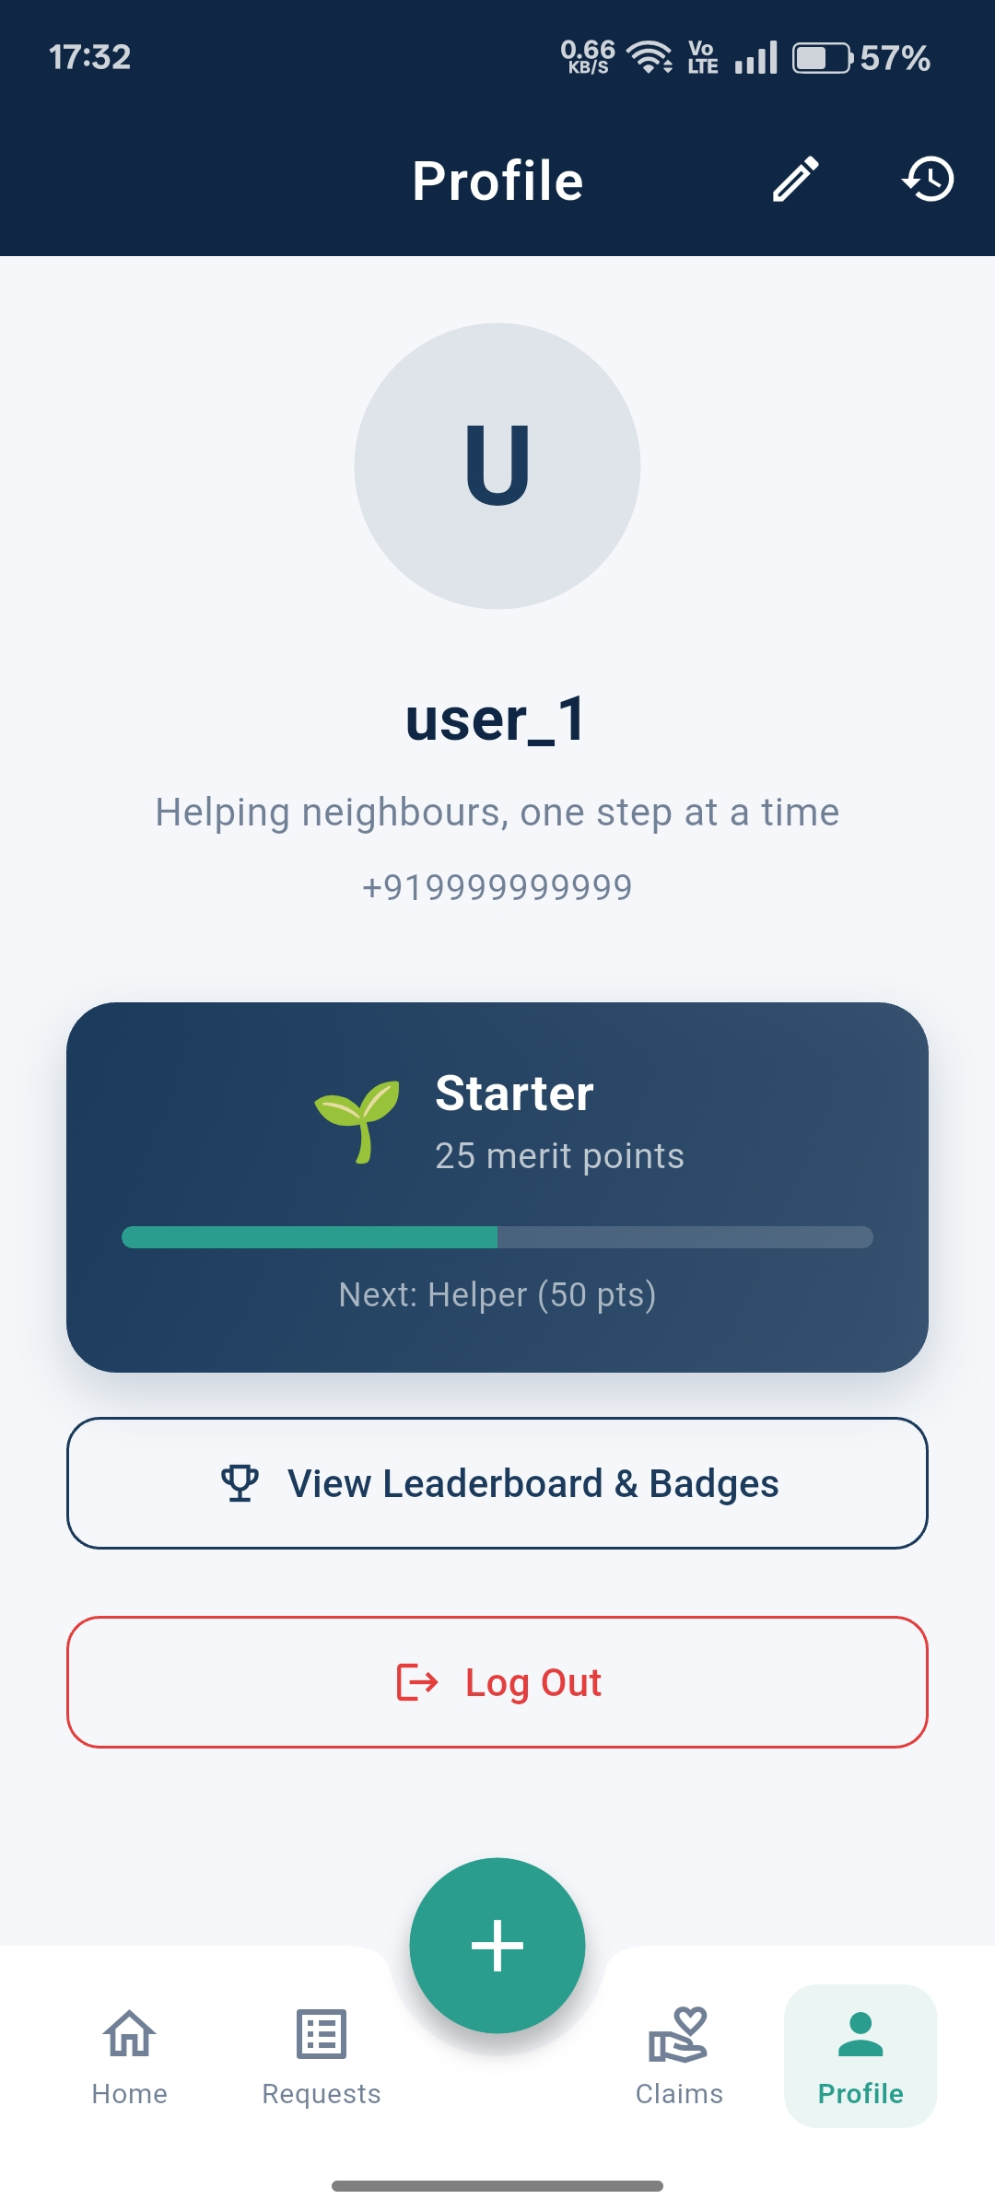
Merit & Badges
Merit Score Logic
+3 to +10
Helping someone (confirmed by requester)
−5 to −15
Claiming but not following through (missed)
−10 to −20
Reported for misconduct by community
0
Posting a request (no merit change)
Badges You Can Earn
🌱
🤝
🏆
⭐
Starter
Helper
Champion
legend

Slide 10
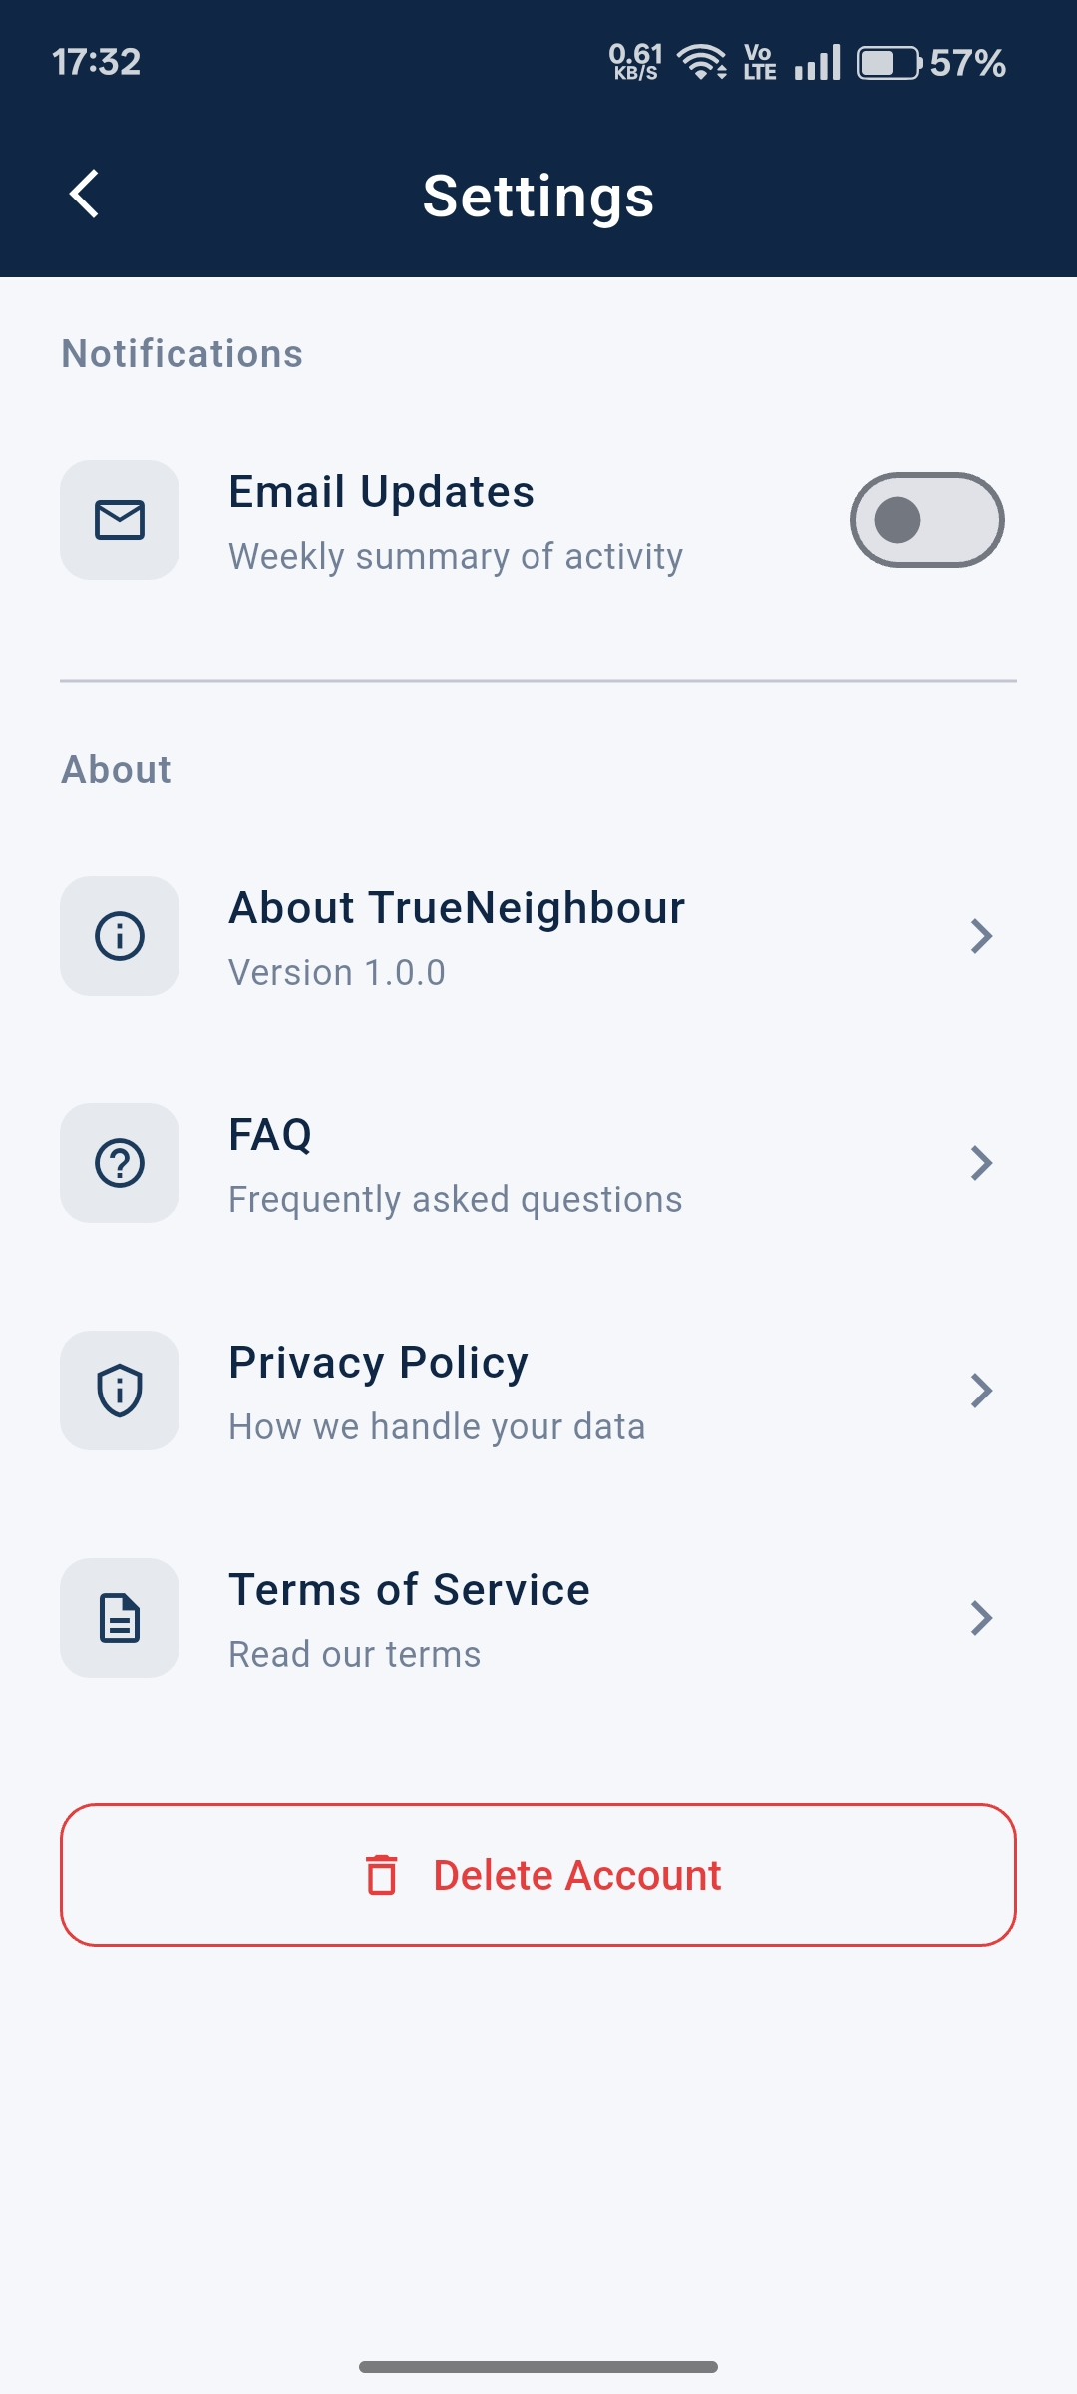
Settings
👤 Account Settings
een ]
Edit Profile (Name, Photo, Bio)
E-Mail updates
Privacy Controls
Notification Preferences
User FAQs

Slide 11
Tech Stack & Key Features
Technology Stack
📱
🔥
📩
Flutter
Firebase
SMS
Mobile App
Auth & DB
OTP Service
Core Feature Highlights
📱 OTP-based verified login
🏘️ Hyper-local community feed
📋 Post with category & urgency
🤝 Claim & confirm request flow
📜 Complete activity history
⭐ Merit score system
🏅 Badges for community service
TrueNeighbour • Unite Locally ,Grow Globally.

