Slide 1
Diabetes Prediction

Slide 2
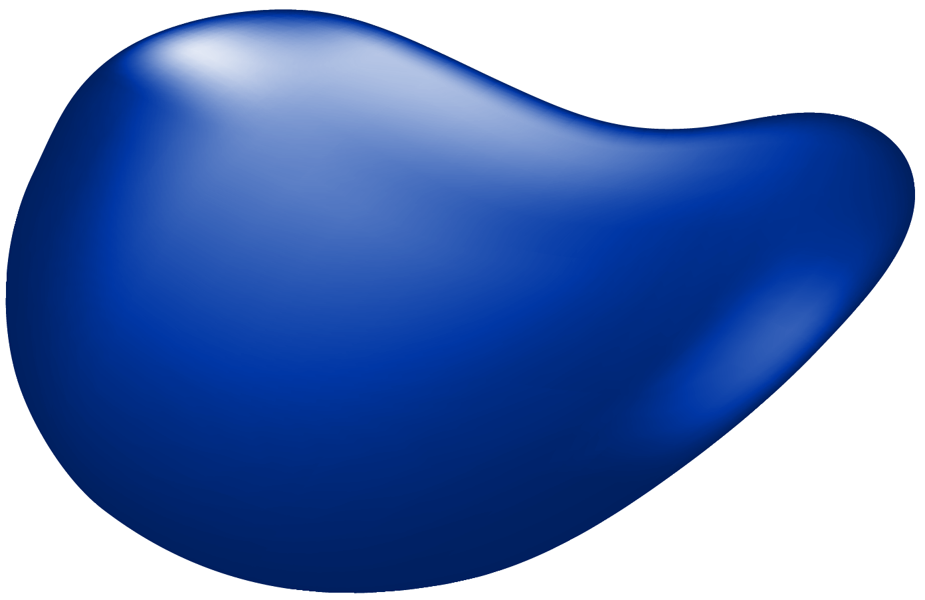
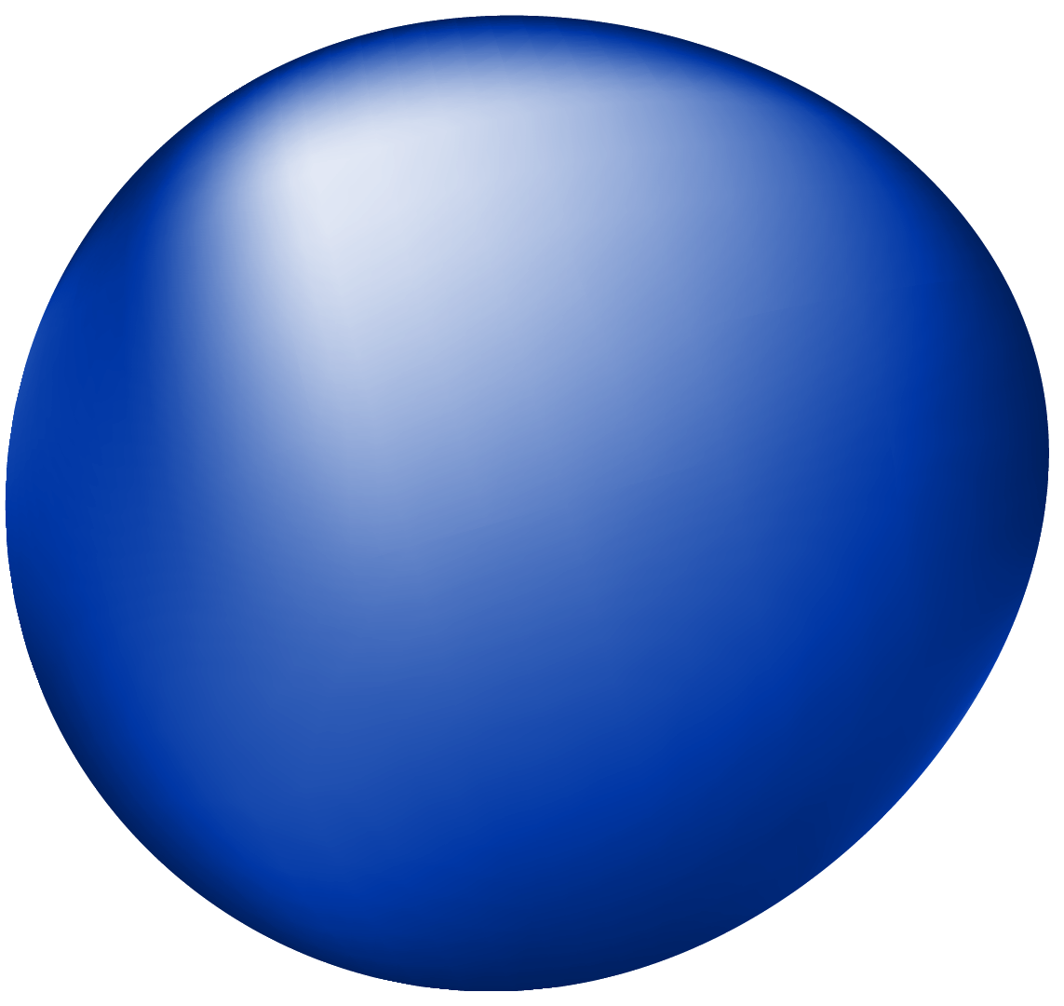
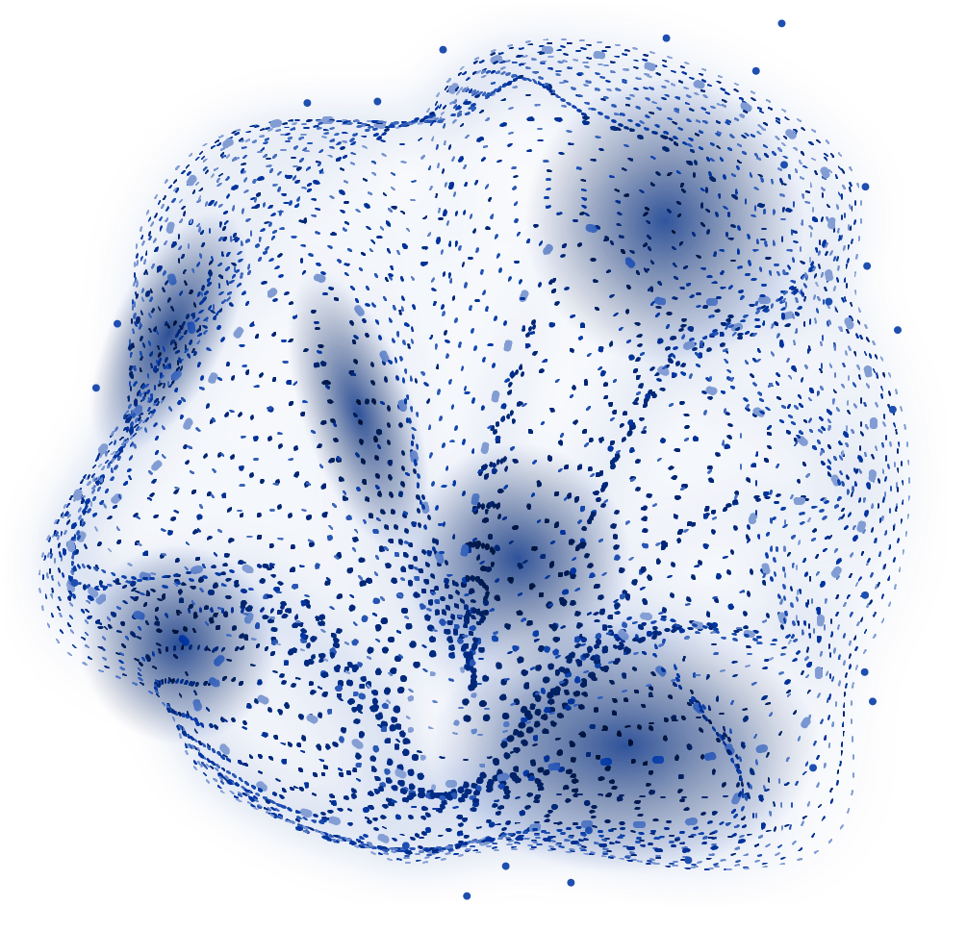
Abstract
Objective: Predict diabetes using multiple machine learning models.
Focus: Data preprocessing, exploratory analysis, and model evaluation.
Models Evaluated: Logistic Regression, Decision Tree, Random Forest, SVM, and KNN.
Key Results: Random Forest achieved the highest accuracy among all models.

Slide 3

Introduction
Diabetes is a chronic disease impacting millions globally.
Timely detection and prediction can improve treatment outcomes.
Machine learning techniques help analyze large datasets for accurate predictions.

Slide 4

Dataset Overview
Dataset: Pima Indians Diabetes dataset.
Features: 8 attributes such as Glucose, BMI, and Age.
Target: Binary outcome (0: No Diabetes, 1: Diabetes).
Dataset Source: Publicly available via UCI Machine Learning Repository.

Slide 5
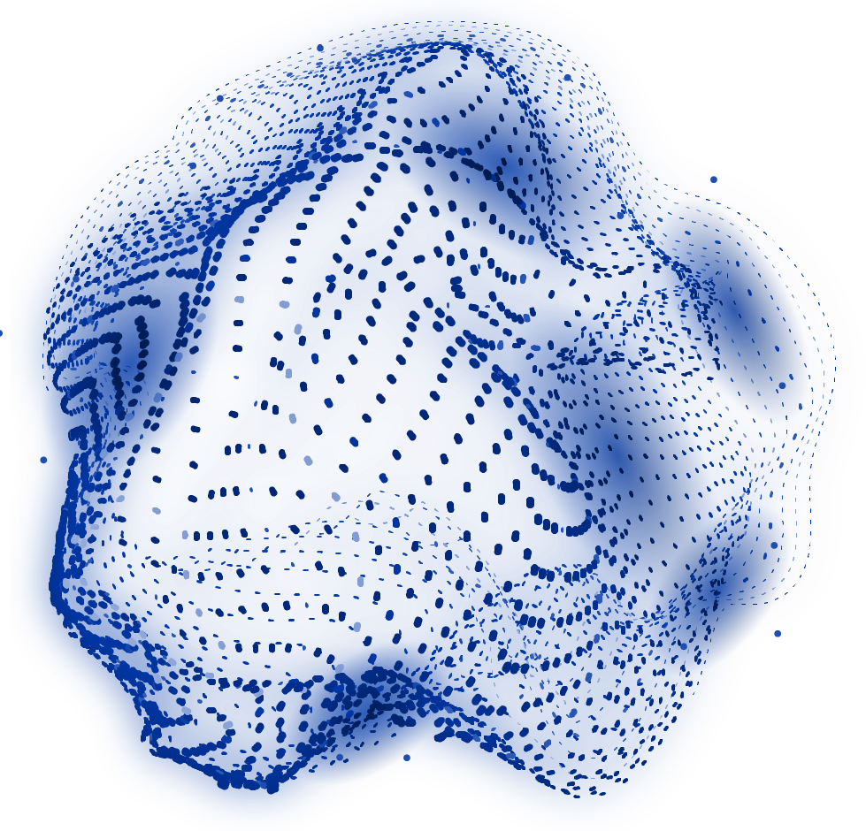
Data Preprocessing
Replaced invalid zeros in key features with median values (e.g., Glucose, BMI).
Scaled numerical features using StandardScaler for consistency.
Split dataset into training (80%) and testing (20%) subsets.

Slide 6
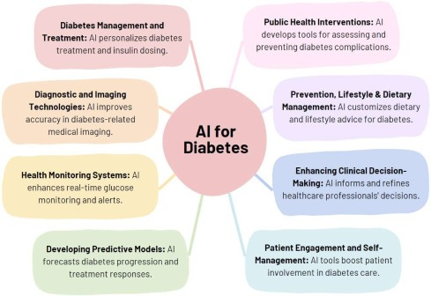
Exploratory Data Analysis (EDA)
Visualized feature distributions stratified by diabetes outcome.
Identified significant features like Glucose and BMI impacting diabetes outcomes.
Analyzed correlation between features using a heatmap.
`

Slide 7

Model Training and Testing
Machine Learning Models: Logistic Regression, Decision Tree, Random Forest, SVM, and KNN.
Evaluation Metrics: Accuracy, Precision, Recall, and F1-Score.
Random Forest achieved the highest accuracy of 85%.
SVM and Logistic Regression performed well on precision.

Slide 8
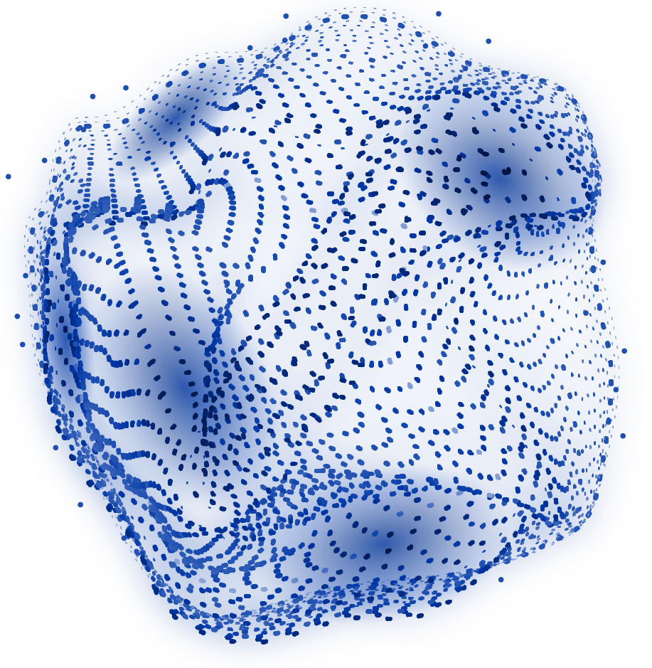
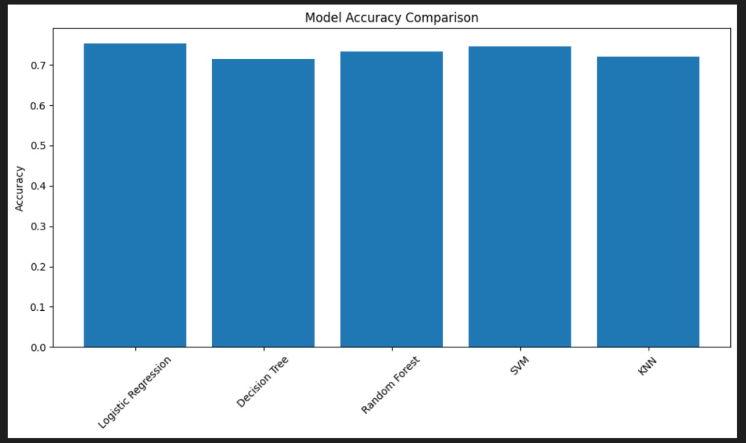
Results and Evaluation
Bar chart comparison showed logistic regression outperforming other models.
Classification reports provided insights into false positives and false negatives.
Model robustness improved through hyperparameter tuning.

Slide 9
Applications and Insights
- Healthcare: Predictive tools for early diabetes diagnosis.
- Research: Understanding factors influencing diabetes outcomes.
- Features like Glucose and BMI are crucial predictors.
- Data quality significantly affects model performance

Slide 10
Workflow of the Model
1. Load dataset and preprocess (handle missing values, scaling).
2. Perform exploratory data analysis (visualize distributions, correlations).
3. Split data into training and testing subsets.
4. Train machine learning models (Logistic Regression, Decision Tree, etc.).
5. Evaluate models using metrics (Accuracy, Precision, Recall).
6. Compare results and select the best model.

Slide 11
Conclusions and Future Work
- Random Forest is the most effective model for diabetes prediction.
- Data preprocessing plays a vital role in improving model accuracy.
- Experiment with neural networks for higher accuracy.
- Integrate real-time patient data for dynamic predictions.

Slide 12



MEET OUR TEAM
TAMNAY JAIN
(E23CSEU0335)
KRISH SHARMA
(E23CSEU0359)
HITEN DHAMIJA
(E23CSEU0332)
WORKED ON
BACKEND AND
AI MODELS
WORKED ON
DATA PREPROCESSING
AND FROMNTEND
WORKED ON
FRONTEND AND
MODEL TRAINING

