Slide 1
SPSS Data Analysis
Drowning in Data
22nd April 2014
ROSLE MOHIDIN
Senior Lecturer
School Of Business & Economics, UMS

Slide 2
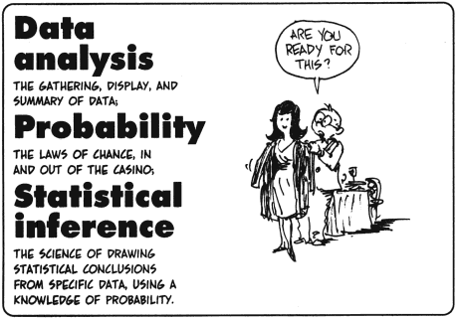

Slide 3
Presentation Outline
SPSS Environment -Review of SPSS Basics
  SPSS interface: data view and variable view
  How to enter data in SPSS
  How to clean and edit data
  How to transform variables
  How to sort and select cases
  How to get descriptive statistics
Inferential Statistics in SPSS
  Independent t-test
  Regression

Slide 4
Features of SPSS
Originally developed for the people in Social Science Areas, therefore, no heavy programming background required
Designed as User Friendly and has Pull Down Menus to Execute Statistical Commands
Ability to do Data Management & Manipulations
Ability to Store Programs & Produce Reports/Graphs

Slide 5
SPSS Program Flow
Outside
Data
Source
Importing
SPSS
Data
File
Data
Modification/
Transformation
Data Analysis
Raw
Data
Direct Entry
Pull-Down
Menu
OR
Syntax
Menu
(Data Steps)
(Analysis Steps)

Slide 6
An Example of Research use SPSS a tool of Data analysis
Youth Risk Behavior Surveillance System (YRBSS, CDC)
  YRBSS monitors priority health-risk behaviors and the prevalence of obesity and asthma among youth and young adults.
  The target population is high school students
  Multiple health behaviors include drinking, smoking, exercise, eating habits, etc.

Slide 7
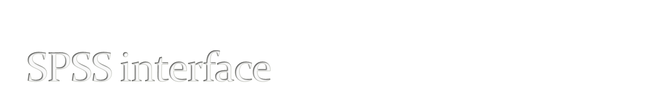
Data view
  The place to enter data
  Columns: variables
  Rows: records
Variable view
  The place to enter variables
  List of all variables
  Characteristics of all variables

Slide 8

You need a Questionnaire/code book/scoring guide
You give ID number for each case (NOT real identification numbers of your subjects) if you use paper survey.
If you use online survey, you need something to identify your cases.
You also can use Excel to do data entry.

Slide 9
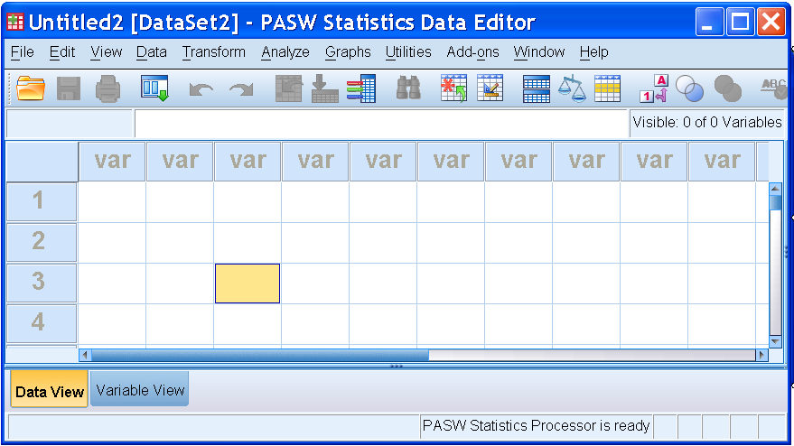
Data View Window - Data Entry Site
(Columns=Variables, Rows=Cases)
Help Menu
Pull-down Menu bar
Tool bar
Information bar
Title bar
Variable
Names
Data View window
Active cell
Action bar

Slide 10
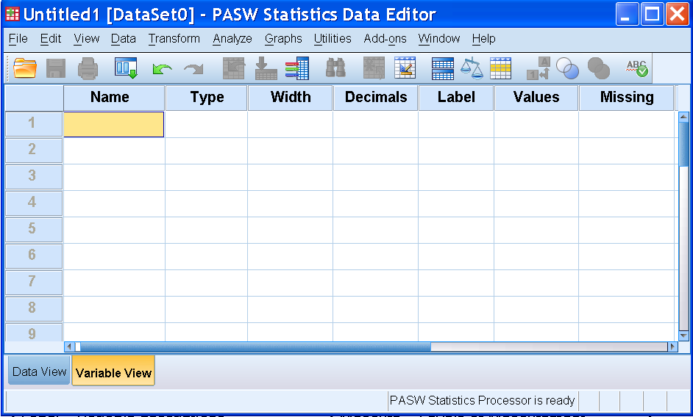
Variable View Window
Data Definition Site
64 Characters
Max, No space
Between
Beg letter, @, #, or $
Numeric,
String, &
Others
Length
# of
Decimals
Variable
Description
Value
Code
Description
Missing value
Description
Click here to see this view

Slide 11

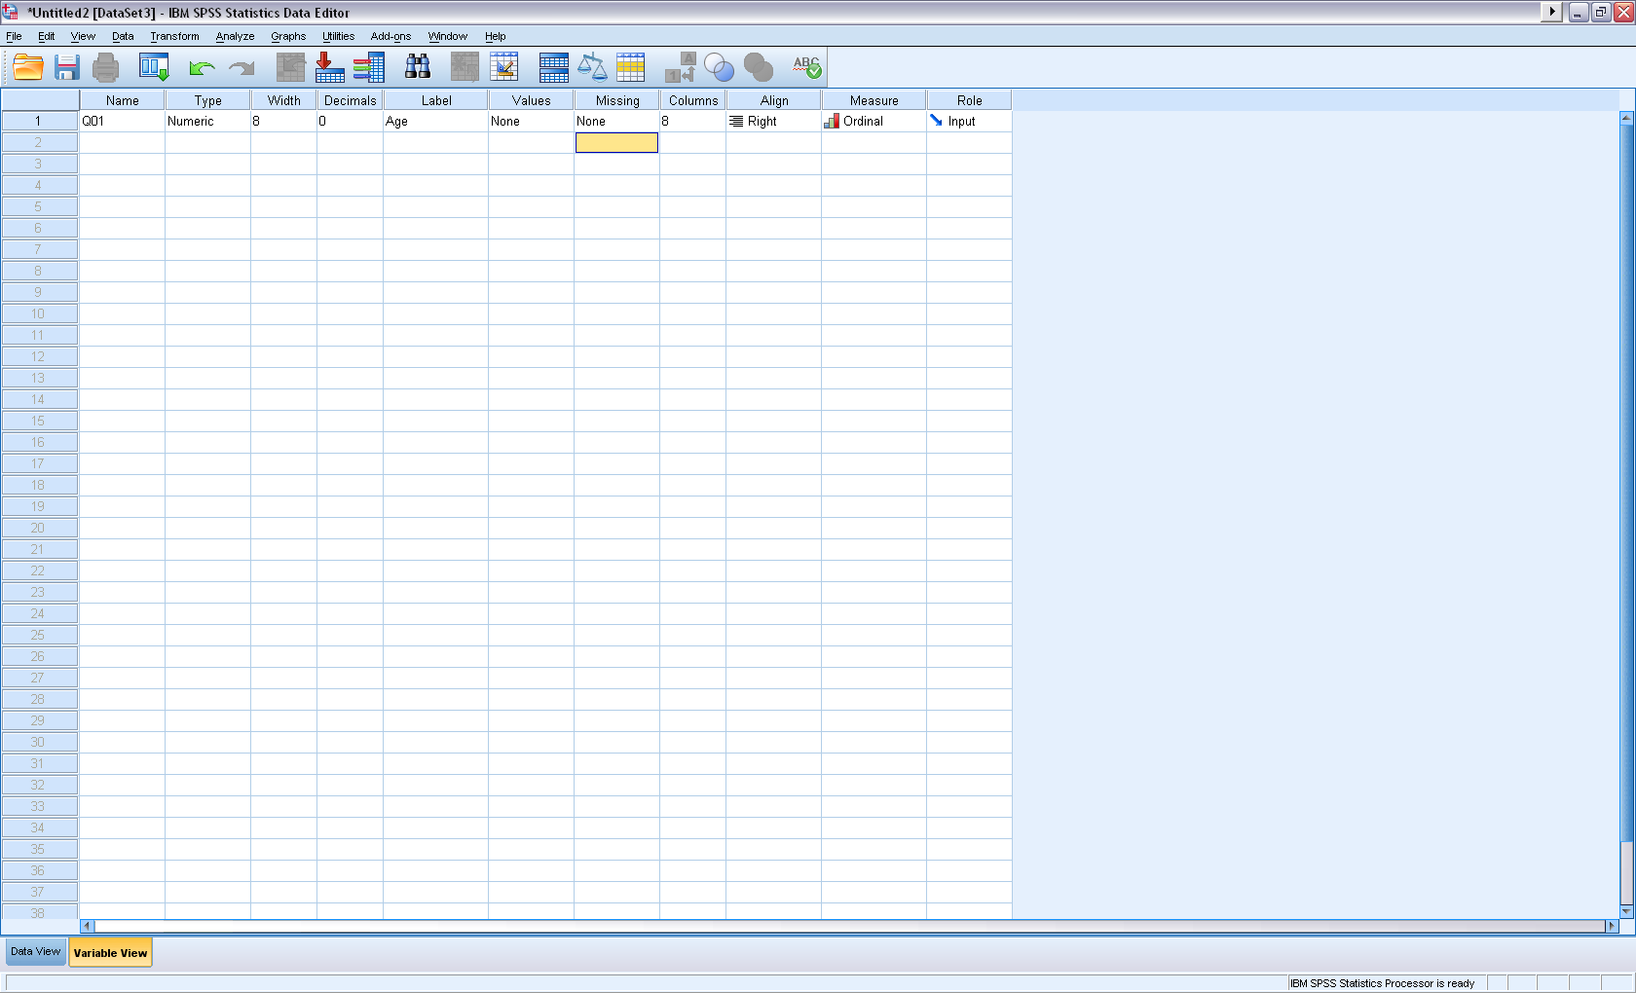
Click Variable View
Type variable name under Name column (e.g. Q01).
NOTE: Variable name can be 64 bytes long, and the first character must be a letter or one of the characters @, #, or $.
Type: Numeric, string, etc.
Label: description of variables.
2. Type variable name
4. Description of variable
3. Type: numeric or string
1. Click this Window

Slide 12
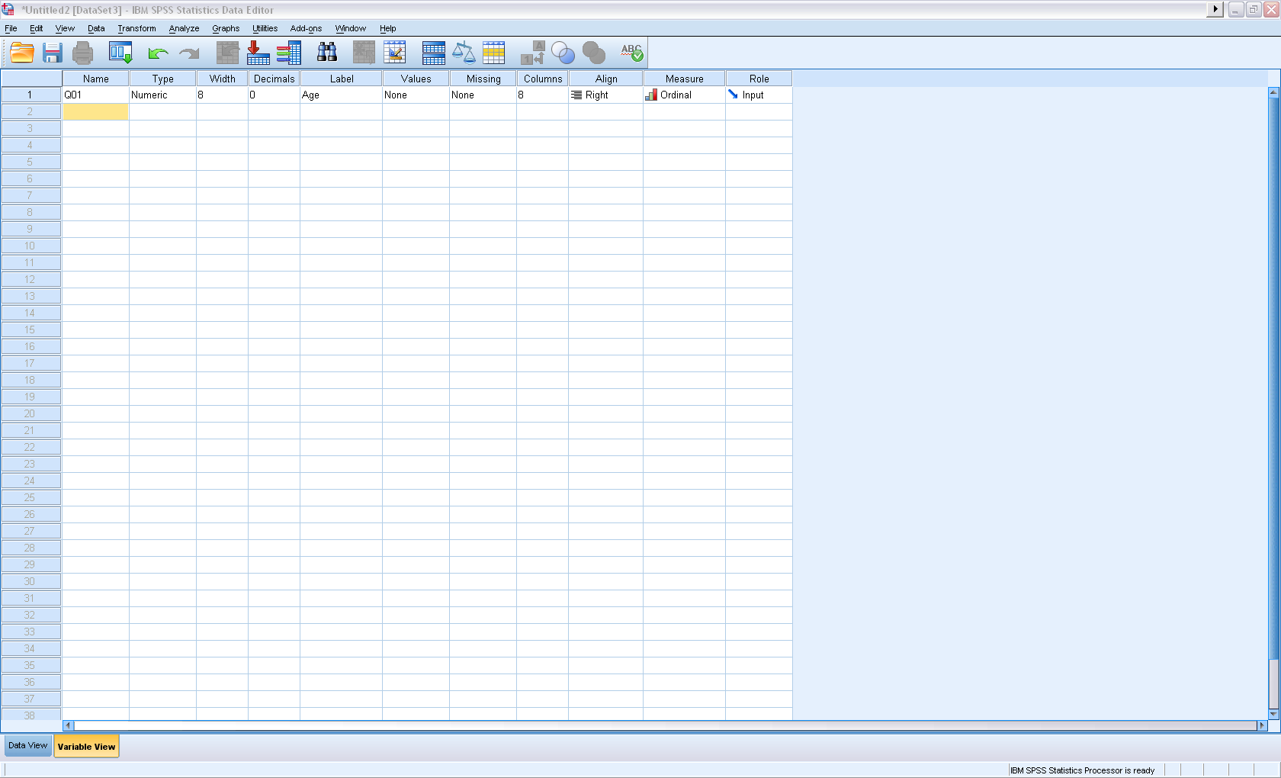
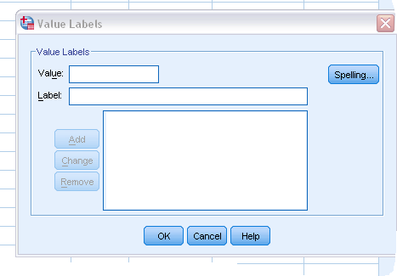
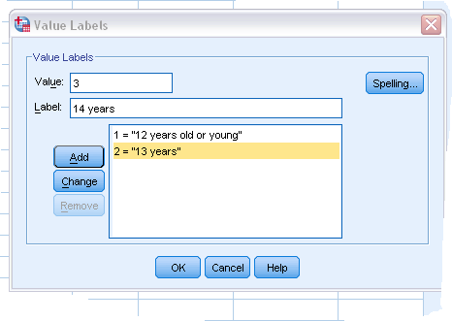
Based on your code book!

Slide 13

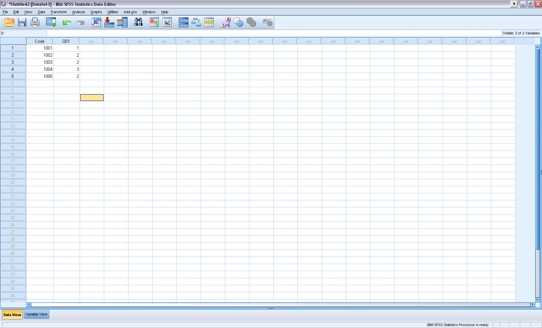
Two variables in the data set.
They are: Code and Q01.
Code is an ID variable, used to identify individual case (NOT people’s real IDs).
Q01 is about participants’ ages: 1 = 12 years or younger, 2 = 13 years, 3 = 14 years…
Under Data View

Slide 14

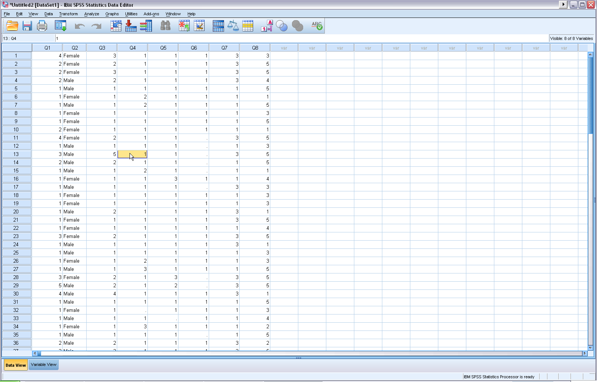
Save this file as SPSS data

Slide 15
Cleaning the Data
Key in values and labels for each variable
Run frequency for each variable
Check outputs to see if you have variables with wrong values.
Check missing values and Questionnaire if you use surveys, and make sure they are real missing.
Sometimes, you need to recode string variables into numeric variables

Slide 16
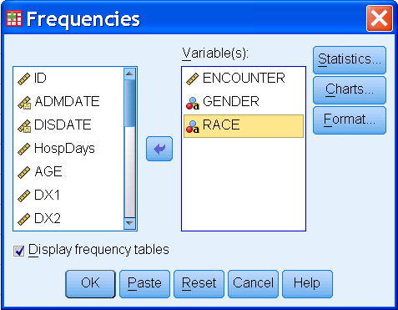
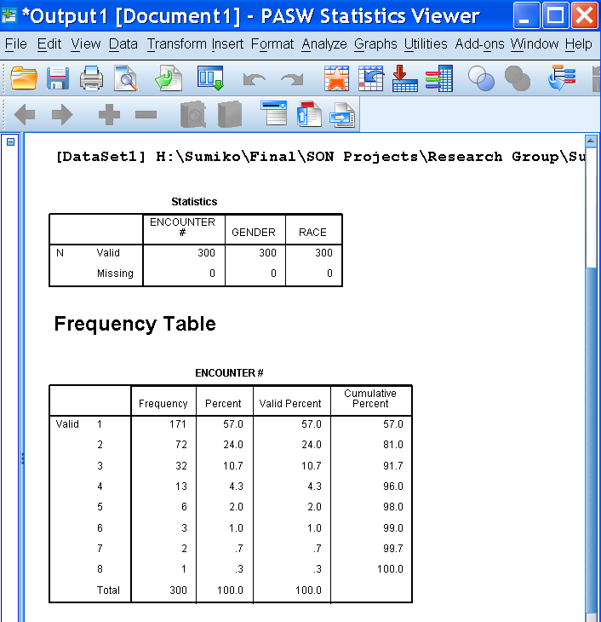
Before we see Examples…
OK
Paste
VS.
buttons
<Output File>
1. OK - results/action
will be executed

Slide 17
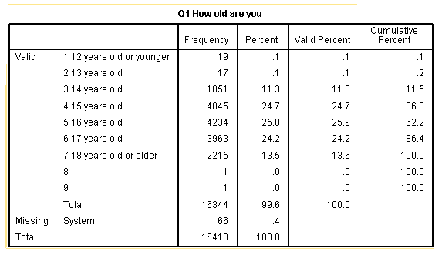
Wrong entries

Slide 18

Descriptive statistics
  Purposes:
  Find wrong entries
  Have basic knowledge about the sample and targeted variables in a study
  Summarize data
Analyze Descriptive statistics Frequency

Slide 19
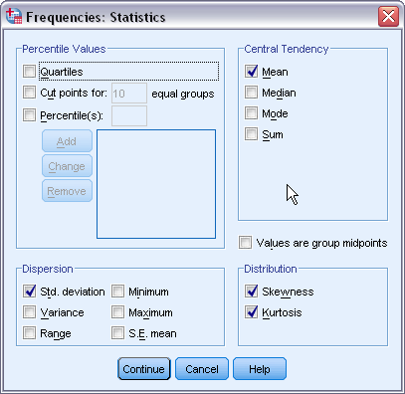
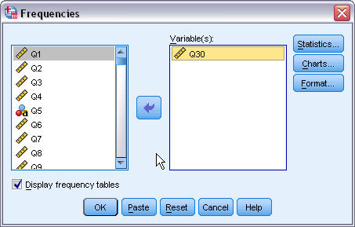
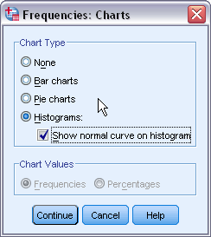

Slide 20

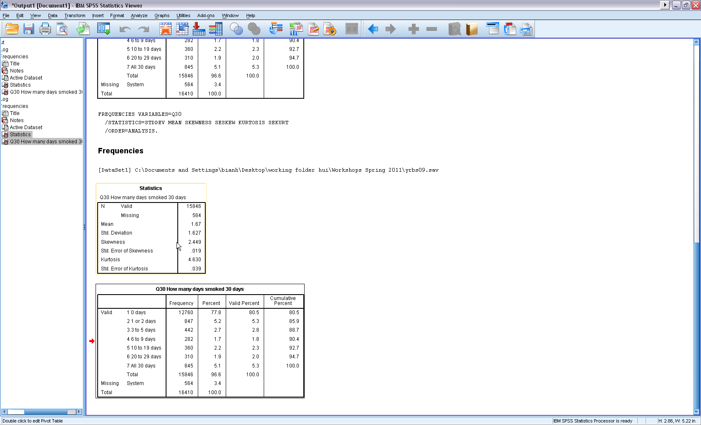

Slide 21
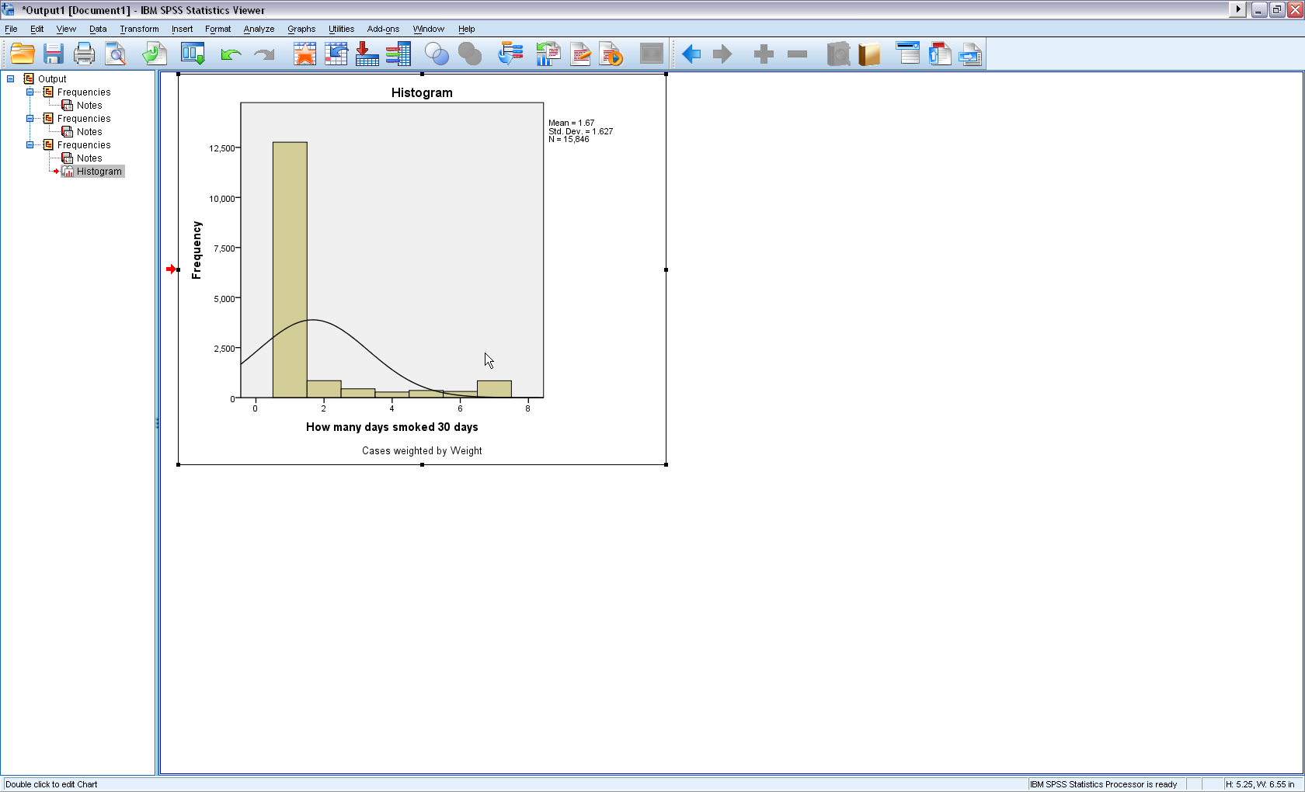
1. Skewness: a measure of the
asymmetry of a distribution.
The normal distribution is
symmetric and has a skewness
value of zero.
Positive skewness: a long right tail.
Negative skewness: a long left tail.
Departure from symmetry : a
skewness value more than twice
its standard error.
2. Kurtosis: A measure of the extent
to which observations cluster around
a central point. For a normal
distribution, the value of the kurtosis
statistic is zero. Leptokurtic data
values are more peaked, whereas
platykurtic data values are flatter and
more dispersed along the X axis.
Normal Curve

Slide 22
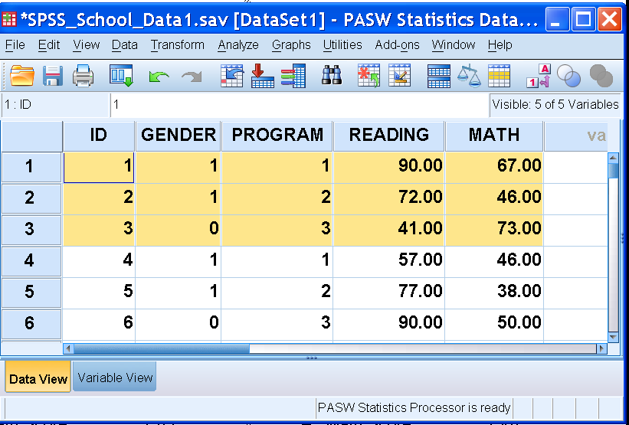
Example - School Data
Raw Data
Subject 1
  Subject # (1)
  Female (1)
  Intensive (1)
  Reading (90)
  Math (67)
Subject 2
  Subject # (2)
  Female (1)
  Moderate (2)
  Reading (72)
  Math (46)
Subject 3
  Subject # (3)
  Male (0)
  Basic (3)
  Reading (41)
  Math (73)

Slide 23
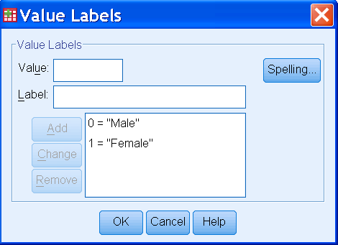
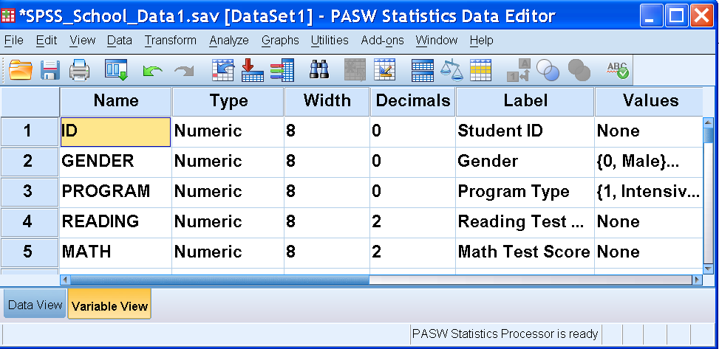
School Data
Variable View
Variable View Activated

Slide 24
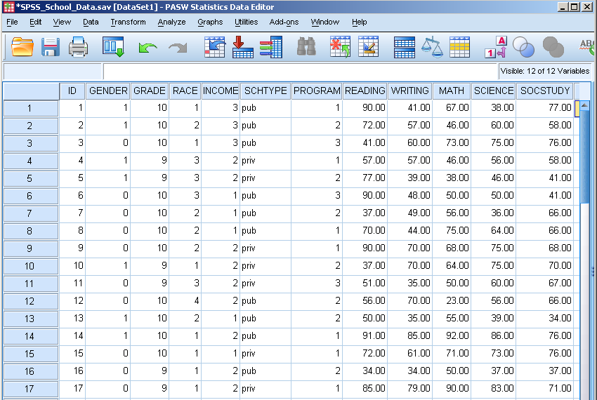
School Data
Completed Dataset – Data View

Slide 25
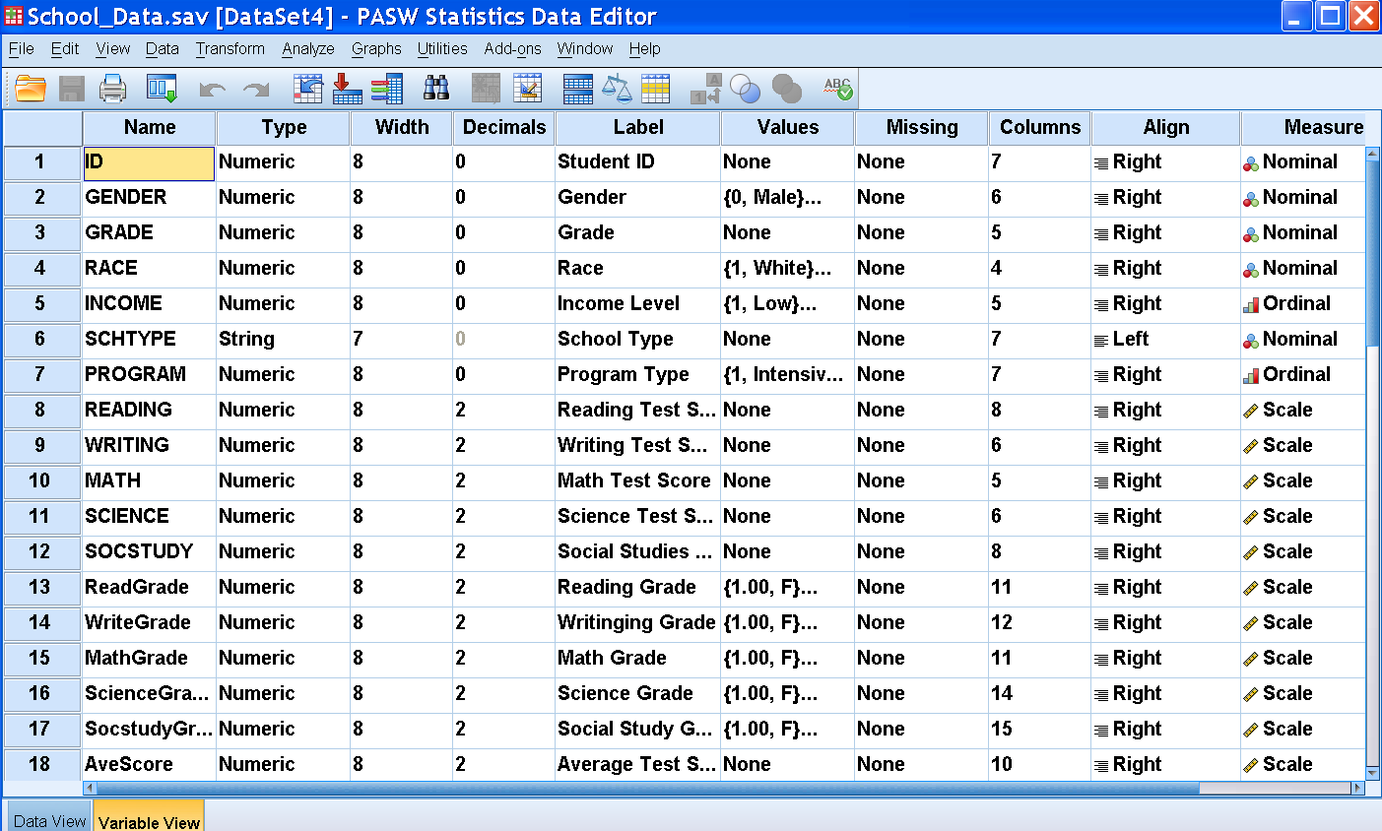
School Data
Completed Dataset – Variable View

Slide 26
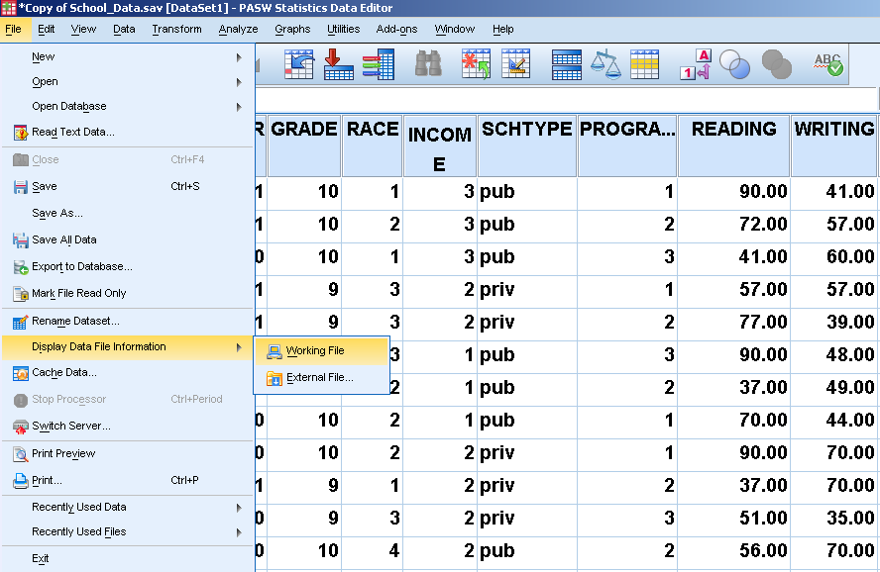
Click to Obtain
Data File Information

Slide 27
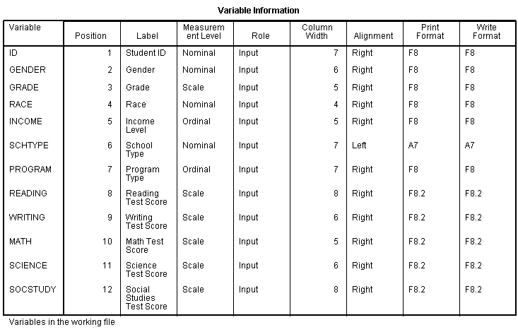
Variable Information

Slide 28
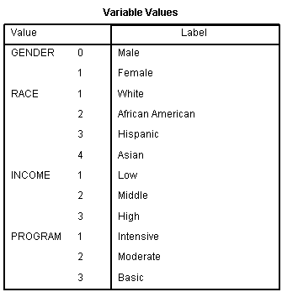
Value Code Information

Slide 29
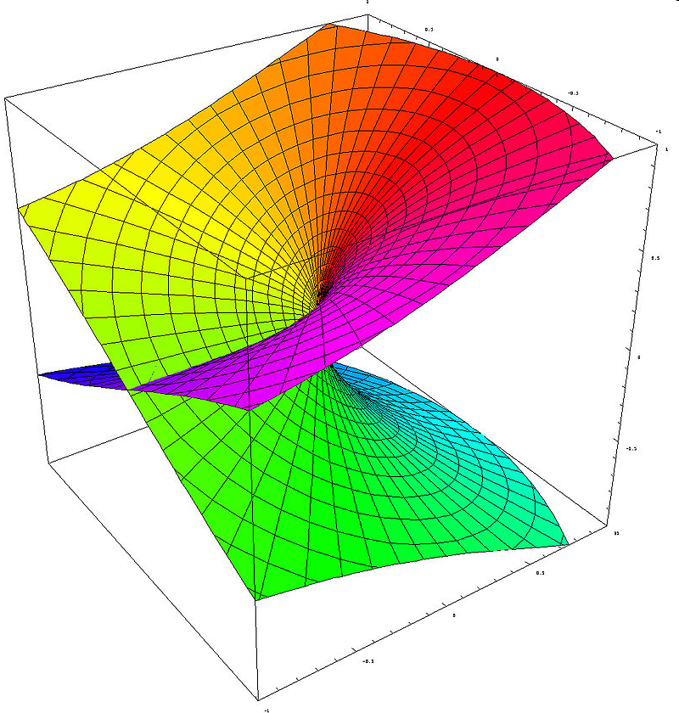
Basic Statistical Methods
Independent t-test
Multiple
Regression

Slide 30
Independent t-test
– Is there a significant difference between 2 groups?
Assumptions | 1. Normality | 2. Variance Equality | 3. Independence
# of Variables | Characteristics | School Data N=100
Dependent = 1 | Continuous | Math Score Range of 0-100
Independent =1 | Categorical 2-levels | Gender
Notes:
Statistical assumptions – background knowledge or rules to obtain results
Independence – the test score of one student doesn’t influence the other students. Each score (or difference score for the paired t-test) must be independent of all other
scores.

Slide 31
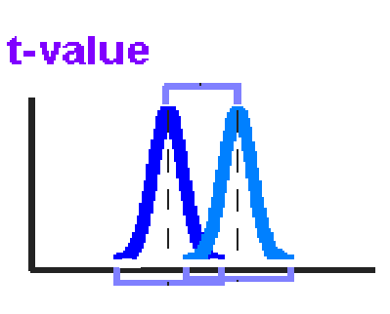
How to calculate t-value?
Mean Difference
Group Variability
t-value=

Slide 32
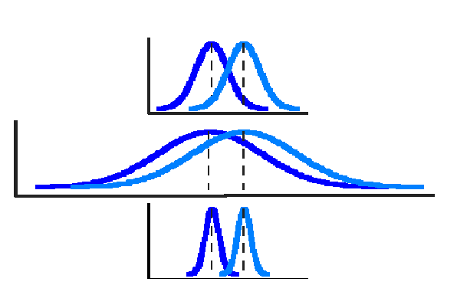
t-test
Medium
Variability
High
Variability
Low
Variability

Slide 33
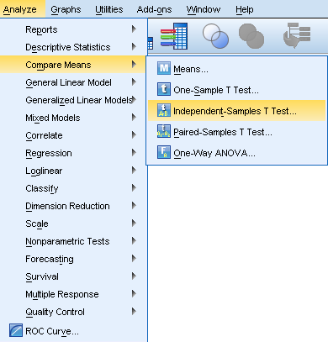
Independent t-test
1. Go to Analyze.
2. Choose
Compare Means.
3. Choose Independent
Samples t Test.

Slide 34
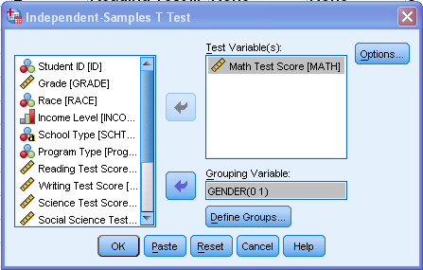
t-test
Choose Dependent
& Independent Variables.

Slide 35
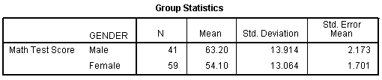
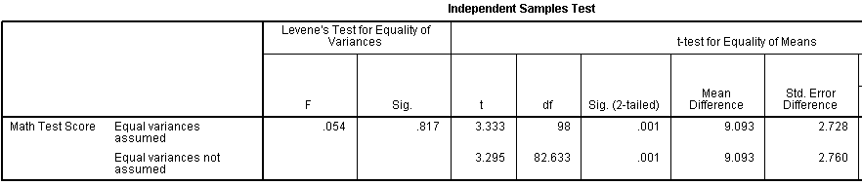
Descriptives &
Analysis
Independent Variable
Dependent Variable
Variance Equality Test
t - statistics
t = Mean Diff
Std. Error Diff
t = Z1 – Z2 = 63.20 – 54.10 = 9.093 = 3.295
SD₁² + SD₂² (13.914)² +(13.064)² 2.760
N₁ N₂
41 59
Notes:
Pooled variance
Sp²=[(N1-1)S1² + (N2-1)S2²] / N1 + N2 – 2
T=(Mean1 – Mean2) / Sqrt [(Sp²/N1) + (Sp²/N2)]
t = X1 – X2 = 63.20 – 54.10 = 9.093/ = 3.295
SD12 + SD22 (13.914)2/ +(13.064)2/ 2.760
h1 h2
41 59

Slide 36
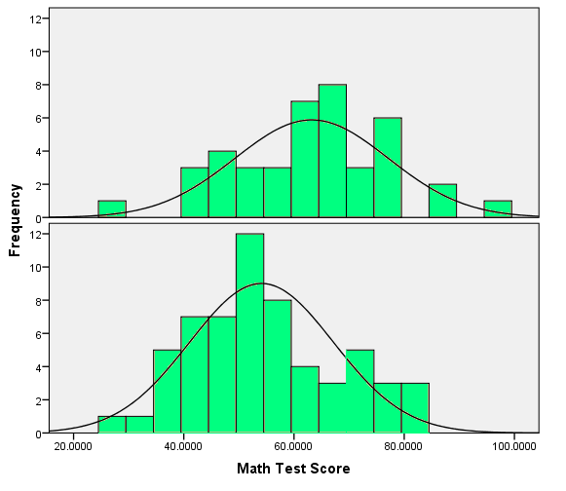
Conclusion &
Chart
There is a significant difference in math ability between males and females.
Male
Female

Slide 37
Multiple Regression
– Which IVs can predict the DV and to estimate the effects of these variables on DV?
Assumptions | 1. Normality | 2. Variance Equality | 3. Independence | 4. Linear Relationship
# of Variables | Characteristics | Health Survey Data N=100
Dependent =1 | Continuous | LDL Value 0-200
Independent > 1 | Continuous or Dichotomous (0 or 1) Variables | HT, WT, BMI, & Exercise

Slide 38
Multiple Regression Diagram
HT
DV
WT
LDL
IV
BMI
Exercise
All 4 IVs are predicting LDL

Slide 39
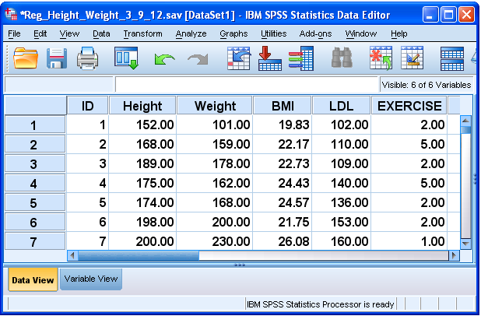
Health Survey Data of N=100

Slide 40
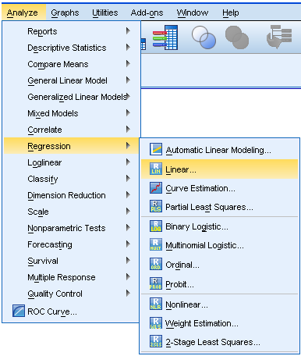
Multiple Regression
1.Choose Regression
2. Choose Linear Regression

Slide 41
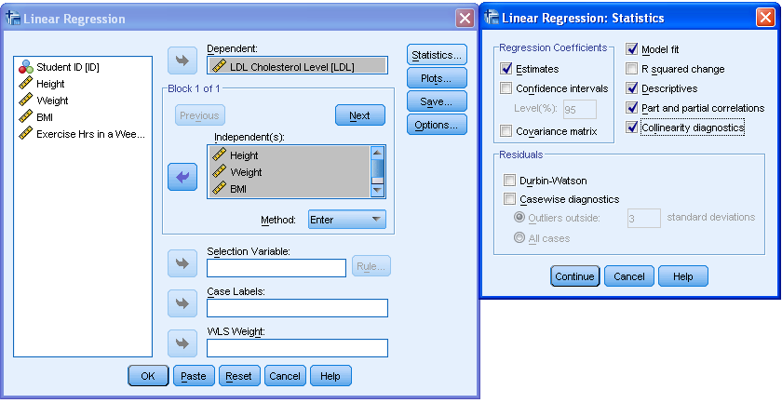
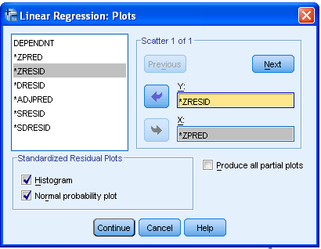
2. Choose Statistics you need.
1. Choose DV, IV, & Method.
3. Choose Residual Plots.

Slide 42
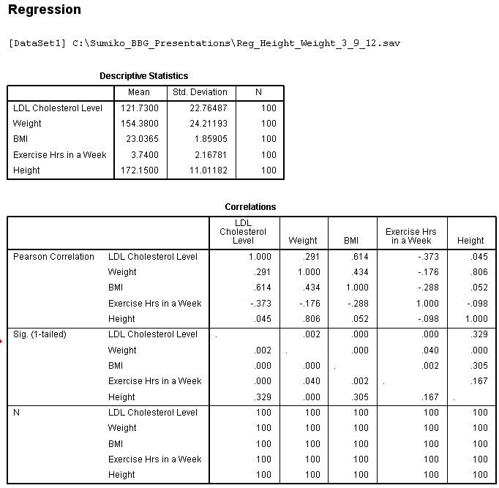
Descriptives
& Correlation
Tables
Descriptive
Stats.
Correlation
Coefficients &
corresponding
p-values.
Notes:
BMI – a heuristic proxy for human body fat based on an individual’s weight and height.

Slide 43
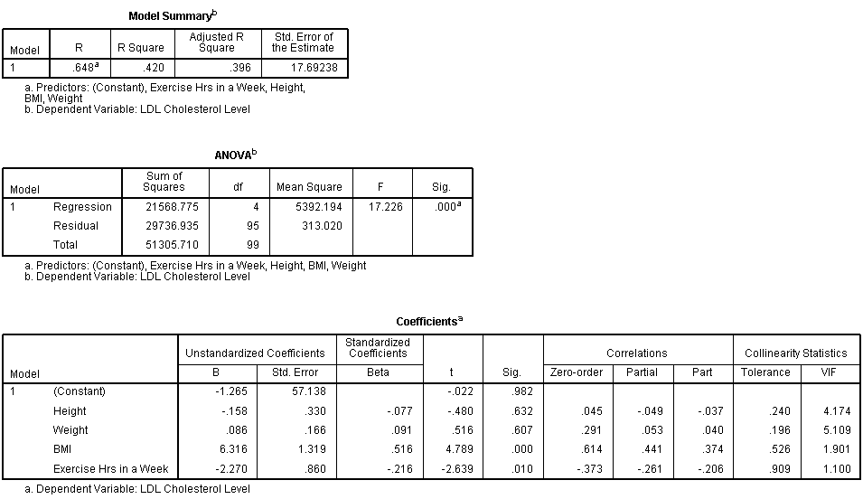
Main Analysis
R²=how much of the variability in the outcome is accounted
for by the predictors (regression sum of squared/total sum of squares)
Adj. R Sq=Adj for the # of
Parameters in the model
R=r between pred and
observ value of the DV
Global test to see if any coefficient is different from “0”
Partial/Part
Correlations
Tolerance
&VIF
t & Sig=IV
predictability
B=Reg Coefficient
Beta=Stdized. Reg
Coefficient.
Something is Wrong
if Beta >1!!
Notes:
R=Multiple correlation coefficient between the predictors and the outcome.
R²=a measure of how much of the variability in the outcome is accounted for by the predictors. (regression sum of squared/total sum of squares)
Adjusted R²= R² – p(1-R2) / N-p-1, where p=# of IV: the loss of predictive power or shrinkage. How much variance in Y would be accounted for if the model had been derived from the population from which the sample was taken.
F=mean square regression / mean square residual
Partial correlation – the correlation between Y and X when the linear effects of the other IVs have been removed from Y and X.
Part Correlation – the correlation between Y and X when the linear effects of the other independent variables have been removed from X.
VIF – Variance Inflation Factor

Slide 44
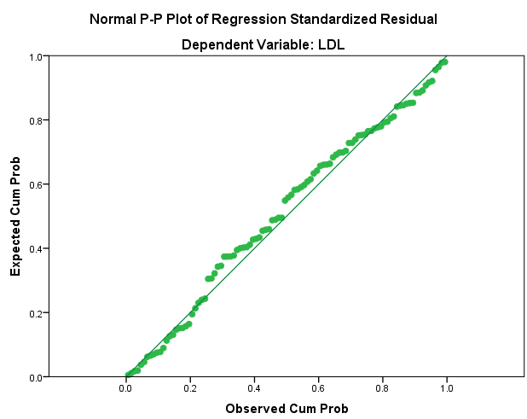
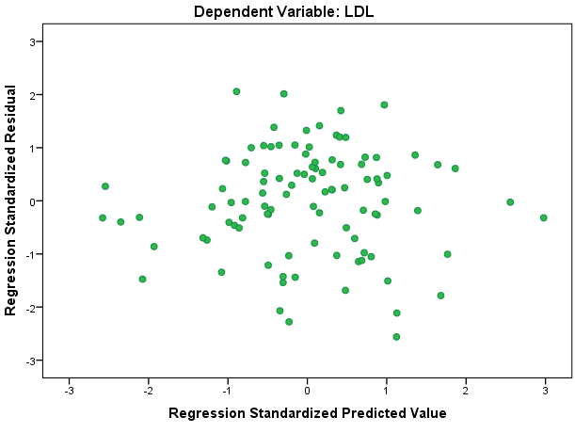
Residual
Analysis
Residual Normality
Linearity and
Equal Variance & residual independence
Notes:
If normality was violated, p-values may be misleading because they are based on the assumption of normally distributed residuals.
If Residuals are not independent, they are not errors any more. This means that they could be a systematic variable hidden behind the seen.

Slide 45
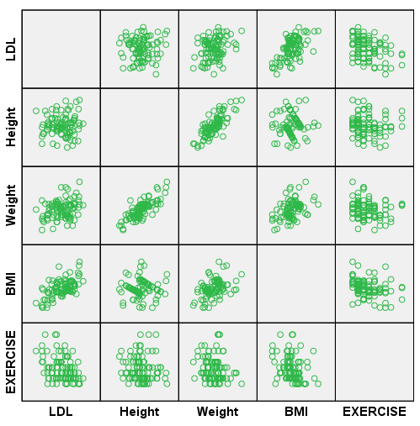
Multiple Regression
Conclusion
IVs explain about 40% of the variability of LDL level.
The significant predictors of LDL were BMI and Hrs of Exercise.
The collinearity statistics didn’t show exceptionally large multicollinearity among predictors.
Assumptions of residual normality and equal variance were met.
Notes:
R=Multiple correlation coefficient between the predictors and the outcome.
R²=a measure of how much of the variability in the outcome is accounted for by the predictors. (residual sum of squared/total sum of squares)
Adjusted R²= R² – p(1-R2) / N-p-1, where p=# of IV
F=mean square regression / mean square residual

Slide 46
Key Concepts
Statistical Models depend on the theory and data. Choose your model wisely to see if it can answer your research questions.
Check Assumptions. Model conclusions may not be valid unless the assumptions were met. If not, use appropriate corrections, do data transformations, or even use other statistical methods.

Slide 47
Conclusions
Statistical judgments come into our daily lives. Statistics are more than mathematical calculations or scientific research, but they are the way of logical thinking…
      Thank you
Notes:
Eta squared=SSgroup/SStotal
Omega squared=SSgroup – (k-1)MS_{error} / SStotal + MSerror

