Slide 1
Capstone Project in Analytics 64099
Tanmoy Kanti Kumar
Notes:
Welcome to your course on Machine Learning.

Slide 2

Problem Statement
This project is based on the Humana/Mays 2020 Healthcare Analytics Case Competition.
Humana is a leading health care company that offers a wide range of insurance products and health and wellness services.
Social Determinants of Health (SDoH) are a key component of Humana’s integrated value-based health ecosystem. In the absence of regular, universal screening for SDoH, Humana needs to utilize robust data and advanced data science to understand which of our members are struggling with SDoH. This analysis will focus only on Transportation Challenges which is one of the major factors of SDoH.
Notes:
Before we begin, it is important that understand what we mean by machine learning. Machine learning is a part of AI, a branch of science born in the 1950s. AI can be broadly thought of as “the effort to automate intellectual tasks normally performed by humans”
Initially, many experts believed that human-level artificial intelligence could be achieved by having programmers handcraft a sufficiently large set of explicit rules for manipulating knowledge. This approach is known as symbolic AI, and while suitable to solve well-defined, logical problems, such as playing chess, it turned out to be intractable to figure out explicit rules for solving more complex, fuzzy problems, such as image classification, speech recognition, and language translation. A new approach arose to take symbolic AI’s place: machine learning.
To do ML, requires three things:
○ Input data points (Experience in the above definition)—For instance, if the task is speech recognition, these data points could be sound files of people speaking.
○ Examples of the expected output—In a speech-recognition task, these could be human-generated transcripts of sound files.
○ A way to measure whether the algorithm is doing a good job (Performance)—This is necessary in order to determine the distance between the algorithm’s current output and its expected output. The measurement is used as a feedback signal to adjust the way the algorithm works.
Excerpt From: François Chollet. “Deep Learning with R MEAP V01.”

Slide 3
Problem Statement
Humana has provided a training data about members on - Medical claims features, Pharmacy claims features, Lab claims features etc. Requirement is to -
Building Predictive model: Since screening all Medicare members is challenging, having an effective predictive model to accurately identify members most likely struggling with Transportation Challenges. Finding the AUC score is the judgment factor.
Identification of key factors: It is likely that members struggling with Transportation Challenges are not homogeneous and hence there are perhaps different solutions for different segments of members. Identifying key factors will help Humana.
Notes:
Before we begin, it is important that understand what we mean by machine learning. Machine learning is a part of AI, a branch of science born in the 1950s. AI can be broadly thought of as “the effort to automate intellectual tasks normally performed by humans”
Initially, many experts believed that human-level artificial intelligence could be achieved by having programmers handcraft a sufficiently large set of explicit rules for manipulating knowledge. This approach is known as symbolic AI, and while suitable to solve well-defined, logical problems, such as playing chess, it turned out to be intractable to figure out explicit rules for solving more complex, fuzzy problems, such as image classification, speech recognition, and language translation. A new approach arose to take symbolic AI’s place: machine learning.
To do ML, requires three things:
○ Input data points (Experience in the above definition)—For instance, if the task is speech recognition, these data points could be sound files of people speaking.
○ Examples of the expected output—In a speech-recognition task, these could be human-generated transcripts of sound files.
○ A way to measure whether the algorithm is doing a good job (Performance)—This is necessary in order to determine the distance between the algorithm’s current output and its expected output. The measurement is used as a feedback signal to adjust the way the algorithm works.
Excerpt From: François Chollet. “Deep Learning with R MEAP V01.”

Slide 4
Predictive Modeling Method
Humana provided 70K training records with 826 features.
Checking on NA values on the data set.
Eliminating the duplicate columns
Eliminating the near zero variance (NZV) features.
Dropping the features with more than 40% missing records.
Impute the NA values using median impute method.
Removed columns with high collinearity and reduced features to 214.
Perform LASSO to find top 20 features.
Perform PCA on the remaining features.

Slide 5
Predictive Modeling Method
After completion of feature selection ran the data through three high performing models to find the AUC value.
Model | AUC
Random Forest | 0.6087
Elastic Net | 0.7359
Logistic Regression | 0.7354

Slide 6
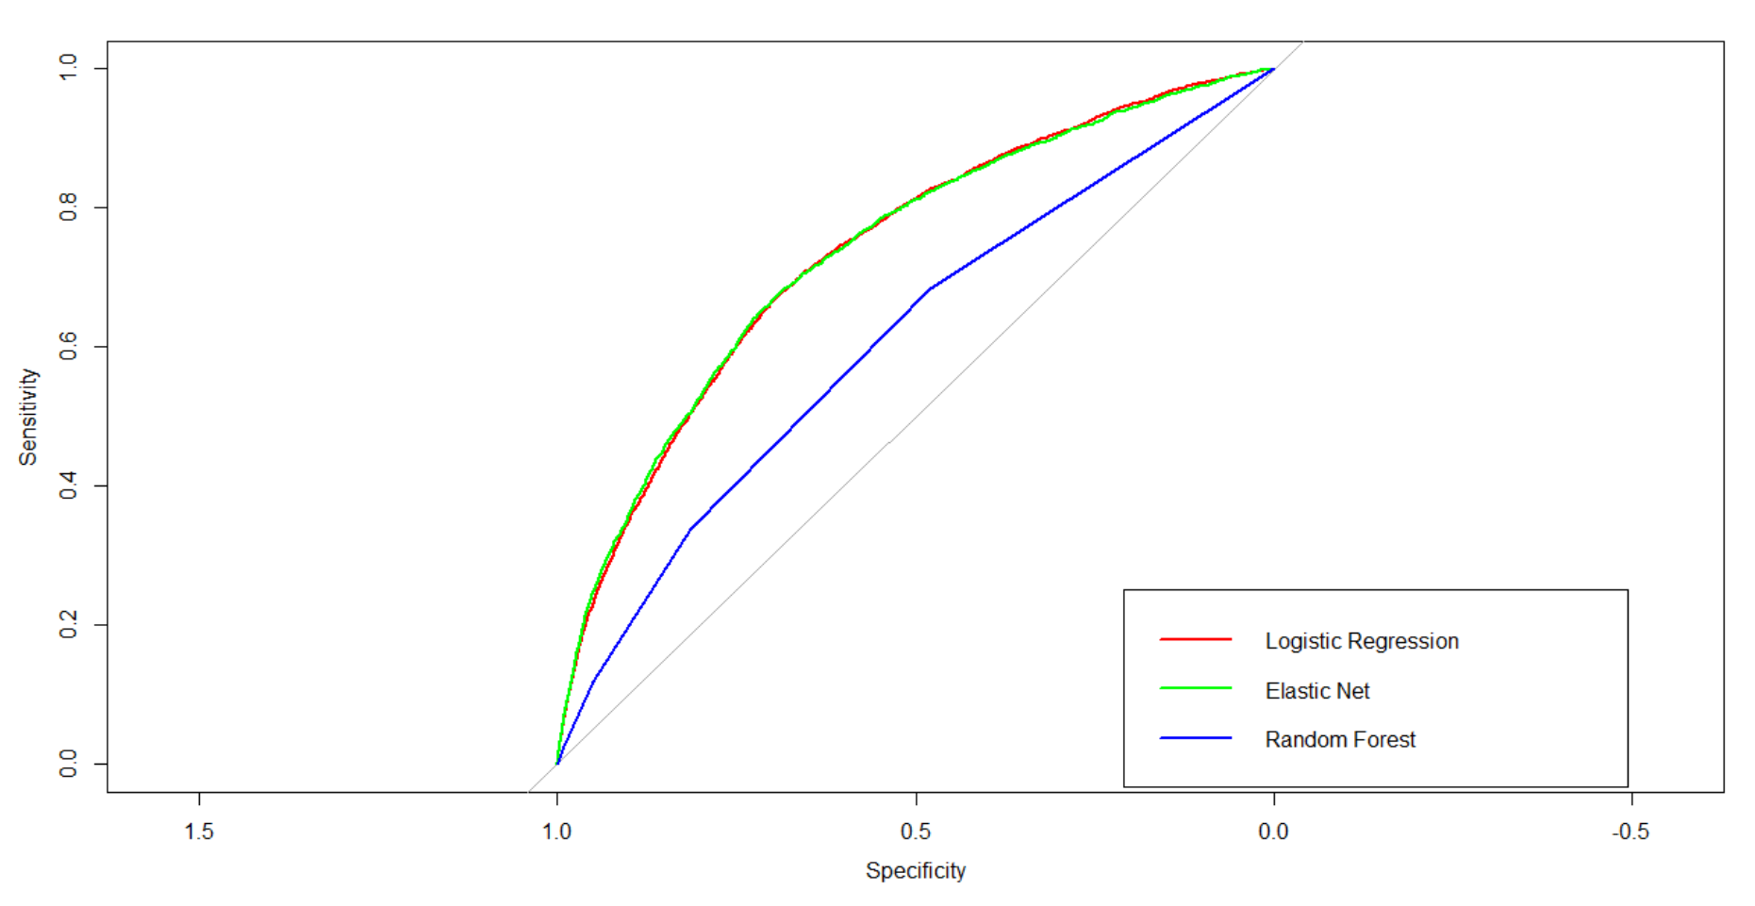
Predictive Modeling Method
Elastic net and Logistic regression performance are same. Hence used Logistic regression model for test data prediction.

Slide 7
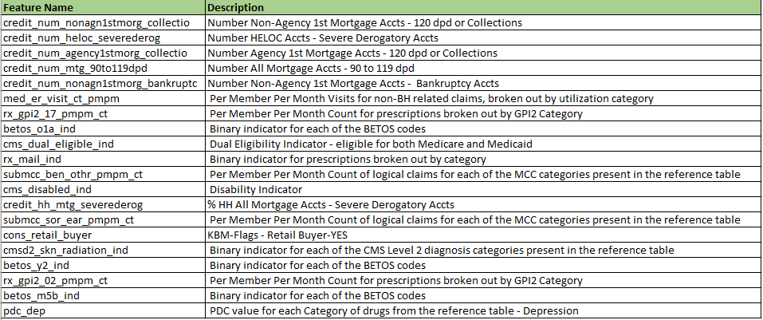
Analysis Outcome
Upon performing the logistic regression model on the test data set of 17681 observations 17305 do not have transpiration issue where 376 members have.
Identified top 20 strongest prediction features.

Slide 8
Suggestions
Further analysis on the top 20 features will revel the relation of these features to the transpiration issues.
It will help to build a mitigation plan. Possible support could be provided to the Medicare members.
Due to the limitation of the processing power of the personal systems other advanced models were not applied here.
5, 10-fold cross validations would have helped in regularizing the prediction model.

