Slide 1
Advanced Machine Learning 64061 Final Project - Chatbots
Tanmoy Kanti Kumar
Notes:
Welcome to your course on Machine Learning.

Slide 2
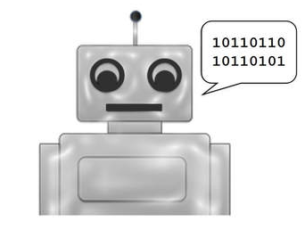
Chatbots
An artificial intelligence-powered piece of software in a device, application or website.
Self-operating with human-like responses
Provides constant connectivity.
Chatbots are used to deliver flight information, connecting customers and their finance information, Customer support operations. The possibilities are almost limitless.

Slide 3
Types of Chatbots
There are broadly two variants of chatbots:
Rule-Based - The bots can handle simple queries but fail to manage complex ones
Self-learning - Ones that use some Machine Learning-based approaches. It can further be classified as:
Retrieval Based models: Uses some heuristic to select a response from a library of predefined responses.
Generative bots: Can generate the answers and not always replies with one of the answers from a set of answers. This makes them more intelligent as they take word by word from the query and generates the answers.

Slide 4
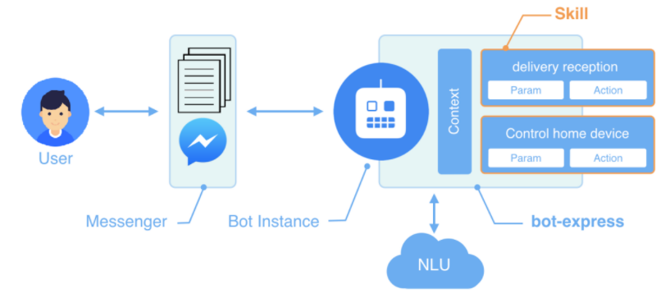
Architecture

Slide 5
NLP (Natural Language Processing)
NLP Chatbots finds a way to convert the user’s speech or text into structured data. Which is then utilized to choose a relevant answer. NLP includes the following steps:
Tokenization: NLP separates a series of words into tokens or pieces that are linguistically representative, with a different value in the application.
Sentiment Analysis: It will study and learn the user’s experience and transfer the inquiry to a human when necessary.
Normalization: Processes the text to find out the typographical errors and common spelling mistakes that might alter the intended meaning of the user’s request.
Named Entity Recognition: Looks for different categories of words, similar to the name of the particular product, the user’s address or name, whichever information is required.
Dependency Parsing: This module searches for the subjects, verbs, objects, common phrases and nouns in the user’s text to discover related phrases that what users want to convey.

Slide 6
Building a simple Chatbot
Codes and Data: Prerequisite object components
train_chatbot.py - The code for reading in the natural language data for training.
chatgui.py - The code for cleaning up the responses based on the predictions from the model and creating a graphical interface for interacting with the chatbot.
classes.pkl -A list of different types of classes of responses.
words.pkl - A list of different words that could be used for pattern recognition.
intents.json – Data file of JavaScript objects that lists different tags that correspond to different types of word patterns.
chatbot_model.h5 - The actual model created by train_chatbot.py and used by chatgui.py

Slide 7
Model Chatbot Cont.
Key program execution library functions:
nltk (Natural Language Toolkit) - contains a whole bunch of tools for cleaning up text and preparing it for deep learning algorithms.
Json - which loads json files directly into Python
Pickle - loads pickle files.
Numpy - which can perform linear algebra operations very efficiently
Keras - which is the deep learning framework we’ll be using.

Slide 8
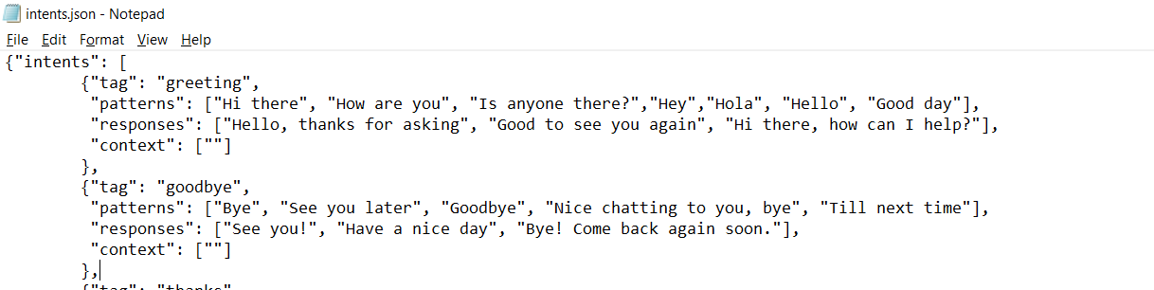
Model Chatbot Cont.
Used the json module to load in the file and save it as the variable intents. contains the “intents”. Here’s a snippet of what the json file looks like.
“Patterns” are added to the words list to further lemmatize it. Then did the Deep Learning Model building using Sequential model in keras. After the model is trained, the whole thing is turned into a numpy array and saved as chatbot_model.h5.

Slide 9
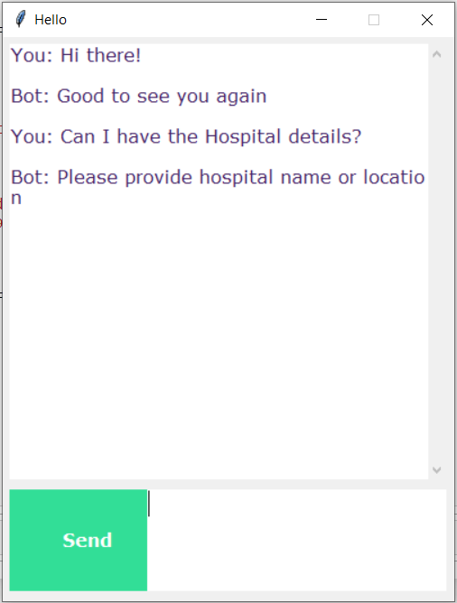
Model Chatbot Cont.
Multiple functions are built to get the input data from the GUI and do the predictions. Text sentences are cleaned up and made it to a bag of words that are used for predicting classes.
Function takes the list outputted and checks the json file and outputs the most response with the highest probability.
Created GUI with tkinter, a Python library that allows us to create custom interfaces.

Slide 10
Questions

Slide 11
Thank You

