Slide 1


Data Analysis –Tanmoy Paul

Slide 2
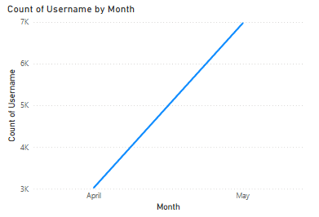
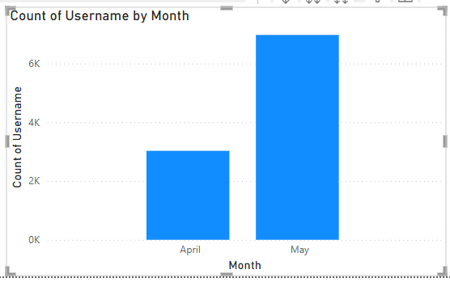

Trend to show Significant Increase in User Activity Over a Month
The slope shows the increase of user activity over a month.
Increased chances for in game purchases.
User Experience should be satisfied as per game server maintenance, game quality and anti cheat measurements due to increased users.

Slide 3
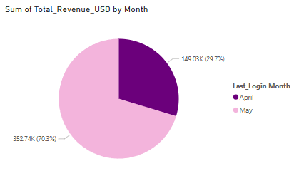
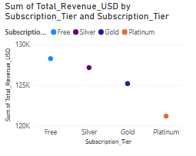

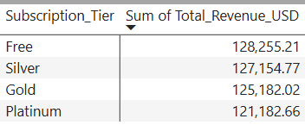
Revenue Generation Segmentation
Increase of Revenue Generation from April to May.
Revenue generation through free subscription tier is the most which shows that User Activity plays a major role.

Slide 4
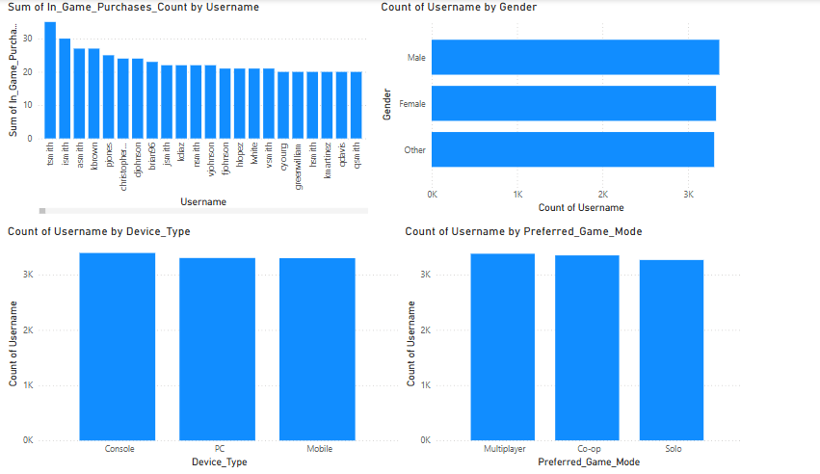
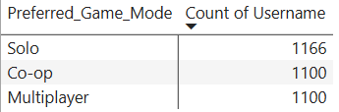
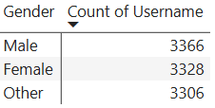
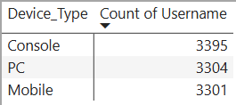
User Breakdown on various factors
In the breakdown evaluation all these factors are:
Game mode preferences, Gender and Device Type
From these available data we can see that these factors are performing head-to-head so it is crucial to maintain the diversity among gaming users for better user activity

Slide 5
THANK YOU

