Slide 1
Object-oriented Analysis and Design
IE 565
B.Ramamurthy
B.Ramamurthy

Slide 2
Introduction
OOAD: object-oriented analysis and design
Class and object concepts
Discovering classes
  CRC card
  Word problem to classes
Classes and relationships
Inheritance and polymorphism
OOP: Object-oriented programming in Java
At the end of this class you should be able to analyze a problem, design a OO solution and implement it in Java programming language
B.Ramamurthy

Slide 3
Object-Oriented Principles
OOP
Encapsulation
(class concept)
-- Information Hiding
-- Interface and
Implementations
-- Standardization
-- Access Control mechanisms
(private /public etc.)
Inheritance
-- Hierarchy
-- Reusability
-- Extensibility
-- Expressive power
-- Reflects many
real-world problems
Polymorphism
-- Many forms of
same function
-- Abstract Methods
-- Abstract Classes
BR

Slide 4
What is an Object?
Object-oriented programming supports the view that programs are composed of objects that interact with one another.
How would you describe an object?
Using its characteristics (has a ----?) and its behaviors (can do ----?)
Object must have unique identity (name) : Basketball, Blue ball
Consider a ball:
  Color and diameter are characteristics (Data Declarations)
  throw, bounce, roll are behaviors (Methods)
BR

Slide 5
Classes are Blueprints
A class defines the general nature of a collection of objects of the same type.
The process creating an object from a class is called instantiation.
Every object is an instance of a particular class.
There can be many instances of objects from the same class possible with different values for data.
BR

Slide 6



Example
objects
Object
References
redRose
class Rose
blueRose
class
BR

Slide 7
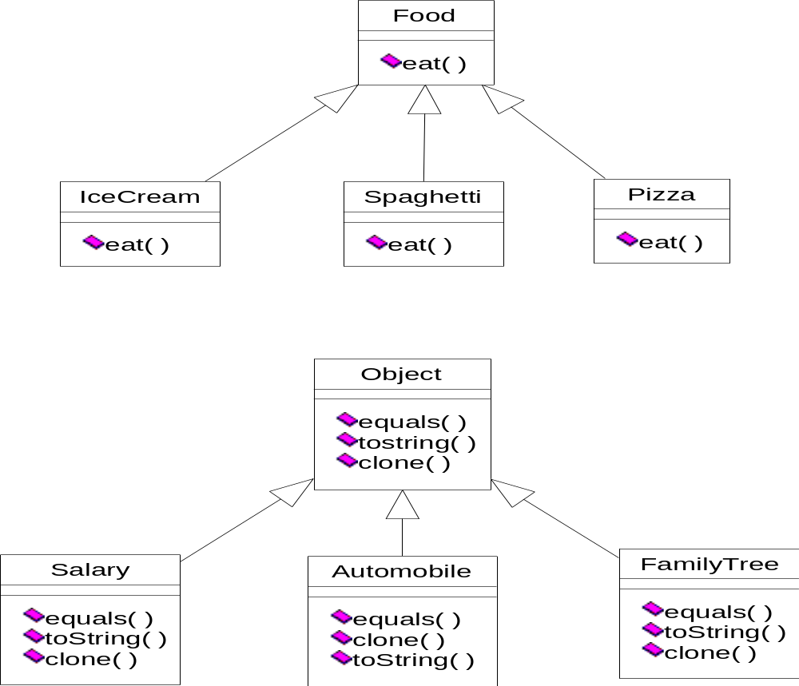
Inheritance Hierarchy
Food Hierarchy
eat() is an example of polymorphic operation.
(Java) Object Hierarchy
equals(), clone() and toString()
illustrate sub-type polymorphism
B.Ramamurthy

Slide 8
Polymorphism (subtype)
Consider a class Food. What can you do with Food? What does it have?
Consider specific food items Ice Cream, Spaghetti and Pizza. How will you eat these? (Invoke eat() operation on objects of these classes)?
eat() operation is polymorphically invoked depending on the type of the item it is invoked on.
B.Ramamurthy

Slide 9
Requirements and Analysis Methods
See the description of a library management system (LMS) from Hwk1, a copy of which is attached.
We will follow these steps:
  Functional requirements represented by Use Case Diagrams
  Classes discovered using CRC cards
  Static Analysis represented by class diagrams
  Dynamic Analysis by a variety of interaction diagrams (inter-class) and state diagram (intra-class).
  Component diagram showing the various modules.
  Deployment diagram showing the platforms and machines used.
B.Ramamurthy

Slide 10
Use-case Analysis
Use case analysis involves reading and analyzing the specifications, as well as discussing the system with potential users of the system.
Actors of the LMS are identified as the librarians and borrowers.
Librarians directly interact with the system whereas borrowers interact with the system through the librarian.
B.Ramamurthy

Slide 11
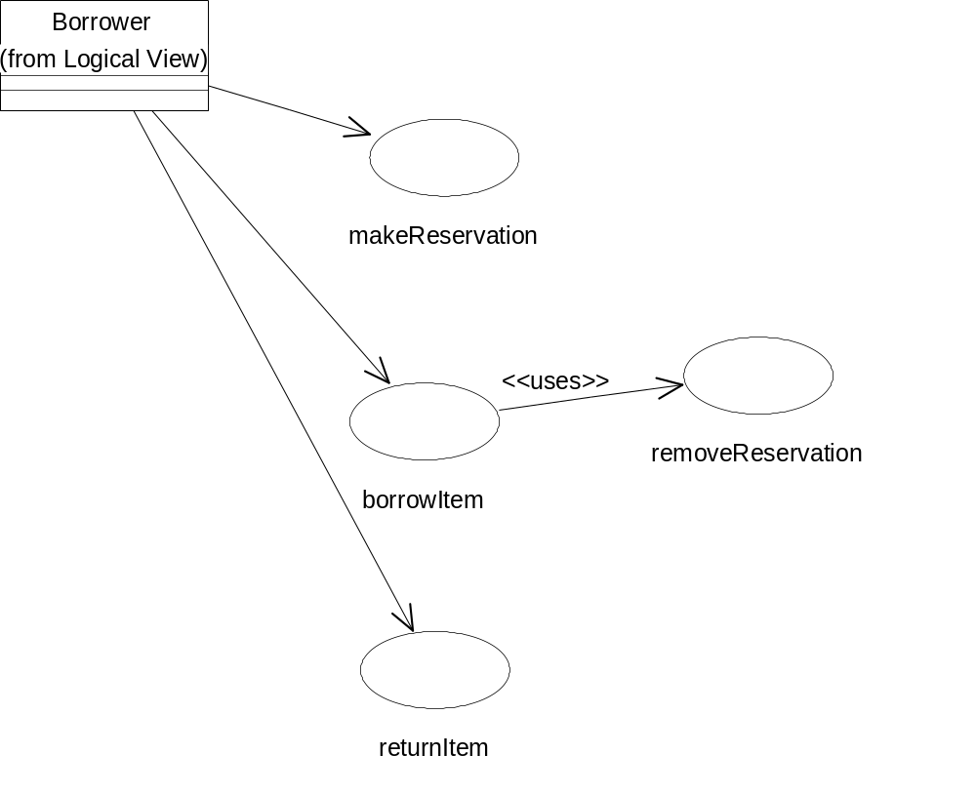
Use-case Diagram For Borrower
B.Ramamurthy

Slide 12
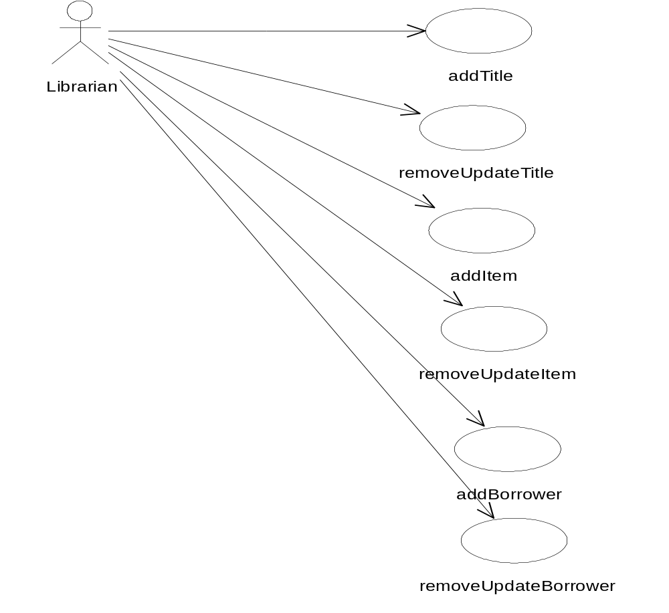
Use-case Diagram for Librarian
B.Ramamurthy

Slide 13
Use Cases For Borrower and Librarian
Use cases for the borrower:
  Borrow item
  Return item
  Make reservation
  Remove reservation
Use cases for the librarian:
  Add title, Update or remove title
  Add borrower, Update or remove borrower
  Add item, Update or remove item
Note 1: A title may have many items: A book may have many copies.
Note 2: Titles may be book or magazine titles
Note 3: Persistence: All use cases involve database access
B.Ramamurthy

Slide 14
Use-case Descriptions
Use Case: Lend Item
Pre-condition: Item may or may be reserved
Post-condition: Borrower gets Item. Database updated.
Exceptions: Title not avail, Item not avail
Actions: Case 1. If borrower has not reserved the item:
a. A title is identified
b. An available item of the title is identified
c. The borrower is identified
d. The item is borrowed(transaction)
c. A new loan (transaction) is registered.
Case 2. If the borrower has a reservation for the item:
a. The borrower is identified
b. The item is borrowed
c. New loan is registered
d. reservation is removed.
B.Ramamurthy

Slide 15
CRC Card Example
Weather Station
Collaborations
User Interface(UI)
Responsibilities
Date
Time
Temp
Wind
Pressure
Humidity
Calibrator
Select 24hr/Current
Set Date Time
Display Current
  Temp(T)
  Wind (W)
  Pressure (P)
  Humidity (H)
Display 24hours
  Hi/Lo for (TWPH)
Display Trends in TWPH
Calibrate
B.Ramamurthy

Slide 16
CRC Card: UserInterface
UserInterface
Collaborators
Responsibilities
Keypad
Display
Temp
Wind
Pressure
Humidity
Input date
Input time
Input selection
Display data
B.Ramamurthy

Slide 17
CRC Card: Keypad
Keypad
Collaborators
Date
Time
Selection
Responsibilities
Store date
Store time
Store selection
B.Ramamurthy

Slide 18
CRC Card: Temperature
Temperature
Collaborations
Responsibilities
Measure and Record temperature
Determine and record Hi/Lo
Determine trend
T.Device
StatDataBase
Date
Time
B.Ramamurthy

Slide 19
Class Discovery
The entries in the collaborations column are possible classes or non-software entities.
In this case these are: UserInterface, Display, Tempertaure, Wind, Pressure, Humidity, StatDataBase, Selection, Date, Time, Keypad, Callibrator.
The responsibility of designing one or more of these classes can be assigned to the members of the group who participated in this discovery process.
On to relations among classes and class diagrams.
B.Ramamurthy

Slide 20
Classes
OO paradigm supports the view that a system is made up of objects interacting by message passing.
Classes represent collection of objects of the same type.
An object is an instance of a class.
A class is defined by its properties and its behaviors.
A class diagram describes the static view of a system in terms of classes and relationships among the classes.
B.Ramamurthy

Slide 21
Discovering Classes (Alternative)
Underline the nouns in a problem statement.
Using the problem context and general knowledge about the problem domain decide on the important nouns.
Design and implement classes to represent the nouns.
Underline the verbs. Verbs related to a class may represent the behavior of the class.
B.Ramamurthy

Slide 22
Examples
Drawing package: Design a user interface for drawing various shapes: circle, square, rectangle.
Football scores: Keep track of football score.
General purpose counter: To keep of track of count for various applications.
Library: Books, different categories of books, details of student borrower, library personnel.
B.Ramamurthy

Slide 23
Designing Classes (Take 2)
A class represents a class of objects.
A class contains the data declarations (“parts”) and methods (“behaviors” or “capabilities” ).
OO Design:
Class properties or characteristics are answers to “What is it made of?” (It has a ____, ____, etc.)
Behaviors, capabilities or operations are answers to “What can it do?” (verbs in the problem)
B.Ramamurthy

Slide 24
Classes are Blueprints (Take 2)
A class defines the general nature of a collection of objects of the same type.
The process creating an object from a class is called instantiation.
Every object is an instance of a particular class.
There can be many instances of objects from the same class possible with different values for data.
A class structure implements encapsulation as well as access control: private, public, protected.
B.Ramamurthy

Slide 25
Example (Take 2)
objects
Object
References
redRose
class Rose
blueRose
class
B.Ramamurthy

Slide 26
Class Diagram : Automobile
Automobile
public:
  seat
  seatBelt
  accelerator
private:
  sparkPlugs
  gear
protected:
  gloveCompartment
public:
  startEngine
  brake
protected: transmission
private: fuelInjection
B.Ramamurthy

Slide 27
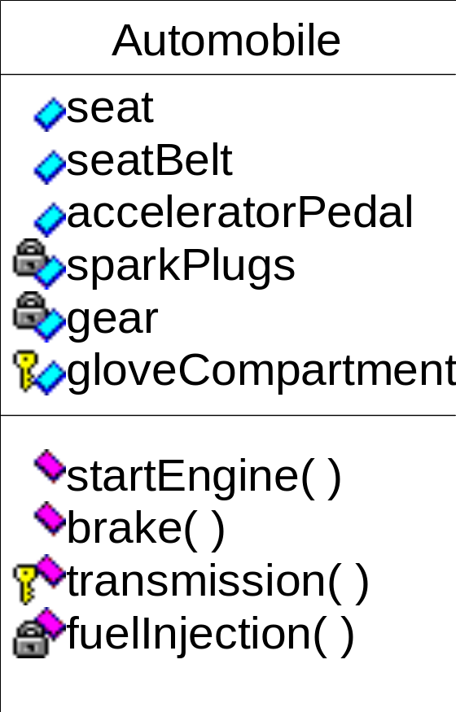
Automobile Class Using Rational Rose Tool
B.Ramamurthy

Slide 28
Access Control
Public, protected, private
Public properties and behaviors are available to any other object to use/invoke
Private: available only within the objects.
Protected: available within the objects and to the class hierarchy inherited from the class. (We will discuss more about this when dealing with OO concept Inheritance.)
B.Ramamurthy

Slide 29
Relationships
Typically an application consists of many related classes.
Commonly used relationships include: associations, aggregations, and generalizations.
B.Ramamurthy

Slide 30
Association
An association is a connection between classes, a semantic connection between objects of classes involved in the association.
Association typically represents “has a” or “uses” relationships.
Indicated by a line,
  sometimes with arrow indicating unidirectional relationship,
  adorned by the name of the relation, and
  the ends of the line adorned by cardinality of relationship and optionally by the roles connected to each class.
B.Ramamurthy

Slide 31
Association : Examples
Uses
Person
Computer
A person uses a computer.
Owns
Person
0..*
Car
A person may own many (zero..many) cars.
B.Ramamurthy

Slide 32
Roles in Association
drives
Person
Car
driver
company car
A person (driver) drives a (company) car.
wife
Person
husband
married to
B.Ramamurthy

Slide 33
Aggregation
Aggregation represents a relation “contains”, “is a part of”, “whole-part” relation.
Indicated by a line adorned on the “whole” by a hollow diamond
  Along with name of relationship and
  Cardinality.
B.Ramamurthy

Slide 34
Aggregation: Example
contains
League
Team
*
Membership aggregation: A league is made up of
Many teams.
4
wheel
made of
Auto
engine
Strong aggregation.
1
*
part
B.Ramamurthy

Slide 35
Generalization
Generalization is a relationship between a general and a specific class.
The specific class called the subclass inherits from the general class, called the superclass.
Public and protected properties (attributes) and behaviors (operations) are inherited.
Design representation “inheritance” OO concept.
B.Ramamurthy

Slide 36
Generalization: Symbol
It represents “is a” relationship among classes and objects.
Represented by a line with an hollow arrow head pointing to the superclass at the superclass end.
B.Ramamurthy

Slide 37
Generalization: Example
Vehicle
Car
Boat
Truck
B.Ramamurthy

Slide 38
Combined Example
drives
Person
0..*
Vehicle
Car
Boat
Truck
B.Ramamurthy

Slide 39
Discovering Classes
Library Management System (LMS)
RESPONSIBILITIES
1. Borrow item
2. Reserve item
3. Return item
4. Remove reservation
5. Add borrower
6. Update or remove borrower
7. Add title (book or magazine)
8. Update or remove title
9. Add item
10. Update or remove item
11. Store loan details
COLLABORATIONS
Item
Reservation
Borrower
Title
Book Title
Magazine Title
Loan (Transaction)
Database
B.Ramamurthy

Slide 40
CRC Cards
LMS
(Librarian)
Borrower
Title: Book Title, Magazine Title
Item
Reservation
Transaction (Loan)
Database for storage
B.Ramamurthy

Slide 41
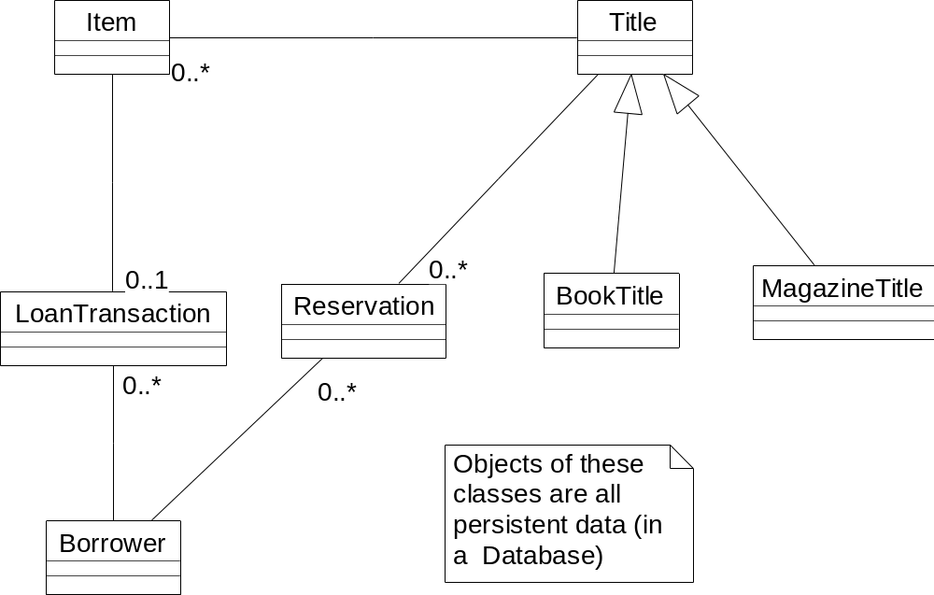
Static Analysis: Initial Class Diagram
B.Ramamurthy

Slide 42
Dynamic Analysis
“Borrow Item” use case using Sequence Diagram
“Add Title” use case using Collaboration diagram
“Add Item” using Activity diagram
“Reservation” state diagram
B.Ramamurthy

Slide 43
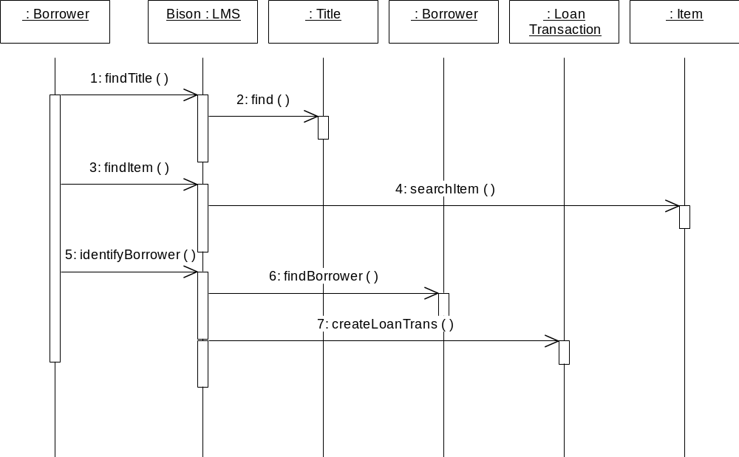
Borrow Item: Sequence Diagram
B.Ramamurthy

Slide 44
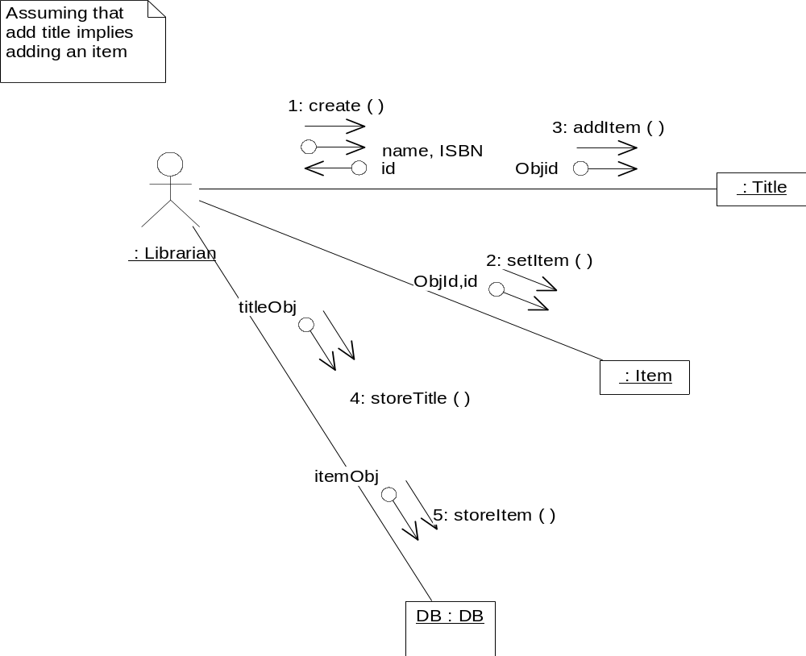
Add Title: Collaboration Diagram
B.Ramamurthy

Slide 45
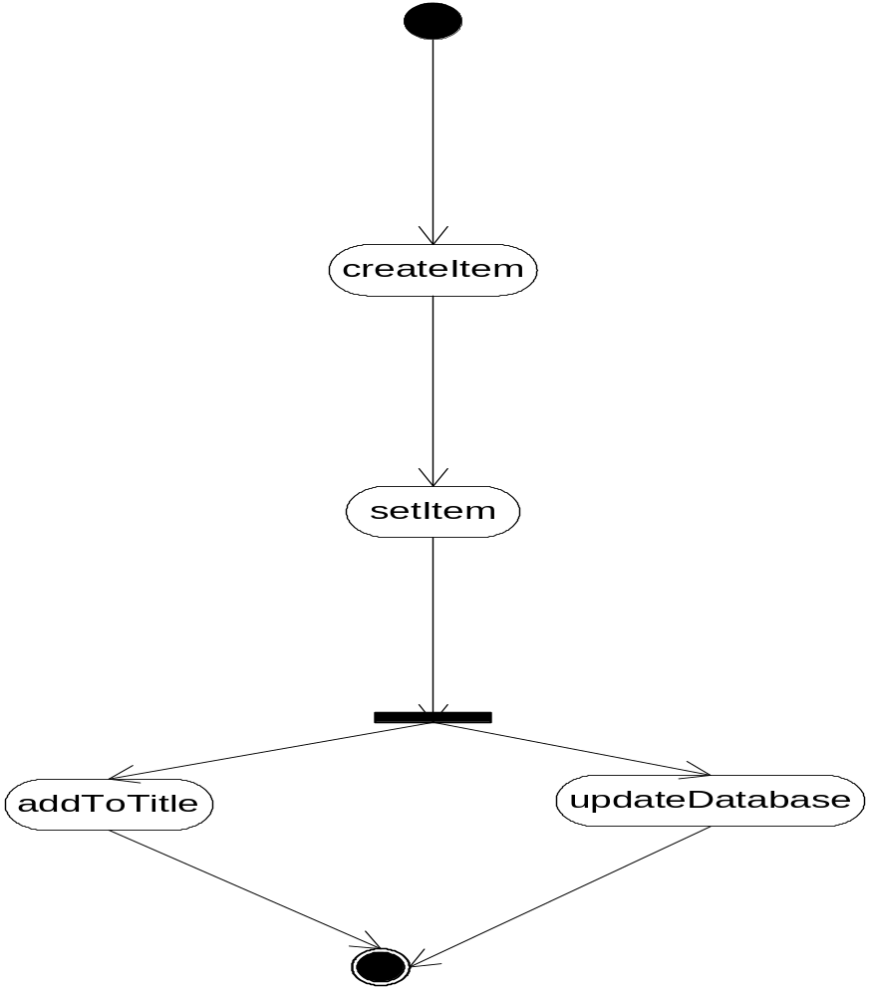
Add Item: Activity Diagram
Title
Item
Database
B.Ramamurthy

Slide 46
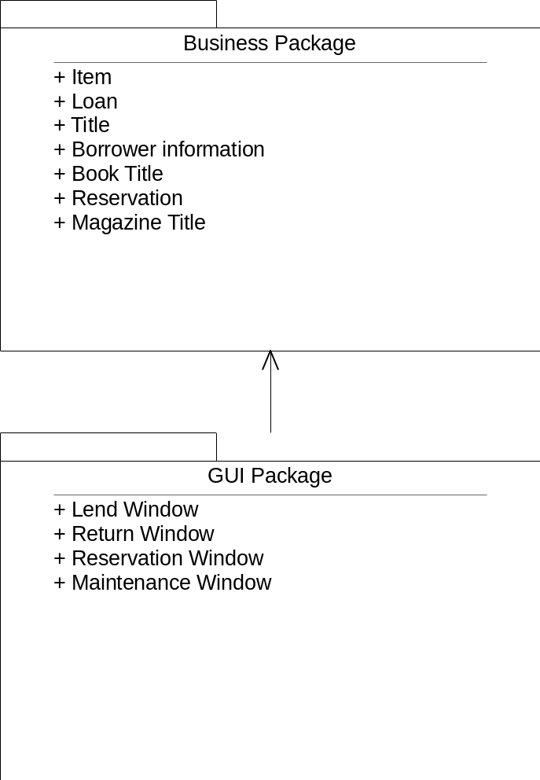
Component Diagram
B.Ramamurthy

Slide 47
Analysis, Design →Implementation/programming
What is the deliverable at the end of the analysis and design phase?
One or more class diagrams showing the classes and the relationships that define the OOD.
On to OOP: Object-oriented programming.
B.Ramamurthy

Slide 48
Problem Solving Using Java
OO Design and Progamming in Java
Write an
applet
class
Identify classes needed
Write an
application
class
Reuse API
classes
Reuse
your classes
Design new
classes
Create and use objects
BR

Slide 49
Instantiation : Examples
class FordCar ---- defines a class name FordCar
FordCar windstar; ---- defines a Object reference windStar
windstar = new FordCar(); ---- instantiates a windstar Object
class HousePlan1 { color….
HousePlan1 blueHouse;
blueHouse = new HousePlan1(BLUE);
HousePlan1 greenHouse = new HousePlan1(GREEN);
BR

Slide 50
Operator new and “dot”
new operator creates a object and returns a reference to that object.
After an object has been instantiated, you can use dot operator to access its methods and data declarations (if you have access permissions).
EX: redRose.bloom(); greenHouse.color
BR

Slide 51
Elements of a Class
class
methods
data declarations (variables,
constants)
header
body
header
modifiers,
type, name
variables,
constants
statements
parameters
selection
repetition
others
assignment
BR

Slide 52
Class Structure
class
variables
constants
methods
BR

Slide 53
Defining Classes
Syntax:
class class_name {
data-declarations
constructors
methods }
Constructors are special methods used for instantiating (or creating) objects from a class.
Data declarations are implemented using variable and constant declarations.
BR

Slide 54
Naming Convention
Constants: All characters in uppercase, words in the identifier separated by underscore: EX: MAX_NUM
Variables, objects, methods: First word all lowercase, subsequent words start with uppercase. EX: nextInt, myPen, readInt()
Classes: Start with an uppercase letter. EX: Tree, Car, System , Math
Packages: are formed by set of related classes and packages.
BR

Slide 55
A complete example
Problem Statement: You have been hired to assist in an secret encryption project. In this project each message (string) sent out is attached to a randomly generated secret code (integer) between 1 and 999. Design and develop an application program in Java to carry out this project.
BR

Slide 56
Identify Objects
There are two central objects:
  Message
  Secret code
Is there any class predefined in JAVA API that can be associated with these objects? Yes ,
  “string” of java.lang and “Random” of java.util
BR

Slide 57
The Random class
Random class is defined in java.util package.
nextInt() method of Random class returns an integer between 0 and MAXINT of the system.
BR

Slide 58
Design
Class String
Class Random
An instance of Random
number generator
An instance of string
Input and fill up message.
Generate Random integer
Attach (concatenate)
Output combined message.
Lets look at an implementation.
BR

Slide 59
Debugging and Testing
Compile-time Errors : Usually typos or syntax errors
Run-time Errors : Occurs during execution. Example: divide by zero .
Logic Errors: Software will compile and execute with no problem, but will not produce expected results. (Solution: testing and correction)
See /projects/bina/java/Peets directory for an exercise.
BR

Slide 60
Class Components
Class name (starts with uppercase), constants, instance variables, constructors definitions and method definitions.
Constants:
public final static double PI = 3.14;
Variables:
private double bonus;
public string name;
BR

Slide 61
Method Invocation/Call
Syntax:
method_name (values);
object_name.method_name(values);
classname.method_name(values);
Examples:
computeSum(); // call to method from within the class where it is located
YourRose.paintIt(Red);
Math.abs(X);
BR

Slide 62
Defining Methods
A method is group of (related) statements that carry out a specified function.
A method is associated with a particular class and it specifies a behavior or functionality of the class.
A method definition specifies the code to be executed when the method is invoked/activated/called.
BR

Slide 63
Method Definition : Syntax
visibility return_type method_name
(parameter_list)
{
statements
}
BR

Slide 64
Return Type
can be void, type or class identifier
void indicates that the method called to perform an action in a self-standing way: Example: println
type or class specify the value returned using a return statement inside the method.
BR

Slide 65
Return Statement
Syntax of return statement:
return; // for void methods
return expression; // for type or class return value
// the expression type and return type should be same
BR

Slide 66
Parameter List
Parameter list specified in method header provides a mechanism for sending information to a method.
It is powerful mechanism for specializing an object.
The parameter list that appears in the header of a method
  specifies the type and name of each parameter and
  is called formal parameter list.
The corresponding parameter list in the method invocation is called an actual parameter list.
BR

Slide 67
Parameter list : Syntax
Formal parameter list: This is like molds or templates
(parm_type parm_name, parm_type parm_name, ....)
Actual parameter list: This is like material that fit into the mold or template specified in the formal list:
(expression, expression....)
BR

Slide 68
Method Definition : review
definition
header
body
Visibility
modifiers
parameter list
return type
Name
{ statements }
BR

Slide 69
Method Definition : Example
Write a method that computes and returns the perimeter of a rectangle class.
Analysis:
  Send to the method: Length and Width
  Compute inside the method: Perimeter
  Return from the method: Perimeter
BR

Slide 70
...Example (contd.)
public int Perimeter (int Length, int Width)
{
int Temp; // local temporary variable
Temp = 2 * (Length + Width); // compute perimeter
return Temp; // return computed value
}
BR

Slide 71
What happens when a method is called?
Control is transferred to the method called and execution continues inside the method.
Control is transferred back to the caller when a return statement is executed inside the method.
BR

Slide 72
Method Invocation : semantics
Operating
System
1
8
1. OS to main method
2. Main method execution
3. Invoke Area
4. Transfer control to Area
5. Execute Area method
6. Return control back to
main method
7. Resume executing main
8. Exit to OS
2
Main method
Rect.Area(….)
3
7
4
8
Area
method
5
6
BR

Slide 73
Constructors
A Constructor is used to create or instantiate an object from the class.
Constructor is a special method:
  It has the same name as the class.
  It has no return type or return statement.
Typically a class has more than one constructor: a default constructor which has no parameters, and other constructors with parameters.
BR

Slide 74
Constructors (contd.)
You don’t have to define a constructor if you need only a default constructor.
When you want initializing constructors :
1. you must include a default constructor in this case.
2. You will use initializing constructors when you want the object to start with a specific initial state rather than as default state.
3. Example: Car myCar(Red); // initializing constructor for Car class with color as parameter
BR

Slide 75
Visibility Modifiers
type
Method/variable name
public
protected
“nothing”
DEFAULT
private
static
“nothing”
DEFAULT
To indicate
class method/
variable
To indicate
object
method/
variable
BR

Slide 76
..Modifiers (contd.)
private : available only within class
“nothing” specified : DEFAULT: within class and within package
protected : within inherited hierarchy (only to sub classes)
public : available to any class.
BR

Slide 77
Inheritance
Inheritance is the act of deriving a new class from an existing one.
A primary purpose of inheritance is to reuse existing software.
Original class used to derive a new class is called “super” class and the derived class is called “sub” class.
Inheritance represents “is a” relationship between the superclass and the subclass.
BR

Slide 78
Syntax
class subclass extends superclass {
class definition
}
Example:
class Windstar extends FordCar // meaning it inherits from class Fordcar{ ....}
Windstar myCar();
In this example, FordCar is the super-class and Windstar is a sub-class and myCar is an object Windstar class.
BR

Slide 79
Representing the Relationship
BankClass
has a
has a
has a
Account [ ]
MortgageSVC
BrokerageSVC
is a
is a
Checking
Savings
is a : use inheritance
has a : use composition, or membership
BR

Slide 80
Modifers
Visibility modifiers: private, public, protected
Protected modifier is used when the entity needs to be available to the subclass but not to the public.
BR

Slide 81
Example : Words
Main class
Book class
Super class
Uses
is a
Dictionary Class
subclass
BR

Slide 82
Example : School
Student
Main class
uses
Grad Student
BR

Slide 83
Example
Food
Abstract super class
Pizza
Hamburger
HotDog
subclasses
BR

Slide 84
Interface
An abstract method is one that does not have a definition within the class. Only the prototype is present.
An interface is collection of constants and abstract methods.
Syntax
interface interface_name {
constant -declarations;
abstract methods;
}
BR

Slide 85
Example
interface EPA {
bool emissionControl();
bool pollutionControl();
…
}
class NYepa implements EPA {
bool emissionControl () {
details/semantics /statements how to implement it }
class CAepa implements EPA {
bool emissionControl () {….
// different details on implementation….}
BR

Slide 86
Inheritance and Interfaces
In Java class may inherit (extend) from only one class. (C++ allows multiple inheritance).
But a Java class may implement many interfaces.
For example,
public class Scribble extends Applet implements MouseListner, MouseMotionListner {
BR

Slide 87
Next Steps
Develop a multi-class java application
Develop a application with graphical user interface
Develop the solution for LMS
Where can you get more info?
http://www.netbeans.org/kb/trails/java-se.html
B.Ramamurthy

Slide 88
Summary
We studied object-oriented analysis and design.
  From problem statement to class diagram
We also studied basics of object-oriented programming (OOP).
B.Ramamurthy

