Slide 1
Take-home Assignment from Han Li
My work flow chart
Data discovery and results
Answers to analytical questions
Next: what to improve

Slide 2

Work flow chart
Logistic Regression
Data Exploration, Cleaning , Resampling
Feature engineering and evaluation
Classification models for ad click predcition
Random Forest
Support Vector Machine
Xgboost
Best performance
Make the model picklable
Parameter Optimization

Slide 3

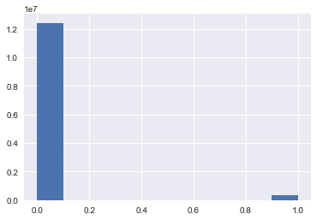
Click vs non-click distribution
Very unbalanced ratio for two categories
Solution: down-sampling non-click data to click scale
--- Because we have enough data

Slide 4
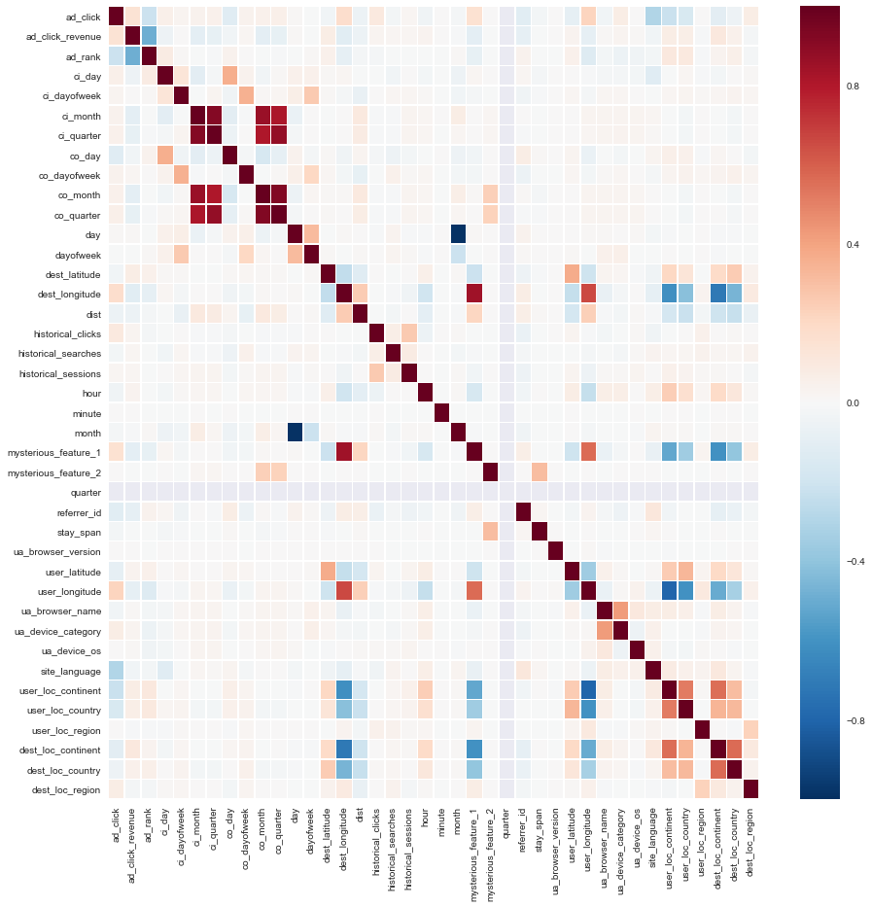
Data Discovery
No direct linear correlations between ad click and other variables. Except for some within-location and within-time relation
Mysterious_feature_1 is strongly indcating some feature of destination --- it's correlated with destination_longtitude; but also possible user location
Mysterious_feature_2 is somewhat season/'time of a year' related

Slide 5
Use ensemble tree based models to assess the feature importance
RandomForestClassifier
XgbClassifier
ExtraTreeClassifier

Slide 6

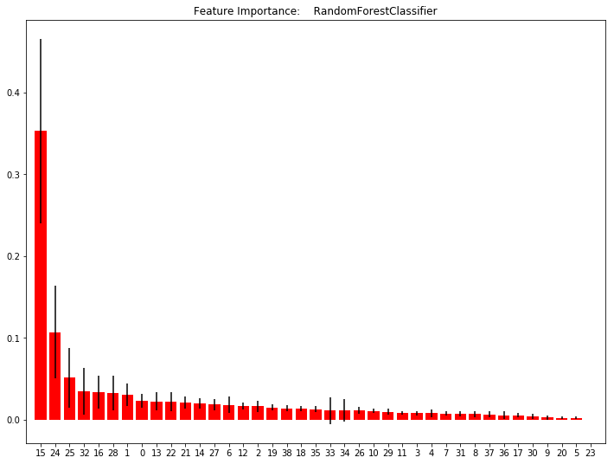
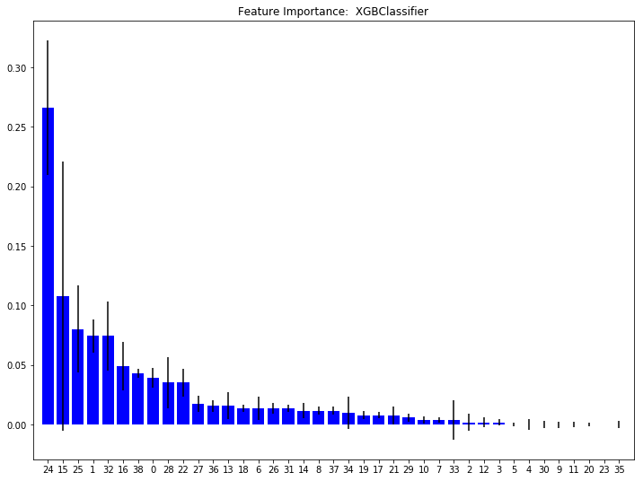
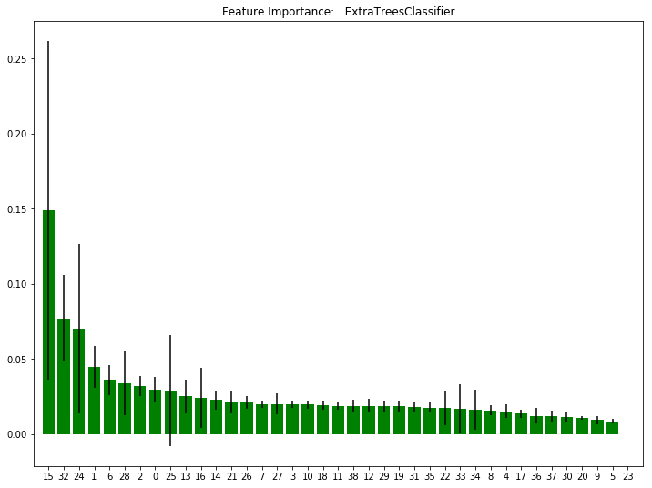
Top 5 feature across 3 different models : RandomForest: 15, 24, 25, 32, 16 Xgboost: 24, 15, 25, 1, 32 Extra Tree: 15, 32, 24, 1, 6

Slide 7

The common top feature variables are:
15 (historical_clicks)
24 (referrer_id),
(site_language)
Conclusion: historical_clicks, referrer_id and site_language are the main factors for ad clicks

Slide 8

Model comparison: 4 single models were used to predict the customers ad clicking
 | Logistic Regression | Random Forest | Support Vector Classification | Xgboost
Accuracy | 65.37% | 87.87% | 81.30% | 89.53%
Precision | 66.58% | 92.61% | 85.48% | 93.04%
xgboost has the best performance across all models!

Slide 9

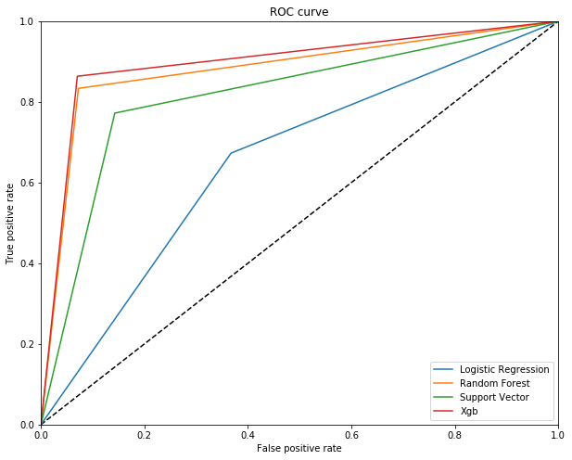

Slide 10
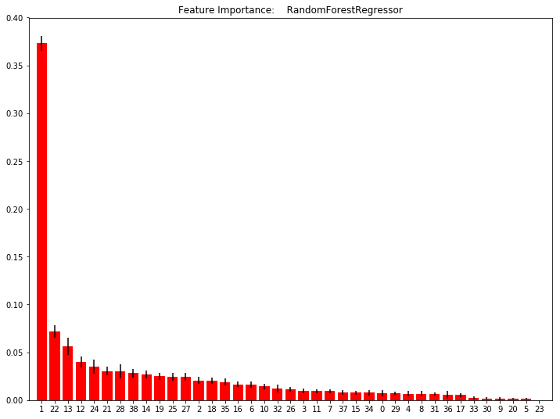
The top factos the affect revenue are: ad_rank, mysterious_feature_2, dest_longitude, dest_latitude, referrer_id
Analytical Questions
Revenue and ad ranking ?
Intuitive thoughts from the correlation plot: ad_rank has some negative correlation with revene, which
means lower ad_rank number indicates higher revenue ---- which is obvious and make sense
A quick feature performance evaluation using random forest regressor
The top factors the affect revenue are:
ad_rank
mysterious_feature_2
dest_longitude
dest_latitude
referrer_id
Suggestions?
Adjust ad rank; Change by time of a year and by user
destination; Keep attention to referral sites

Slide 11
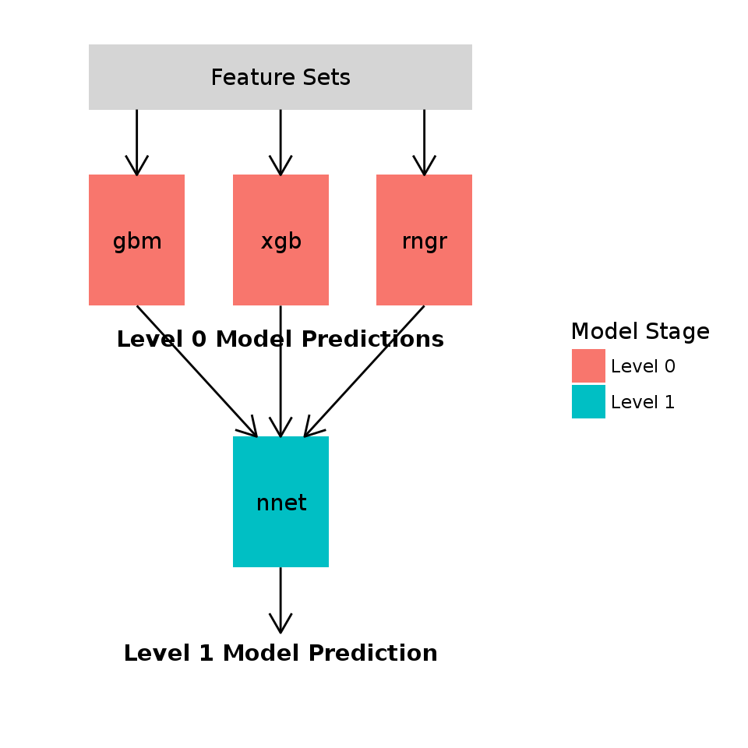
Next Step to Improve
Built more complexed model for ad click prediction: a two-layer stacking method, a possible flow chart would like the picture at rightside
2. Cross validation folds needed to generate the Meta Features
3. Cost per Click (CPC) and Click Through Rate(CTR) prediction:
Metrics and loss function

