Slide 1
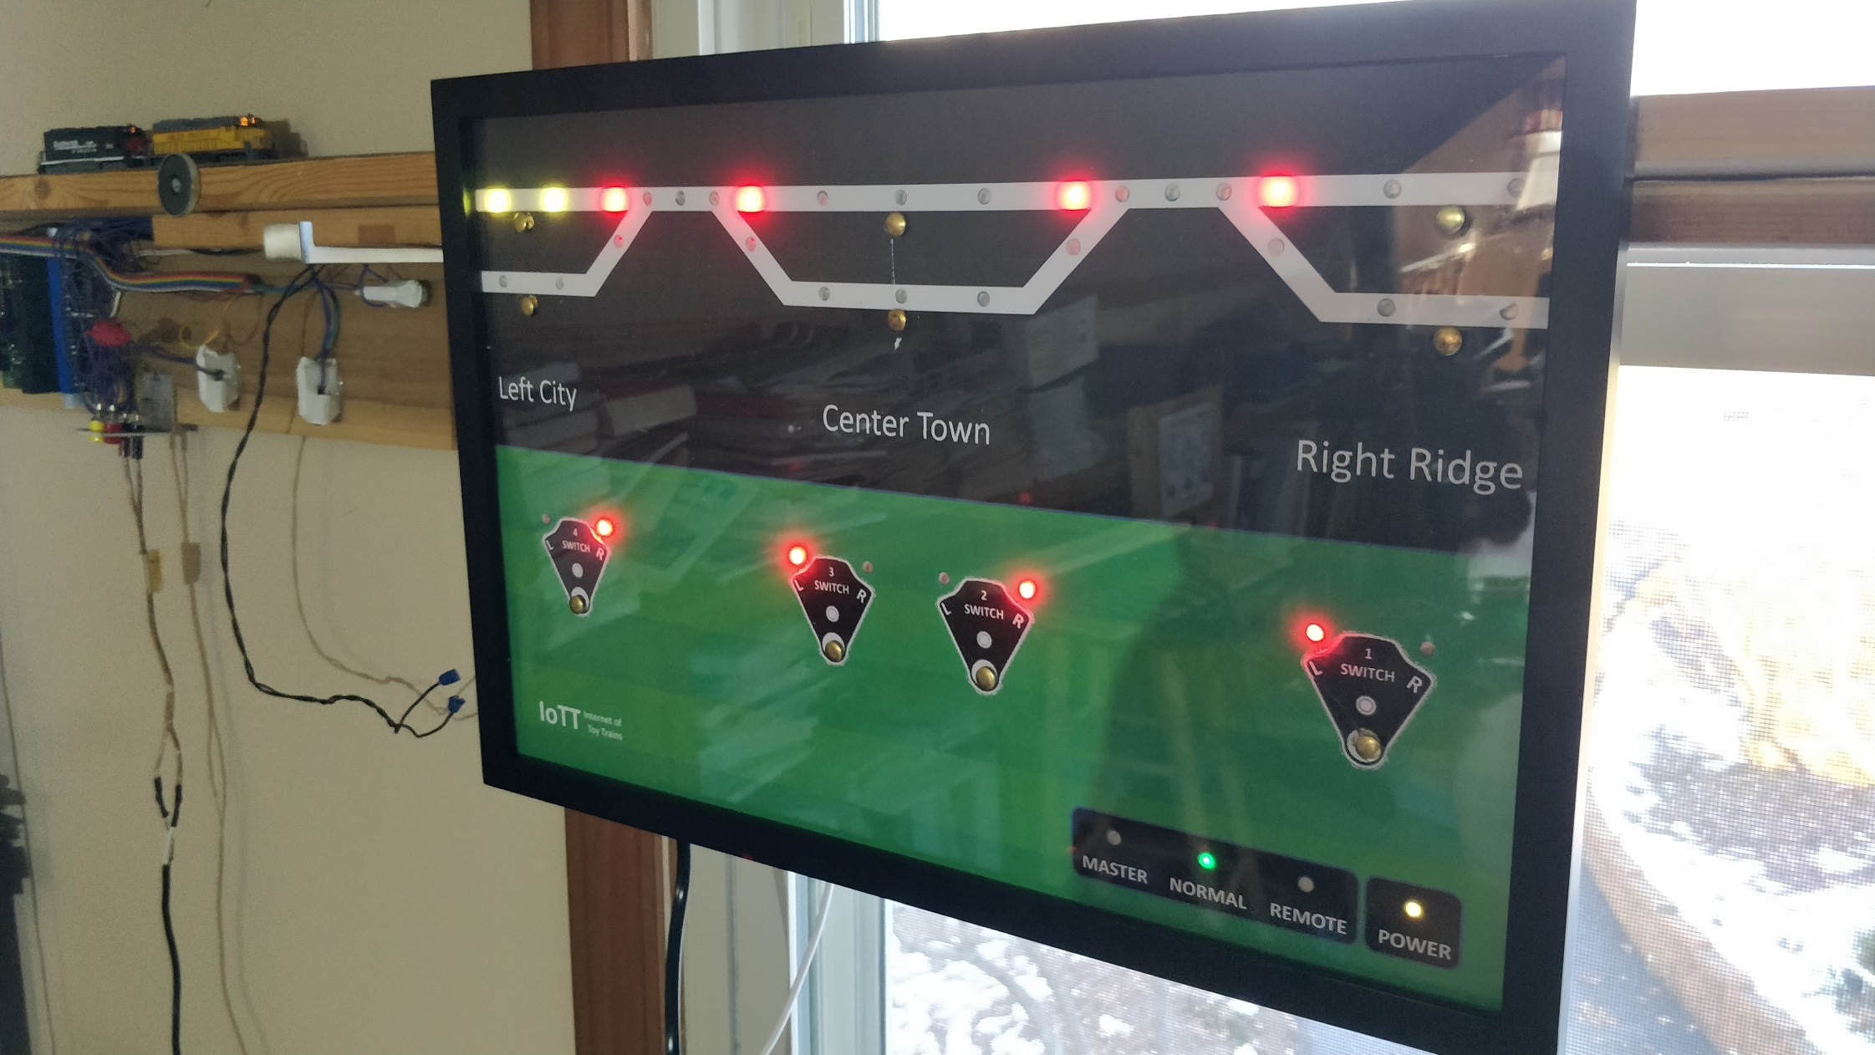
CTC Panel
Buttons, Turnouts, Block Detectors
Configuration

Slide 2
Yellow Box Software Structure
Yellow Box Software
Wifi Access Configuration
LED Display Configuration
Work Mode Configuration
Basic Structural Data (Block Detectors, Switches, Signals)
Higher Level Structural Data (Routes, Security Elements)
User Application Data
Route Management and CTC Control
ABS Signal Monitoring
Turnout Activation and Monitoring
Button Input Status
LED Display Chain
Block Detector and Switch Status
MQTT Interface
LocoNet Interface
Current Occupancy Statuses
Current Turnout positions
Current Signal Aspects
Current Route statuses
Runtime Data

Slide 3
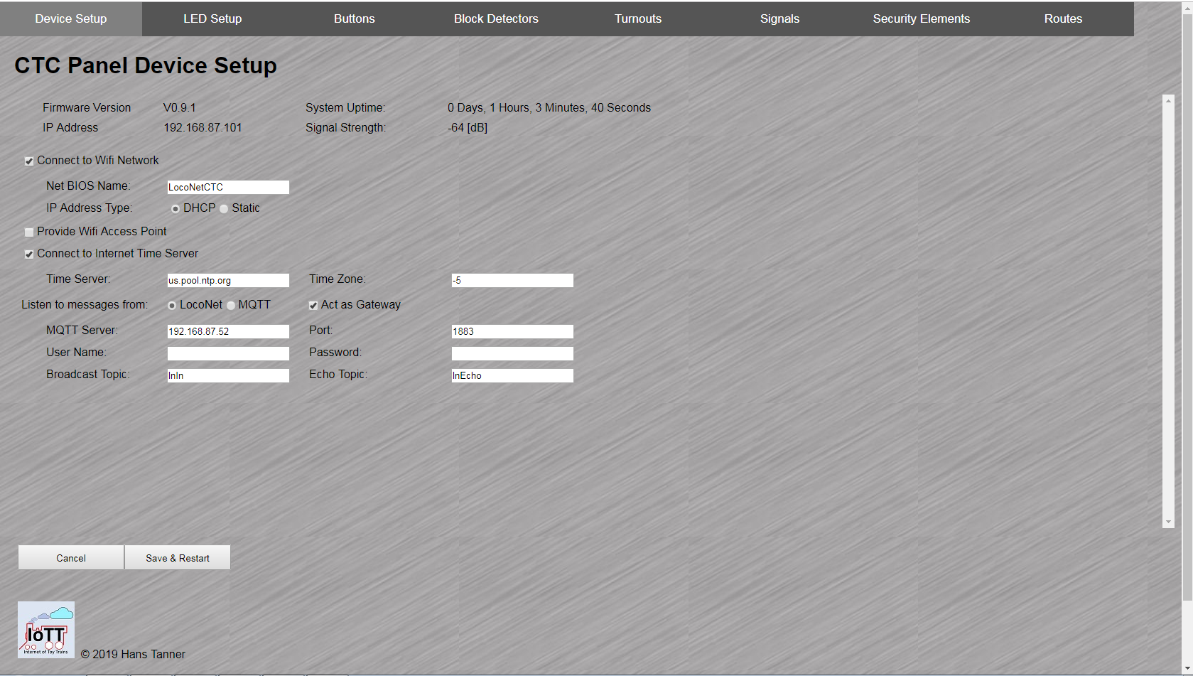

Slide 4

Table of content Min/Sec
Software Architecture 1:17
JSON Configuration File 2:11
LED Chain and Basic Modes 4:28
Buttons 11:04
Block Detectors 12:28
Turnouts 13:17
Signals and Why I interrupt the development 14:20
Summary 16:16

Slide 5
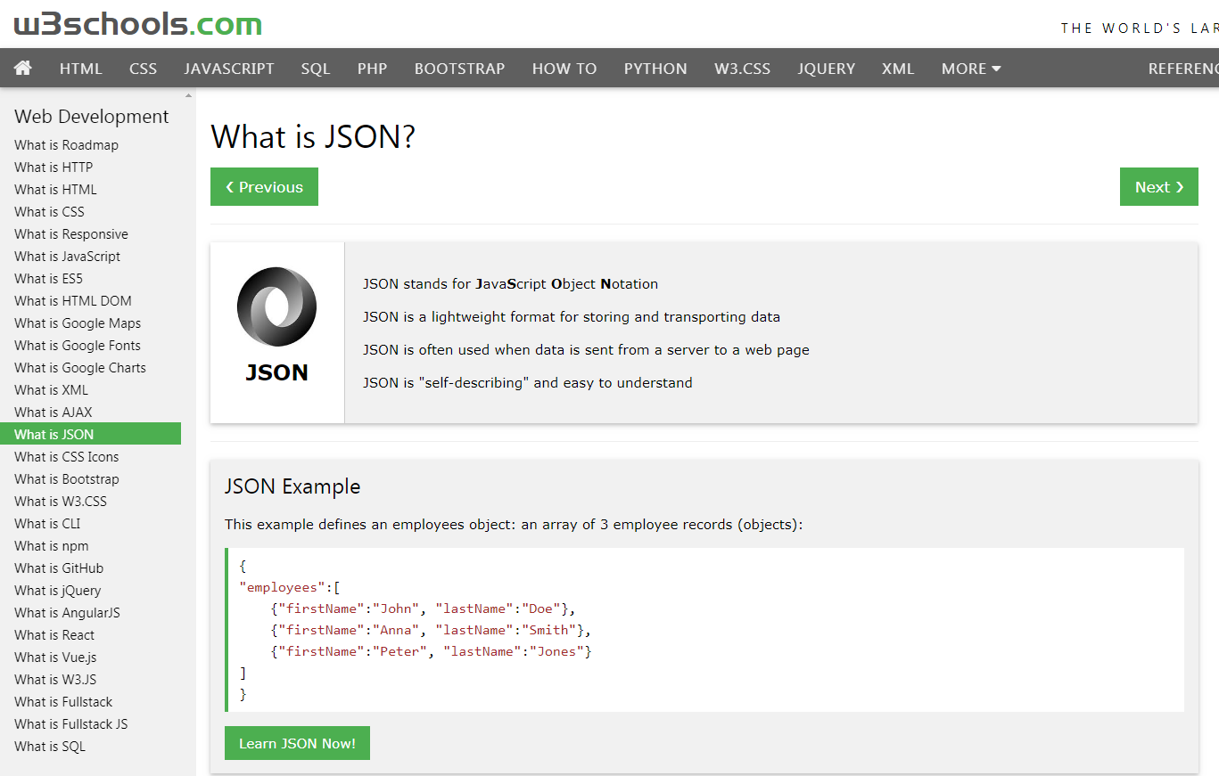
Source: https://www.w3schools.com/whatis/whatis_json.asp

Slide 6
Power Modes
Value | Name | Descr
0 | OFF | All LED’s dark, Power LED can show “Stand by” showing OFF Color
1 | ON | Panel ready and working, Power LED shows ON Color. Work Mode and Control Mode used to determine mode of operation

Slide 7
Work Modes
Value | Name | Descr
0 | Normal Mode | Use OPC_SW_REQ for switch commands, this will only work if the Bushby bit in the command station is cleared
1 | Master Mode | Use OPC_SW_ACK for switch commands, this will work if Bushby bit is set

Slide 8
Control Modes
Value | Name | Descr
0 | OFF | All buttons deactivated, LEDs show occupancy and switch statuses. The panel displays what is set or happening in other locations.
1 | Manual | Single Touch and Double Touch buttons active to control switches and signals, but no Route locking and reservation or automatic signaling
2 | ABS | Single Touch and Double Touch buttons active to control switches. Signals automatically controlled using ABS rules, i.e. based on block detector statuses
3 | CTC | Single Touch and Double Touch active, Route locking and reservation control active using CTC functionality rules

Slide 9
Summary
To make a device like the Yellow Box universal, program code and application data need to be completely separated. It should be possible to change the application data without changing the program code
JSON provides a suitable description language for the application data. It is even human readable, if needed
Of course, a computer based tool for configuration makes things much easier
Thanks to the WebSocket technology the Yellow Box can be emulated in real-time in the browser. The user can see the effects of configuration changes immediately on the physical CTC panel

Slide 10
Additional Materials on Github: https://github.com/tanner87661/IoTT-Video12
Layout Intro Sequence Outdoor Layout: Beat Deola, Switzerland​
Indoor Layout Videos: Hendersonville, NC Train Depot https://www.avmrc.com/

Slide 11




IoTT
Internet of Toy Trains

