Slide 1
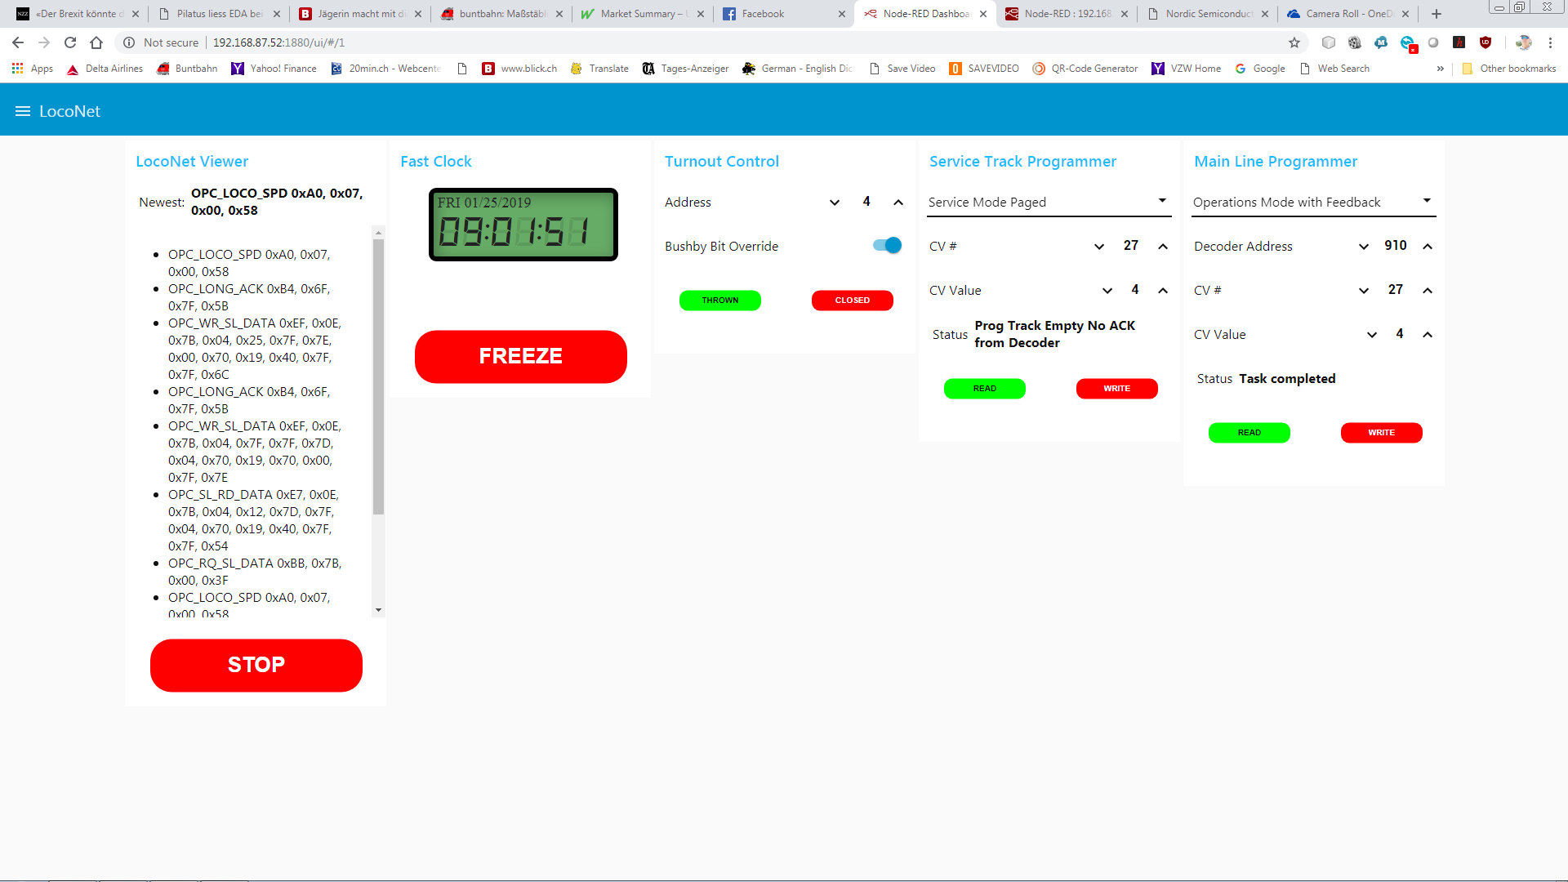
Finalizing the
LocoNet
Toolbox

Slide 2
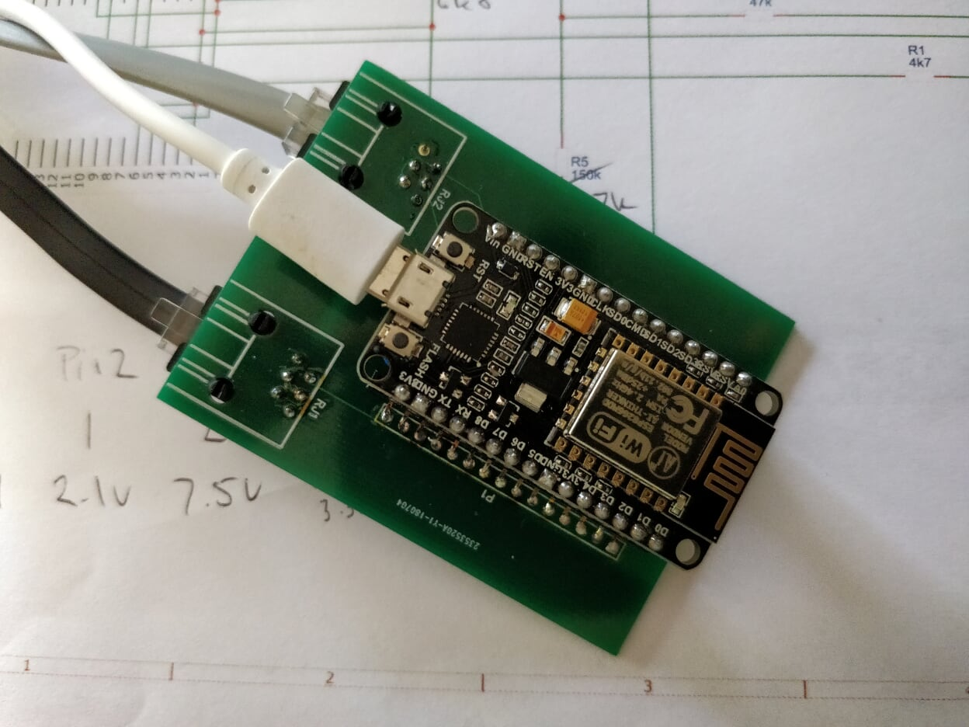

Slide 3
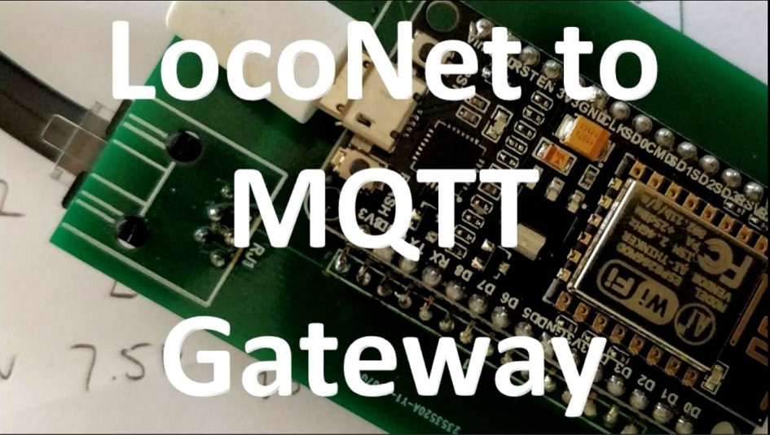
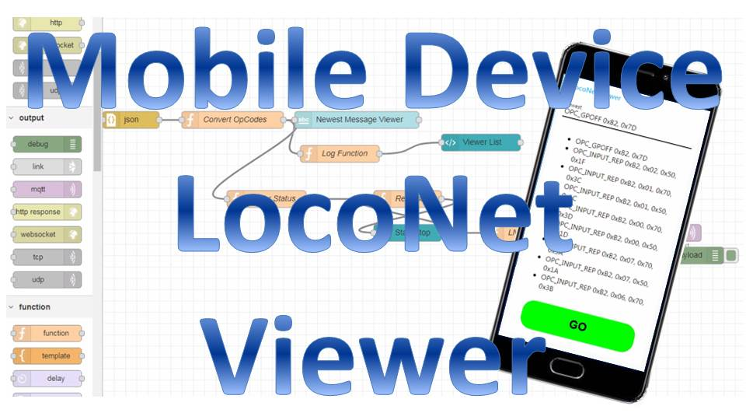
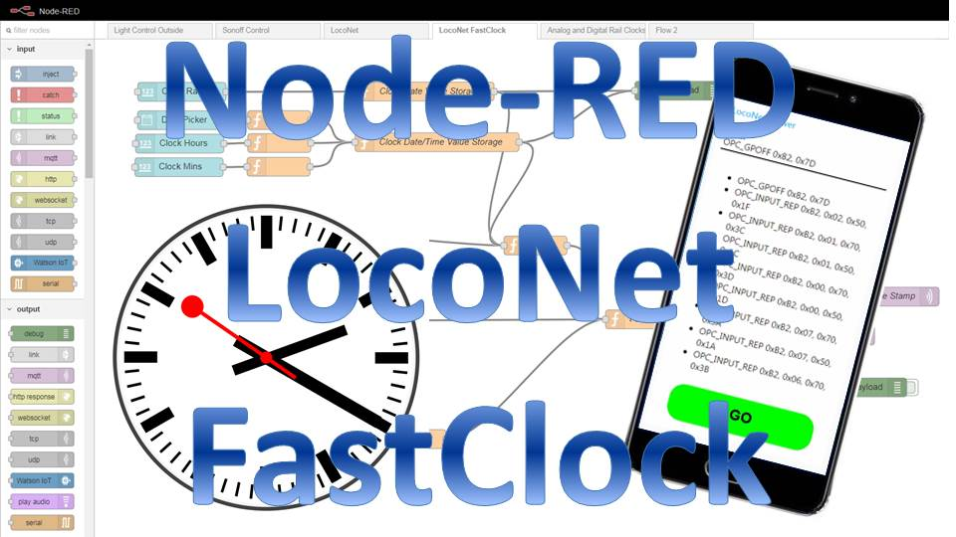

Slide 10
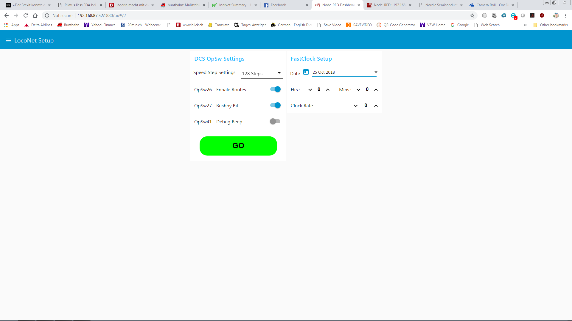

Slide 12
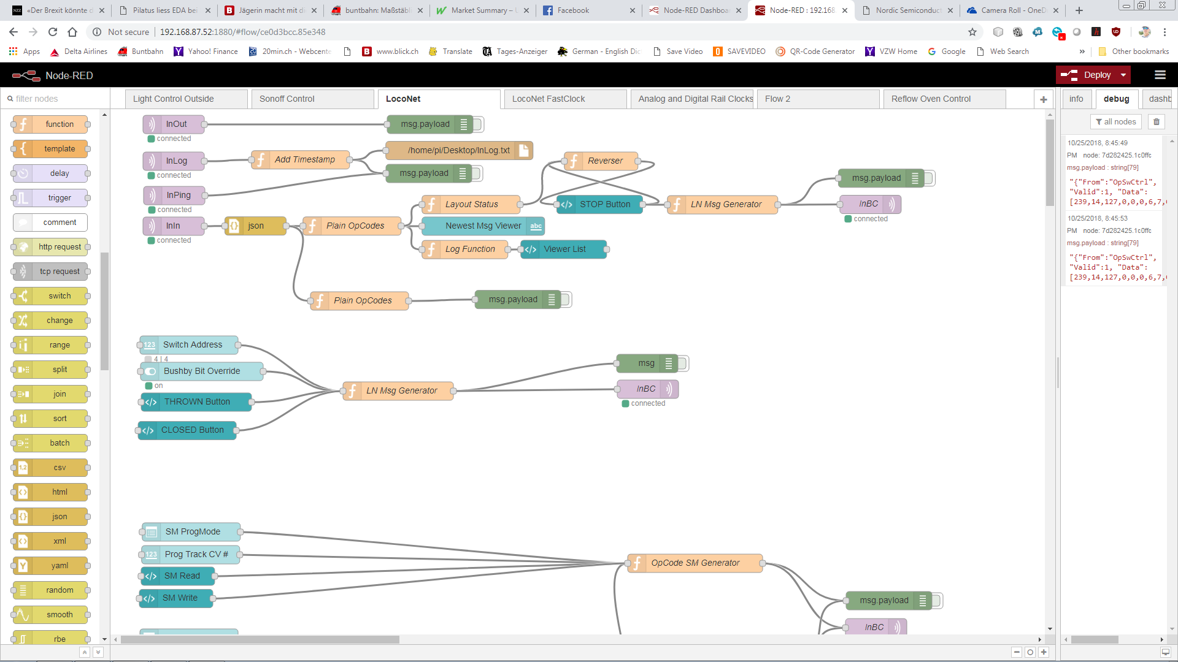
Node-RED Flow
Node-RED User Interface on Mobile Device

Slide 13
Similar HTML sequence for CLOSED button, just different color and label
<md-button class="vibrate filled touched bigfont rounded" style="background-color:#FFFFFF" ng-mousedown="send({payload: buttondown()})" ng-mouseup="send({payload: buttonup()})" ng-mouseleave="send({payload: buttonup()})">
<script>
var mouseDownTH = false;
var defValTH = 0x00;
var downVal = 0x10;
var upVal = 0x00;
this.scope.buttondown = function() {mouseDownTH = true; return (defValTH + downVal);}
this.scope.buttonup = function() {if (mouseDownTH) {mouseDownTH = false; return (defValTH + upVal);} else return null}
</script>
<svg width="100px" height="60px" version="1.1" viewBox="0 0 800 200">
<g id="Button_Long_TH">
<rect fill="#FFFFFF" width="800" height="200"/>
<g ng-style="{fill: 'lime'}">
<rect width="800" height="200" rx="80" ry="80"/>
</g>
<g ng-style="{fill: 'lime'}">
<rect x="11" y="10" width="778" height="180" rx="90" ry="90"/>
</g> <g ng-style="{fill:'black'}">
<text x="400" y="125" style="text-anchor:middle" font-weight="bold" font-size="80" font-family="Arial">{{"THROWN"}} </text>
</g>
</g>
</svg></md-button>

Slide 14
//storing incoming values for Switch Address and Bushby Bit Status
if (msg.payload === null)
return null;
if (msg.topic == "setBushby")
{
context.set("setBushby", msg.payload)
return null}
if (msg.topic == "swAddr")
{
var newAddr = parseInt(msg.payload)-1;
context.set("swAddr", newAddr)
return null
}
//function to create JSON String for sending to the MQTT broker
function createJSON(fromData)
{
var retStr = "{\"From\":\"Switch Board\", \"Valid\":1, \"Data\":[";
var xorCode = 0;
for (i = 0; i < fromData.length; i++)
{ var byteCode = parseInt(fromData[i]);
retStr = retStr + byteCode.toString() + ",“
xorCode = xorCode ^ byteCode;
}
xorCode = xorCode ^ 0xFF;
retStr = retStr + xorCode.toString() + "]}";
return retStr;
}
//in case Bushby bit data is not stored, we initialize it to CLEARED
var ignoreBushby = context.get("setBushby")
if (ignoreBushby === undefined)
ignoreBushby = false;
//in case the user has not set a Switch Address, we exit without sending anything
var swAddr = context.get("swAddr");
if (swAddr === undefined) return null;
//everything looking good, let's send the commandvar onMsg;
var data= [0,0,0];if (ignoreBushby === false)
data[0] = 0xB0; //OPC_SW_REQ
else
data[0] = 0xBD; //OPC_SW_ACC to overrule Bushby
data[1] = swAddr & 0x7F;
data[2] = (swAddr & 0x0780) >>> 7;
data[2] = data[2] | ((msg.payload & 0x30));
onMsg = {payload : createJSON(data)};
return onMsg;

Slide 15
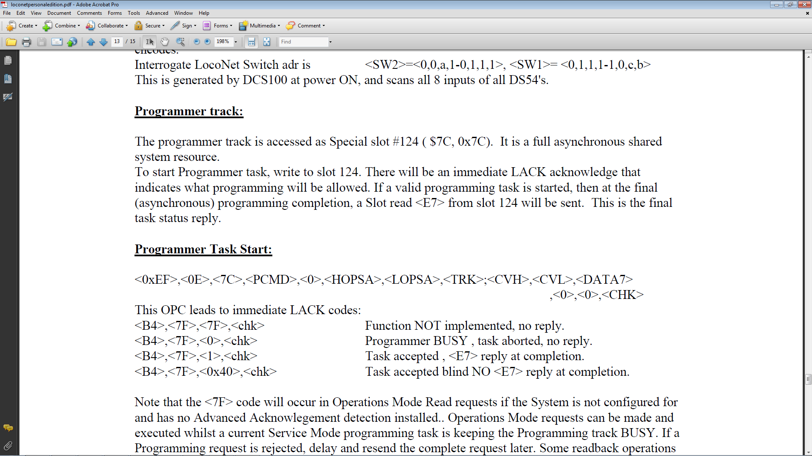
From Digitrax LocoNet PE Document

Slide 16
From Digitrax LocoNet PE Document
Throttle / Mobile Device DCS Command Station Programming Track
Send Start Task OPC_WR_SL
Process and send OPC_LACK message
Receive confirmation and status information
Execute Read or Write Operation, return result
Process result and send final reply OPC_SL_RD
Receive and display results and status

Slide 17
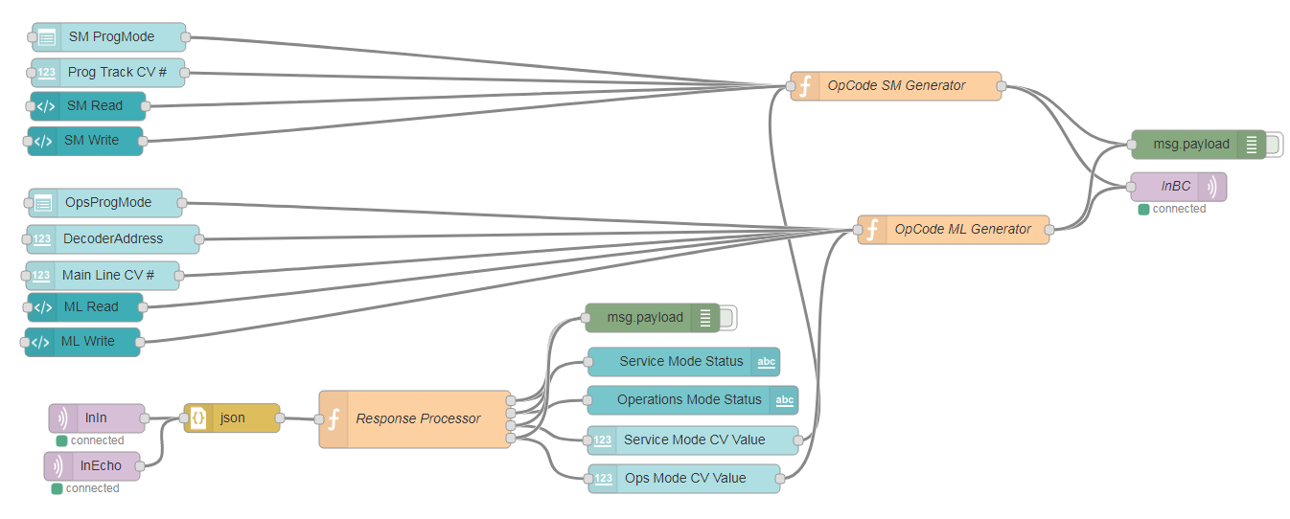
Node-RED Flow
Node-RED User Interface on Mobile Device

Slide 18
var dispMsgSM = null;
var valMsgSM = null;
var dispMsgOM = null;
var valMsgOM = null;
if ((msg.payload.Valid == 1) && (msg.payload.From == "LocoNetGateway"))
{
var res = msg.payload.Data.length;
var myNumber = parseInt(msg.payload.Data[0]);
switch(myNumber)
{
case 0xB4 : //LACK
{ if (context.get("AwaitLACK") > 0)
{
var newMsg;
var lackResult = parseInt(msg.payload.Data[2]);
switch (lackResult)
{
case 0x00: newMsg = {payload : "Programmer busy"}; break;
case 0x01: newMsg = {payload : "Working. Please wait..."}; break;
case 0x40: newMsg = {payload : "Task completed, no E7 Reply"}; break;
case 0x7F: newMsg = {payload : "not implemented"}; break;
default : newMsg = {payload : "unknown Status"}; break;
}
if (context.get("AwaitLACK") == 1)
dispMsgSM = newMsg;
else
dispMsgOM = newMsg;
context.set("AwaitLACK", 0);
}
break;
}
case 0xE7 : //SL_RD_DATA
{
if (parseInt(msg.payload.Data[1]) == 0x0E)
{
var valMsg;
var dispMsg;
var slotNr = parseInt(msg.payload.Data[2]);
if (slotNr == 0x7C)
{
var slrdPSTAT = parseInt(msg.payload.Data[4]);
var retString = "";
if (slrdPSTAT === 0)
{
retString = "Task Successfull“
var CVValue = (parseInt(msg.payload.Data[10]) & 0x7F) + ((parseInt(msg.payload.Data[8]) & 0x02) << 6);
valMsg = {payload : CVValue.toString()};
}
else
{
if ((slrdPSTAT & 0x01) > 0)
retString += "Prog Track Empty ";
if ((slrdPSTAT & 0x02) > 0)
retString += "No ACK from Decoder ";
if ((slrdPSTAT & 0x04) > 0)
retString += "No Read Compare ACK ";
if ((slrdPSTAT & 0x08) > 0)
retString += "Task Aborted by User";
}
dispMsg = {payload : retString};
if ((msg.payload.Data[3] & 0x04) === 0)
{
dispMsgSM = dispMsg;
valMsgSM = valMsg;
}
else
{
dispMsgOM = dispMsg;
valMsgOM = valMsg;
}
}
context.set("AwaitLACK", 0);
}
break;
}
case 0xEF : //SL_WR_DATA
{
if (parseInt(msg.payload.Data[1]) == 0x0E)
{
var slotNr = parseInt(msg.payload.Data[2]);
if (slotNr == 0x7C)
{
if ((msg.payload.Data[3] & 0x04) === 0)
{
context.set("AwaitLACK", 1);
dispMsgSM = {payload : "Start Task " + msg.payload.Data[3]};
}
else
{
context.set("AwaitLACK", 2);
dispMsgOM = {payload : "Start Task " + msg.payload.Data[3]};
}
}
}
break;
}
default:
{
context.set("AwaitLACK", 0);
break;
}
}}
return [dispMsgSM, dispMsgOM, valMsgSM, valMsgOM];
Filters for SM or ML programmer

Slide 20
DCS Command Station Slot #127 (0x7F)
<Slot#><OpSw 1-7><OpSw 9-15><OpSw 17-23><OpSw 25-31><TRK><OpSw 33-39><OpSw 41-47><OpSw 48-54>
OpSw assignment by bit
N/A
23
22
21
20
19
18
17
Bit 7
MSB
Bit 0
LSB

Slide 21
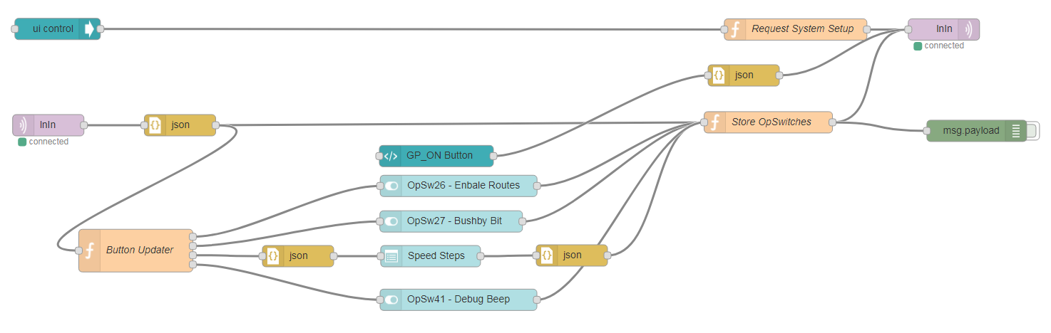
Node-RED Flow
Node-RED User Interface on Mobile Device

Slide 22
OpSw 27 (Bushby – Bit) Effects
Bushby Bit Status | Switch Command | Command Station Result
Cleared | OPC_SW_REQ | Execute Switch
Cleared | OPC_SW_ACK | Execute Switch
Set | OPC_SW_REQ | Refuse Switch Execution
Set | OPC_SW_ACK | Execute Switch
Note: Digitrax Handheld Throttles can only send OPC_SW_REQ commands

Slide 23
Summary
We added a switch controller and programmers for Service Track and Main Line to the LocoNet Tool Box

Slide 24
Summary
We added a switch controller and programmers for Service Track and Main Line to the LocoNet Tool Box
We added a setup tool for setting the OpSw in the DCS command station from remote, without setting the mode switch to the Ops position

