Slide 1
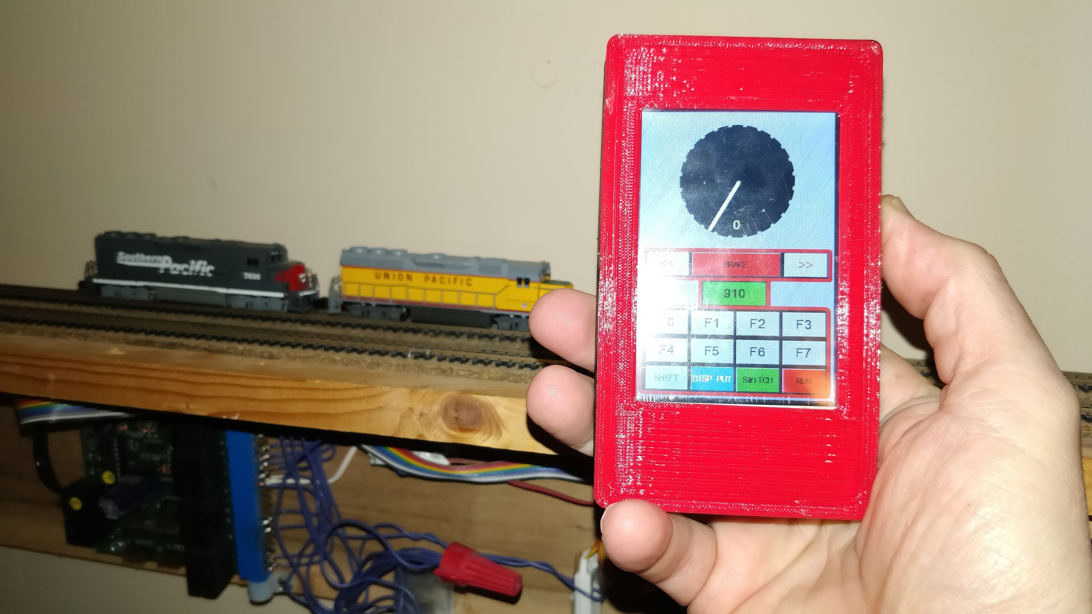
Inside the LocoNet
Wifi Throttle

Slide 2
Touch Display 3.5” $26.00
Battery $ 3.00
ESP8266 $ 4.00
Filament $ 2.50
Total Material Cost $35.50

Slide 3
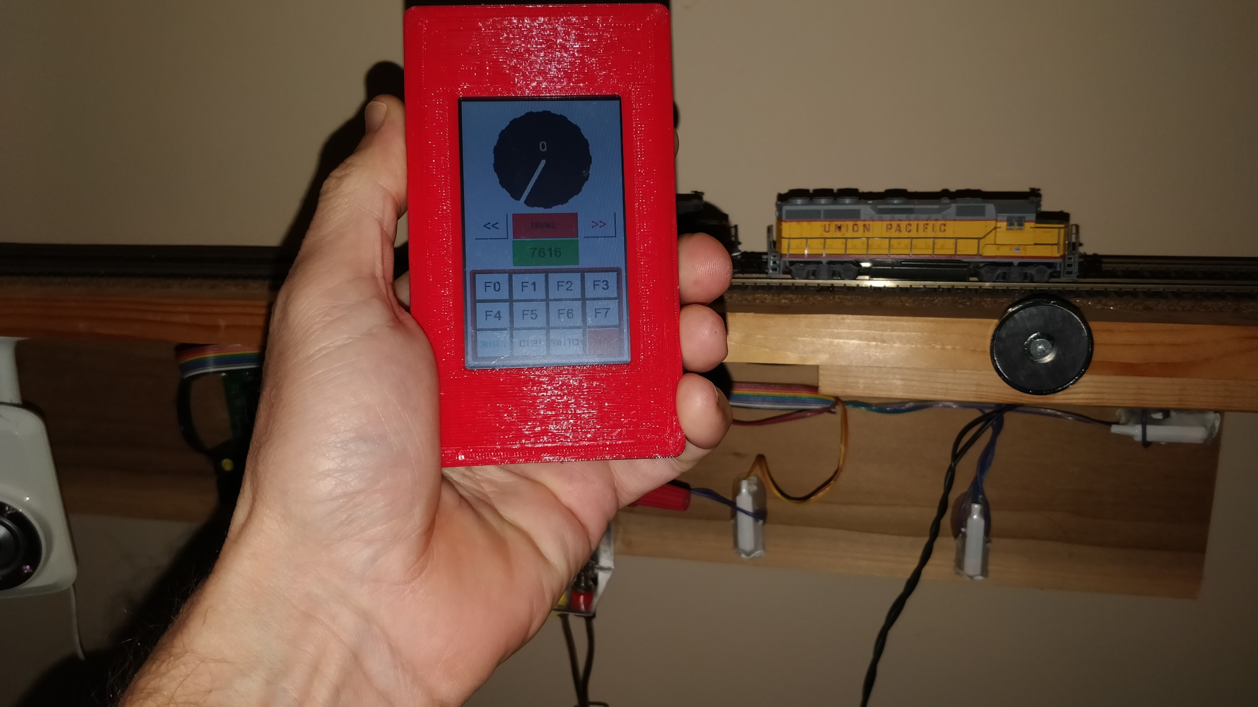
3.2” 240 x 400
3.5” 320 x 480

Slide 4

Jump to your topic of interest: @ Time
Update on Functionality 0:56
Display Layout Design 3:16
Display Events Programming 7:08
ESP8266 Programming 11:34
Summary 16:38

Slide 5
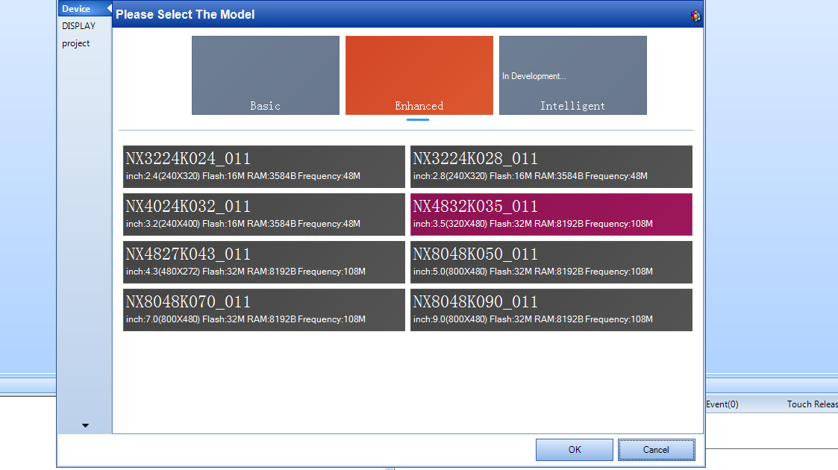

Slide 6
NodeMCU
ESP8266
Controller
(Arduino IDE)
Nextion
Display 3.5”
320 x 480 pixel
Serial Comm 9600 Baud

Slide 8
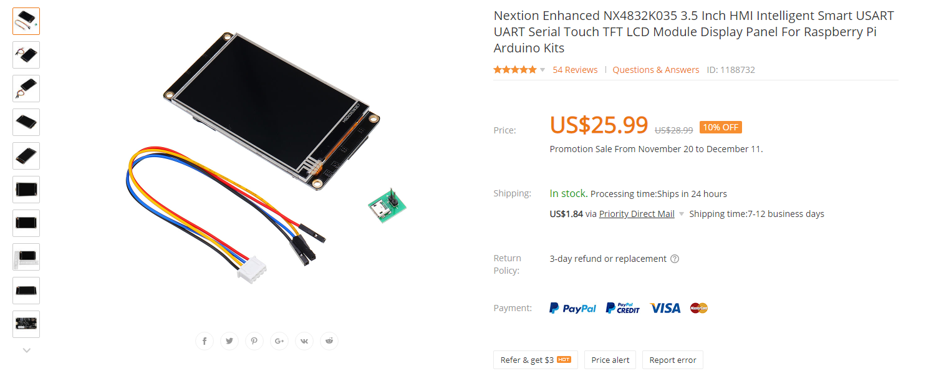

Slide 9
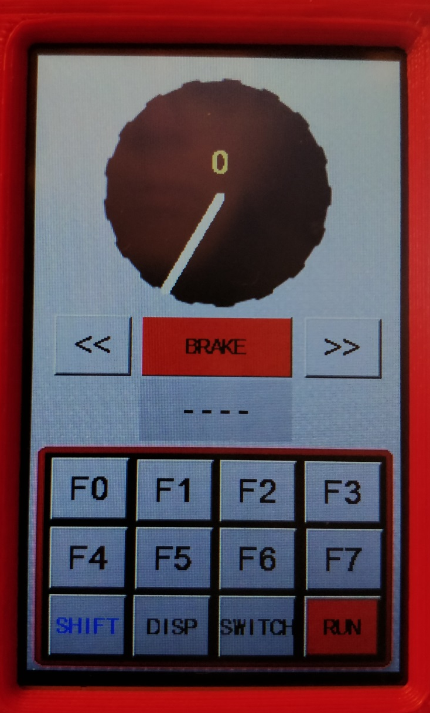
Speed Knob
Speed Indicator
Brake Button
Backward Selector
Forward Selector
Loco Address Display
Function Buttons
Disp Put/Get Button
Mode Selector
Keyboard Shift
Run/Idle Selector

Slide 10
Press on Rim to set Target Speed
Current Speed Indicator
Press Brake Button to set 0 Speed Target
Hold for 500+ ms for immediate stop
Press to change Target Direction
Click to select Locomotive or Consist Screen
Click to activate / deactivate functions
Click to Dispatch or Assign
Click to go to Switch or CTC boards
Click to switch function display to F8 – F15
Click to change Layout Power Status

Slide 11
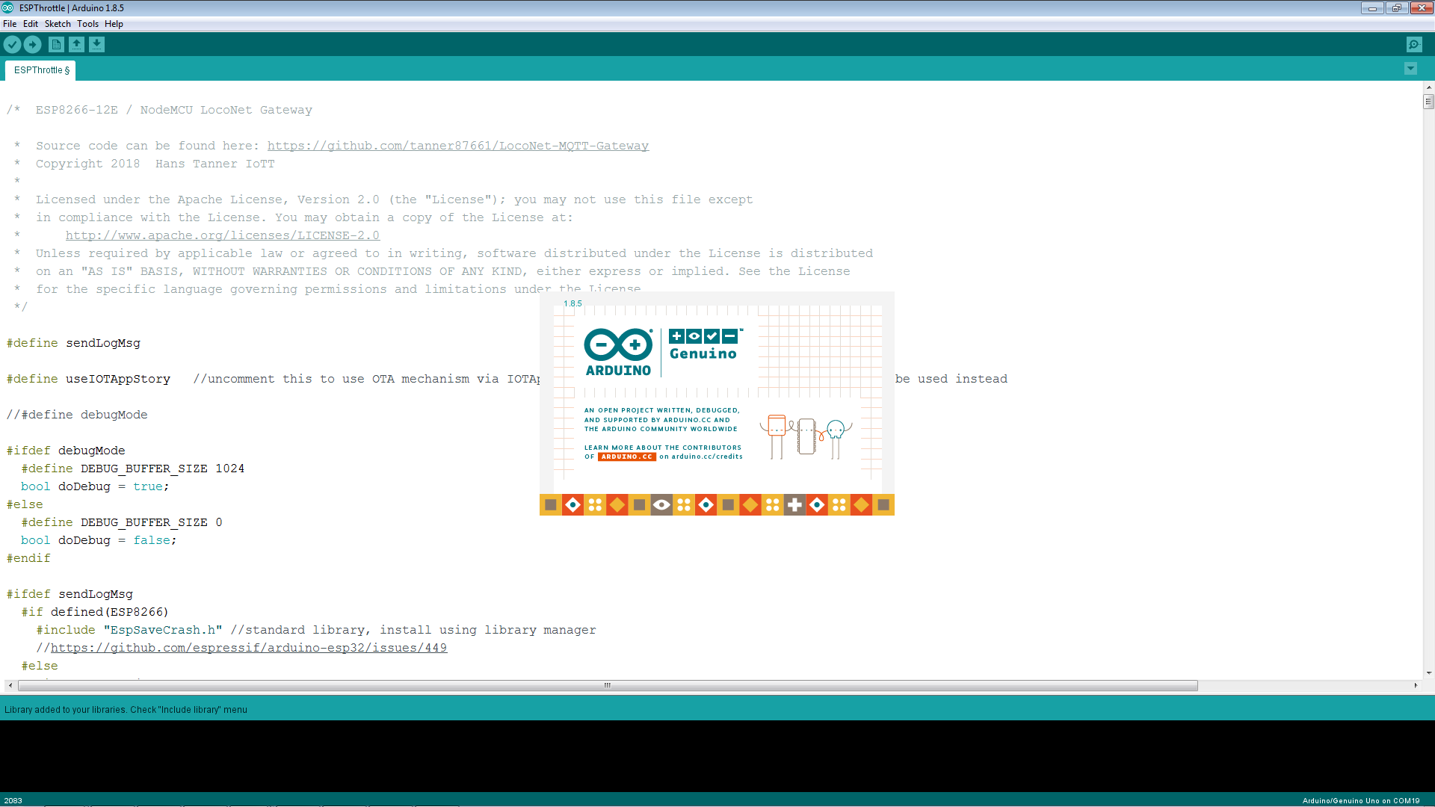

Slide 12
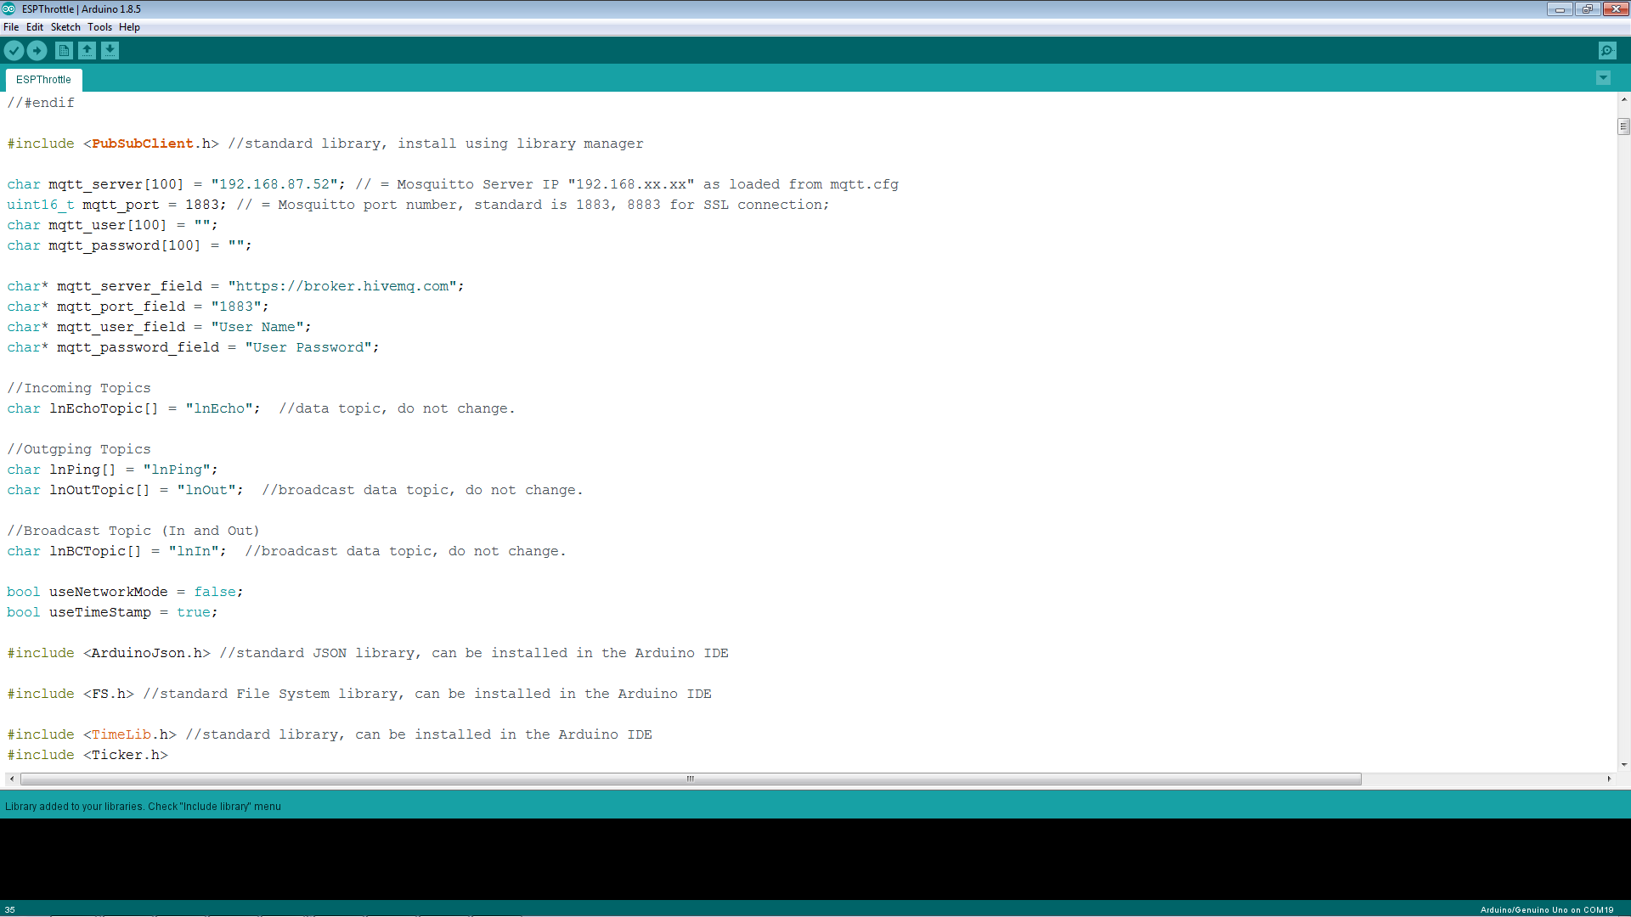
In this video, I do not explain the components that deal with Wifi and LocoNet as many libraries and routines are the same.
Check Video #1 for more details.

Slide 13
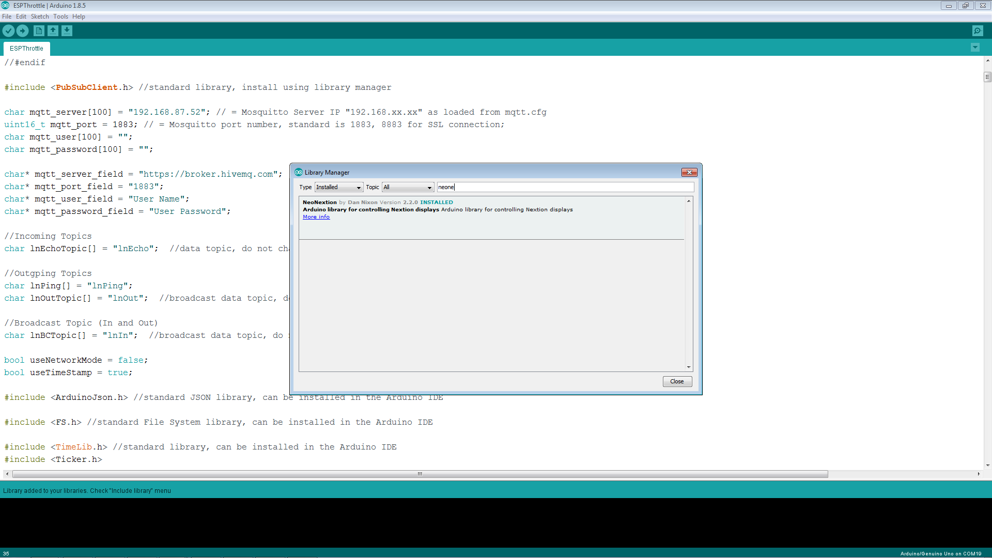

Slide 14
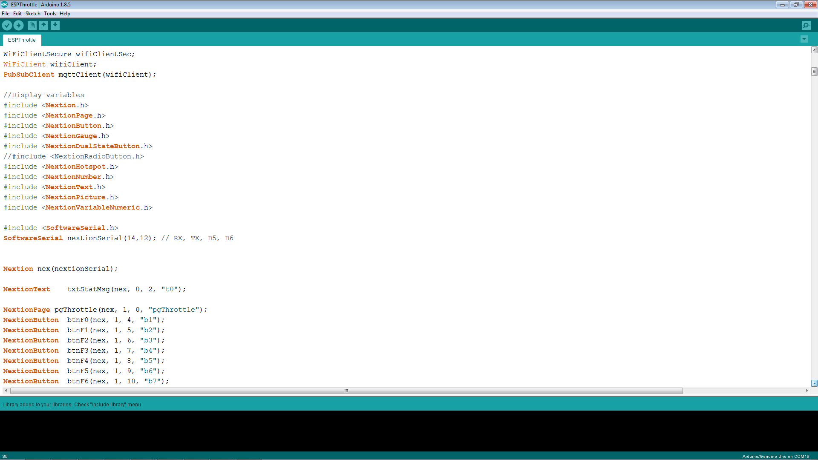
Nextion libraries for all used components
Definitions for touchable Nextion components on page 1 (Throttle Main Page)

Slide 15
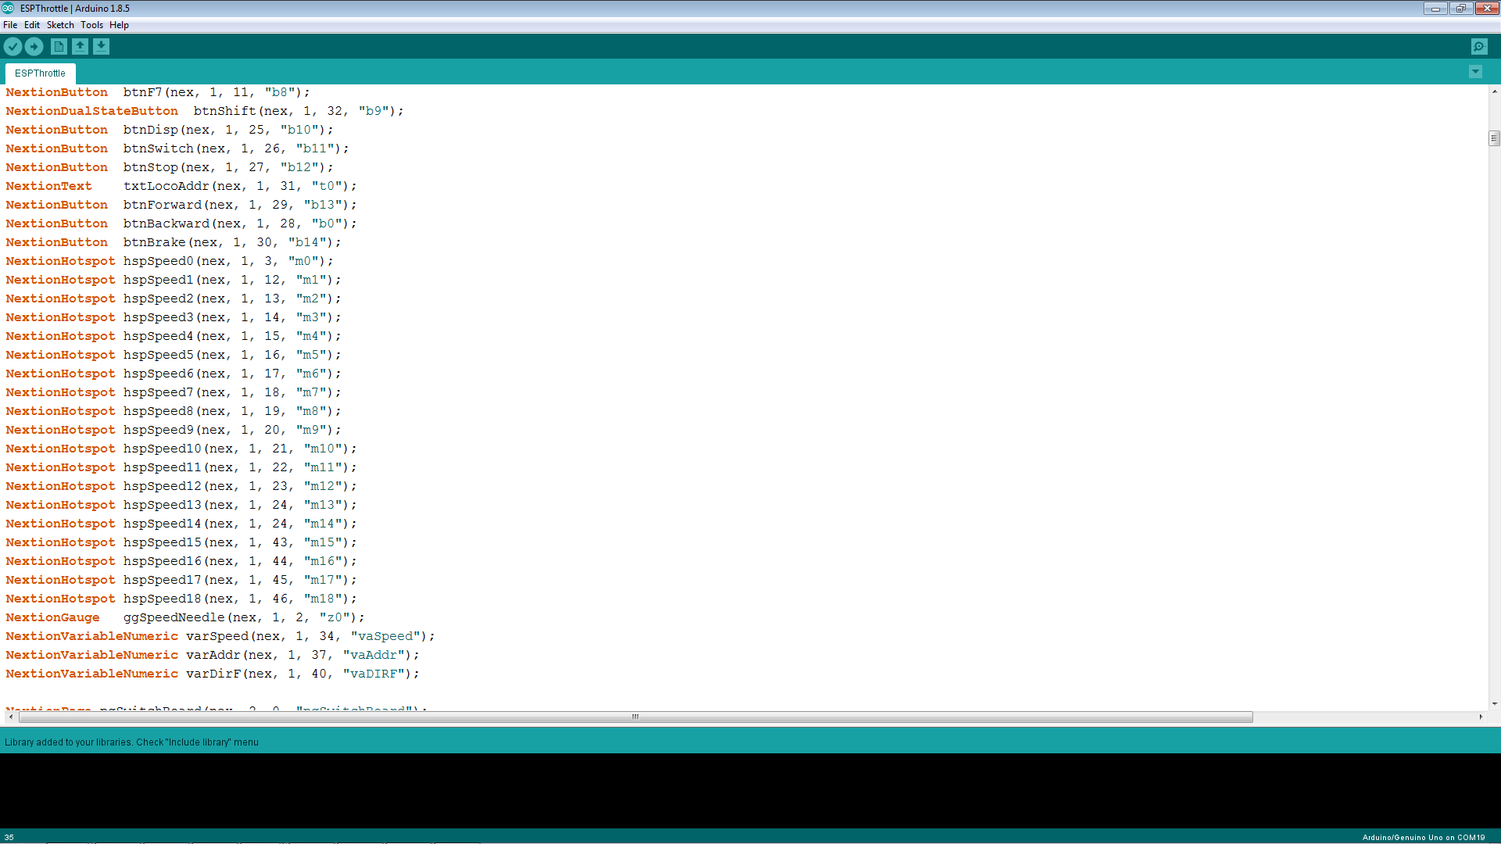
More definitions for touchable Nextion components on page 1 (Throttle Main Page)

Slide 16
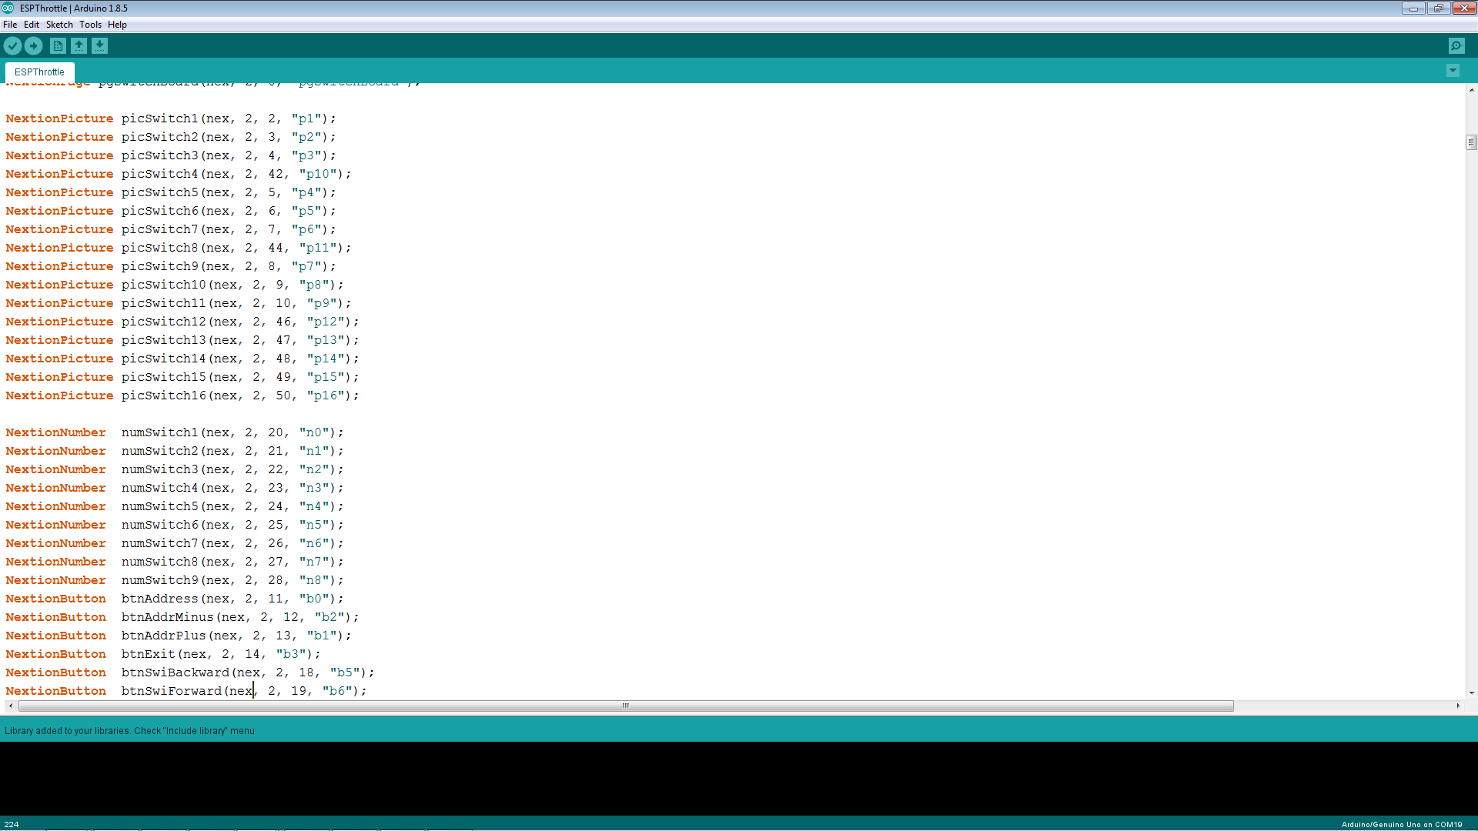
Definitions for touchable Nextion components on page 2 (Switch Board)

Slide 17
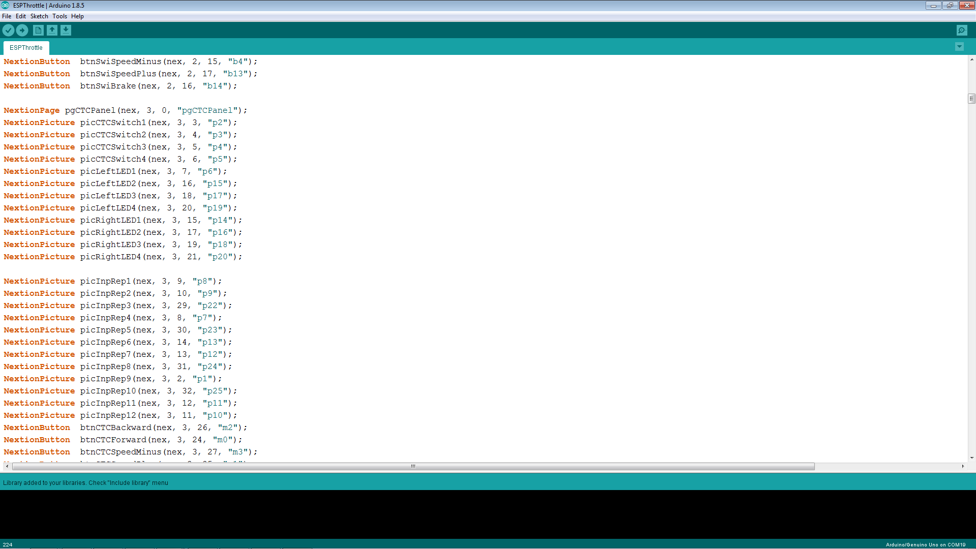
Definitions for touchable Nextion components on page 3 (CTC Panel Page)

Slide 18
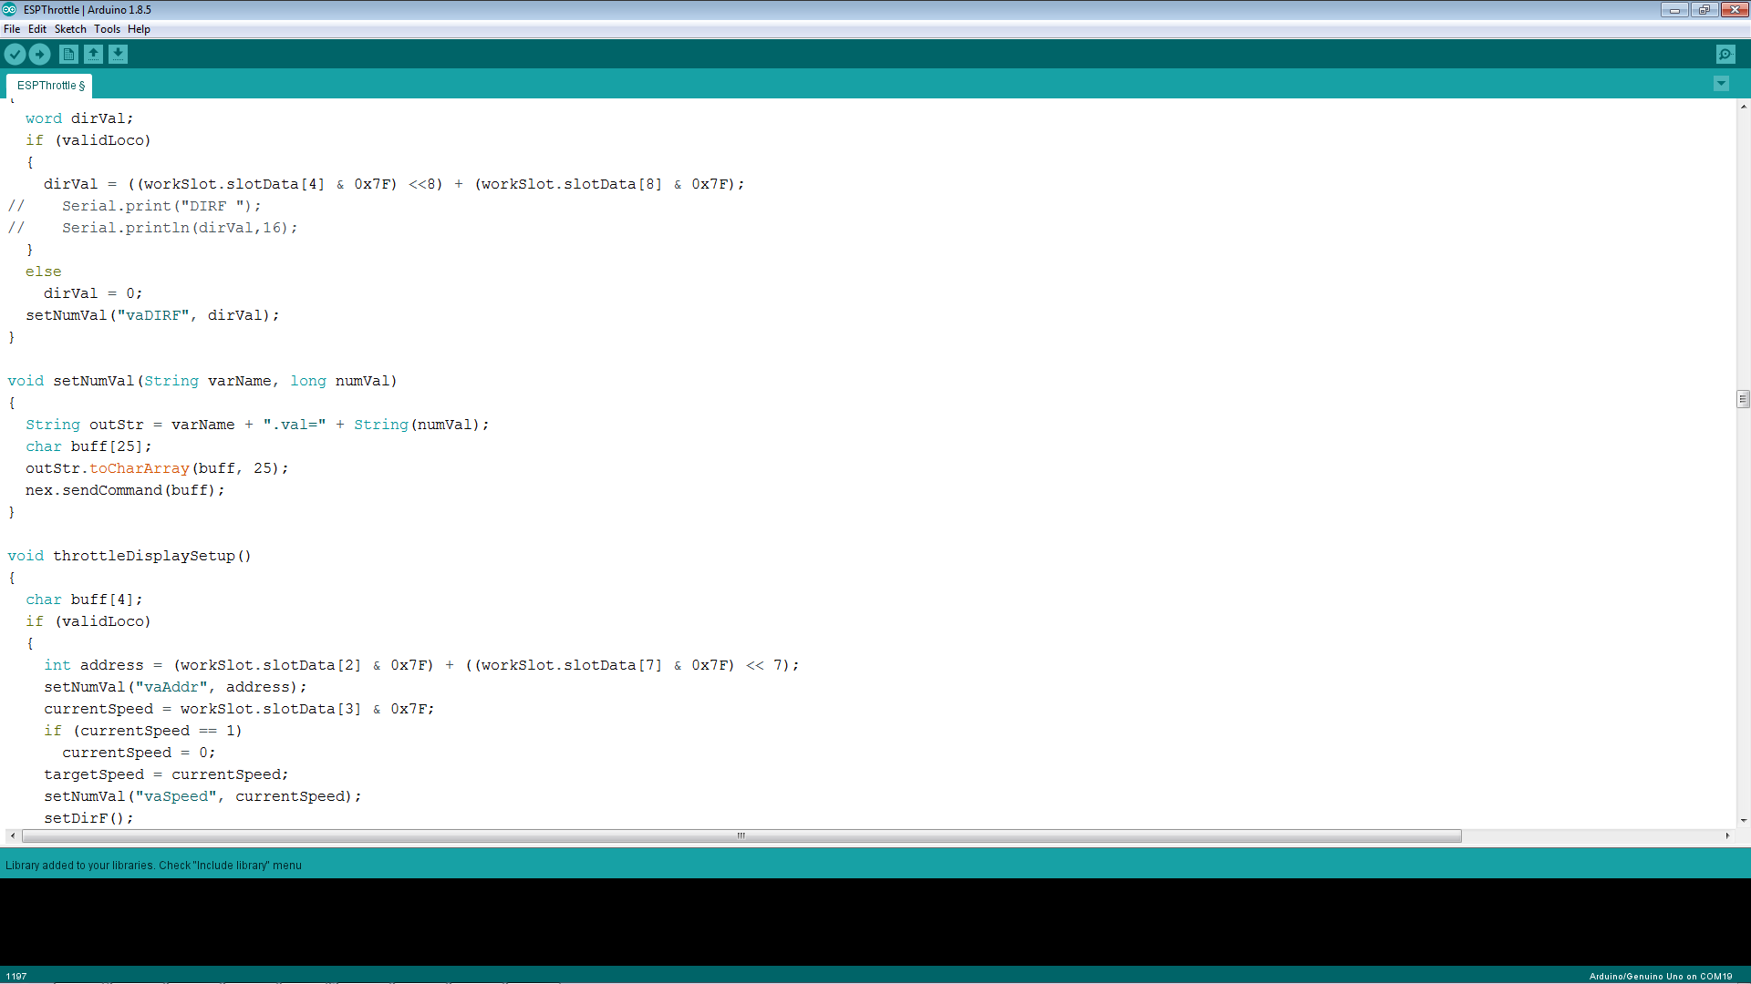
Instead of defining each variable individually, I use the nex.sendCommand() function to send information by Variable Name

Slide 19
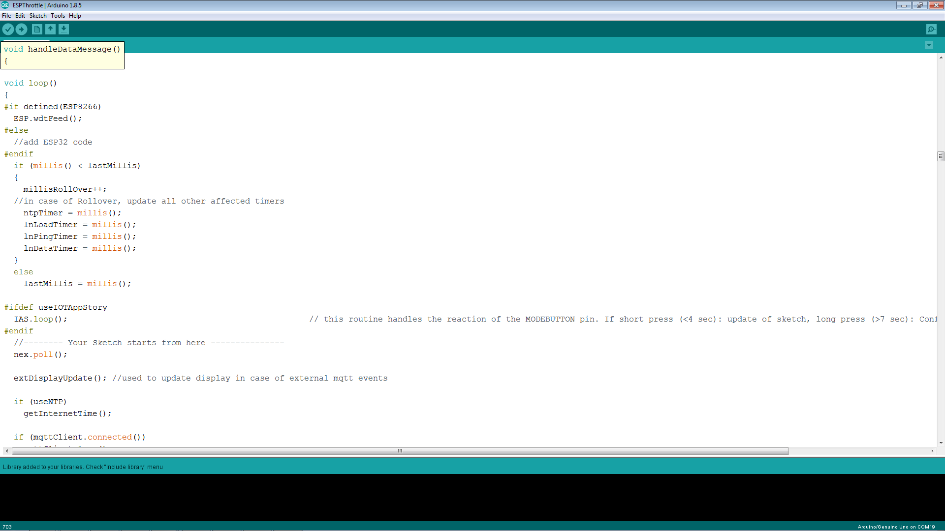
Nex.poll() in the main loop of the program does all the communication handling with the display

Slide 20
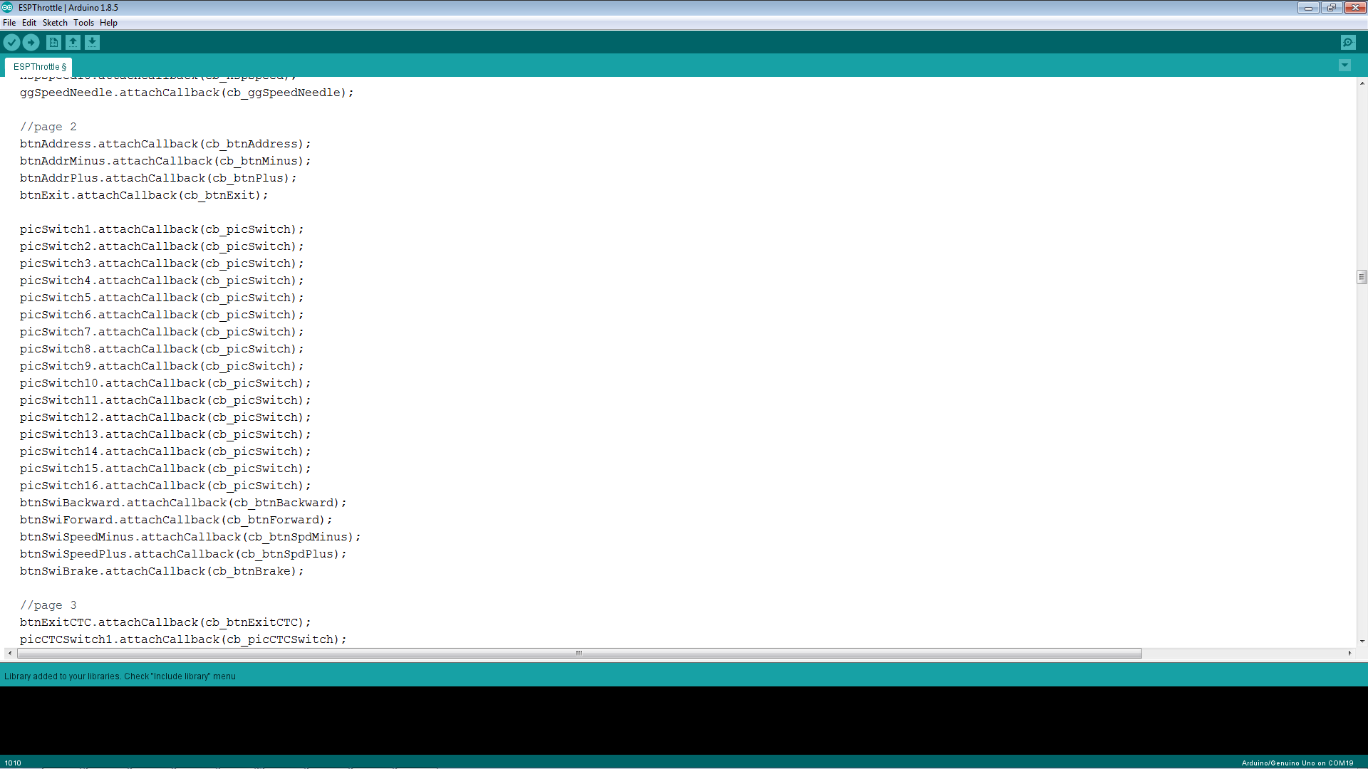
As a result, messages are received in a callback function by component

Slide 21
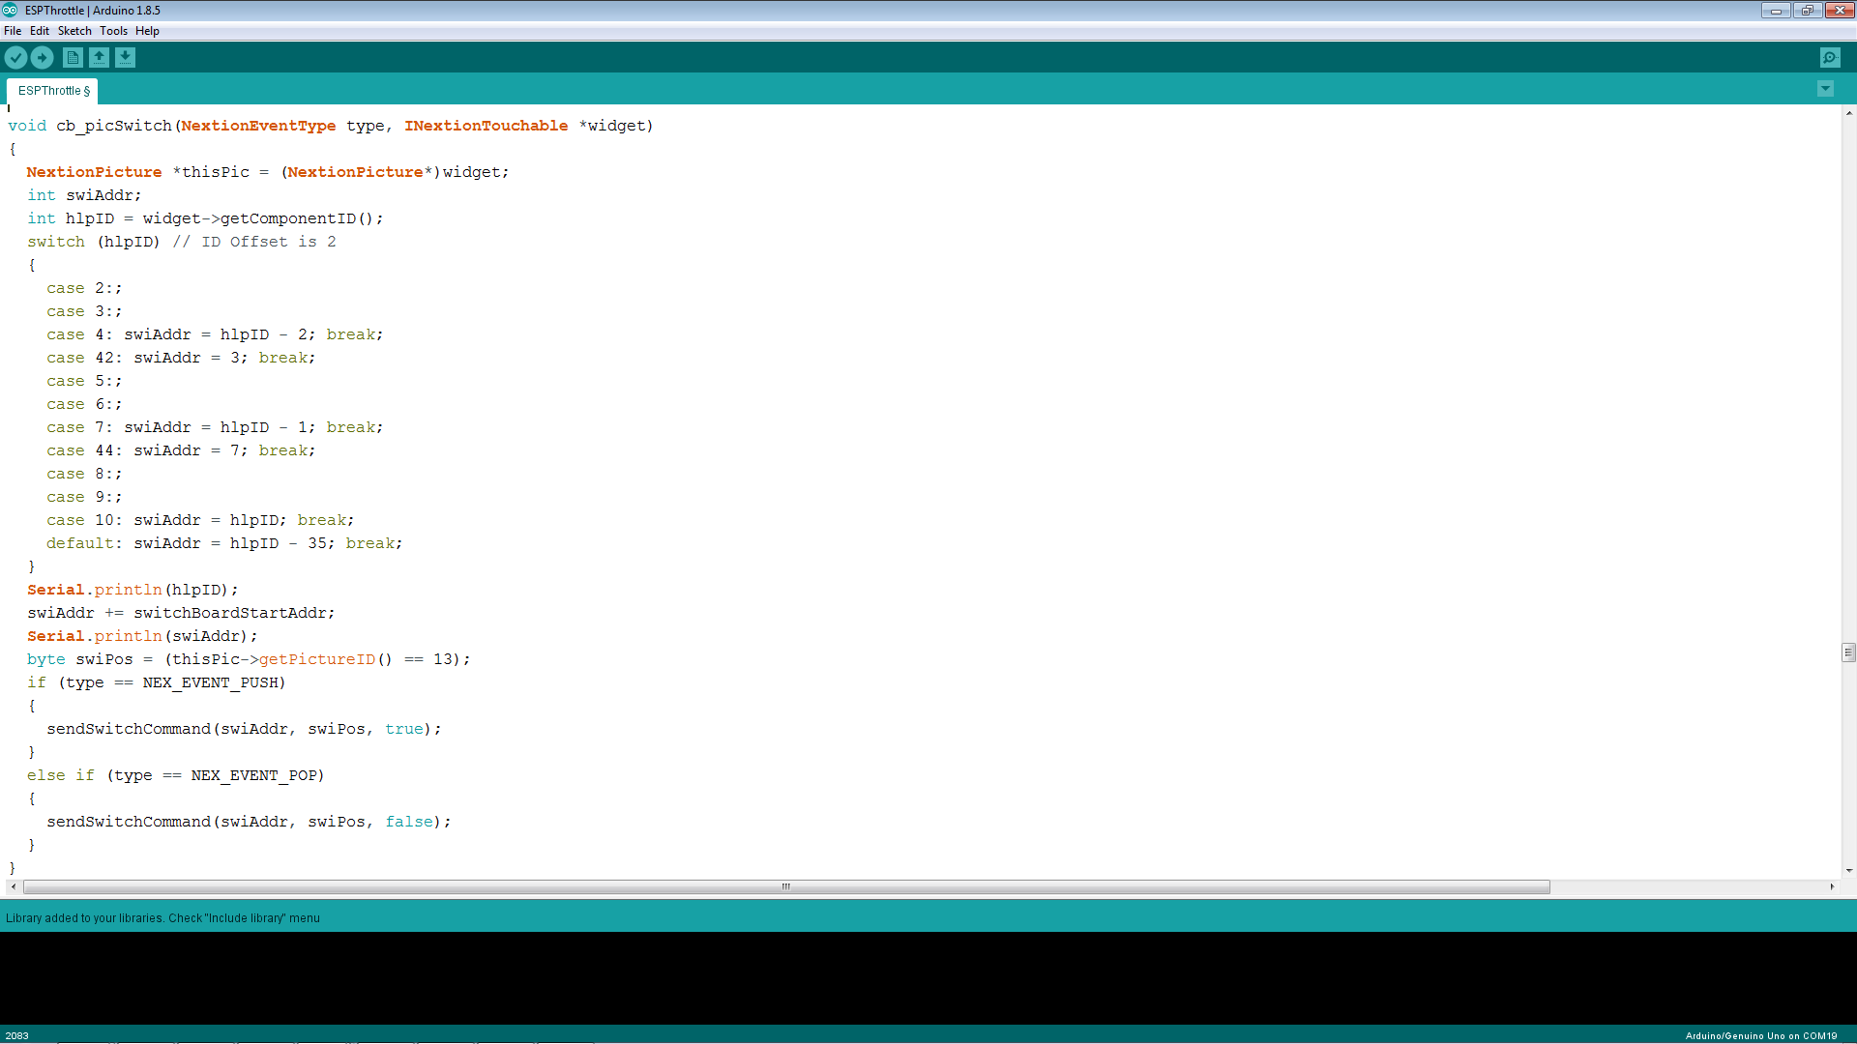
Find out who is calling. This is a value from 0 to 15 …
… to which I add the current Base Address of the Switchboard to get the Switch number
And finally I send the appropriate LocoNet command (via MQTT)

Slide 22
Summary
The Nextion display allows for a complete separation of codes for the graphical user interface and the application
The main thing on the display side is to do as much as possible just in the display
Combine data input for several components in just one data element, then update the components internally by using a timer function
Work with callback functions to keep the code simple
The 3.5” display is definitively worth the few extra bucks

Slide 23
Nextion Display: https://www.banggood.com/3_2-Inch-Nextion-HMI-Intelligent-Smart-USART-UART-Serial-Touch-TFT-LCD-Screen-Module-p-1105286.html?rmmds=search&cur_warehouse=CN
LiPo Batteries: https://www.banggood.com/6Pcs-ZOP-POWER-3_7V-750mAH-30C-1S-Lipo-Battery-JST-Plug-With-Charger-For-RC-Model-p-1329739.html?rmmds=search&cur_warehouse=CN
NodeMCU ESP8266: https://www.banggood.com/NodeMcu-Lua-WIFI-Internet-Things-Development-Board-Based-ESP8266-CP2102-Wireless-Module-p-1097112.html?rmmds=search&cur_warehouse=CN
Itead 3D Model Repository: https://www.itead.cc/wiki/Nextion_HMI_Solution#3D_printing_bezel
Nextion Similator: https://nextion.itead.cc/resources/download
Additional Materials on Github: https://github.com/tanner87661/-IoTT-Video08
Layout Intro Sequence Outdoor Layout: Beat Deola, Switzerland
Indoor Layout Videos: Hendersonville, NC Train Depot https://www.avmrc.com/

