Slide 1
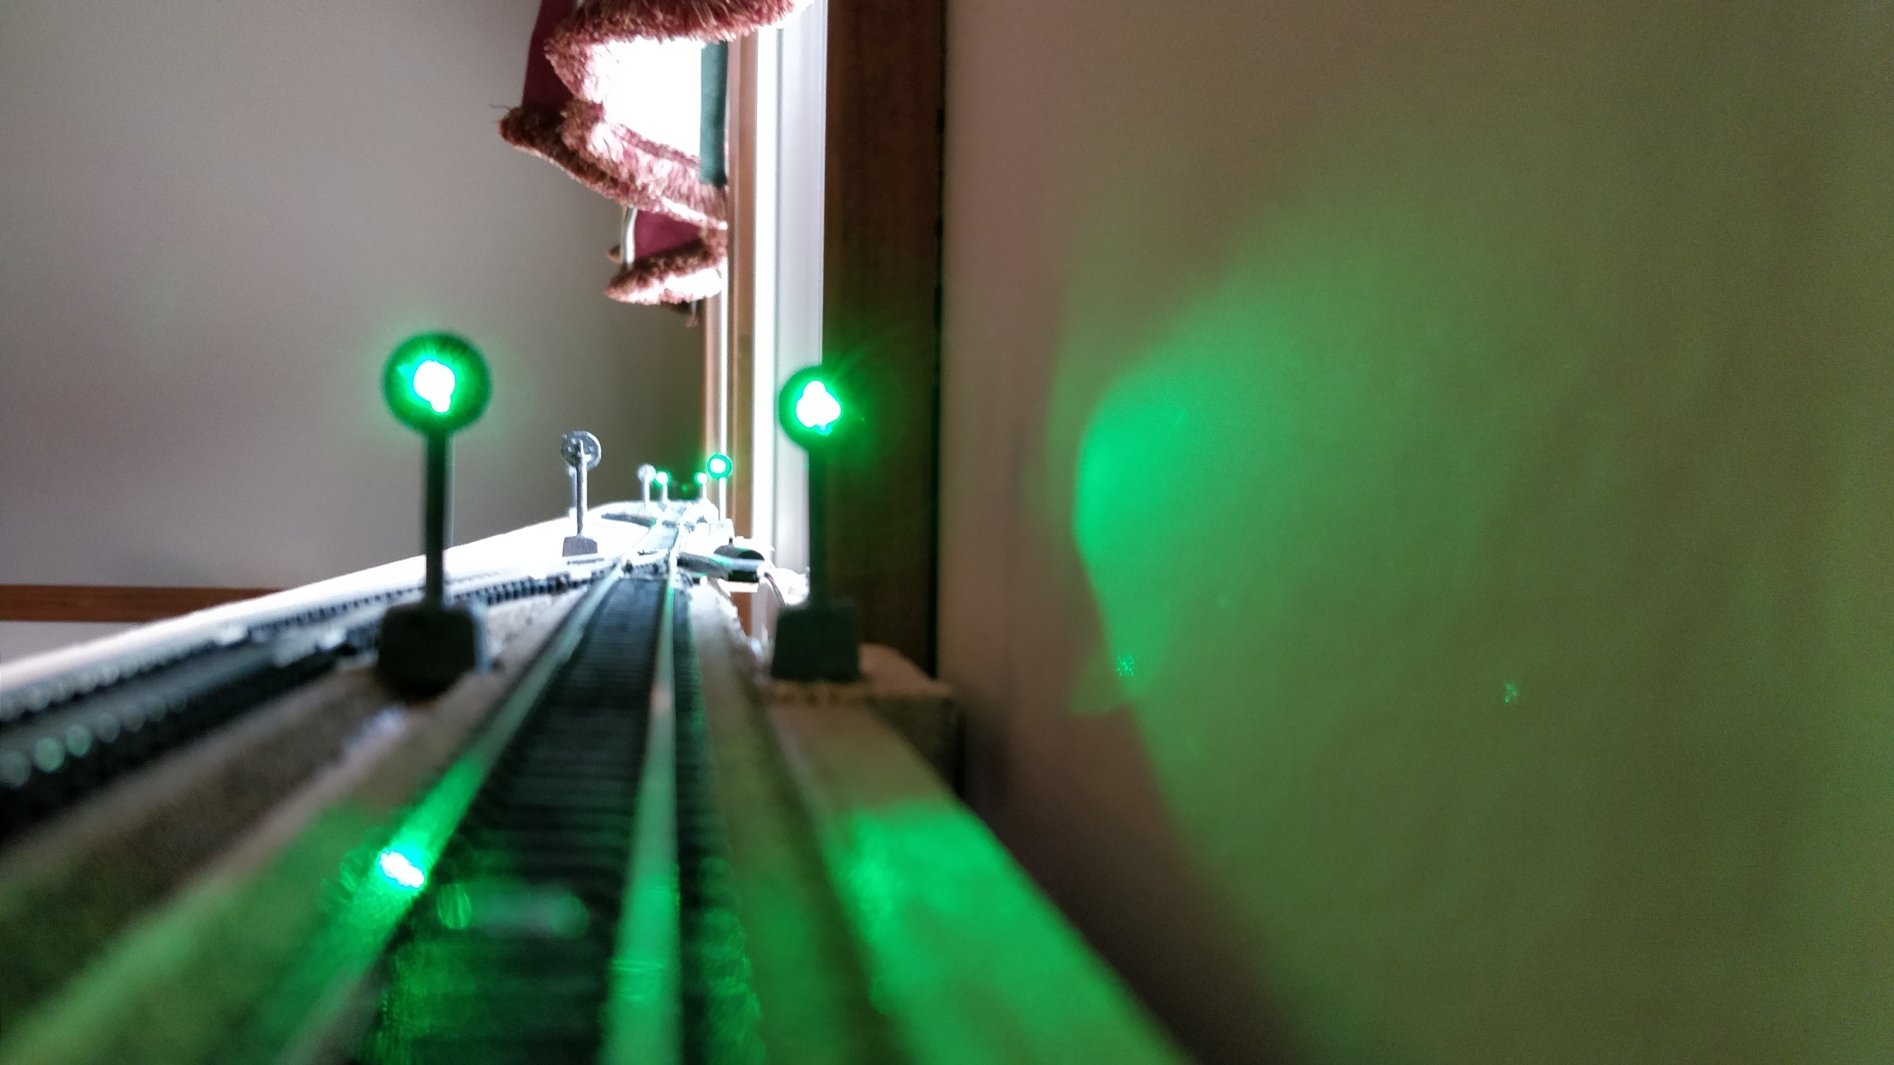
Signaling
System
Setup Part 1

Slide 2
Signal System Capabilities
Number of Signals only limited by device memory. 200+ signals are realistic with just one signaling device
Can receive aspect commands via LocoNet, DCC Track Signal, or Wifi (MQTT Gateway)
Supports full range of Switch Addresses as well as Extended Accessory Decoder commands (NMRA Signal commands supporting 36 Aspects)
All signals can be different regarding number of LED’s, number of aspects, colors, etc.
Supports up to 4 switch addresses per signal for a maximum of 16 Aspects in static or 8 Aspects in dynamic mode
Simple 3-wire cable for serial connection chain to all signals
Graphical user interface with built-in simulator for the design of aspects of each signal, depending on number of lamps on the signal

Slide 3
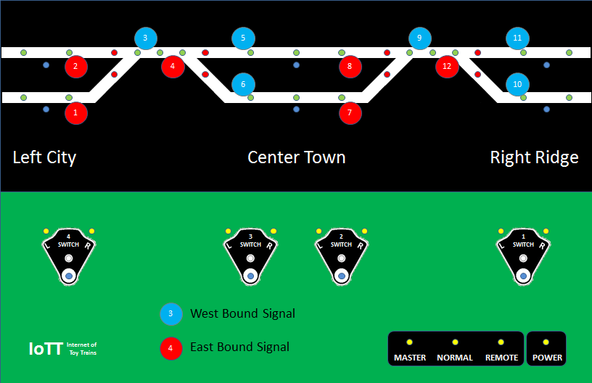

Slide 4
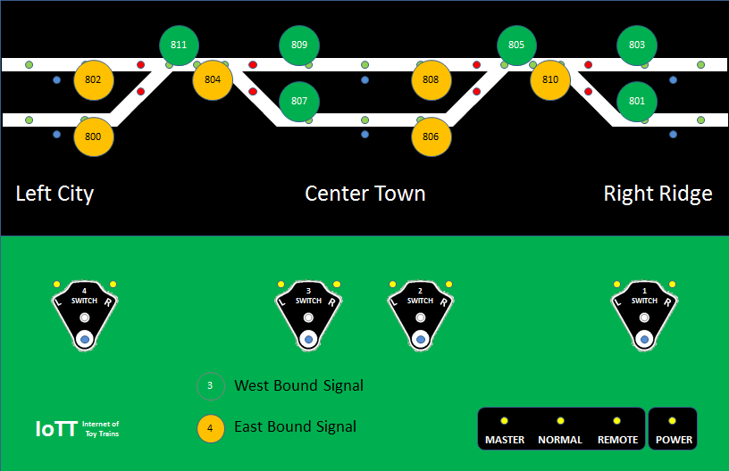

Slide 5
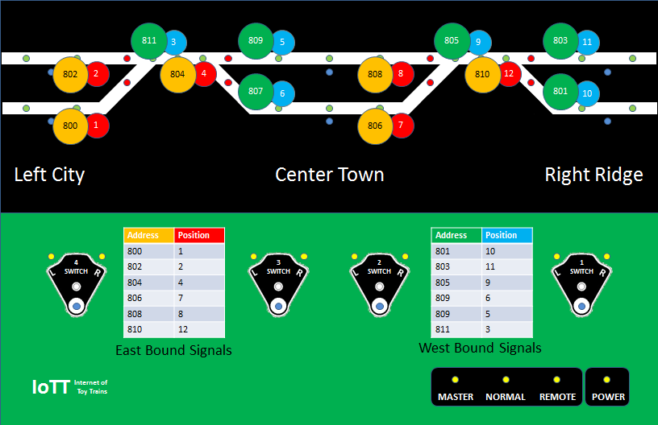

Slide 6
800 802 811 804 809 807 806 808 805 801 803 810
1 2 3 4 5 6 7 8 9 10 11 12
Aspects: Color: Value:
Stop: Red 0
Slow Approach: Yellow 1-3
Medium Approach: Yellow blinking 4-6
Clear: Green 7-31

Slide 7
Summary
Neopixel LED’s allow for both, simpler and easier to install signaling hardware as well as a more flexible configuration process after the installation
A modern web app provided from the signaling system’s built-in web server makes configuration very user friendly and flexible
The configuration screen at the same time is the documentation of the system

Slide 8
Extended Accessory Decoder
Extended Accessory Decoder Control Packet Format
The Extended Accessory Decoder Control Packet is included for the purpose of transmitting aspect control to signal decoders or data bytes to more complex accessory decoders. Each signal head can display one aspect at a time.
{preamble} 0 10AAAAAA 0 0AAA0AA1 0 000XXXXX 0 EEEEEEEE 1
XXXXX is for a single head. A value of 00000 for XXXXX indicates the absolute stop aspect. All other aspects represented by the values for XXXXX are determined by the signaling system used and the prototype being modeled.
11 Bit Addresses: 2048 Signal Heads
5 Bit Data: Aspects 0 -31
OPC_IMM_PACKET 0xED ;SEND n-byte packet immediate LACK
<0xED>,<0B>,<7F>,<REPS>,<DHI>,<IM1>,<IM2>,<IM3>,<IM4>,<IM5>,<CHK>
<DHI>=<0,0,1,IM5.7-IM4.7,IM3.7,IM2.7,IM1.7>
in <REPS> D4,5,6=#IM bytes,D3=0(reserved); D2,1,0=repeat CNT
Not limited MASTER then LACK=<B4>,<7D>,<7F>,<chk> if CMD ok
IF limited MASTER then Lim Masters respond with <B4>,<7E>,<lim adr>,<chk>
If internal buffer BUSY/full respond with <B4>,<7D>,<0>,<chk>

Slide 9
Additional Materials on Github: https://github.com/tanner87661/IoTT-Video14
JMRI Signaling Intro: http://jmri.org/help/en/html/tools/signaling/index.shtml
NA Signal Heads: https://en.wikipedia.org/wiki/North_American_railroad_signals
NORAC Signal Aspects: http://rail.pgengler.net/signals/fixed_norac.html
Websockets Intro: https://www.html5rocks.com/en/tutorials/websockets/basics/
Websockets Wiki: https://en.wikipedia.org/wiki/WebSocket
JSON Overview: https://www.w3schools.com/whatis/whatis_json.asp
NMRA 9.2.1 https://www.nmra.org/sites/default/files/s-9.2.1_2012_07.pdf

