Slide 1
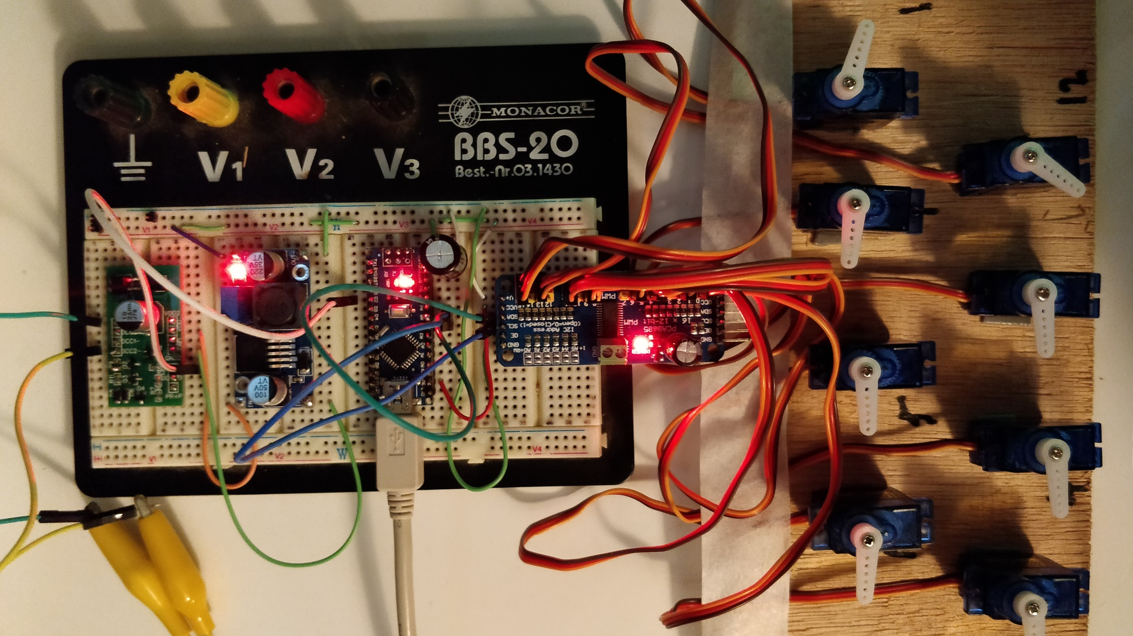
DIY 16 Channel DCC Servo Decoder

Slide 2
Table of Contents
Words of caution before starting your own project 1:21
Building the decoder hardware 3:54
Software Strategy 16:00
NMRA DCC decoding 17:10
Controlling the servo 21:40
Building a functioning decoder 24:20
Summary 36:30

Slide 3
Servo Decoder Requirements
Connects to DCC, no additional power supply
Individual Address for each Servo
Support of full Switch and Signal Address Ranges
Adjustable Rotation Angles per Servo
Adjustable Rotation Speed per Servo

Slide 4
A Word of Caution
Always buy plenty of components
Always disconnect DCC when working on the wiring and always check for shorts before reconnecting
Always check the pin numbers. Never connect an Arduino Output pin to a line that is driven to GND
Place a capacitor next to the Arduino
Closely monitor all components during the first few seconds after power up
You do this at your Own Risk!

Slide 5
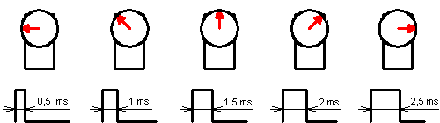
Servo rotation angle is proportional to the PWM ON time from 0.5 – 2.5ms
Calculations:
PWM Frequency = 60Hz -> Cycle = 1000/60 = 16.66ms
PWM Resolution = 4096 -> 1 Tick = 16.66ms / 4096 = 0.004069ms
PWM Value for 0.5ms Pulse = 0.5 / 0.004069 = 122.8 -> selected SERVOMIN: 150
PWM Value for 2.5ms Pulse = 2.5 / 0.004069 = 614.4 -> selected SERVOMAX: 600

Slide 6
Aspect to Servo Angle
Calculation: ServoPos = SERVOMIN + (AspectValue * (SERVOMAX – SERVOMIN)/8)
Range Limitation to SERVOMAX: ServoPos = min(ServoPos, SERVOMAX)
SERVOMAX
Aspect to Servo Angle Curve
SERVOMIN
8
0 5 10 15 20 Aspect Value

Slide 7
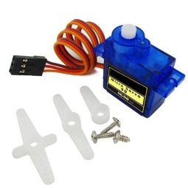
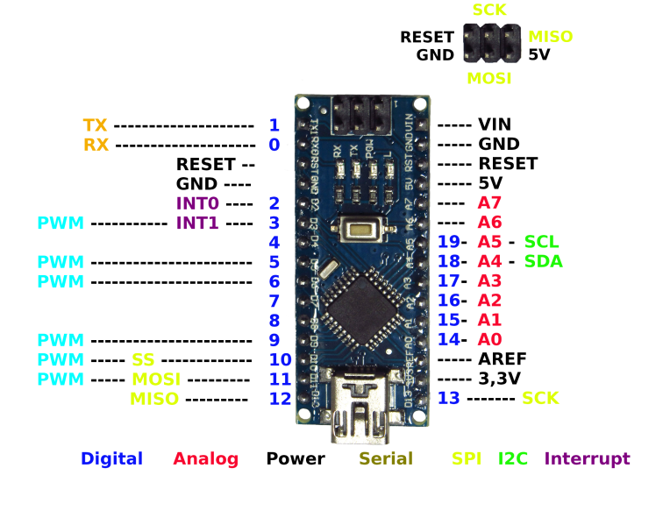
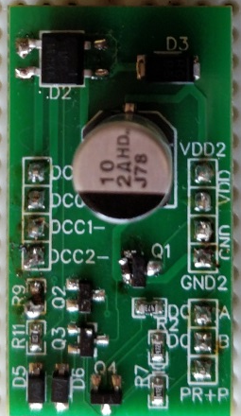
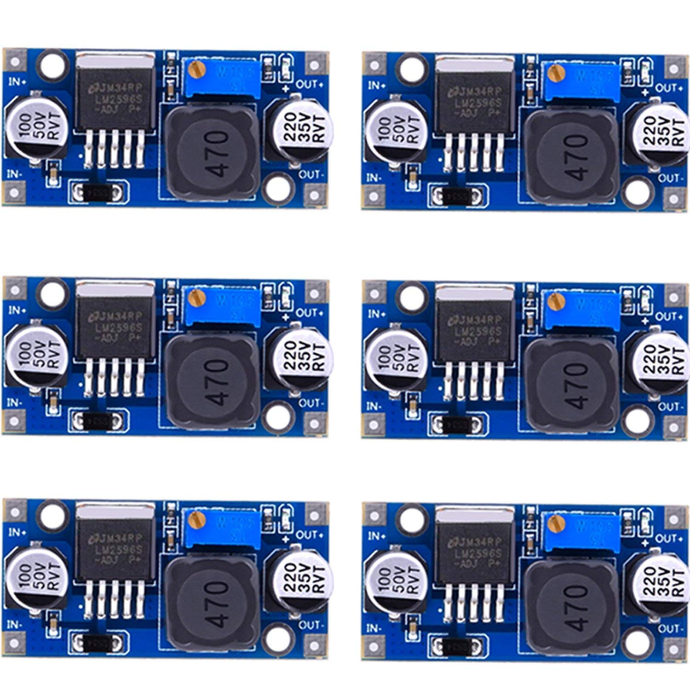
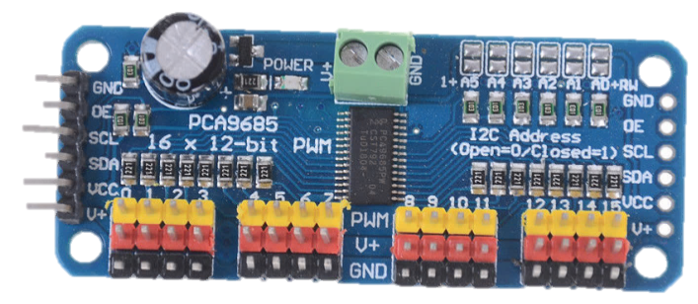
Arduino Nano Accessory Decoder
5V
Set to 7.5V
Connect up to
16 Servos SG90
3.5 - 8.4 Volts
DCC Track
DCC Interface
Buck Converter
Arduino Nano
PWM Driver

Slide 8
Software Development Steps
Verify that DCC Signal is decoded
Verify that Servos can be controlled
Build the bridge between DCC and Servos
Improve and add more features

Slide 9
Building the Bridge
The initial approach
Works, but…
All Servos in a linear address range starting with first address
Signal commands not handled at all
All Servos with the same minimum and maximum rotation angles
Decode DCC Input
Set Servo port PWM Output

Slide 10
Additional Materials on Github: https://github.com/tanner87661/IoTT-Video17
Arduino Basics 101: https://www.youtube.com/watch?v=BtLwoNJ6klE
Arduino Basics 102: https://www.youtube.com/watch?v=YT3birSKLLU&t=398s
Arduino Basics 103: https://www.youtube.com/watch?v=EVm0qVJ56II
Layout Intro Sequence Outdoor Layout: Beat Deola, Switzerland​
DCC Interface: If interested, send me a PM. I have some of the prototypes available for cost plus shipping.
Buck converter: https://www.amazon.com/MCIGICM-step-down-Converter-3-0-40V-1-5-35V/dp/B06XZ1DKF2/ref=sr_1_5?keywords=buck+converter&qid=1554521368&s=gateway&sr=8-5
Arduino Nano: https://www.amazon.com/Keywish-Arduino-ATmega328P-Moudle-Compatible/dp/B07D12TWNZ/ref=sr_1_18?keywords=arduino+nano&qid=1554521411&s=gateway&sr=8-18
PWM driver: https://www.amazon.com/Onyehn-Channel-PCA9685-Arduino-Raspberry/dp/B07GJCPWW2/ref=pd_day0_hl_147_2/144-9269444-7135168?_encoding=UTF8&pd_rd_i=B07GJCPWW2&pd_rd_r=7c0128c8-581c-11e9-8362-b1c2d0dccc11&pd_rd_w=ebl7B&pd_rd_wg=XDjih&pf_rd_p=ad07871c-e646-4161-82c7-5ed0d4c85b07&pf_rd_r=MFZXEC12T0FFV415AHQ4&psc=1&refRID=MFZXEC12T0FFV415AHQ4
Micro Servos: https://www.amazon.com/Micro-Helicopter-Airplane-Remote-Control/dp/B072V529YD/ref=pd_bxgy_60_img_2/144-9269444-7135168?_encoding=UTF8&pd_rd_i=B072V529YD&pd_rd_r=86eda38f-581c-11e9-9502-091092cc734e&pd_rd_w=OfHyY&pd_rd_wg=VPeRR&pf_rd_p=a2006322-0bc0-4db9-a08e-d168c18ce6f0&pf_rd_r=PTY6VGCE68SEB9VVHH2E&psc=1&refRID=PTY6VGCE68SEB9VVHH2E

