Slide 1
!IDIOT
Presented by Tanner Hooper and JT Gibson

Slide 2
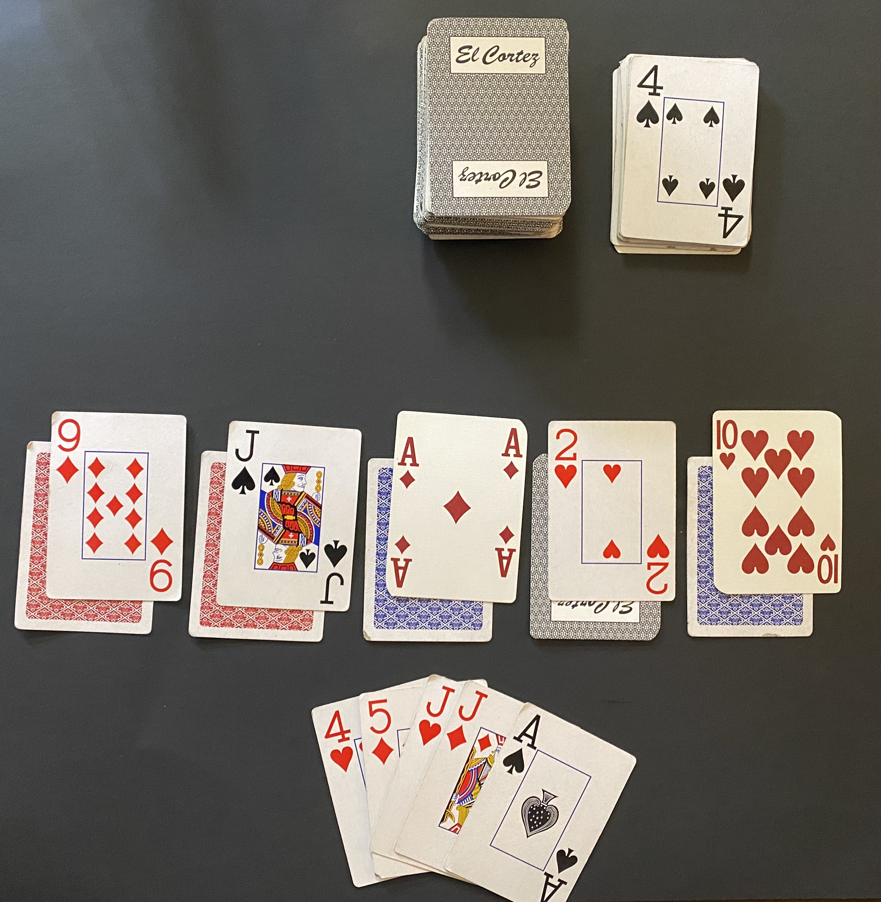
What is Idiot?
A turn-based card game consisting of multiple decks and multiple players (3+)
First person to get rid of all their cards is not an idiot and wins
Table
Deck
Up
Down
Hand
Notes:
Dealt a total of 15 cards
5 face down, 5 face up, and 5 in hand

Slide 3
Rules
Player must play a card greater than or equal to previously placed card
First player chooses what to start with
Multiple cards of same value can be played in a turn
4 or more of the same card on the table clears the table
If player cannot play card within rules, they must pick up the table
3 is low and Ace is high
Special cards
2 starts the table over at lowest card and allows player to play again
10 clears the table

Slide 4
Rules
Player must always have at least 5 cards in hand while deck is present
Players with more than 5 cards do not need to draw from deck
When a players hand is empty, the player plays from their face up cards
If table is picked up, those cards in hand must be played first
Once a players face up cards are empty, the player plays a random card from their face down cards
Once all of a players face down cards are gone, that player is not an idiot and wins!
Notes:
When deck runs out, players no longer draw cards
Cards in hand must be played first if table is picked up while playing random cards as well

Slide 5
Program vs Real Life
Hand and face up cards are not exchanged at beginning of game
Lowest cards that can be played are always played
Processor 0 manages the deck and table (like a dealer)
Only one special card is played at time

Slide 6
Code and Demo Time! :D

