Slide 1
An AHRS Particle Filter Compared to Conventional Estimation Techniques
Nicholas Ott & Tanner Koza
MECH 7710 - Dr. Scott Martin
6 May 2022

Slide 2
Outline
Introduction
AHRS Explanation
A Brief Introduction to Quaternions
Plan of Action
AHRS Particle Filter Formulation
Results
Conclusions
References
2

Slide 3
Introduction
3

Slide 4
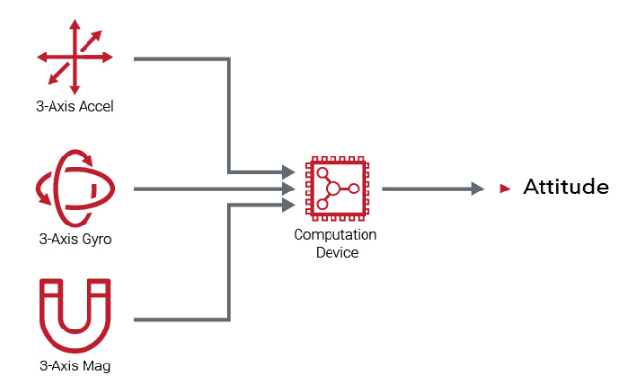
AHRS
What is an AHRS?
Attitude & Heading Reference System
Employs an IMU (typically 9DOF) whose measurements are used to provide attitude states
Fusion of these measurements is often accomplished using a Kalman Filter
4

Slide 5

Quaternions
A 4 Dimensional way to Represent a 3-D rotation (attitude states)
3 elements represent axis of rotation
4th element represents magnitude of rotation
Doesn’t have issues associated with rotation matrices “Gimbal Lock”
$$q= \left[\begin{matrix}q_{w} \\ q_{x} \\ q_{y} \\ q_{z}\end{matrix}\right]$$
5

Slide 6

Plan of Action
Implement an AHRS as a particle filter for the sake of becoming familiar with them
Compare with existing AHRS fusion algorithms
Everything always traces back to AHRS!
6

Slide 7
Particle Filter Formulation
7

Slide 8
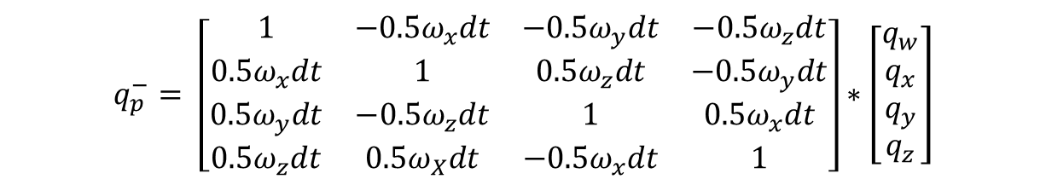
AHRS Particle Filter Formulation
2000 Particles
A uniform multivariate distribution used to propagate particles
Distribution informed from Gyroscope noise floor
Mechanized Gyroscope formed time update:
$$q_{p}^{−}= \left[\begin{matrix}1 & −0.5ω_{x}dt & −0.5ω_{y}dt & −0.5ω_{z}dt \\ 0.5ω_{x}dt & 1 & 0.5ω_{z}dt & −0.5ω_{y}dt \\ 0.5ω_{y}dt & −0.5ω_{z}dt & 1 & 0.5ω_{x}dt \\ 0.5ω_{z}dt & 0.5ω_{X}dt & −0.5ω_{x}dt & 1\end{matrix}\right]∗\left[\begin{matrix}q_{w} \\ q_{x} \\ q_{y} \\ q_{z}\end{matrix}\right]$$
8

Slide 9
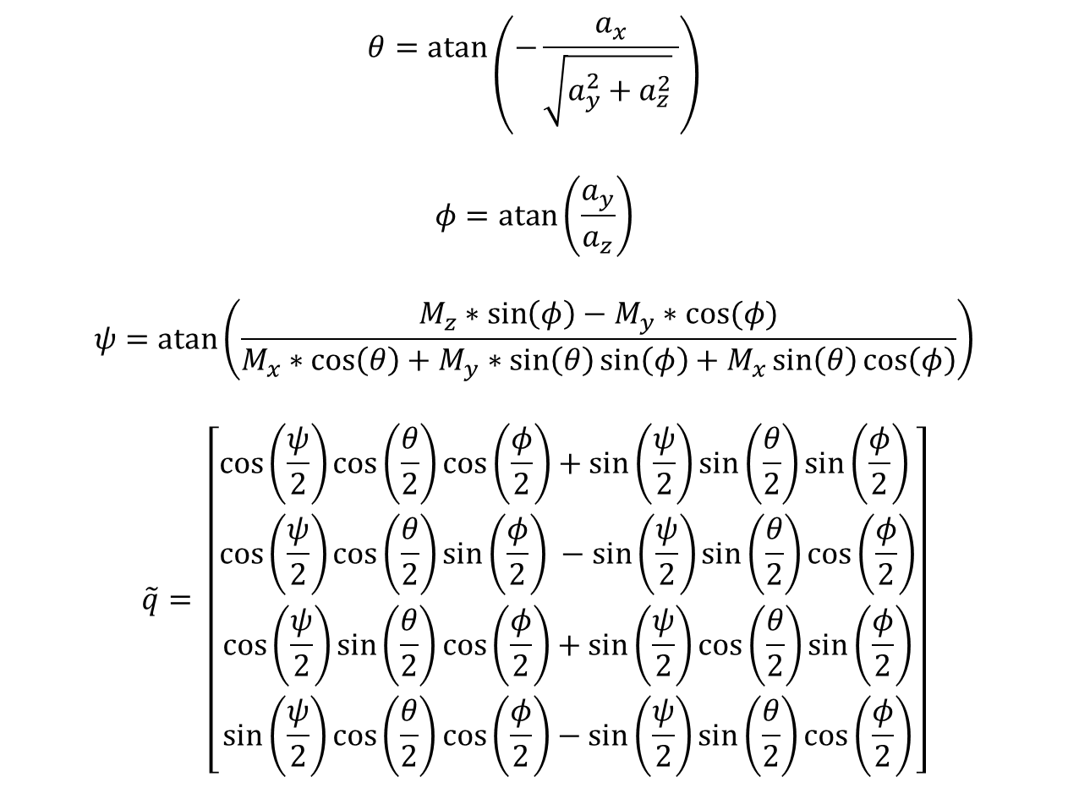
Measurement Update
$$θ=\operatorname{atan}\left(−\frac{a_{x}}{\sqrt{a_{y}^{2}+a_{z}^{2}} }\right)$$
$$φ=\operatorname{atan}\left(\frac{a_{y}}{a_{z}}\right)$$
$$ψ=\operatorname{atan}\left(\frac{M_{z}∗\sin\left(φ\right)−M_{y}∗cos⁡(φ)}{M_{x}∗\cos\left(θ\right)+M_{y}∗\sin\left(θ\right)\sin\left(φ\right)+M_{x}\sin\left(θ\right)\cos\left(φ\right)}\right)$$
$$\tilde{q}= \left[\begin{matrix}\cos\left(\frac{ψ}{2}\right)\cos\left(\frac{θ}{2}\right)\cos\left(\frac{φ}{2}\right)+\sin\left(\frac{ψ}{2}\right)\sin\left(\frac{θ}{2}\right)\sin\left(\frac{φ}{2}\right) \\ \cos\left(\frac{ψ}{2}\right)\cos\left(\frac{θ}{2}\right)\sin\left(\frac{φ}{2}\right) −\sin\left(\frac{ψ}{2}\right)\sin\left(\frac{θ}{2}\right)\cos\left(\frac{φ}{2}\right) \\ \cos\left(\frac{ψ}{2}\right)\sin\left(\frac{θ}{2}\right)\cos\left(\frac{φ}{2}\right)+\sin\left(\frac{ψ}{2}\right)\cos\left(\frac{θ}{2}\right)\sin\left(\frac{φ}{2}\right) \\ \sin\left(\frac{ψ}{2}\right)\cos\left(\frac{θ}{2}\right)\cos\left(\frac{φ}{2}\right)−\sin\left(\frac{ψ}{2}\right)\sin\left(\frac{θ}{2}\right)\cos\left(\frac{φ}{2}\right)\end{matrix}\right]$$
9

Slide 10

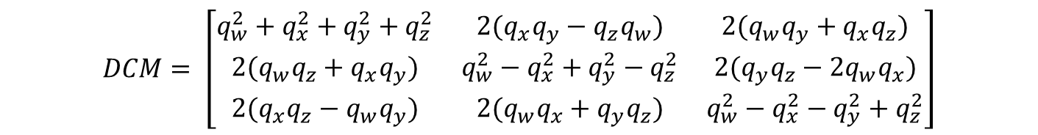
Likelihood Function
Propagated Quaternion and Measured Quaternion used to calculate two direction cosine matrices:
$$DCM= \left[\begin{matrix}q_{w}^{2}+q_{x}^{2}+q_{y}^{2}+q_{z}^{2} & 2(q_{x}q_{y}−q_{z}q_{w}) & 2(q_{w}q_{y}+q_{x}q_{z}) \\ 2(q_{w}q_{z}+q_{x}q_{y}) & q_{w}^{2}−q_{x}^{2}+q_{y}^{2}−q_{z}^{2} & 2(q_{y}q_{z}−2q_{w}q_{x}) \\ 2(q_{x}q_{z}−q_{w}q_{y}) & 2(q_{w}q_{x}+q_{y}q_{z}) & q_{w}^{2}−q_{x}^{2}−q_{y}^{2}+q_{z}^{2}\end{matrix}\right]$$
$$δDCM=\tilde{DCM}−\hat{DCM}$$
$$L=\frac{1}{\left|\left|r_{x}\right|\right|∗\left|\left|r_{y}\right|\right|∗|\left|r_{z}\right||}$$

Slide 11
Particle Resampling
Select with Replacement
Particle Weights compared to a unit uniform distribution
When the sequential sum of particle weights is greater than a random number pulled from uniform distribution, the most recent particle in the sequential sum replaces all particles between it and the previous acceptable particle
Effective Sample Size threshold was full particle population (resample every step)
11

Slide 12
Results
12

Slide 13
Comparison
We decided to compare the performance of our particle filter with two other AHRS
Multiplicative Extended Kalman Filter (MEKF)
Madgwick Filter
These were plotted against the internal Kalman Filter provided by the VectorNav IMUs used for data collection
We considered this attitude solution to be truth
13

Slide 14
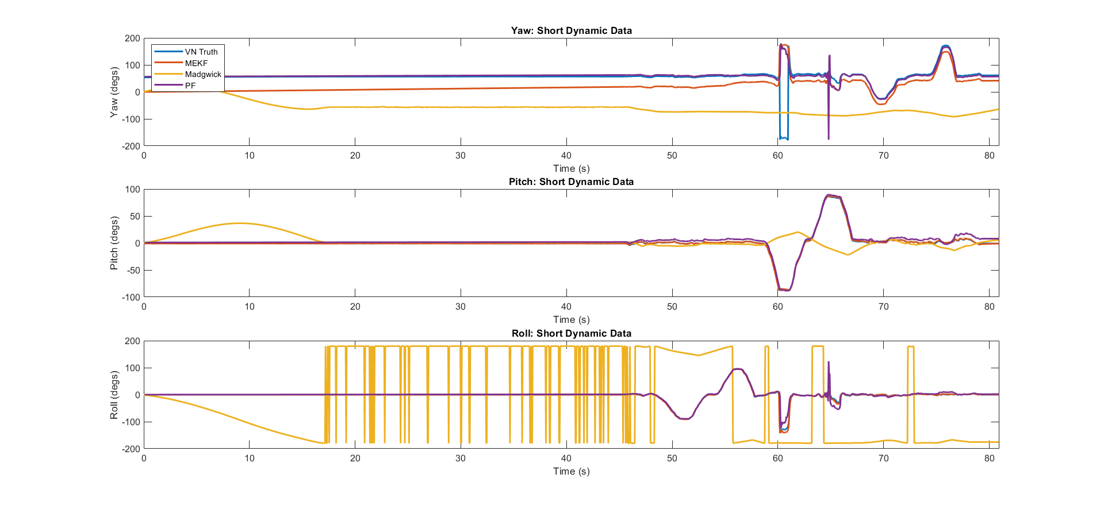
Short Dynamic (SD) Data Results
14

Slide 15
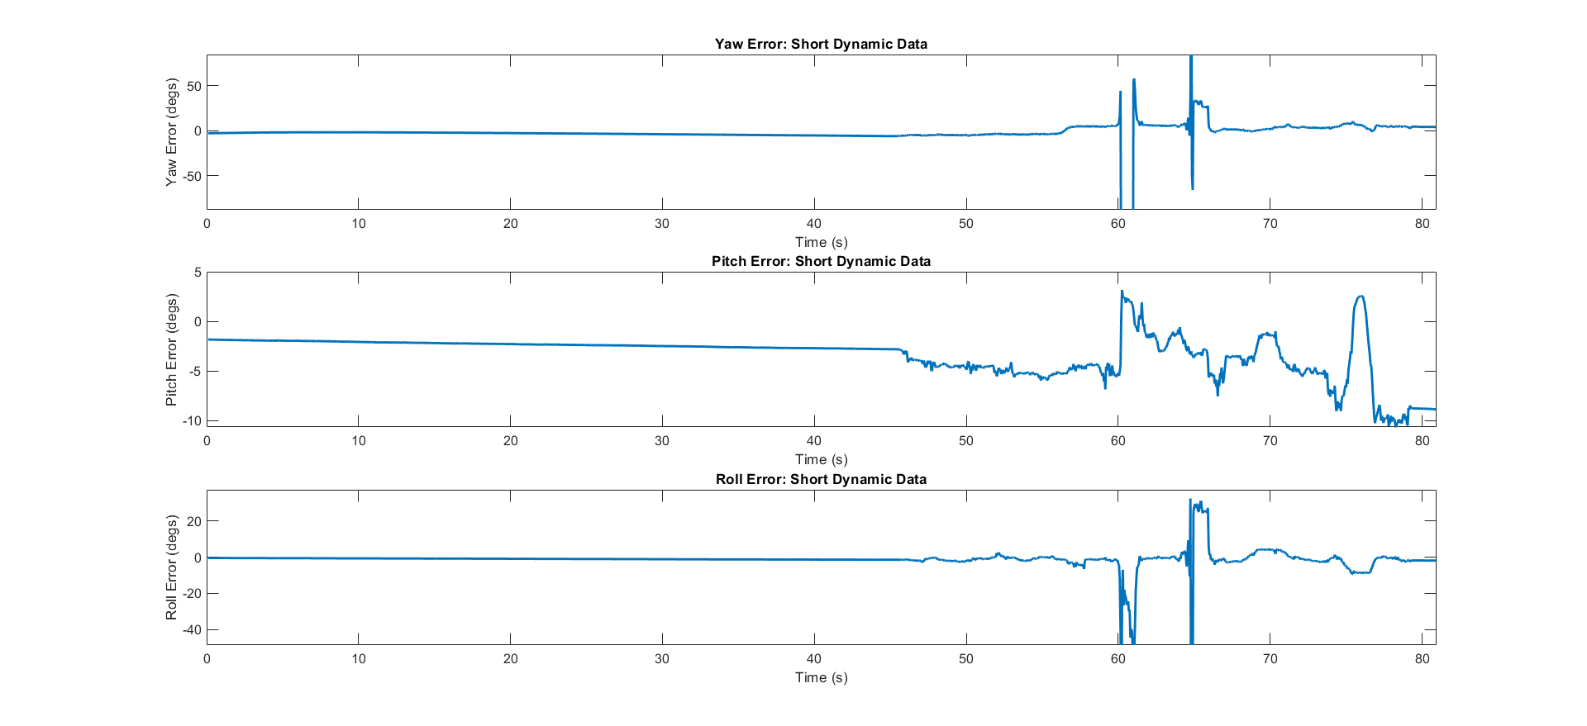
SD Particle Filter Data Error
15

Slide 16
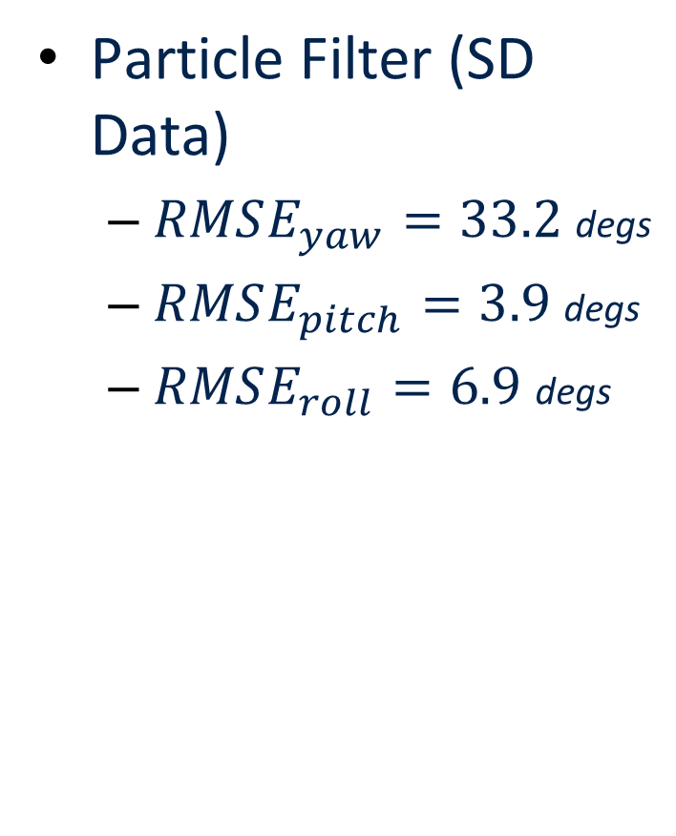
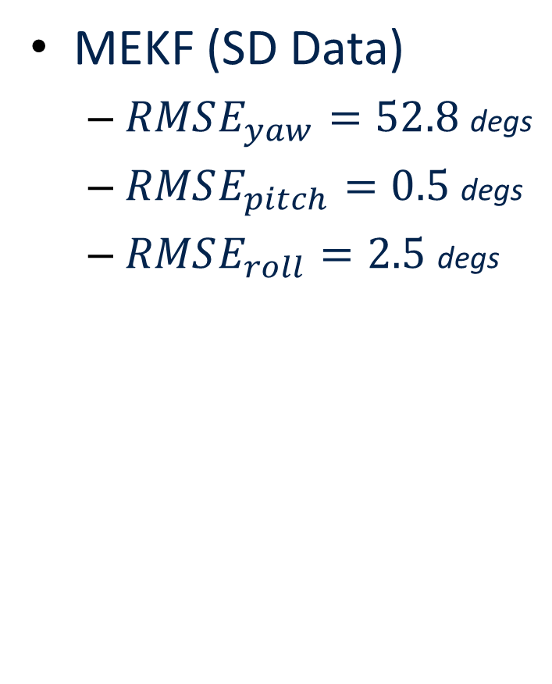
Quantified Error Comparison
Particle Filter (SD Data)
$RMSE_{yaw}=33.2$degs
$RMSE_{pitch}=3.9$ degs
$RMSE_{roll}=6.9$ degs
MEKF (SD Data)
$RMSE_{yaw}=52.8$degs
$RMSE_{pitch}=0.5$ degs
$RMSE_{roll}=2.5$ degs

Slide 17
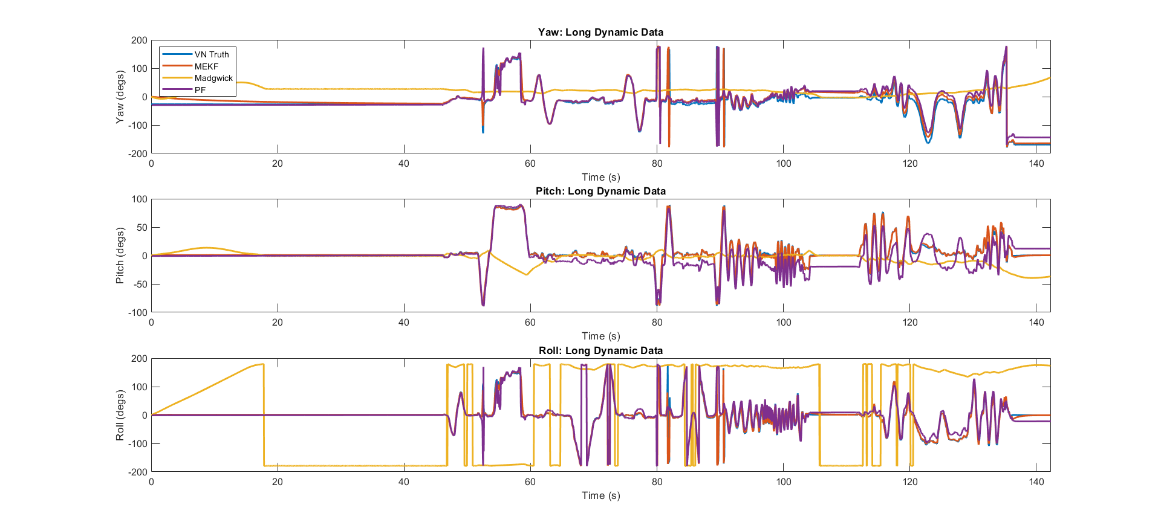
Long Dynamic (LD) Data Results
17

Slide 18
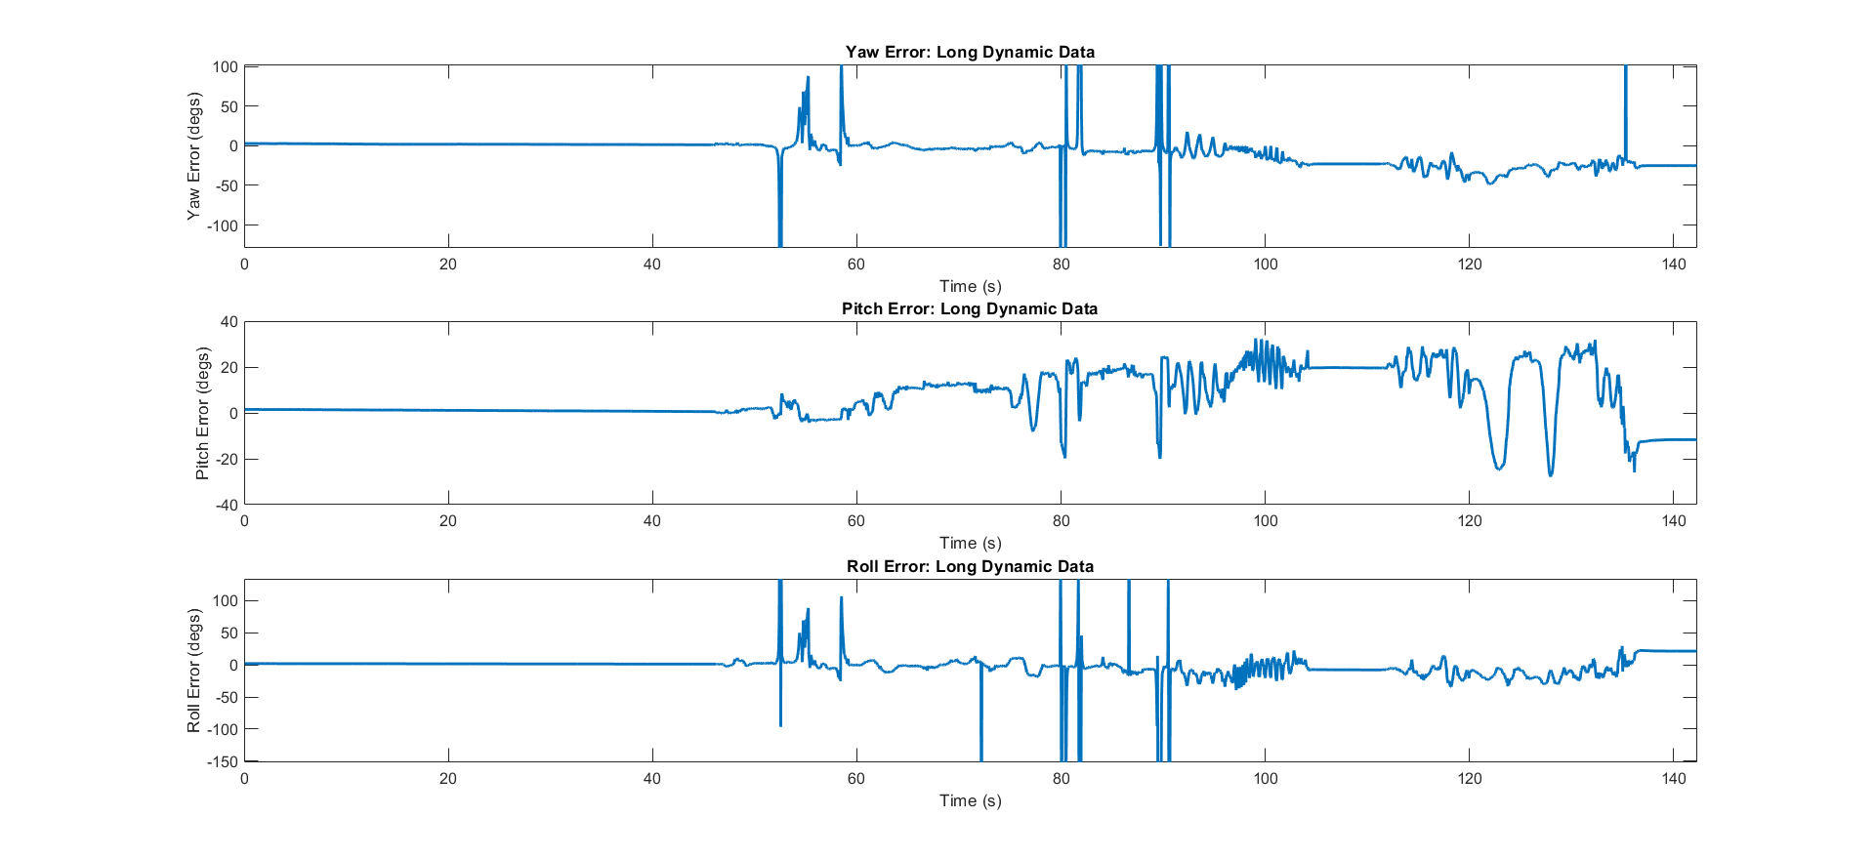
LD Particle Filter Data Error
18

Slide 19
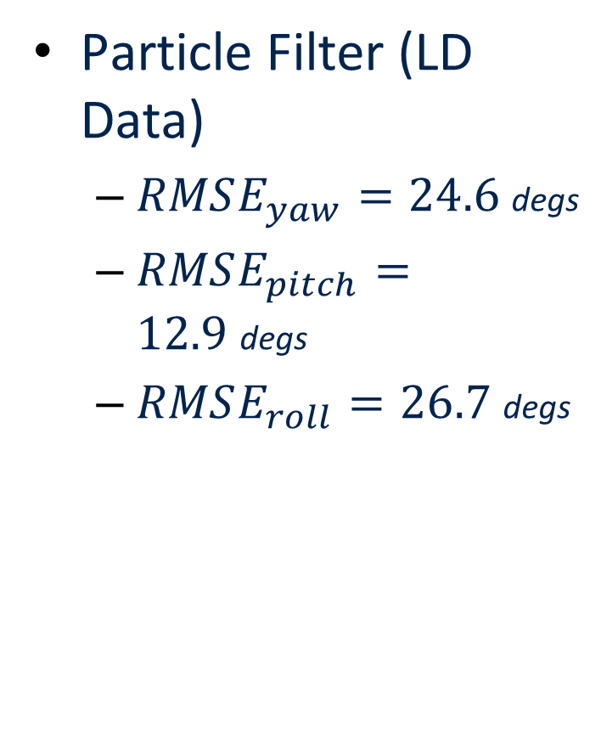
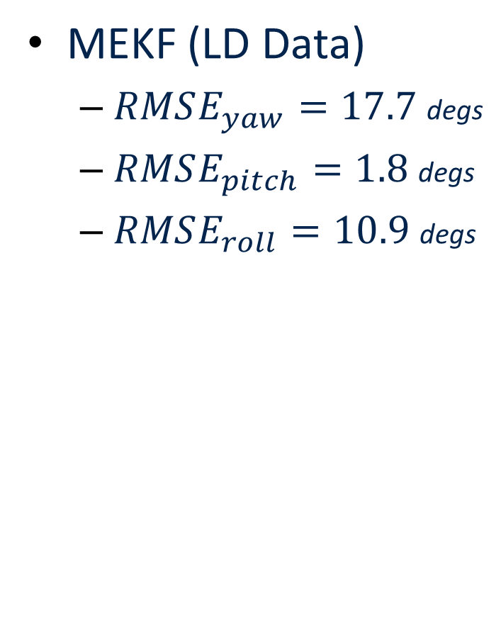
Quantified Error Comparison
Particle Filter (LD Data)
$RMSE_{yaw}=24.6$degs
$RMSE_{pitch}=12.9$degs
$RMSE_{roll}=26.7$ degs
MEKF (LD Data)
$RMSE_{yaw}=17.7$degs
$RMSE_{pitch}=1.8$degs
$RMSE_{roll}=10.9$ degs

Slide 20
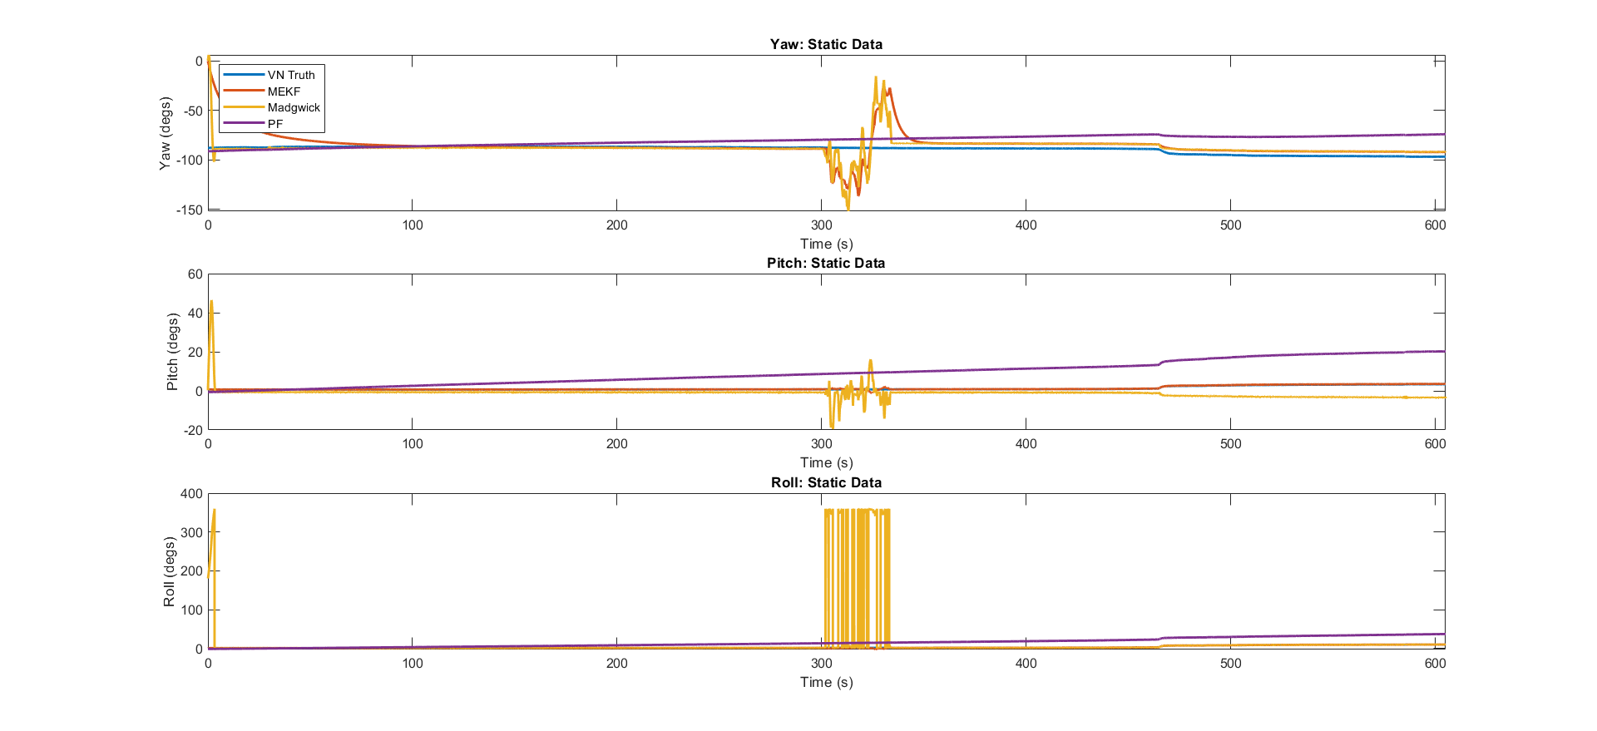
Static Data Results
20

Slide 21
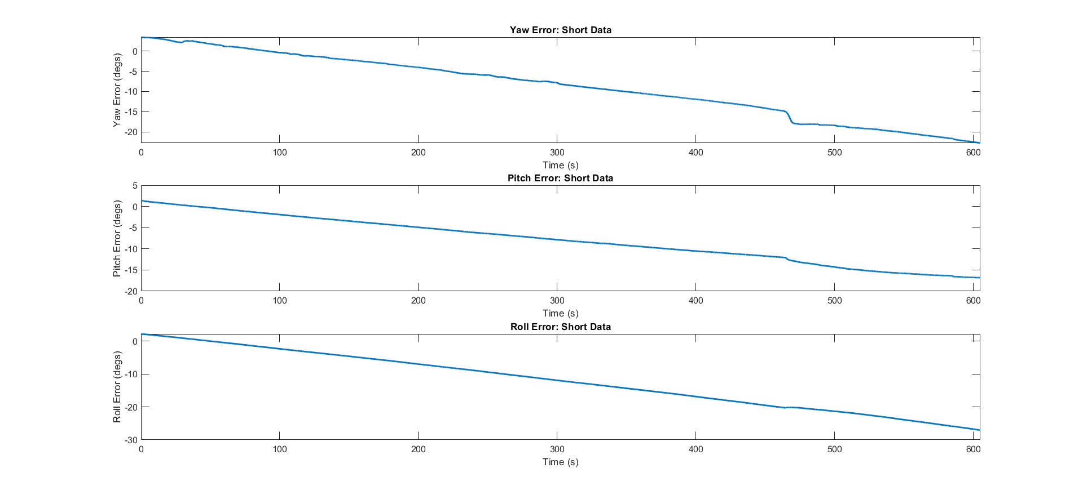
Static Particle Filter Data Error
21

Slide 22
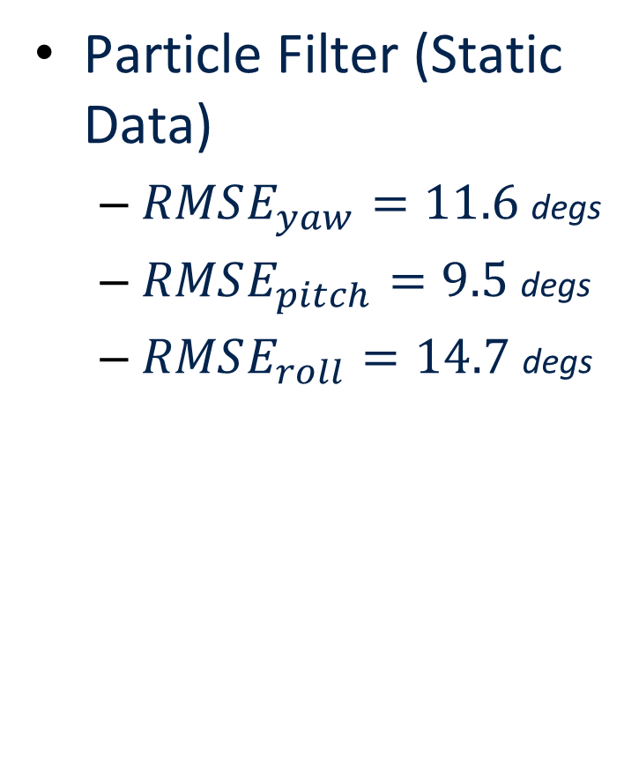
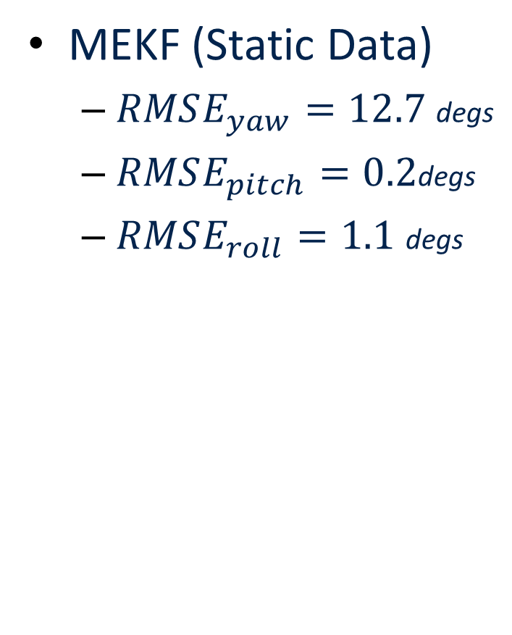
Quantified Error Comparison
Particle Filter (Static Data)
$RMSE_{yaw}=11.6$ degs
$RMSE_{pitch}=9.5$degs
$RMSE_{roll}=14.7$ degs
MEKF (Static Data)
$RMSE_{yaw}=12.7$ degs
$RMSE_{pitch}=0.2$degs
$RMSE_{roll}=1.1$ degs

Slide 23
Conclusions
23

Slide 24
Conclusions
Although it performs decently well, the AHRS particle filter is not as robust as an MEKF
In addition to this, it is very computationally expensive
There is no practical reason to use an AHRS particle filter given the results of this project
24

Slide 25
References
N. Yadav and C. Bleakley, “Accurate Orientation Estimation Using AHRS under Conditions of Magnetic Distortion,” Sensors, vol. 14, no. 11, Art. no. 11, Nov. 2014, doi: 10.3390/s141120008.
25

Slide 26
Questions?
Thank You!

