Slide 1
Critto
Identify South Africa's wildlife from a photo.
AMD Developer Hackathon: ACT II · Track 3 (Unicorn)
Aidan Dean · Tanner Mundell

Slide 2
THE PROBLEM
Knowing a name isn't knowing the animal
1
Hard to identify
Faced with an unfamiliar bird, mammal, or snake, most people have no idea what they're looking at.
2
A name isn't enough
Even when you get a name, you don't learn anything about it — or remember it tomorrow.
3
Nothing pulls you back
No reason to keep exploring, collecting, or caring about the wildlife around you.
People want to understand the wildlife around them — not just tag it and move on.

Slide 3
THE SOLUTION
Snap it. Know it. Collect it.
1
2
3
Snap
Know
Collect
Take or upload a photo of any bird, mammal, or reptile.
Instant species ID plus a rich, source-backed field-guide entry.
Earn the card, grow your collection, chase coins and fill your journal.
A South African field guide in your pocket — that turns getting outside into a game.

Slide 4
HOW IT WORKS
One photo, a full field guide
Web app
(Lovable)
→
Supabase
(auth · data · photos)
→
Inference API
(Fireworks AI)
→
Result:
ID + field guide
Identification and field-guide content are generated on demand and grounded in real sources (Wikipedia + IUCN), with citations.

Slide 5
USE OF AMD
Built on AMD
Inference via Fireworks AI
BioCLIP on AMD GPU (ROCm)
Both endpoints call Minimax M3 on Fireworks AI — AMD's inference partner, accessed through the AMD AI Developer Program and powered by AMD Instinct GPUs.
Our specialised classifier is validated directly on an AMD GPU via ROCm — 99.95% on a test image. The high-accuracy vision path.
AMD on two fronts: our classifier on an AMD GPU (ROCm), and inference via Fireworks AI — AMD's partner.

Slide 6
PROOF
Real recognition. Grounded content.
99.95%
150
3
2
BioCLIP on AMD
GPU (test)
curated SA
species
classes: birds,
mammals, reptiles
AMD platforms:
AMD GPU + Fireworks
Field-guide entries are grounded in Wikipedia + IUCN and cite their sources — no invented facts.

Slide 7
OUR DIFFERENCE
We go deeper
A name is just the start.
Rich, cited field guides
Habitat, diet, range, size, conservation — from real sources.
Critto helps you actually learn about the wildlife around you — and keeps you coming back to discover more.
Learn as you collect
Rarity, sets, and your Journal make it stick.
Conservation built in
See what's threatened and why it matters.

Slide 8
ENGAGEMENT
A collection game with a conservation heart
Rarity cards
Coins
Common → Legendary, weighted by how rare and threatened a species is.
Complete sets — the Big Five, Endangered Guardians, class masters.
Your Journal
Read-aloud guide
A running record of every encounter, synced across devices.
Listen to any species' field-guide entry, hands-free.
Rarity rewards the rare and the threatened — turning spotting into stewardship.

Slide 9
MARKET
Who it's for
Tourists & safari-goers
Birders & nature lovers
Schools & education
Conservation & citizen science
Millions visit SA for wildlife each year.
A passionate, list-keeping community.
Hands-on, local biodiversity learning.
Sightings that build awareness and data.
South Africa draws millions of wildlife tourists a year — Critto is their pocket guide, and a gateway to local conservation.

Slide 10
ROADMAP
Where Critto goes next
1
2
3
4
Now
Next
Then
Later
SA image ID + collection — live now
Sound ID — identify birds by their call
Beyond SA — more species and regions
Social play + verified sightings

Slide 11
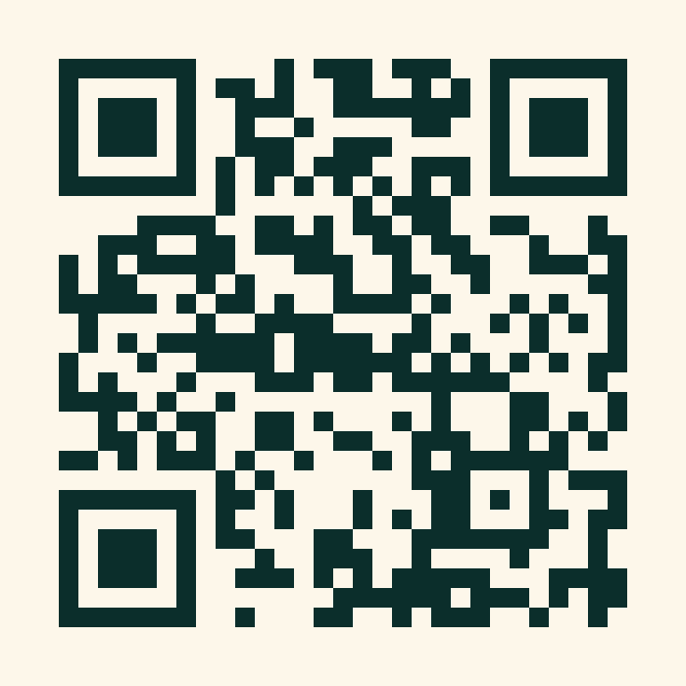
TRY IT
See it for yourself
It's live — try it right now.
Open the app:
critto.org
Scan to open critto.org

Slide 12
Critto
Reconnecting people with the wild — one photo at a time.
Aidan Dean
Tanner Mundell
Design & UX
Build & AI
AMD Developer Hackathon: ACT II · Track 3 (Unicorn)

