Slide 1
ePC-SAFT For Produced-Water Lithium Extraction
Rezaee DES/TOPO Li/Na bridge for thermodynamic and process-systems integration Chemical engineering technical review

Slide 2
0. Technical Thesis
This deck makes one chemical-engineering argument:
None
Produced-water lithium extraction needs a thermodynamic model that maps basin chemistry into solvent-extraction transfer variables. The active Li/Na bridge is Rezaee DES/TOPO after divalent pretreatment; ePC-SAFT is evaluated as the equilibrium and diagnostics backbone for PrOMMiS and IDAES.
Feed basis: southern Arkansas Smackover brine.
Solvent chemistry: Rezaee TBAC/decanoic-acid DES with TOPO coextractant.
Thermodynamic target: phase-specific reactive equilibrium, electrolyte diagnostics, and ion-specific distribution.
Process target: staged extraction, surrogate generation, and IDAES costing.
Notes:
Restrict quantitative claims to source-backed literature, generated validation tables, and explicitly labeled model outputs. Divalent ions are feed-context species only; the active objective is Li extraction from Na after divalent pretreatment.
Open with the implementation need, not with a generic lithium motivation. The audience should understand within the first minute that this is a case for thermodynamic integration, not a broad solvent-discovery survey.

Slide 3
1. Basin Thermodynamic Basis

Slide 4
1.1 Produced Water Is Not One Feed
Basin | Representative lithium signal | Representative TDS signal | Why it matters
Appalachian | Marcellus subsets reach 127-205 mg/L Li | Often >100,000 mg/L TDS | High Li, chemically variable
Permian | Wolfcamp average near 14 ppm Li | <25-140 g/L TDS range | High water volume, lower Li grade
Williston | Brines can exceed 100 mg/L Li | Bakken/Three Forks near 308 g/L TDS | Salinity can dominate pretreatment
Smackover | Observed Li about 1-477 mg/L | 156,000-340,000 mg/L TDS | Premium but thermodynamically hard

Slide 5
None
The case study starts with basin screening because the same extraction train will not behave the same across these feeds.
Notes:
This is the first premise. If produced water were a single feed, a simple recovery factor might be defensible. It is not a single feed, so the model needs to carry chemistry.

Slide 6
1.2 Why Smackover Is The Flagship Case
Signal | Smackover basis
Li range | observed wells span about 1-477 mg/L
TDS range | observed samples span 156,000-340,000 mg/L
Median TDS | current observation-set median is 305,000 mg/L
Infrastructure | existing Arkansas bromine/brine operations
Why this location makes sense
Southern Arkansas Smackover combines high Li with very high salinity, so the chemistry is both valuable and hard.
Smackover and Marcellus are the more favorable U.S. plays on major-metals-to-lithium and divalent-to-lithium ratios in the cited screening work.
Arkansas already has commercial bromine and brine-handling infrastructure.
That combination connects chemistry, location, and process deployment.
Notes:
The key line is: Smackover wins not because it is easy, but because it is valuable and thermodynamically unforgiving. That is exactly where an electrolyte EoS earns its keep.

Slide 7
1.3 Smackover Feed Basis
Case | Row | Li (mg/L) | TDS (mg/L) | Na/Ca/Mg (mg/L) | Role
Low observed | SH-2 | 11.7 | 156,000 | 37,100 / 13,900 / 2,250 | Lower source bound
Base observed | MS-2 | 168 | 305,000 | 64,100 / 36,900 / 3,310 | Median-TDS base proxy
High observed | BR-2 | 252 | 340,000 | 70,800 / 39,900 / 3,130 | High-TDS/high-Li proxy

Slide 8
None
These are source rows from the USGS southern-Arkansas Smackover data release after duplicate and blank rows are excluded. The separate 100/200/400 mg/L Li rows are sensitivity cases, not direct well samples.
Notes:
This slide shows true source composition without implying that the Rezaee extraction experiments were performed on this Smackover sample.

Slide 9
1.4 Selected Base Brine
Field | Value
Source row | MS-2 / MSPU 4-W1
Formation | Smackover
Li | 168 mg/L
TDS | 305,000 mg/L
Na / Ca / Mg | 64,100 / 36,900 / 3,310 mg/L
Cl / Br | 174,000 / 2,700 mg/L

Slide 10
None
The feed is Smackover-specific. The extraction chemistry is Rezaee DES/TOPO. The model couples a source-backed brine to a literature-backed Li/Na extraction chemistry without claiming a fully calibrated Arkansas extraction experiment.
Notes:
This slide makes the case concrete while preserving the source-vs-chemistry boundary.

Slide 11
1.5 Critical Minerals And REE Boundary
Group | What the Smackover source table supports | How to present it
Reported trace fields | Fe, Mn, Zn, Al, As, Be, Cd, Co, Cu, Cr, Hg, Mo, Ni, Pb, U, V | Use as trace/pretreatment context, with censoring caveats
REE | not_reported in the source table | Do not infer; make this a future-data need
Notes:
Many trace-metal values are censored thresholds, so avoid treating medians as exact resource grades. The key message is disciplined: REE are not source-supported for this feed yet.

Slide 12
1.6 Variables The Case Must Vary
Axis | Why it matters | Process consequence
Li concentration | Sets value and concentration driving force | Changes recovery target and stage count
Na/Li ratio | Defines the clean post-pretreatment competition problem | Changes Li/Na selectivity and sodium co-transfer
pH and temperature | Rezaee reports these as major response drivers | Moves extraction and selectivity at the chemistry level
TOPO loading | Controls ligand capacity and solvent cost | Changes (D_i), selectivity, and solvent inventory
O/A ratio | Directly affects stage transfer | Becomes a design and optimization variable
TDS / salinity feature | Carries produced-water severity into the process model | Sets surrogate validity and pretreatment/costing context
Notes:
The raw Smackover brine is still the source site. The extraction model starts after pretreatment, so Mg, Ca, Sr, and Ba are not active extraction variables in this Li/Na bridge.

Slide 13
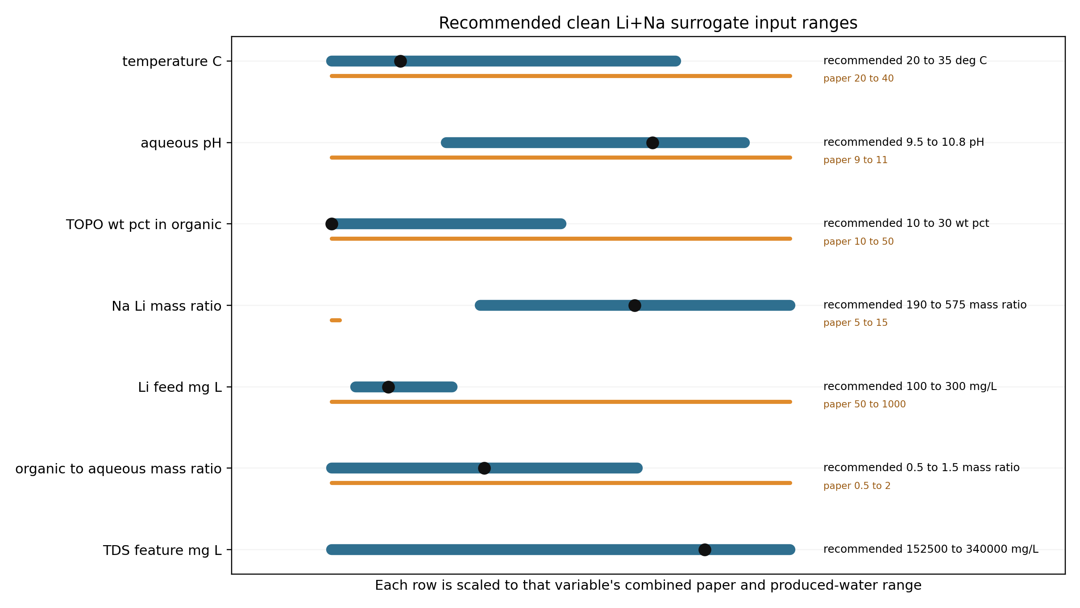
1.7 Clean Li/Na Surrogate Input Space
Notes:
This is the input contract for the next surrogate run. It separates Rezaee’s paper-tested ranges from the produced-water extension needed for the selected Smackover clean Li+Na stream. Do not present these bounds as completed response surfaces until the concrete run script generates the extraction outputs.

Slide 14
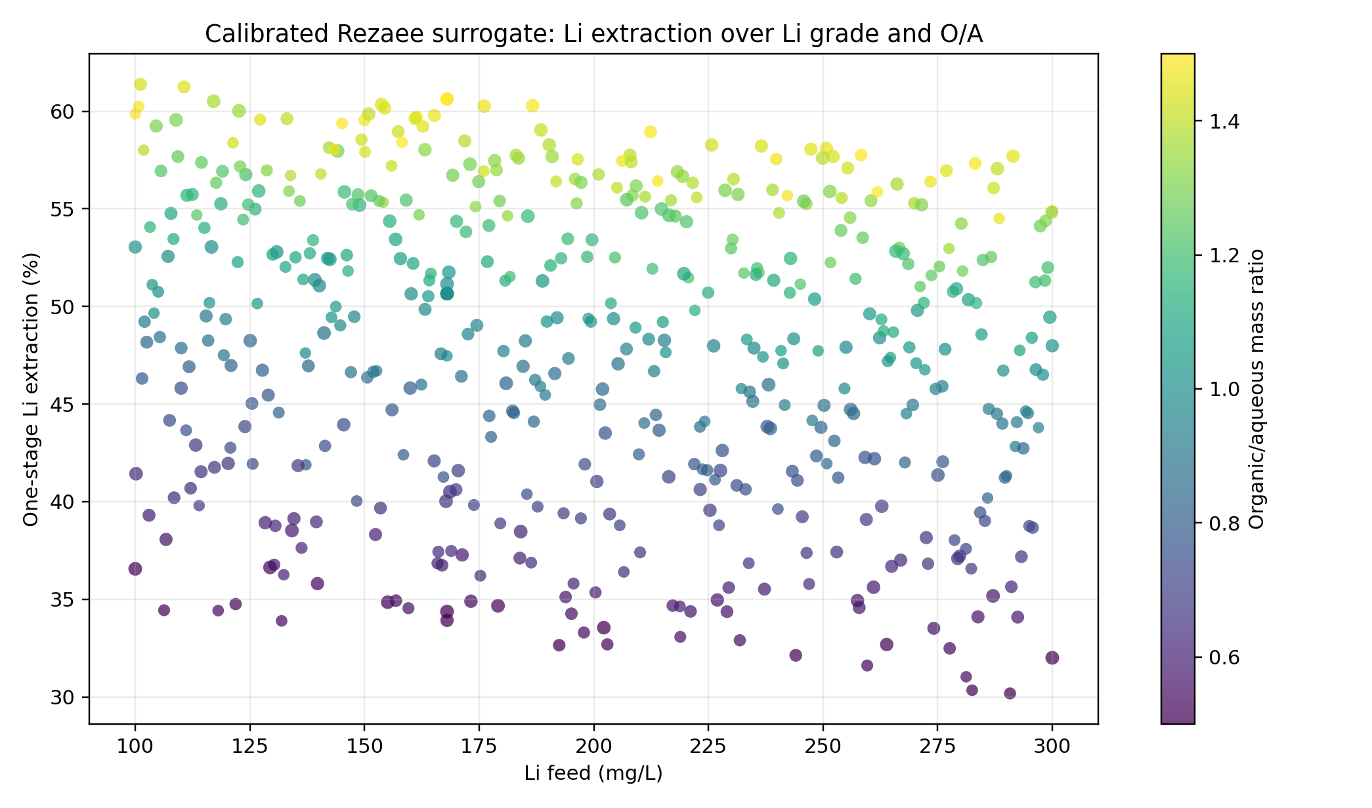
1.8 Surrogate Readiness Surface
Notes:
This scaffold response surface is for process-integration readiness. It checks that the TDS, Li, and O/A design can be carried through transfer variables, staged recovery, and costing before the calibrated Rezaee/ePC-SAFT surrogate rows replace it.

Slide 15
2. ePC-SAFT Thermodynamic Role

Slide 16
2.1 The Model Gap
What weak placeholders can do
Reproduce a narrow demonstration point
Provide a quick stage recovery factor
Run fast inside a flowsheet
Help debug material balances
What they cannot defend
Basin-to-basin extrapolation
Hypersaline electrolyte behavior
Solvent and O/A sensitivity
Ion-specific distribution behavior
Trust-region bounds for optimization

Slide 17
None
The process model needs a physical equilibrium layer before the surrogate or optimizer is meaningful.
Notes:
Be careful not to oversell. This is a replacement for unsupported transfer assumptions, not a claim that ePC-SAFT solves kinetics, hydraulics, or plant economics by itself.

Slide 18
2.2 What ePC-SAFT Adds
Modeling need | ePC-SAFT contribution | Why it is novel for this case
Hypersaline brine | Electrolyte activity and phase-equilibrium structure | Salinity becomes a modeled variable, not a correction factor
Aqueous/organic split | Phase compositions and phase fractions | The extraction stage gets a thermodynamic target
Ion partitioning | Distribution ratios and selectivity metrics | Li movement can be separated from bulk salt movement
Sensitivity surfaces | Response to TDS, O/A, solvent, and feed composition | Surrogates can be trained inside a meaningful region
Diagnostics | Stability, convergence, and phase-distance checks | Failed or collapsed points do not silently become process data
Notes:
The novelty claim is reusable insight. The model lets the project ask where the chemistry should work, why the answer changes across basins, and what variables the process model should receive. For this deck, those variables are transfer variables, not equipment performance coefficients.

Slide 19
2.3 Rezaee 2026 As A Parameter-Fitting Smoke Test
What Rezaee gives | How this deck should use it
2025 extraction responses and SI phase-composition rows | Source-backed Li/Na bridge targets
2026 DES/TOPO/RLi/RNa PC-SAFT parameters and organic (k_{ij}) values | Package-facing parameter payload
2026 reaction constants and phase-specific ion-exchange equations | Reactive-equilibrium diagnostic target
Aqueous electrolyte phase modeled with ePC-SAFT | Activity and stability diagnostics for the brine side

Slide 20
None
Rezaee is now the active Li/Na bridge. Direct published-constant closure is still a documented activity-reference gap.
Notes:
This slide prevents overclaiming. The source-regressed bridge is presentation-facing; the direct published-constant thermodynamic replay remains diagnostic until the activity-reference gap is closed.

Slide 21
2.4 Active Rezaee Workflow Chain
Step | Current artifact | Use
1 | Rezaee 2025/2026 source tables | Li/Na extraction and PC-SAFT/ePC-SAFT parameter evidence
2 | Section 3.2 DOE-basis surface | calibrated log-(D_i) response basis
3 | 523-row TDS-Li-O/A matrix | produced-water process screening
4 | PrOMMiS/IDAES transfer table | staged-contacting and costing handoff
Notes:
Legacy solvent-choice artifacts are retained only in the archive. The active presentation chain is Rezaee DES/TOPO after divalent pretreatment.

Slide 22
2.5 Why The Calibrated Surrogate Is The Right Bridge
What it now gives
finite Li and Na extraction for all 523 rows
explicit (D_{Li}), (D_{Na}), and selectivity
transfer variables ready for staged process models
What remains bounded
raw Smackover is not fed directly to extraction
divalents are pretreatment species
high Na/Li rows carry extrapolation warnings

Slide 23
3. Selective Extraction Model

Slide 24
3.1 One-Stage Selective Split
MS-2 O/A = 1 stage result
Li extraction: 45.3660%
Na extraction: 8.9780%
(D_{Li} = 0.8304)
(D_{Na} = 0.09864)
(S_{Li/Na} = 8.4185)
Trust label: anchored_by_rezaee_real_brine_high_na_li
None
Source-regressed Rezaee Li/Na bridge after divalent pretreatment; not a divalent reactive LLE flash.
What changed from the old wrapper
The active bridge now uses Rezaee DES/TOPO source responses instead of the old HBTA/TOPO placeholder.
The package evaluates ePC-SAFT electrolyte stability and PC-SAFT/ePC-SAFT activity diagnostics.
The old HBTA/TOPO wrapper remains only as comparison and future parameterization context.
The current stage-output table carries extraction, distribution, selectivity, and validity labels.
Notes:
The important contrast is selective transfer after divalent pretreatment: lithium moves more strongly than sodium, and the bridge remains explicitly source-regressed until direct Rezaee thermodynamic closure is resolved.

Slide 25
3.2 Rezaee Bridge Closure
Evidence item | Source artifact | Value | Use
Extraction target rows | rezaee_2025_extraction_target_summary.csv | 32 | Source-regressed bridge fit
SI phase-composition rows | rezaee_2025_extraction_equilibrium_summary.csv | 26 | Reactive-equilibrium diagnostic
Median source (D_{Li}) | rezaee_li_na_distribution_coefficients.csv | 0.6017 | Surrogate prior
Median source (D_{Na}) | rezaee_li_na_distribution_coefficients.csv | 0.1257 | Surrogate prior
Bridge Li logit RMSE | rezaee_li_na_distribution_bridge_report.md | 0.154 | Fit diagnostic
Bridge Na logit RMSE | rezaee_li_na_distribution_bridge_report.md | 0.1615 | Fit diagnostic

Slide 26
None
This is the current presentation-facing closure: Li/Na staged transfer from a Rezaee source-regressed bridge. Ca, Mg, and other divalent ions remain pretreatment context, not active extraction targets.

Slide 27
3.3 Multi-Stage Performance
Stage metric | Rezaee bridge value
Stage 1 Li extraction | 45.3660%
Stage 1 Na extraction | 8.9780%
Stage 3 Li recovery | 83.6925%
Stage 3 Na recovery | 24.5883%
Three-stage bridge interpretation
The stage chain is source-regressed from Rezaee Li/Na responses.
The Smackover row is a feed-context projection, not a measured Arkansas extraction experiment.
The result is strong enough for PrOMMiS/IDAES handoff, not investment-grade TEA.
Notes:
The three-stage value is useful as a design signal and bridge output. It should not be presented as direct published-constant ePC-SAFT LLE closure.

Slide 28
3.4 Thermodynamic Insight
The old question
Can this solvent extract lithium from this brine?
The stronger question
Where should this chemistry work, how does the answer change with basin chemistry, and what stage variables should enter a process model?
Why ePC-SAFT changes the question
It turns feed chemistry into equilibrium states.
It lets salt load and O/A ratio become computable sensitivities.
It provides distribution and selectivity variables, not only recovery percentages.
Notes:
This is the main “novel insight” slide. The idea is not just a better lithium number. It is a more reusable way to reason from location to chemistry to process design.

Slide 29
4. PrOMMiS / IDAES Process Bridge

Slide 30
4.1 From Equilibrium To Transfer Variables
Process-model need | ePC-SAFT-derived quantity | Use in PrOMMiS / IDAES
Feed state | (z_i), TDS, Li/Na/Mg/Ca/Sr/Ba/Cl basis, temperature | Basin-specific solvent-extraction inlet
Phase split | aqueous and organic compositions, phase fraction | Equilibrium target or closure for a stage
Transfer strength | (D_i = C_{i,org}/C_{i,aq}) | Distribution behavior in material balances
Selectivity | (S_{Li/Na}) | Separation constraint for the active Li/Na showcase

Slide 31
None
PrOMMiS and IDAES do not just need a lithium recovery number. They need a defensible map from produced-water chemistry to stage transfer variables.
Notes:
This is the concrete software interface. Percent extraction is the audience-friendly number; the unit model needs compositions, phase splits, distribution ratios, selectivity, and diagnostics.

Slide 32
4.2 Transfer-Variable Contract
Variable | Definition | Why PrOMMiS / IDAES needs it
(_i) | stage removal (= (C_{i,in} - C_{i,out}) / C_{i,in}) | Links chemistry to process-wide recovery objectives
(D_i) | (C_{i,org} / C_{i,aq}) | Controls staged transfer in material balance equations
(S_{Li/Na}) | Selectivity ratio from stage/phase outputs | Enables solvent and design comparison without refitting fixed coefficients
Validity flags | residuals, phase flags, domain bounds | Prevents brittle points from entering surrogate or optimizer datasets
For process integration, the ePC-SAFT output should be treated as the following structured contract:

Slide 33
None
This keeps the story concrete: ePC-SAFT computes the transfer map; PrOMMiS/IDAES consumes it.
Notes:
This slide is the strongest technical anchor for implementation reviewers because it is explicit about what gets passed across process boundaries.

Slide 34
4.3 Why This Belongs In PrOMMiS / IDAES
1. Offline engine Run ePC-SAFT outside the flowsheet to generate equilibrium tables over feed chemistry, O/A ratio, and solvent conditions.
2. Surrogate layer Fit ALAMO or another surrogate inside a documented trust region so optimization is fast and bounded.
3. External function Expose high-fidelity calls for studies where direct thermodynamic solves are worth the cost.
4. Process model Use PrOMMiS/IDAES for staged extraction, recycle, stripping, costing hooks, and optimization.
Notes:
This is the recommended maturity ladder. Do not pitch direct coupling as the only path. The lowest-risk first step is an offline data generator that feeds a bounded surrogate.

Slide 35
4.4 Formal IDAES Costing Scaffold
Costing block | Current basis | Needed before formal TEA
Feed and annual basis | Smackover base feed; 100/1000/10000 m3/day scenarios | approved flowrate and uptime
Pretreatment | IDAES/Pyomo scenario expression from model inputs | removal target, reagent use, waste handling
Extraction/contacting | three-stage Rezaee DES/TOPO Li/Na bridge | contactor sizing, residence time, solvent inventory
Solvent makeup/loss | low/base/high placeholder per m3 feed | DES/TOPO prices and solvent-loss rate
Concentration and Li2CO3 precipitation | bridge recovery 83.6925% | evaporation duty, carbonate reagent, product spec

Slide 36
None
The formal IDAES/Pyomo layer computes production, revenue, annual operating cost, annualized contactor CAPEX, breakeven Li2CO3 price, and net-before-tax scenario values.
Notes:
The assumptions are scenario placeholders, not vendor quotes.

Slide 37
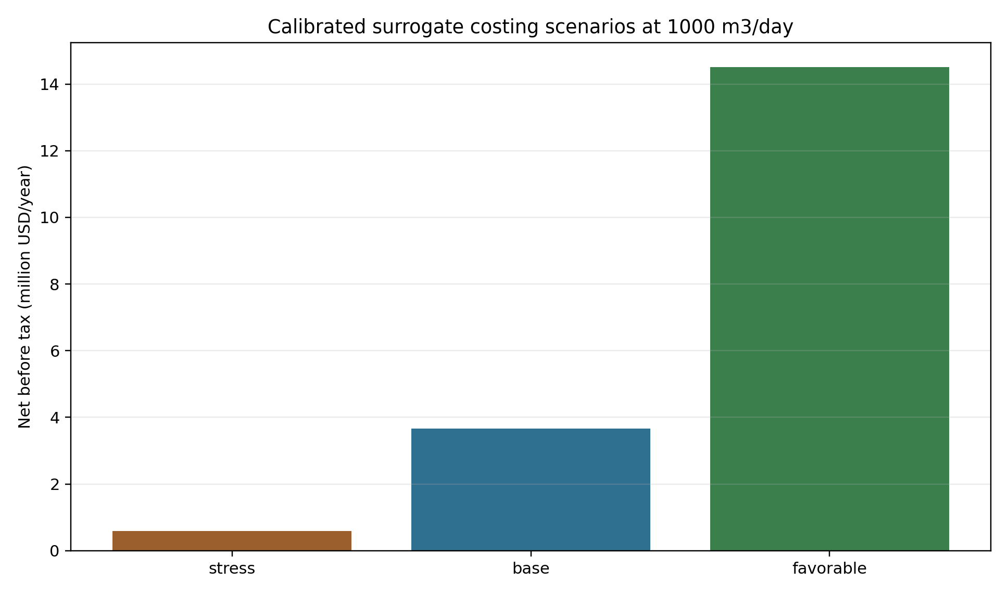
4.5 MSContactor/Costing Readiness Check
Notes:
The Rezaee clean Li/Na transfer table now drives a PrOMMiS-side IDAES/Pyomo costing block with stress, base, and favorable cases. This verifies the handoff shape and cost-accounting hooks; the calibrated surrogate will replace the scaffold response values.

Slide 38
4.6 Implementation Requirements
Add ePC-SAFT as the thermodynamic backbone
property/equilibrium service for electrolyte LLE
documented species and feed basis
diagnostics carried with every result
reproducible dataset generation
Use PrOMMiS/IDAES for the process system
solvent-extraction stage balances
multi-stage contactors
surrogate and external-function interfaces
flowsheet optimization and costing hooks

Slide 39
None
The sell is simple: ePC-SAFT supplies the equilibrium evidence; PrOMMiS/IDAES turns that evidence into a process model.
Notes:
This slide is the ask. It should leave no ambiguity about what you want: implement ePC-SAFT into the ecosystem so these cases can move from isolated scripts into reusable process models.

Slide 40
4.7 Remaining Engineering Work
Priority | Work item | Why it matters
1 | Resolve the Rezaee activity-reference gap | Determines whether direct published-constant reactive equilibrium can replace the bridge
2 | Validate high-Na/Li extraction data | Tests the main extrapolation warning beyond the Rezaee DOE range
3 | Upgrade the Rezaee-named PrOMMiS MSContactor case from algebraic transfer to unit-model validation | Tests convergence and material-balance consistency under staged operation
4 | Replace Class-5 costing assumptions with engineering ranges | Improves economic credibility before TEA-style interpretation
5 | Keep legacy solvent artifacts in the archive | Preserves traceability without confusing the active Rezaee chain
Notes:
This gives you a transparent ending if someone asks what is already proven versus what remains. It also turns the next work into a clear roadmap rather than a vague promise.

Slide 41
5. Backup: Sensitivity Expansion

Slide 42
5.1 Next-Step Sensitivity Expansion
Re-run the Rezaee bridge across basin-style feed envelopes:
Appalachian high-Li case
Permian volume-driven low-grade case
Williston high-TDS case
Smackover premium-brine case
Keep the next design-of-experiments table in Markdown so trust-region bounds and surrogate regions are explicit.
Start from the scaffold response table and replace the response columns with calibrated model outputs.
Add a PrOMMiS/IDAES interface table for every generated variable: units, species basis, source basis, and validity limits.
Keep the narrative in one place: screening, thermodynamics, selective result, and process-design interface.
Notes:
This backup slide is the roadmap for the next systematic screening campaign. It should be shown when someone asks how this becomes more than one case.

