Slide 1
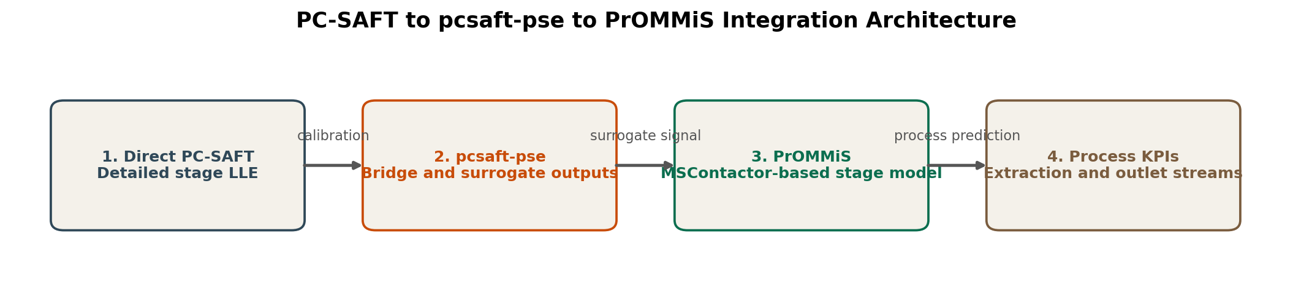
PC-SAFT to PrOMMiS Integration Flow
Summary slides from the full tutorial notebook for chemical engineers learning the detailed-chemistry-to-process-model workflow.
Direct PC-SAFT supplies the single-stage liquid-liquid equilibrium truth model.
pcsaft-pse converts that chemistry output into process-facing quantities such as extraction efficiency and distribution ratio.
PrOMMiS embeds those quantities in an IDAES MSContactor stage model so outlet streams and KPIs can be solved at the process level.
Case study basis
Aqueous ions: Li, Na, Cl
Organic phase: TOP + Hexane
Unit operation: one equilibrium contact stage
Nominal O/A ratio: 1.00
Use this pattern when you want thermodynamic fidelity where it matters but still need a flowsheet-friendly unit model for design studies and scale-up.
Tutorial source: docs/tutorials/pcsaft_full_integration.ipynb

Slide 2
How the Coupling Actually Works
The tutorial is valuable because it shows the specific handoff variables and constraints rather than treating the surrogate as a black box.
Step 1
Step 2
Step 3
Step 4
Define a chemically consistent feed basis. Chloride is back-calculated from electroneutrality so the aqueous chemistry closes cleanly.
Run the direct PC-SAFT stage calculation to obtain lithium extraction efficiency, lithium distribution ratio, and calibration values.
Build the PrOMMiS one-stage solvent extraction model and pass the detailed-chemistry outputs into process-level variables.
Replace the default Li mass-transfer relation with a flowsheet-level coupling constraint so the process model follows the surrogate-derived Li behavior.
Sodium and chloride use direct calibration values in this proof of concept, while lithium partitioning is explicitly tied to the surrogate output.
The integrated model is still a standard solvable PrOMMiS unit, which means it can sit inside larger flowsheets and optimization studies.
This is the core integration lesson: preserve the process-relevant chemistry signal while moving into a process-systems framework.
Key chemistry relations
$n_{Cl^-} = n_{Li^+} + n_{Na^+}$
$K_{Li} = \eta_{Li}/100$
Notebook section focus: feed definition, detailed chemistry truth model, and Li transfer coupling

Slide 3
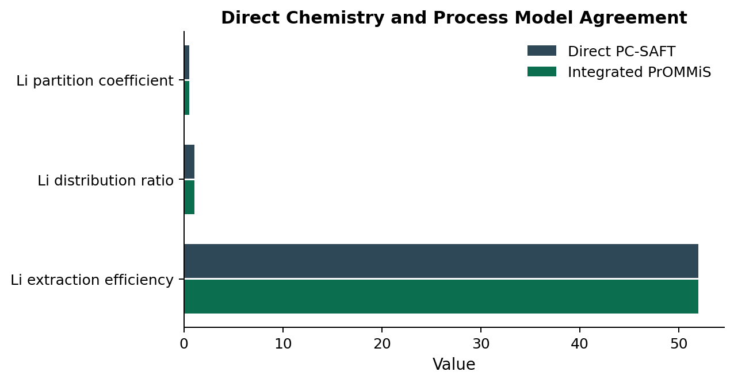
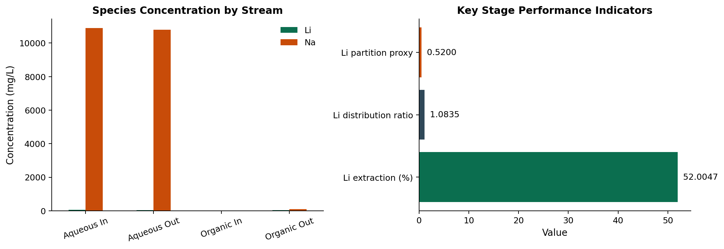
The Integrated Stage Preserves the Chemistry Signal
The point of the bridge is not just to solve; it is to reproduce the detailed-chemistry quantities that drive extraction performance.
Li extraction
52.00%
Integrated one-stage result
Li distribution ratio
1.0835
Process-level D_Li
The stage-outcome plot shows what a process engineer needs next: how Li and Na move between inlet and outlet streams once the chemistry layer is embedded in the unit model.
Aq. outlet Li
28.80 mg/L
Stage outlet concentration
Direct PC-SAFT and the integrated PrOMMiS model agree to within 3.34e-8 for the transferred Li metrics. That is the validation step that makes the integration credible.
Validation emphasis: transferred Li metrics remain consistent across the chemistry and process layers

Slide 4
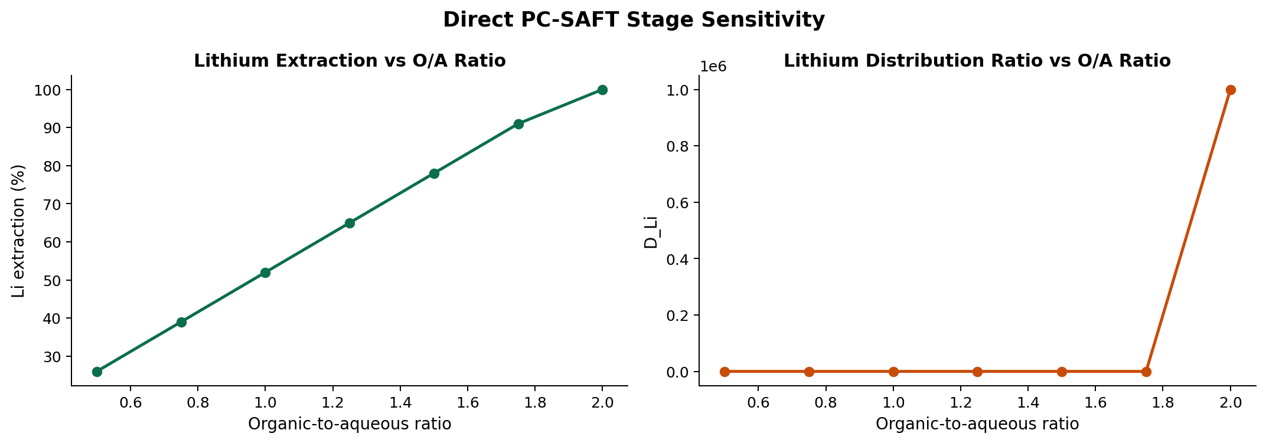
Why This Workflow Is Useful
For process engineers, the benefit is not a prettier chemistry calculation. The benefit is a tractable process model informed by thermodynamics.
You can explore design levers such as organic-to-aqueous ratio while keeping the chemistry basis explicit.
In the tutorial case, increasing O/A from 0.50 to 2.00 raises Li extraction from 26.00% to 100.00%.
The same pattern can support larger flowsheets, stagewise studies, optimization, and eventually richer fitted surrogates over a wider operating domain.
That makes this a practical bridge from detailed equilibrium science to process synthesis and decision making.
Best takeaway for learners
Use direct chemistry to establish the truth model, then expose only the quantities the unit model actually needs. That keeps the process model fast without losing physical meaning.
Forward path from the notebook: replace the constant bridge with a fitted surrogate over a broader operating window

