Slide 1
Notes:
The big question: can a woman’s blood early in pregnancy tell us anything about who later develops preeclampsia?
The dataset has 157 pregnant women with blood drawn in the first half of pregnancy, before preeclampsia shows up, so expression is measured before the outcome.
I linked each woman’s gene data to her health information and picked one gene, RUNDC3A, that looked different between the two groups.
This plot just gets to know the gene. Expression is spread in a fairly normal, bell-shaped way, with nothing unusual to worry about.

Slide 2
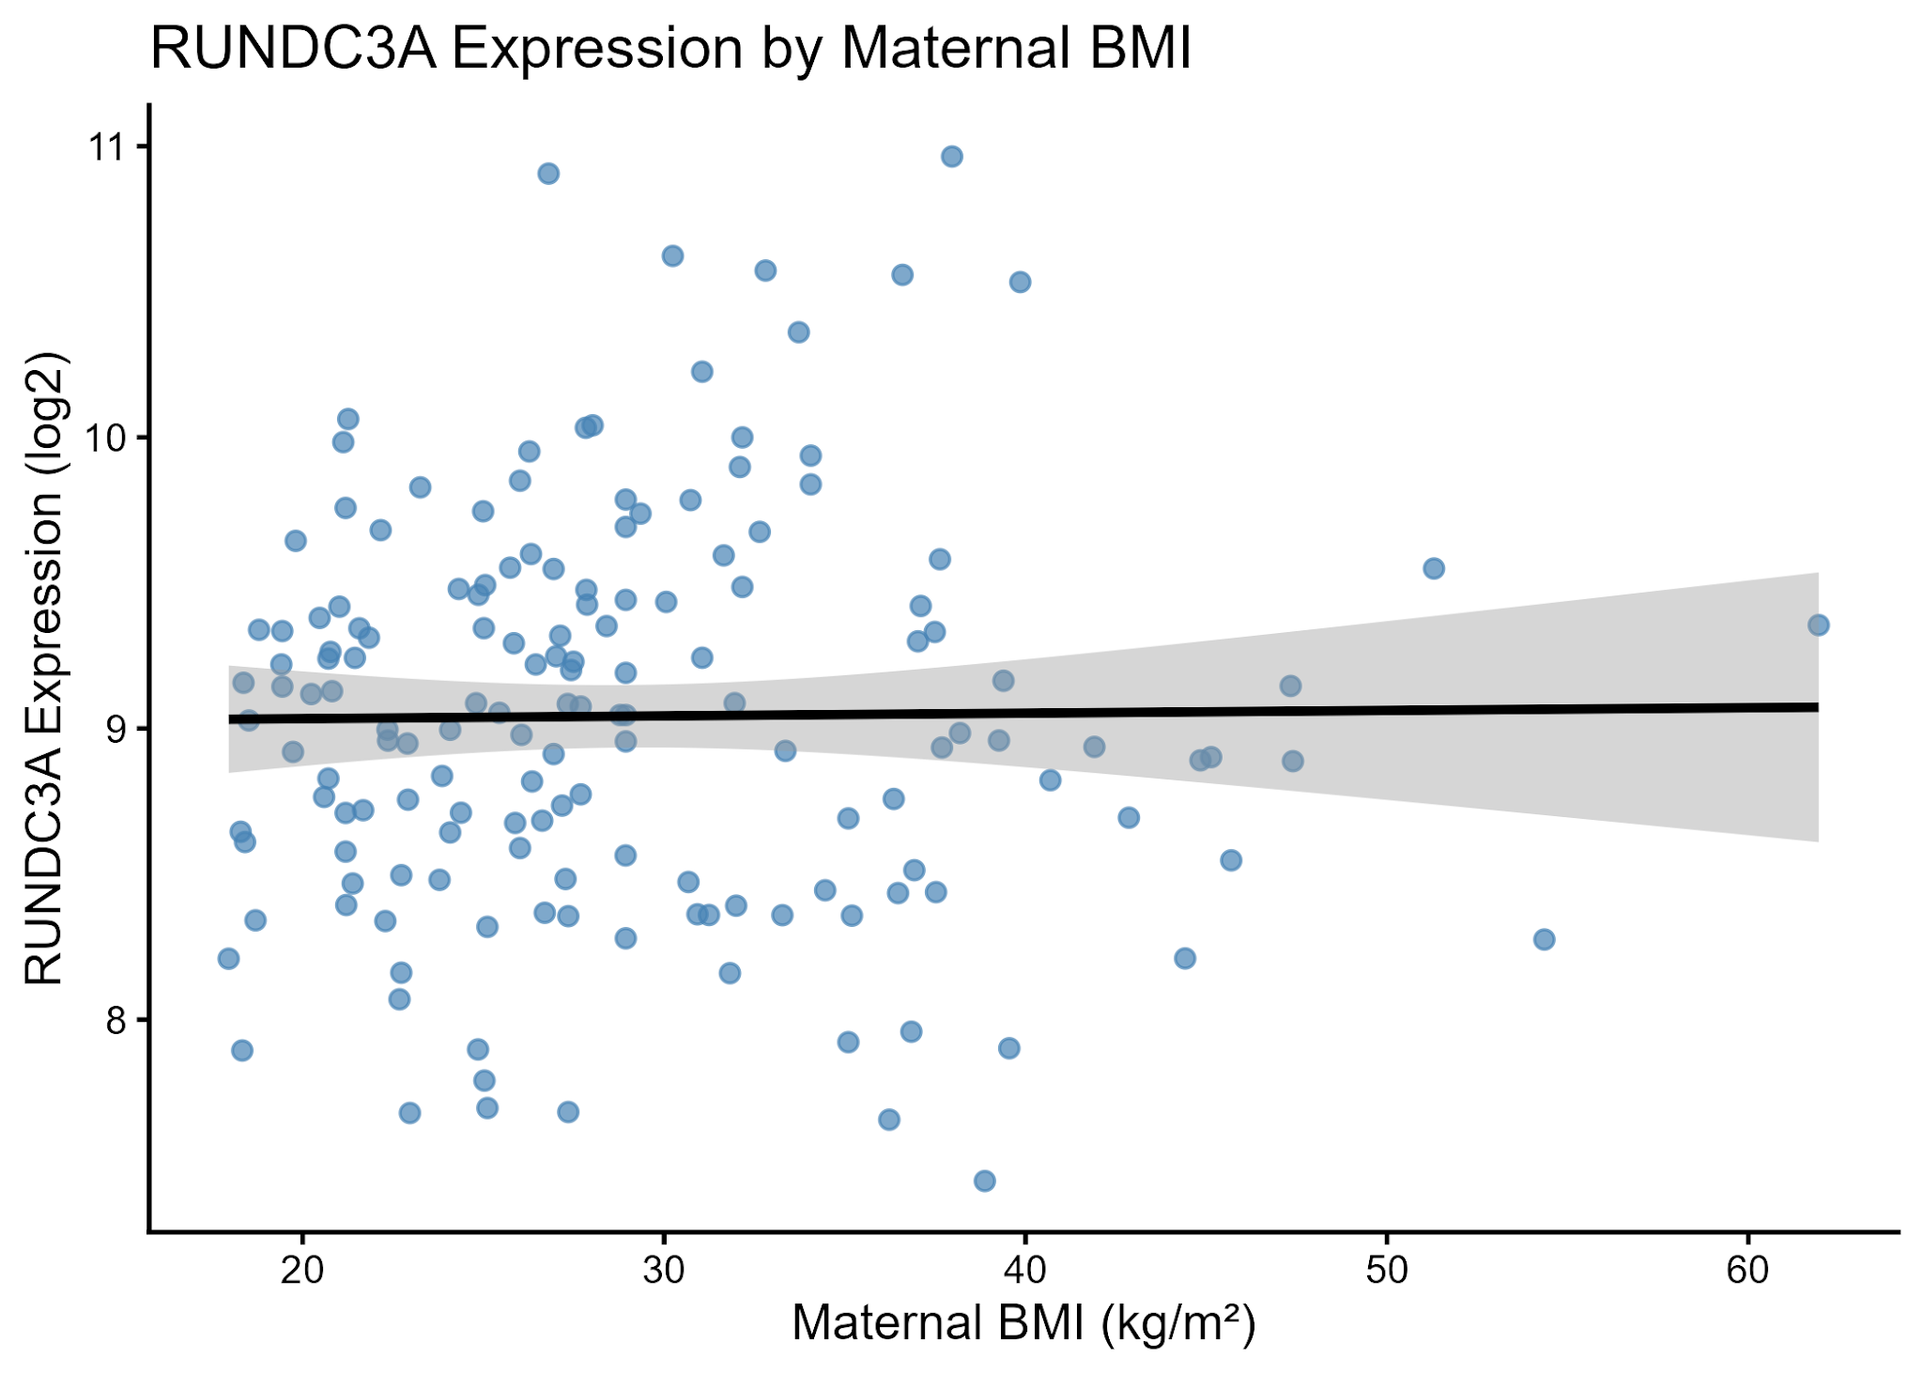
Notes:
Before looking at preeclampsia, I wanted to rule something out. BMI is a known preeclampsia risk factor.
If this gene tracked with BMI, any link to preeclampsia might really be BMI behind the scenes.
The line is flat, so BMI doesn’t seem to be driving this gene.

Slide 3
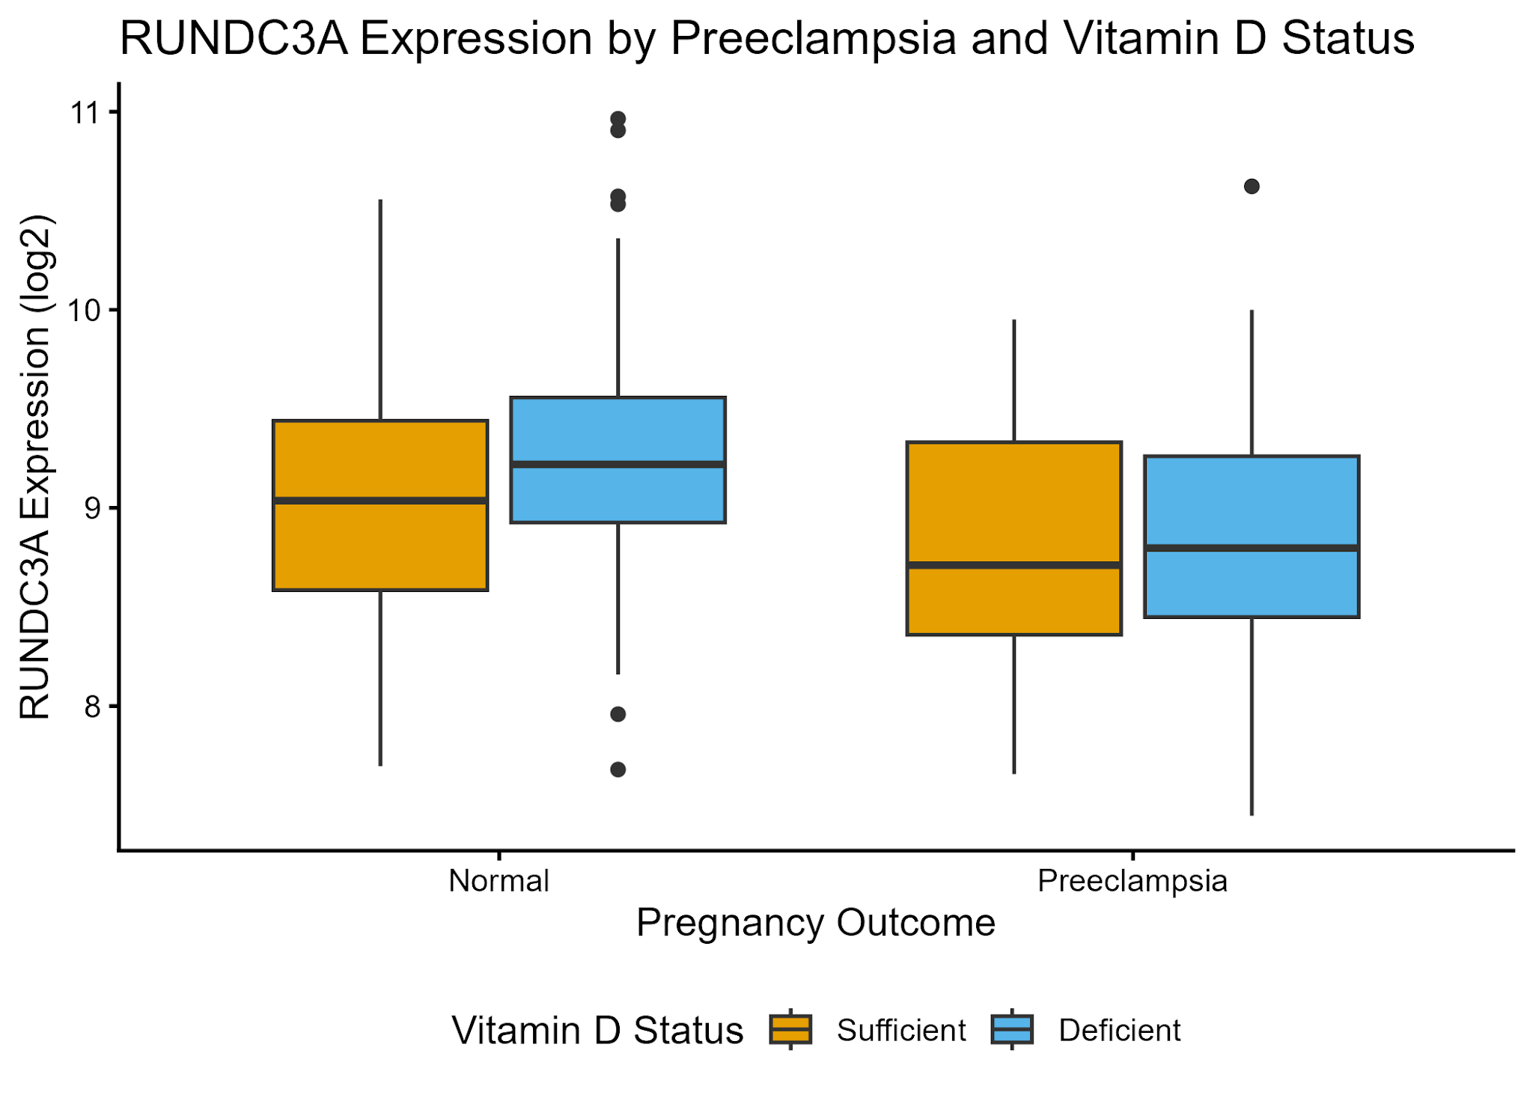
Notes:
This plot gets to the main question: how does the gene compare between pregnancies that developed preeclampsia and those that didn’t?
II also split women by vitamin D level, using the common deficiency cutoff of 20 ng/mL, since low vitamin D has been studied as a possible preeclampsia risk factor.
Women who developed preeclampsia had slightly lower expression, whatever their vitamin D level, but the groups overlap quite a bit.
The takeaway is that this is an interesting early signal, not a predictor yet. I chose this gene from 500 candidates, so it needs further testing before it means anything.

